Slide 1
Accelerating Genomics Applications
Robert Settlage
Advanced Research Computing
Spring 2020

Slide 2
Agenda
ARC
Getting Started on ARC
Computing on a Cluster
Overall cluster design
Shared vs distributed memory
Disk
Data location
/home vs /work
Local vs network
Disk vs RAM
Parallelizing within a node
OpenBLAS/MKL
Forking
GNU parallel
Parallelizing across nodes
GNU parallel
MPI
GPUs
Containers

Slide 3
ARC (1)
Unit within the Office of the Vice President of Information Technology
Provide centralized resources for:
Research computing
Visualization
Staff to assist users
Website: http://www.arc.vt.edu

Slide 4
ARC (2)
Advance the use of computing and visualization in VT research
Centralize resource acquisition, maintenance, and support for research community
Provide support to facilitate usage of resources and minimize barriers to entry
Enable and participate in research collaborations between departments
Provide resources for instruction

Slide 5
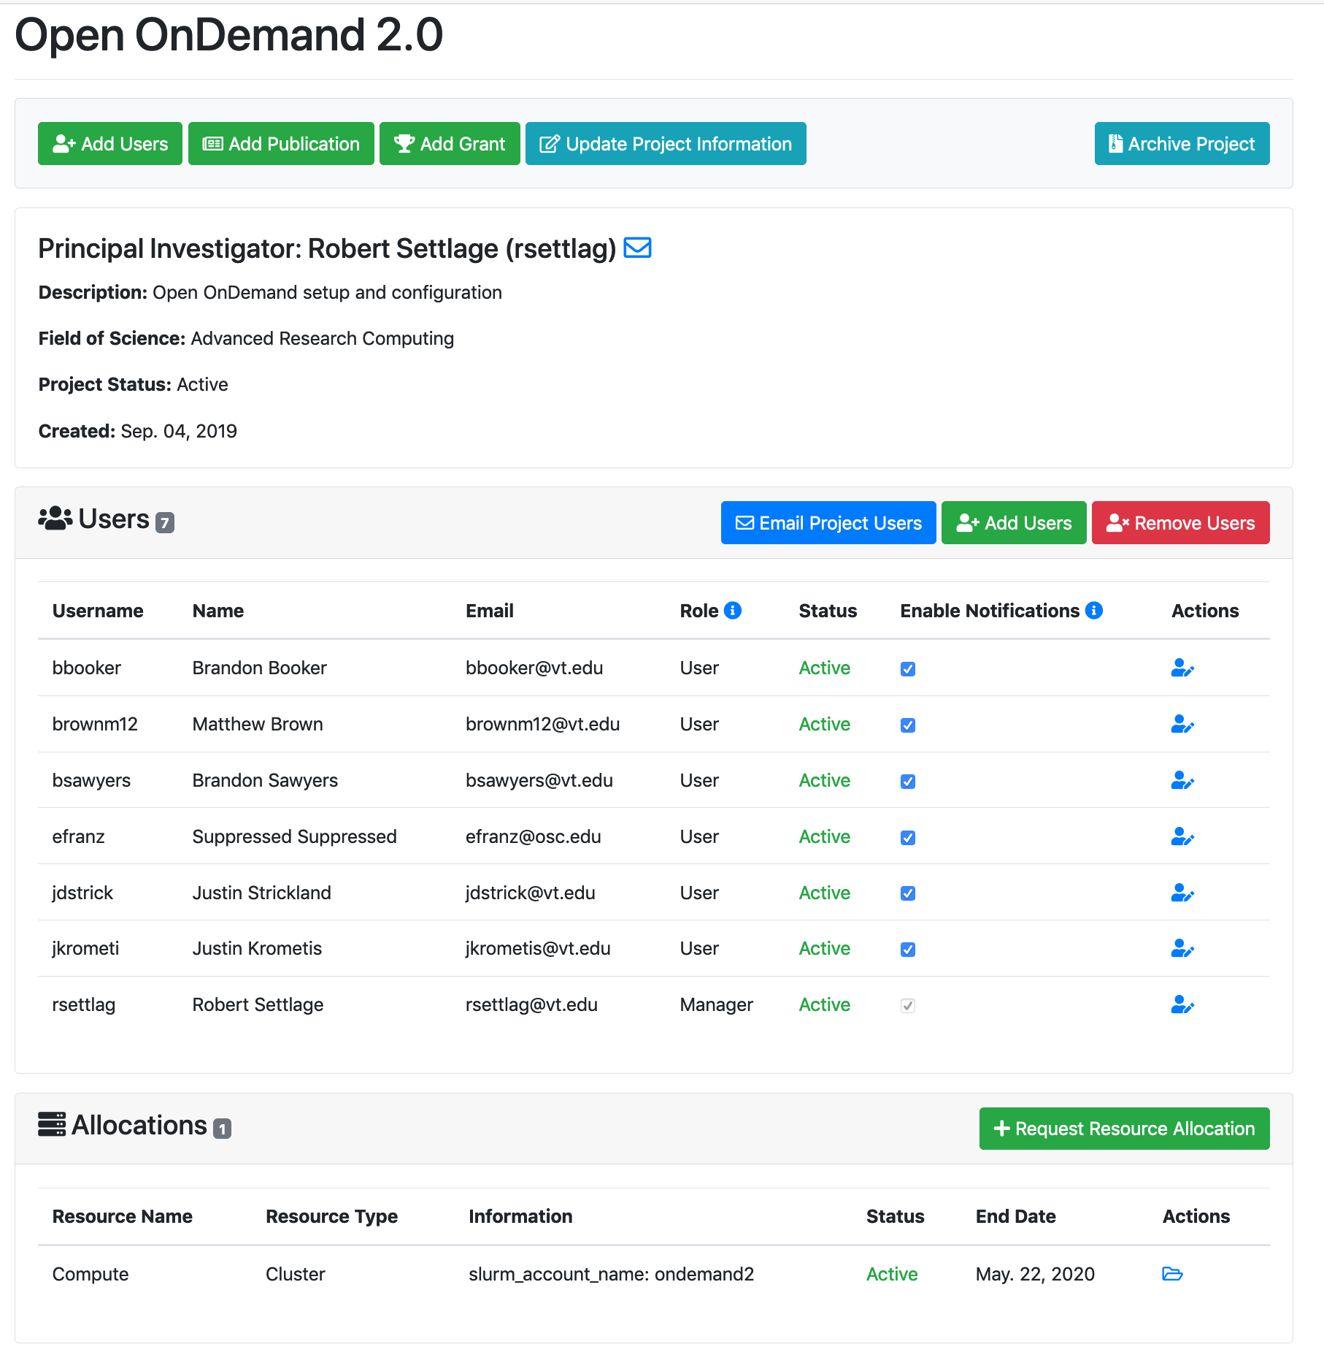
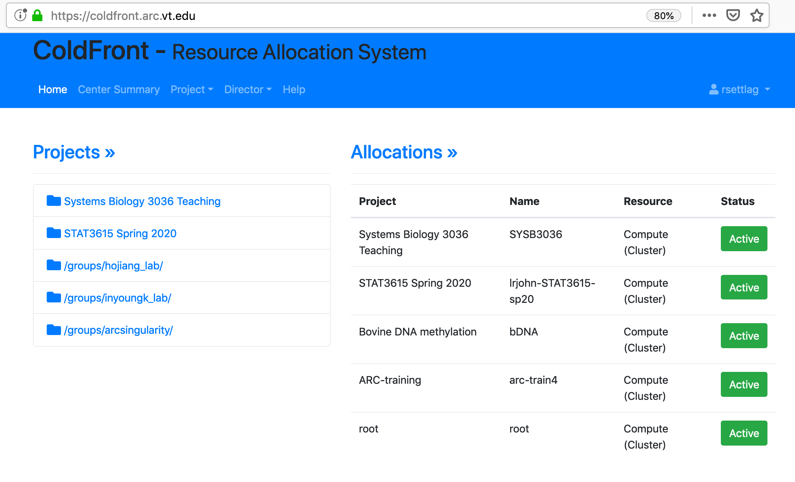

Getting started on ARC (1)
What do you need?
Coldfront.arc.vt.edu
An account
An allocation
Create a project
Create an allocation
ARC.vt.edu
Requests
account request

Slide 6
Getting started on ARC (2)
System | Usage | Nodes | Node Description | Special Features
Cascades | Large-scale CPU, Powerful GPU, Large data | 236 | Mainly: 32 cores, 128GB (2x Intel Broadwell) | 190 General 2 Large Mem (3TB) 4 nodes with 4 K80 40 nodes with 2 V100
NewRiver | Large-scale, Data Intensive | 134 | 24 cores, 128 GB (2× Intel Haswell) | 8 K80 GPU 16 “big data” nodes 24 512GB nodes 2 3TB nodes 40 nodes with 2 P100s
DragonsTooth | Pleasingly parallel, long jobs | 48 | 24 cores, 256 GB (2× Intel Haswell) | 2TB SSD local storage 30 day walltime
Huckleberry | DeepLearning | 14 | Power 8, 256 GB (2x IBM Minsky S822LC) | 4 P100s / Node NVLink
Choose a system
RAM
CPU
Storage
interconnect
GPU
Walltime
Jobs in queue

Slide 7


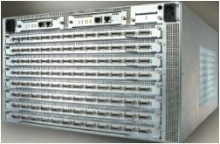
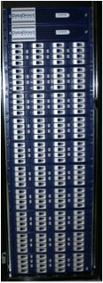


Overall cluster design
internet
1
TopSpin 120
Login Nodes
2950
1
TopSpin 270
2
2
InfiniBand
Switch
Hierarchy
Raid 5
Home Server
…
HOME
130
1
2
TopSpin 120
…
16
I/O Nodes
WORK File System
GigE
GigE Switch Hierarchy
InfiniBand

Slide 8
Shared vs distributed memory
All processors have access to a pool of shared memory
Access times vary from CPU to CPU in NUMA systems
Example: SGI UV, CPUs on same node
Memory is local to each processor
Data exchange by message passing over a network
Example: Clusters with single-socket blades
M
M
M
M
M
Memory
P
P
P
P
P
P
P
P
P
P
Network

Slide 9
Disk
Compute
login
NFS
$HOME
NFS
NFS
$archive
compute
compute
compute
compute
compute
GPFS
$WORK
GPFS
Tape library
compute
compute
compute
compute
GPFS
$GROUPS
GPFS
compute
compute
Tape storage
140TB
Storage Gateway

Slide 10
Genomics -- Data location
Choices are:
Central store via network
/home and /work (/groups)
Local disk
$TMPDIR/$TMPSSD/$TMPNVME
Local RAM
$TMPFS
NOTE: local data is wiped!!
~$ interact --partition=largemem_q -n 1
Using arctest, the default allocation/account for rsettlag.
salloc: Granted job allocation 295110
salloc: Waiting for resource configuration
salloc: Nodes ca002 are ready for job
[rsettlag@ca002 ~]$ env | grep TMP
TMPSSD=/scratch-ssd/295110
TMPDIR=/scratch-local/295110
TMPRAM=/scratch-local/295110/tmpfs
TMPFS=/scratch-local/295110/tmpfs
TMPNVME=/scratch-nvme/295110

Slide 11
Genomics -- Data location for mapping
Let’s map some reads to a genome
interact --partition=largemem_q -n 30
module purge
module load gcc/5.2.0 python/2.7.10 boost/1.58.0 gsl/2.4 hisat2/2.1.0 samtools/1.3.1
time hisat2 -p 10 -x Mus_musculus.GRCm38.dna.primary_assembly --rna-strandness RF --rf \
-1 mouse_reads_R1.fastq.gz -2 mouse_reads_R2.fastq.gz -S test.sam.bam
 | /home | /work | $TMPDIR | $TMPFS | $TMPNVME
Real | 19s | 20s | 23s | 17s | --
User | 2m3s | 2m4s | 2m6s | 2m2s | --
Sys | 17s | 19s | 17s | 16s | --
Used 1M read partition

Slide 12

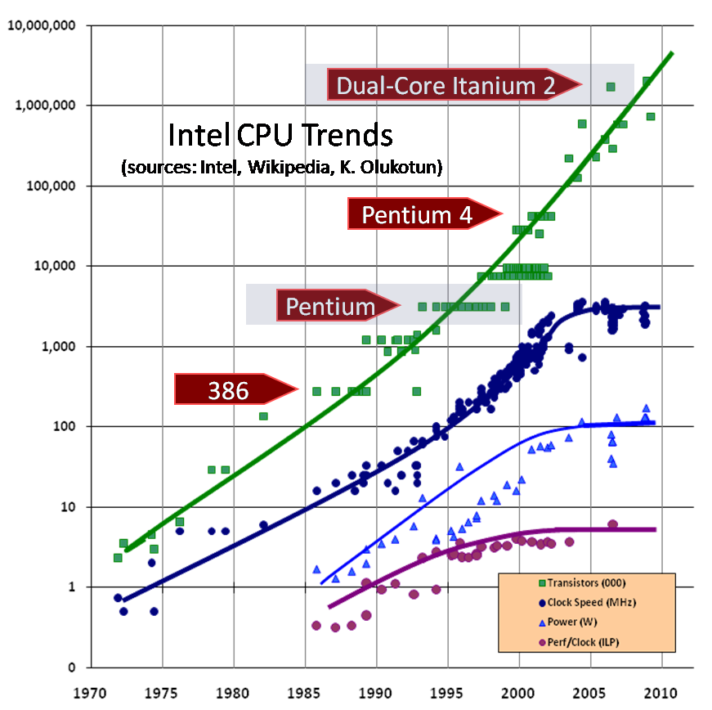
Parallelizing within a node – application threading
Parallelism is the New Moore’s Law
Power and energy efficiency impose a key constraint on design of micro-architectures
Clock speeds have plateaued
Hardware parallelism is increasing rapidly to make up the difference

Slide 13
Parallelizing within a node – application threading
 | p30 | p10 | p1
Real | 17s | 19s | 1m44s
User | 4m42s | 2m4s | 1m36s
Sys | 1m17s | 16s | 7s
Caution: Use env variable to avoid oversubscription.
$SLURM_CPUS_ON_NODE
module purge
module load gcc/5.2.0 python/2.7.10 boost/1.58.0 gsl/2.4 hisat2/2.1.0 samtools/1.3.1
time hisat2 -p 30 -x Mus_musculus.GRCm38.dna.primary_assembly --rna-strandness RF --rf \
-1 mouse_reads_R1.fastq.gz -2 mouse_reads_R2.fastq.gz -S test.sam.bam
time hisat2 -p 1 -x Mus_musculus.GRCm38.dna.primary_assembly --rna-strandness RF --rf \
-1 mouse_reads_R1.fastq.gz -2 mouse_reads_R2.fastq.gz -S test.sam.bam
Used 1M read partition

Slide 14
Parallelizing within a node – OpenBLAS/MKL
Vectorizing and parallelizing matrix operations
module load intel/18.2 R 3.6.2
export MKL_NUM_THREADS=1 or 36
>temp <- matrix(rnorm(100000000),nrow=10000,ncol=10000)
>system.time(temp1<-solve(temp))
 | user | system | elapsed
1 | 57s | 1s | 59s
32 | 123s | 7s | 5s

Slide 15
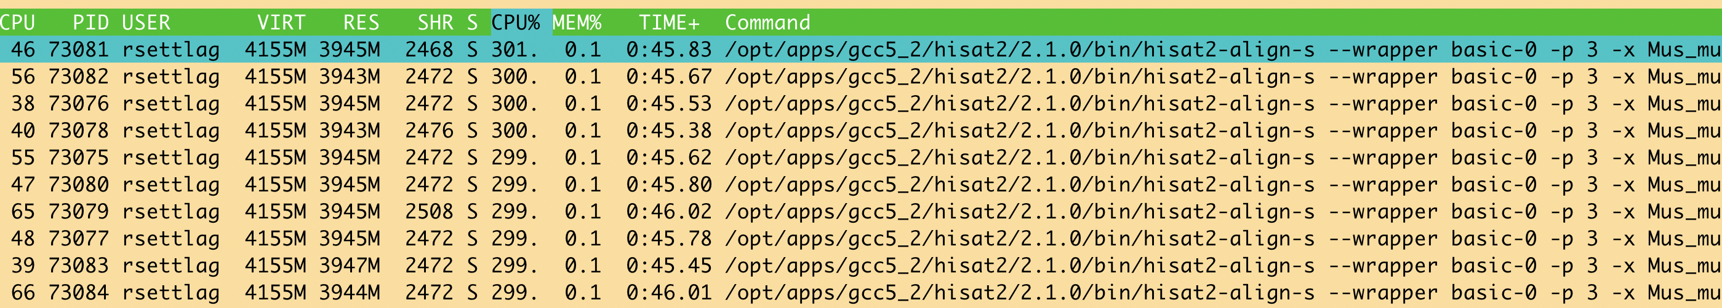
Parallelizing within a node – Forking
for i in {0..9}; do
hisat2 -p 30 -x Mus_musculus.GRCm38.dna.primary_assembly --rna-strandness RF \
--rf -1 mouse_R1_00$i -2 mouse_R2_00$i -S test.sam.b ;
done
real 2m35s
for i in {0..9}; do
hisat2 -p 3 -x Mus_musculus.GRCm38.dna.primary_assembly --rna-strandness RF \
--rf -1 mouse_R1_00$i -2 mouse_R2_00$i -S test.sam.b &
done
real ~40s

Slide 16
Parallelizing within a node – GNU parallel (1)
find ./ -iname '*R1_???' | parallel "wc -l {}"
1681428 ./mouse_R1_050
4000000 ./mouse_R1_008
4000000 ./mouse_R1_006
cat for_loop.sh
for i in {0..9}; do
echo hisat2 -p 3 -x Mus_musculus.GRCm38.dna.primary_assembly --rna-strandness RF --rf -1 \
mouse_R1_00$i -2 mouse_R2_00$i -S test.sam.b &
done
bash for_loop.sh | parallel "{}"
NOTE: care must be taken to match the total core count with threads running.

Slide 17
Parallelizing within a node – GNU parallel (2)
NOTE: care must be taken to match the total core count with threads running.
for f in test_seq*.fas; do
out=${f/.fas/.out}; echo "blastp -db pdb_blast_db_example/pdb_seqres.txt -query $f –out \
blastp_outfiles3/$out -evalue 0.0001 -word_size 7 -outfmt \"6 std stitle staxids sscinames\" \
-max_target_seqs 10 -num_threads 1" >> blastp_cmds.txt
done
cat blastp_cmds.txt | parallel --eta -j 2 --load 80% --noswap '{}'

Slide 18
Parallelizing across nodes – GNU parallel
la *R?_??? | awk '{ print "wc -l "$9 }' >line_count.txt
sort -u $PBS_NODEFILE > nodelist.txt
parallel --jobs 1 --sshloginfile nodelist.txt --workdir $PWD < line_count.txt
Need to worry about the environment on the different nodes.
for i in {1..80}; do
echo "module load gcc/7.3.0 bowtie; \
bowtie --version; grep bowtie"
done >command.txt
parallel -j 1 --sshloginfile node_list < command.txt | sort -u

Slide 19
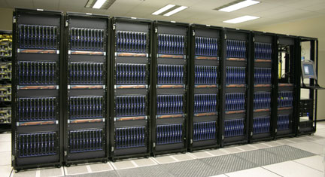
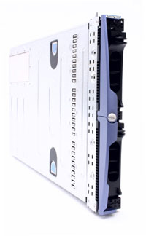
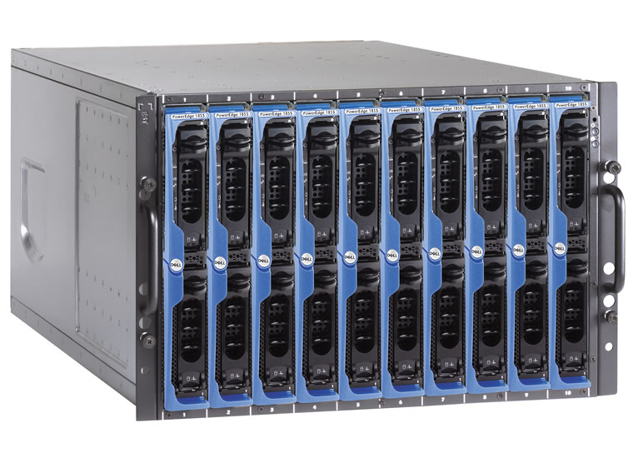
Parallelizing across nodes – pleasingly parallel
Independent tasks can be separate jobs
Use the scheduler to handle tasks
Blade : Rack : System
1 node : 2 x 64 cores : 128 cores
1 rack : 44 nodes : 5,632 cores
System : 7 racks (316) : 40,448 cores
x 4
x 10

Slide 20
Parallelizing across nodes – find/for + script
find `pwd` -iname '*fastq.gz' -exec sbatch --export=PAIRED=Y,STRANDED=second,FILE1='{}’, \
INDEX= /home/rsettlag/useful_PBS/SLURM_tophat_FILE.sh \;
PASS value into script, each job will perform same function based on file in this case
for i in `ls basename*fastq.gz`; do
sbatch --export=PAIRED=Y,STRANDED=second,FILE1=$i, \
INDEX=musmus.dna.toplevel \
/home/rsettlag/useful_PBS/SLURM_tophat_FILE.sh \;
Done
module load gcc tophat
mv $INDEX $TMPFS
tophat2 -p $SLURM_CPUS_ON_NODE -r 100 --library-type fr-firststrand -o $SLURM_SUBMIT_DIR \
$TMPFS/$INDEX $FILE1

Slide 21
GPUs – massive parallelism at a cost
Memory
Memory
M
P
GPU
Architecture | Code
Single core | Serial
Multicore | OpenMP, Pthreads
GPU | CUDA, OpenACC
Cluster | MPI

Slide 22
GPUs – massive parallelism at a cost
Not widespread in Bioinformatics yet, notable exceptions:
MinION Guppy basecaller
Clara
AtakWorks
NVBIO
module load gcc/5.2.0 python/3.5.0
guppy_basecaller -i ./ -s fastq_out --gpu_runners_per_device 2 --num_callers 6 \
--flowcell FLO-MIN107 --kit SQK-LSK109

Slide 23
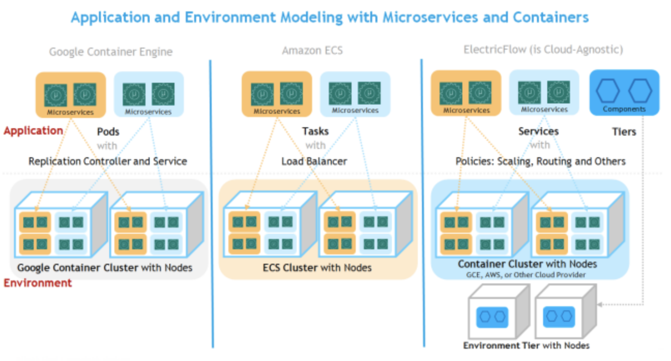
Containers
The future of HPC, cloud, computing (IMO)
Orchestrators give throughput, scale, and parallelism
Docker, Singularity, Kubernetes
Coming soon to a HPC center near you. ;)
https://www.bing.com/images/search?view=detailV2&ccid=trPGfGPV&id=9BE0825E037D8110760FBD2E1F61CE20C96475A5&thid=OIP.trPGfGPVmtOlMr8n-vV6kgHaEE&mediaurl=http%3A%2F%2Fdocs.electric-cloud.com%2Feflow_doc%2F7_1%2FUser%2FMobile%2FAdvanced%2FContent%2FResources%2FImages%2FAppAndEnvModelingWithMicroservicesAndContainers_652x359.png&exph=359&expw=652&q=microservices+containers+and+orchestration+examples&simid=608004396061886820&selectedindex=17&adlt=demote&shtp=GetUrl&shid=9323cf01-da6a-4e5d-884c-4df9022f5287&shtk=TWljcm9zZXJ2aWNlIEFwcGxpY2F0aW9uIERlcGxveW1lbnQgVXNpbmcgQ29udGFpbmVycw%3D%3D&shdk=Rm91bmQgb24gQmluZyBmcm9tIGRvY3MuZWxlY3RyaWMtY2xvdWQuY29t&shhk=sKfxoPobdccij5iFwTvL3hpcXktY4c0q%2Fa9l%2F3z3g3o%3D&form=EX0023&shth=OSH.Irb6wl1IRURxLwuTZDKIyQ

