Slide 1


Cloud ROI
Robert Settlage/Srijith Rajamohan
Advanced Research Computing
@Virginia Tech
Gateways 2020

Slide 2
Agenda
Why Cloud
Creating a cost calculator
What is in/out
Method for costing
Public vs On-premise cloud
Thoughts and conclusions

Slide 3
Why cloud
Each Institution will answer these broad needs categories differently, however, most will find compelling needs for both on/off-prem
Classroom
Platform
Software
Cost
Research
Bursting (speed/scale)
Interactive work
Cost savings
Cost shift (cap/op)
Specialty hardware (FPGA, TPU, …)
Specific research (cloud, regional, risky …)
Security, data retention, contract terms/lengths

Slide 4
What costs are in/out
In
Hardware
System software
System administration
Electricity
Facilities
Out
Computational Scientist
Scientific software licenses
Data transfer costs (egress waiver)
Each site may have a different view of what to include based on a variety of factors including funding source, transparency of the cost, etc
https://github.com/rsettlage/cloud_cost_calculator

Slide 5
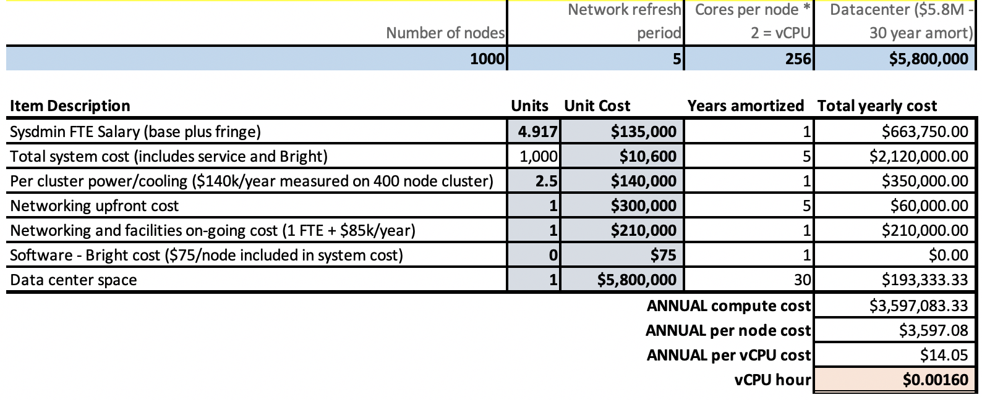
On-prem compute costs
Based on 2020 Cray-AMD purchase – bulked up to our average number of nodes

Slide 6
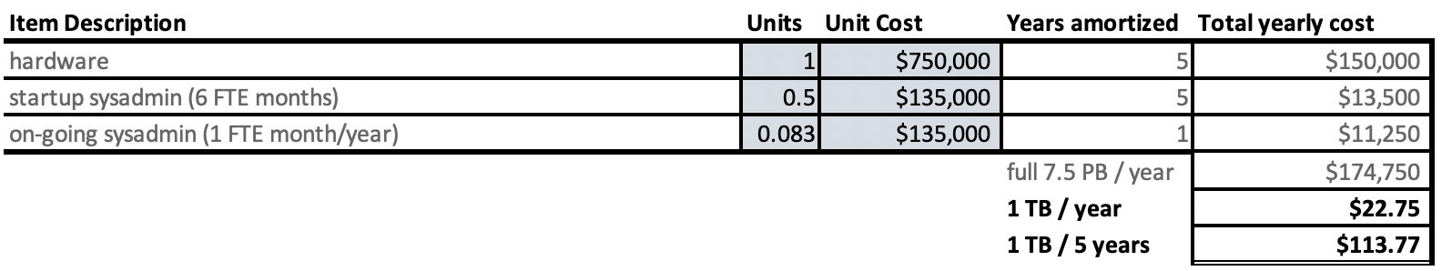
On-prem storage costs
Based on 2019 Dell-BGFS purchase

Slide 7
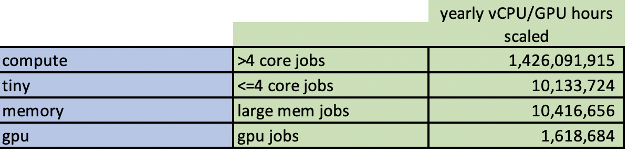
Setting up the comparison
Determine actual use by category, create “projects”
Cascades: Oct 1, 2019 – Jan 31, 2020
85,485 CPU jobs, 11,407 GPU jobs
Scaled to 1000 nodes, similar core count
Need cloud like projects, classify use by:
Tiny <4 core jobs
Compute =>4 core jobs
Memory – large mem jobs
GPU jobs

Slide 8
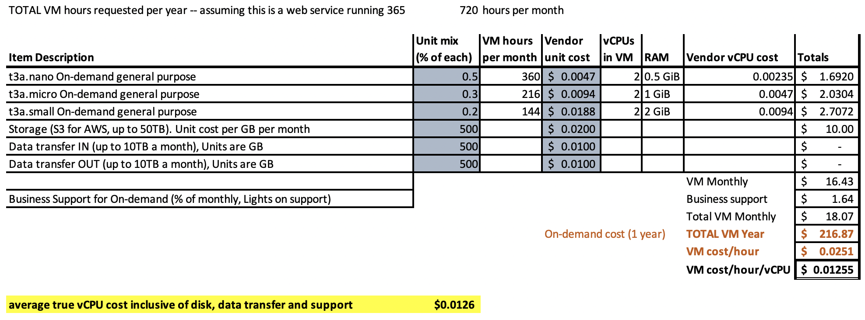
Tiny project

Slide 9
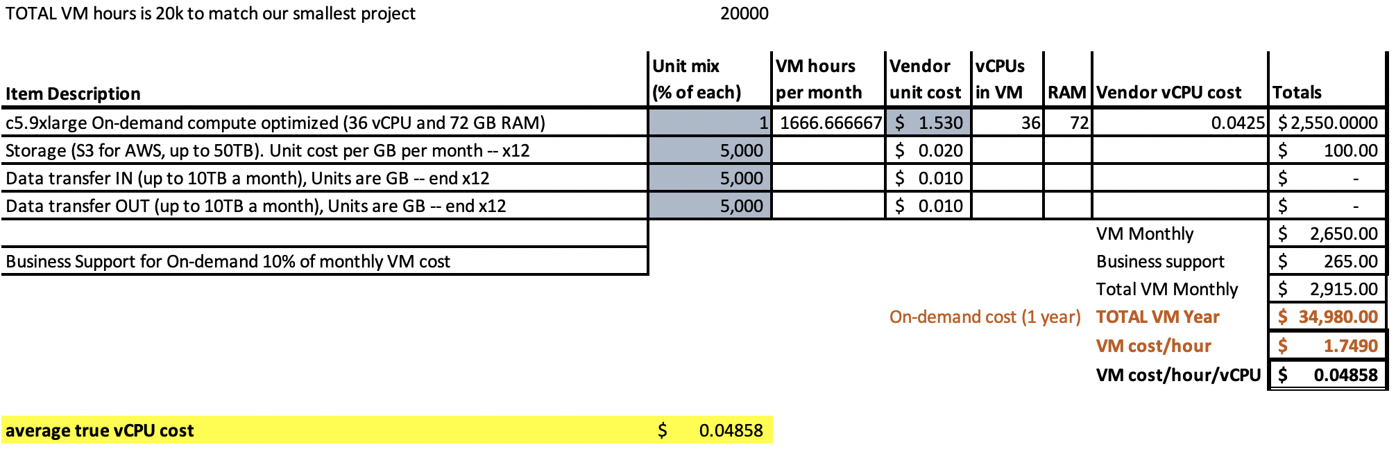
Compute project

Slide 10
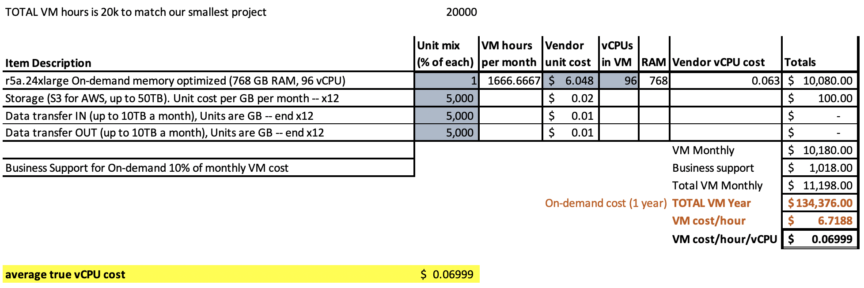
Large-mem project

Slide 11
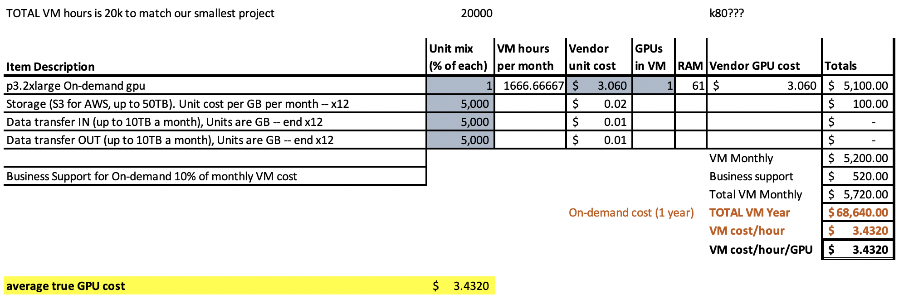
GPU project

Slide 12
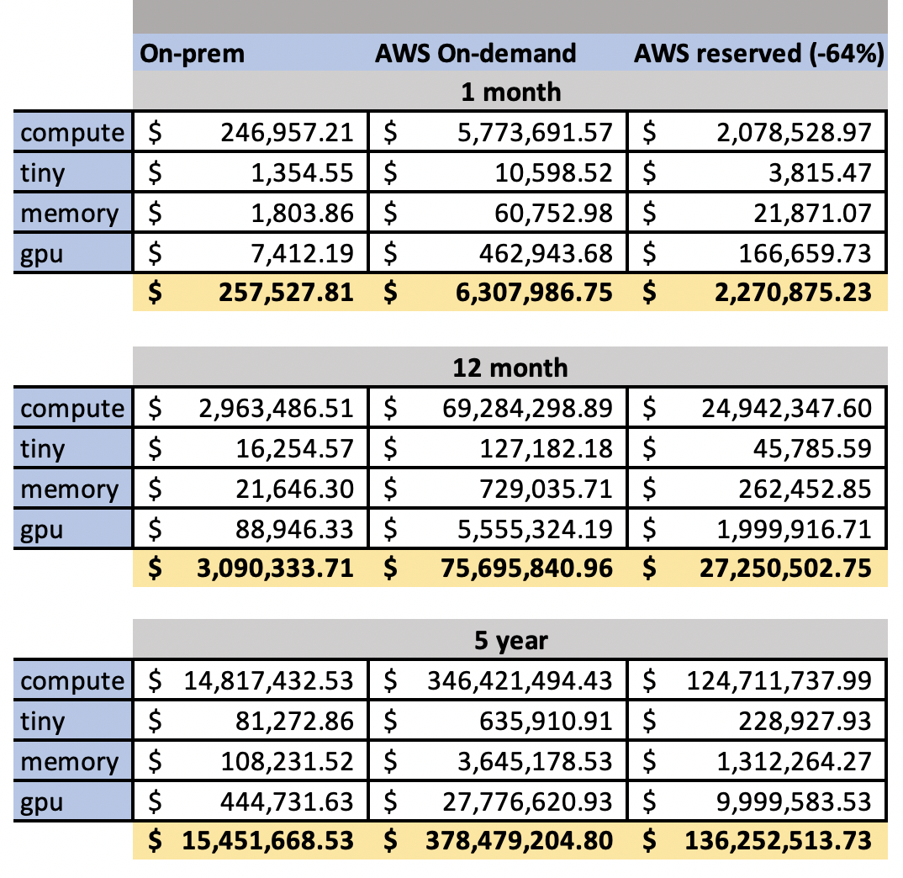
Cost comparison

Slide 13
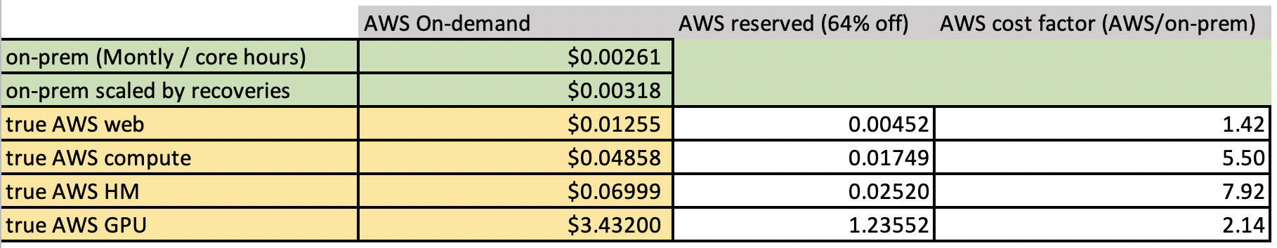
True costs
No apples-apples: K80 off-prem vs V100 on on-prem, mem diffs, etc
https://github.com/rsettlage/cloud_cost_calculator

Slide 14
Conclusion
Public cloud use cases:
Research
Bursting (speed/scale)
Interactive work
Cost shift (cap/op)
Specialty hardware (FPGA, TPU, …)
Specific research (cloud, regional, risky …)
Security, data retention, contract terms/lengths
Public cloud has a place
Cost saving is not it
Classroom
Platform
Software

