Slide 1
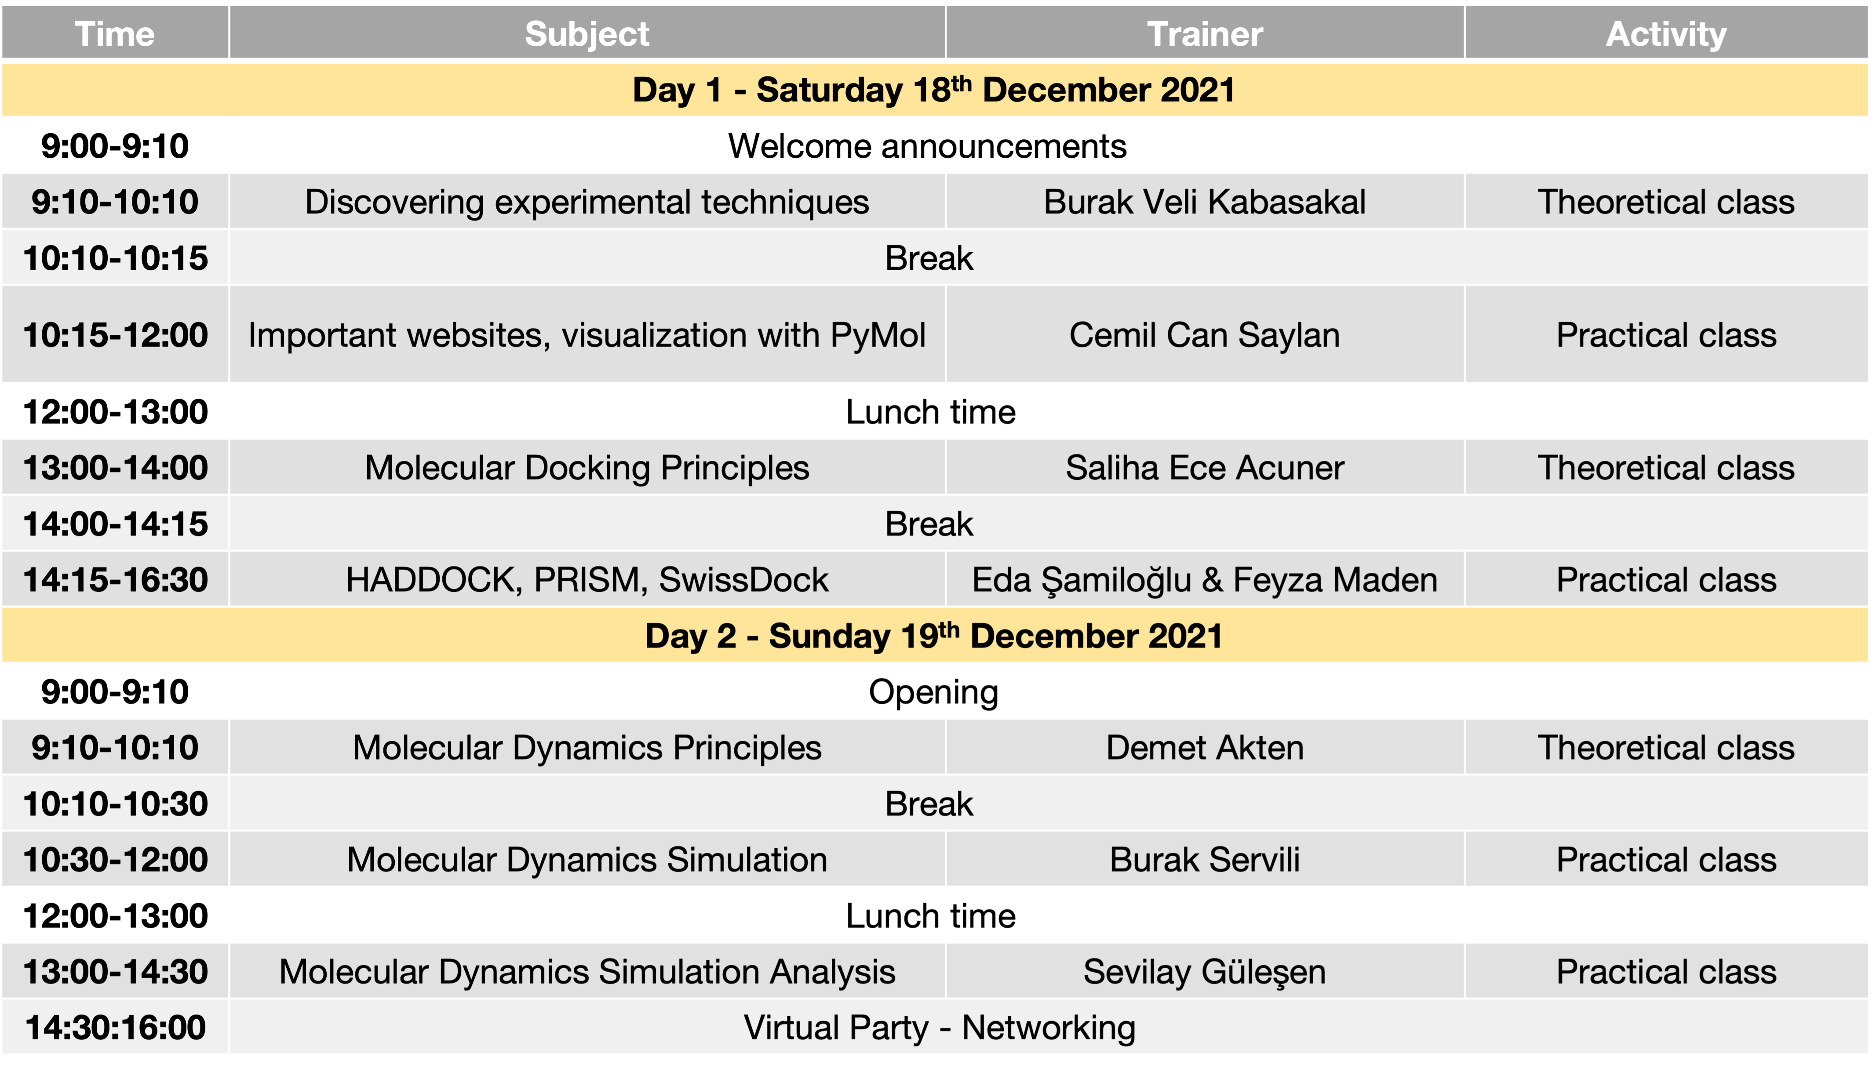

Slide 2
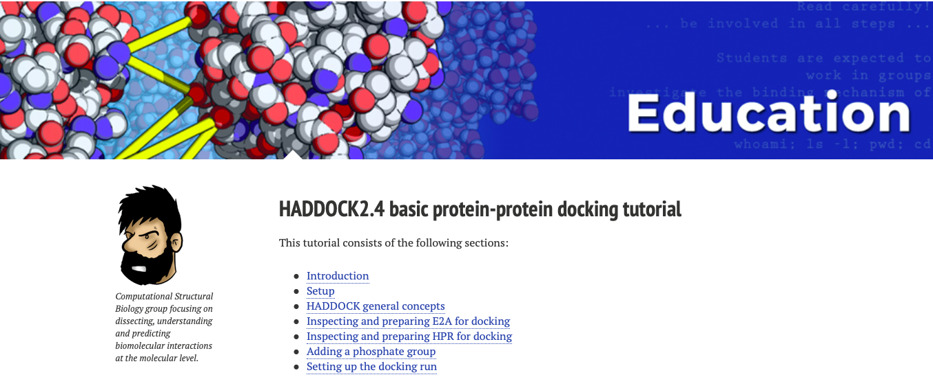
HADDOCK 2.4 basic protein-protein docking tutorial
https://www.bonvinlab.org/education/HADDOCK24/HADDOCK24-protein-protein-basic/#introduction

Slide 3
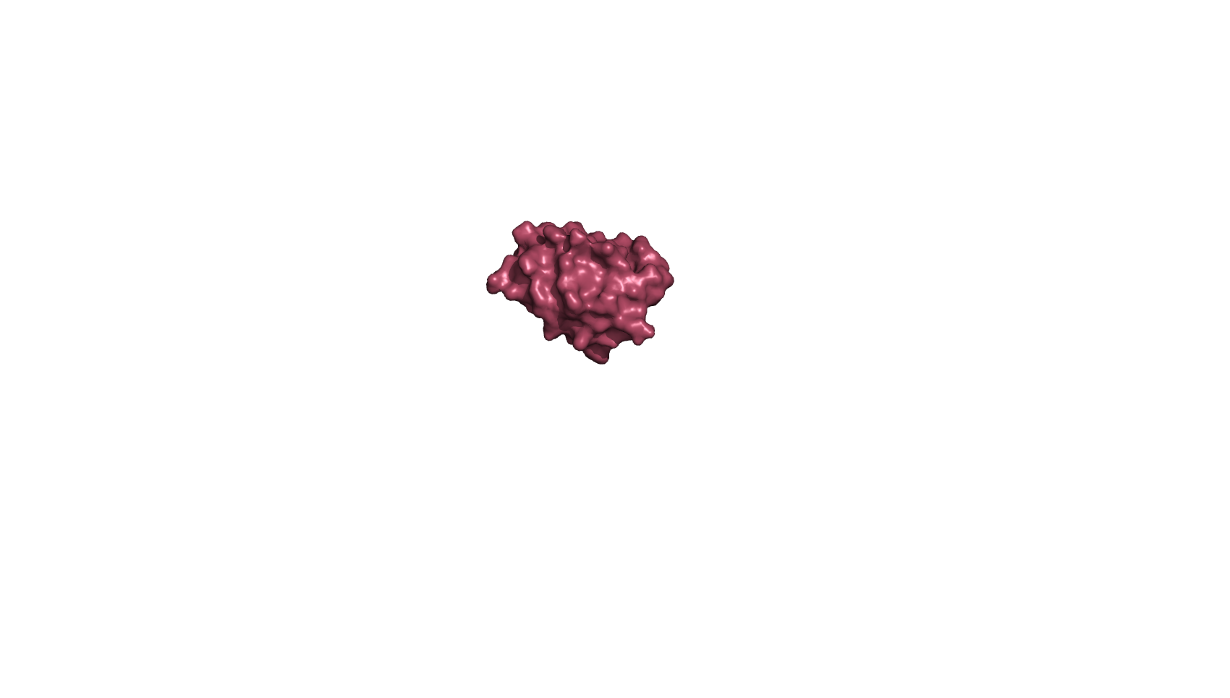
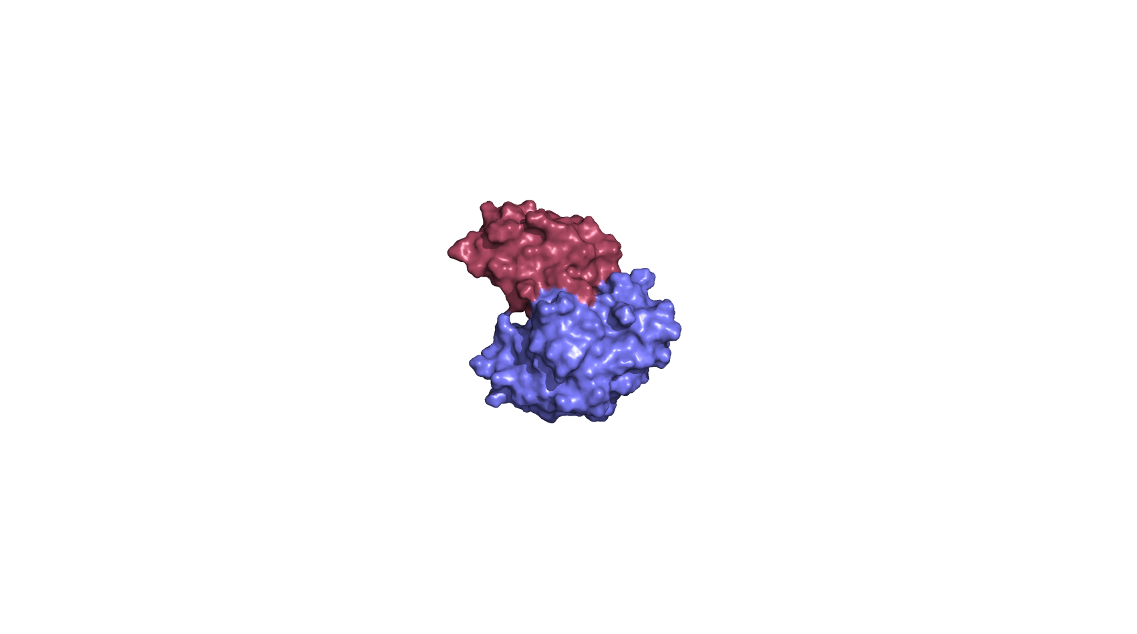
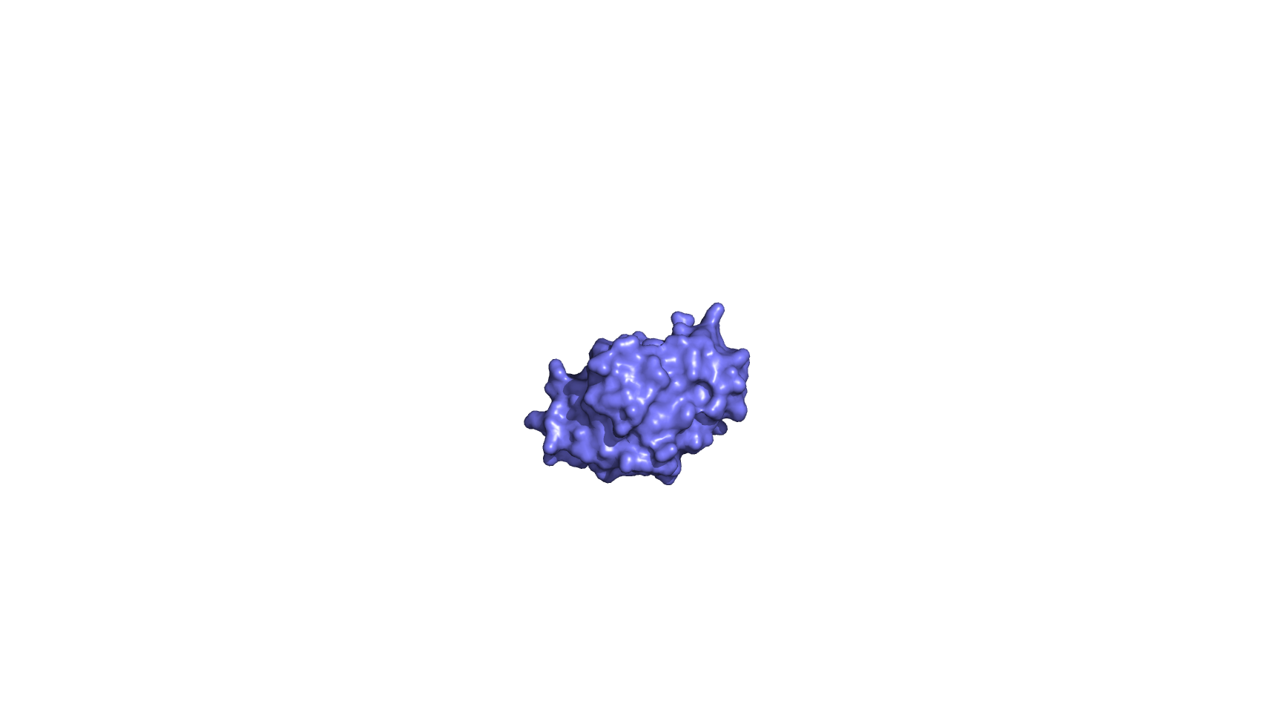
Biological background
E. coli proteins involved in glucose transport
transfer a phosphate group from one protein to another
histidine-containing phosphocarrier protein (HPr)
NMR
PDB ID: 1HDN
+
PDB ID: 1GGR
PDB ID: 1F3G
complex structure of HPr and E2A
NMR
glucose-specific enzyme IIA (E2A)
X-ray

Slide 4
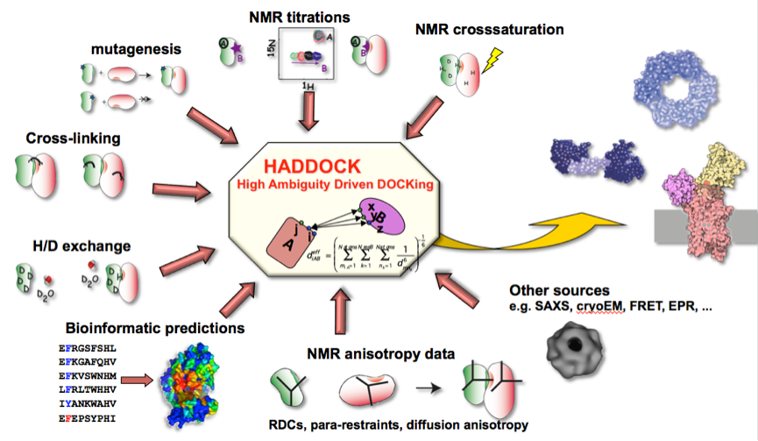
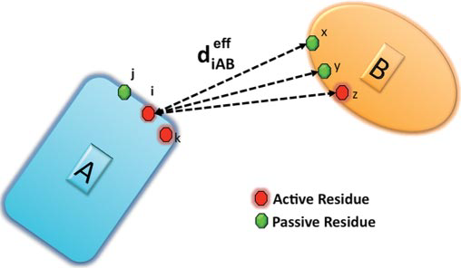
HADDOCK

Slide 5
HADDOCK- Information Guided Docking
histidine-containing phosphocarrier protein (HPr)
NMR
PDB ID: 1HDN
+
inteface residues identified from NMR chemical shift perturbation data.
Wang et al, EMBO J (2000)
+
HADDOCK Model
PDB ID: 1F3G
glucose-specific enzyme IIA (E2A)
X-ray

