Slide 1

R Markdown: Efficient Reporting Workflows
Rich Hanna, MS
(that one guy who’s constantly posting on Slack)
hannar1@email.chop.edu
CHOP Critical Care Medicine

Slide 2



Pre-Requisites
Some understanding of Rstudio layout
Base level understanding of R language:
ggplot2()
dplyr()
An incessant loathing of Excel
A desire to learn

Slide 3

Project Materials
CHOP R User Group.Rproj
CHOP R User Group.rmd
reference.docx
heart.csv

Slide 4
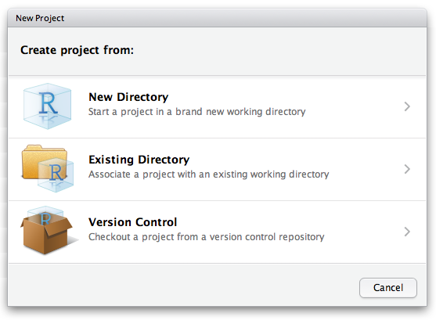
RProjects
R Projects come with many benefits:
Remove the need for declaring working directories
Can be moved all together without breaking links
Takes advantage of the file explorer view pane
Will always load your last saved display and environment

Slide 5
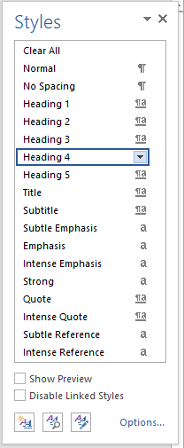
Word Reference Doc
R Markdown has 3 main output formats
HTML (Yay these rock!)
PDF (Ok I guess this is fine)
MS Word (oh goodness please no)
We will be working with Word…
The reference doc is what R will use for all Word styles
Word Styles are declared within your reference document

Slide 6
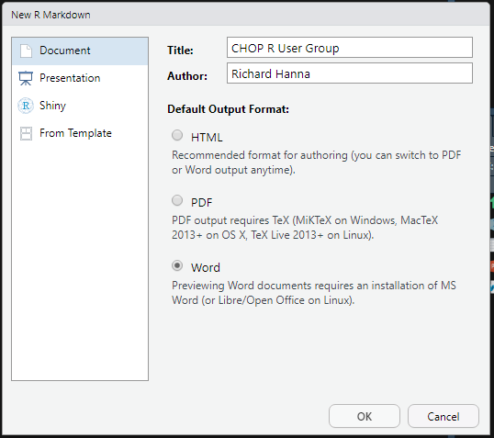

R Markdown
Use markdown syntax to make reproducible reports
Rmarkdown Cheat Sheet
Consists of markdown writing and code chunks
Can be run individually
Can use different languages (r, python, SQL)
Consider chunks like individual scripts
Start with ```{} and end with ```
{} is where you declare the language, suppression commands, figure details and much more

Slide 7
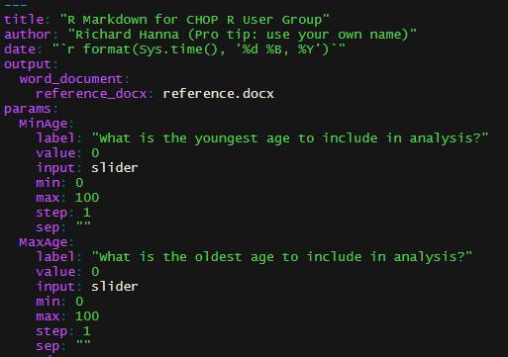

YAML
“YAML Ain’t Another Markdown Language” “Yet Another Markdown Language”
http://www.yamllint.com/
Area to declare report elements, outputs, and parameters

Slide 8
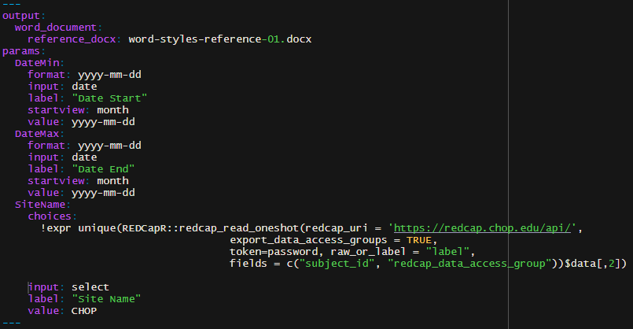
YAML
YAML is always at the very top of the markdown
Always starts and ends with “---”
You can include R elements in your YAML
Example: Enable all REDCap DAGs to be live choices on knitting
asdasd

Slide 9

Parameters
Go to the bookdown chapter a lot
Parameters allow you to take the framework of your code and substitute varying inputs
Inputs are user-defined on “knitting”
Examples:
Same report, different recipients
Varying dates between recipients
Varying graphic needs
Constantly changing datasets

Slide 10
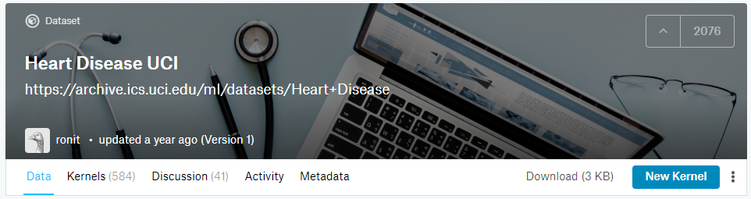
Kaggle
Online community platform for data scientists owned by Google
Offers public data sets for competitions and exploration
We will be exploring the `heart.csv`
14 attributes from UCI Machine Learning Repository
303 patients

Slide 11


Thank you!

