Slide 1

Foundational Model For Predicting Movie Gross
Rick Shapiro

Slide 2
Gradient Boosted Regressor
Cross Validated R² score of 0.75
Pros | Cons
Powerful Learner – Minimize Error | Complex
Robust Model | Less Interpretable
Flexible | Possible to Over-fit
Maximal Explained Variance | Longer Training time
Notes:
I used a Gradient Boosted Regressor to make predictions because it is a powerful model that was able to dive into the details of the data in order to maximize the explained variance. The features on their own are not very predictive so the added complexity of the GBR is needed to get better predictions.

Slide 3
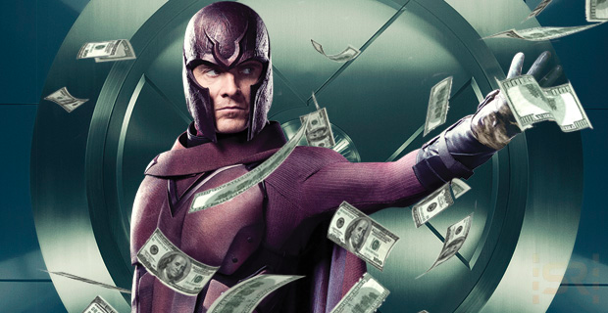
Feature Selection
Sources: BoxOfficeMojo, IMDB, The Numbers, Wikipedia
Runtime
Opening Number of Theaters
Total Number of Theaters
Production Budget
Release Date
Genre
Actor Score*
Director Score*
Notes:
Features are what was readily available to me on websites I could scrape

Slide 4
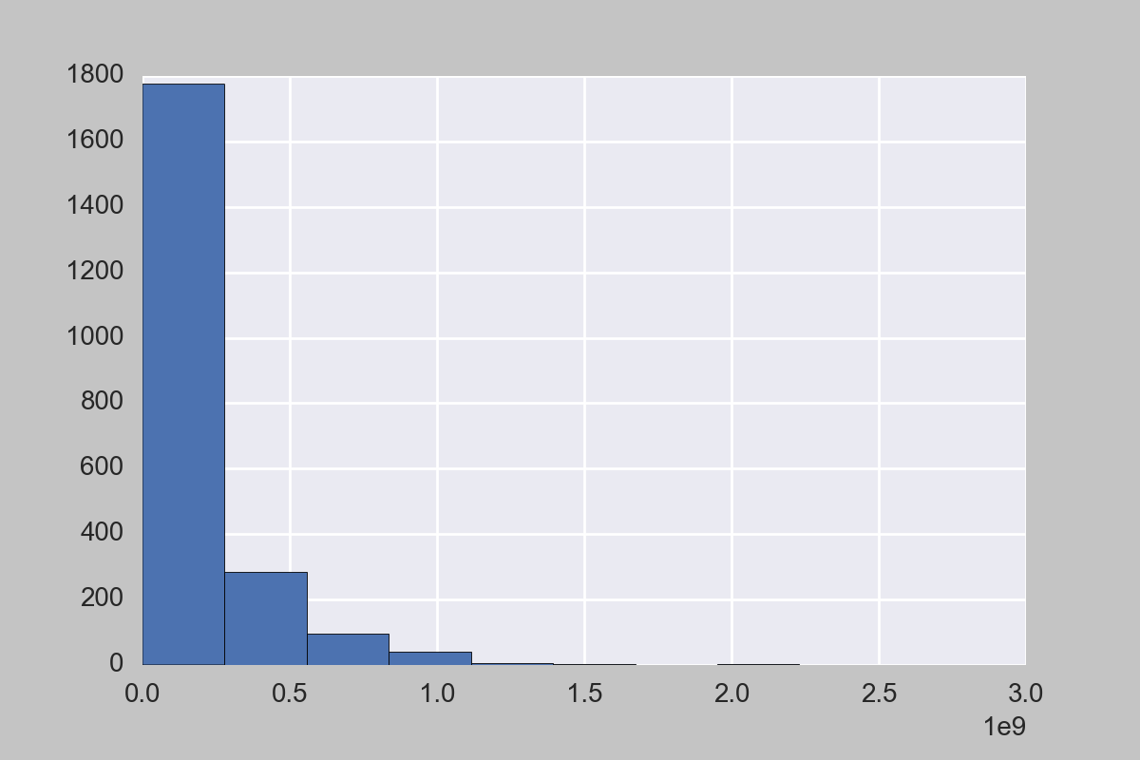
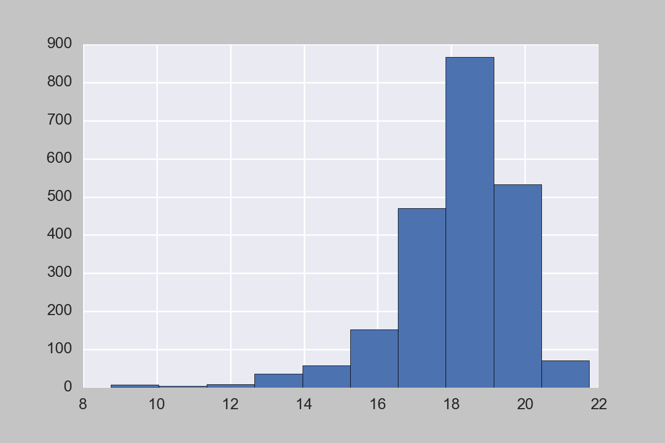
Target Variable
Distribution of Movie Gross
Distribution of Log Gross
Notes:
Tried to predict Log Gross as Total Gross was too skewed. Alternative (had I known about it) would have been to oversample.

Slide 5
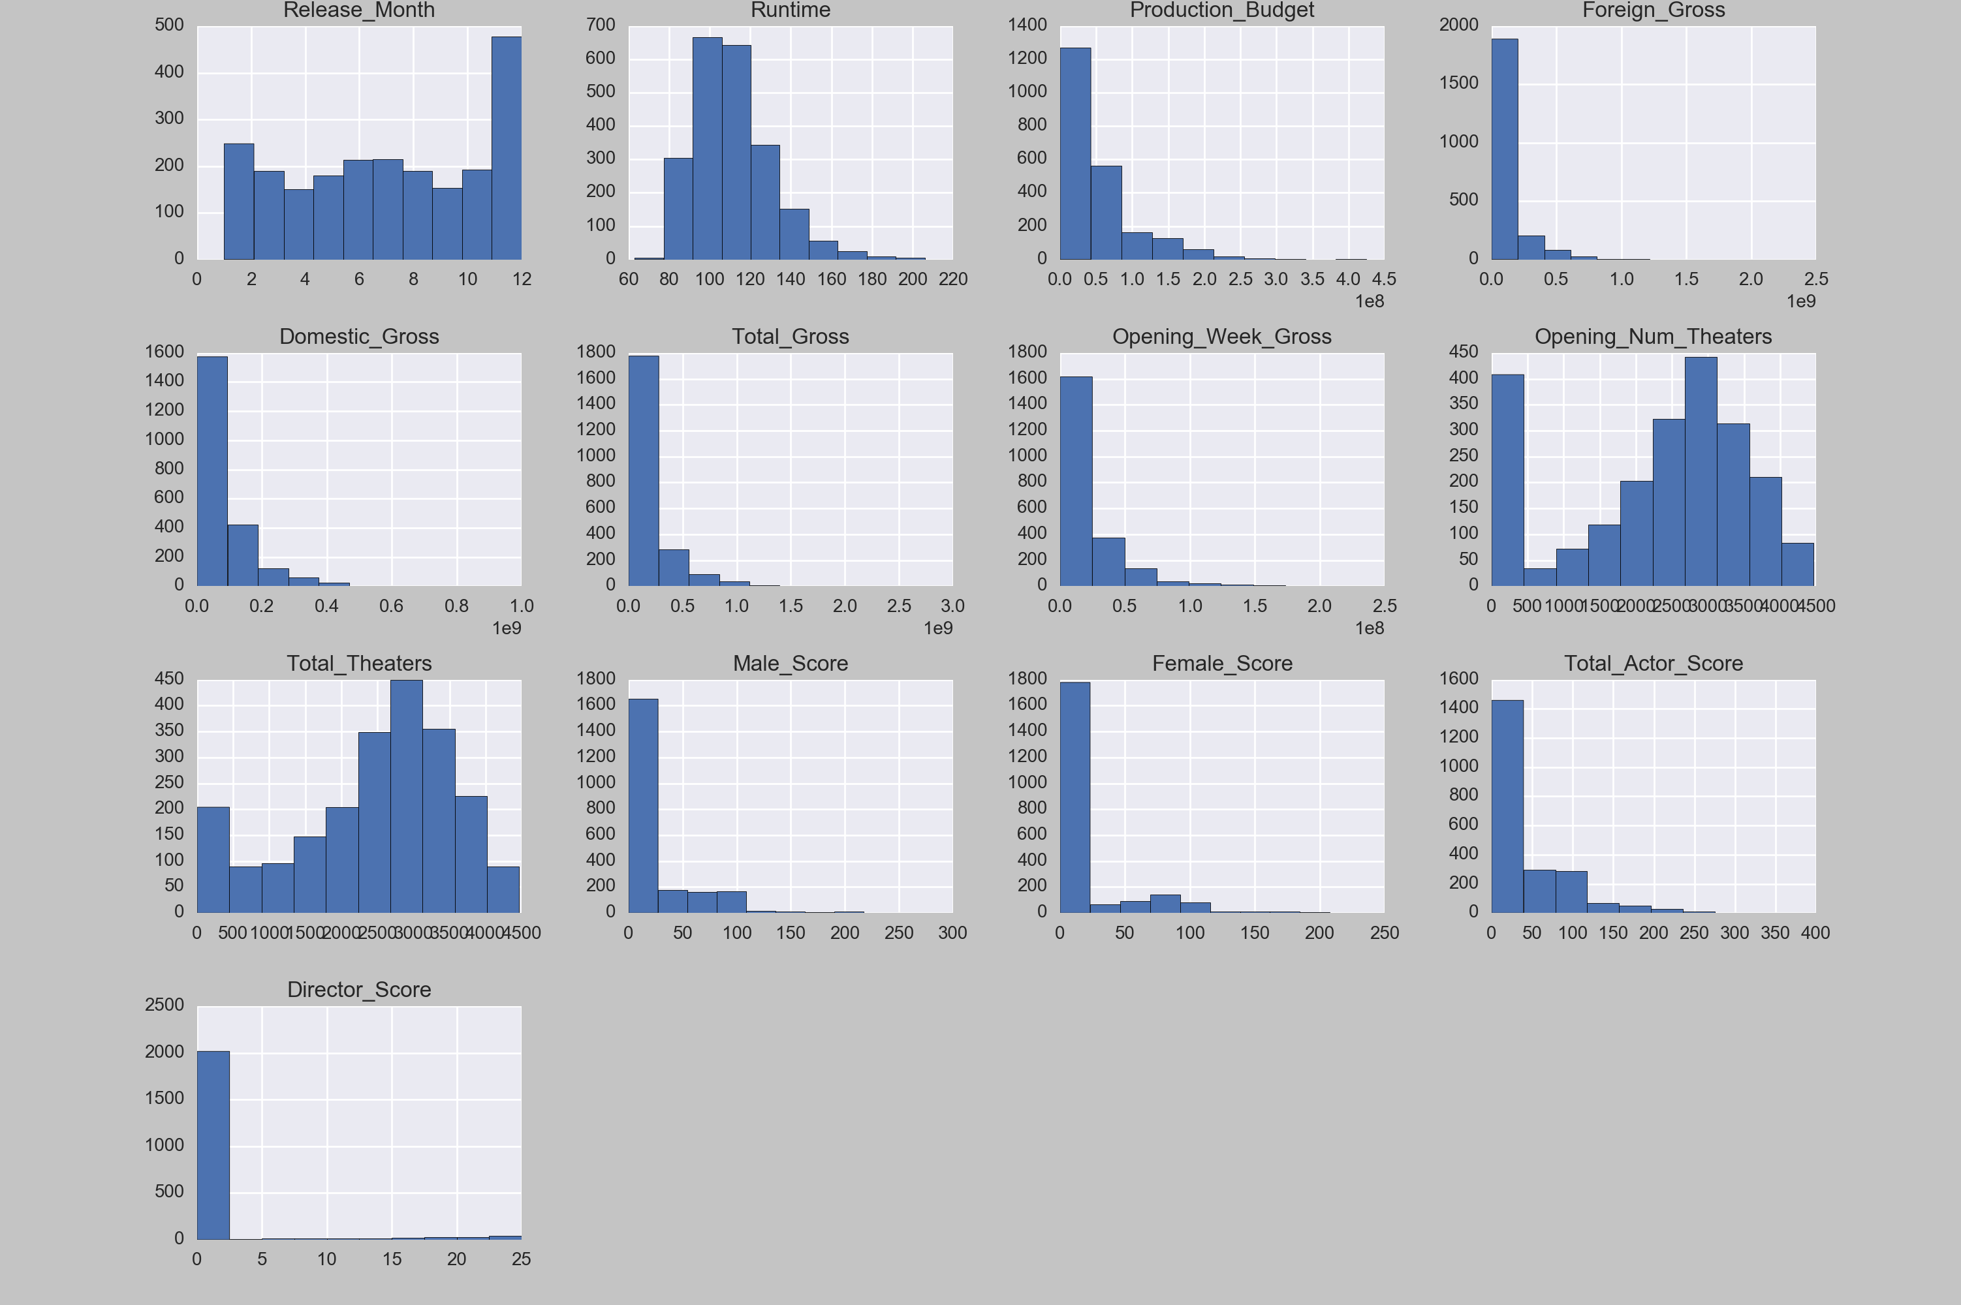
First Glance
Heavy Skew and Outliers!

Slide 6
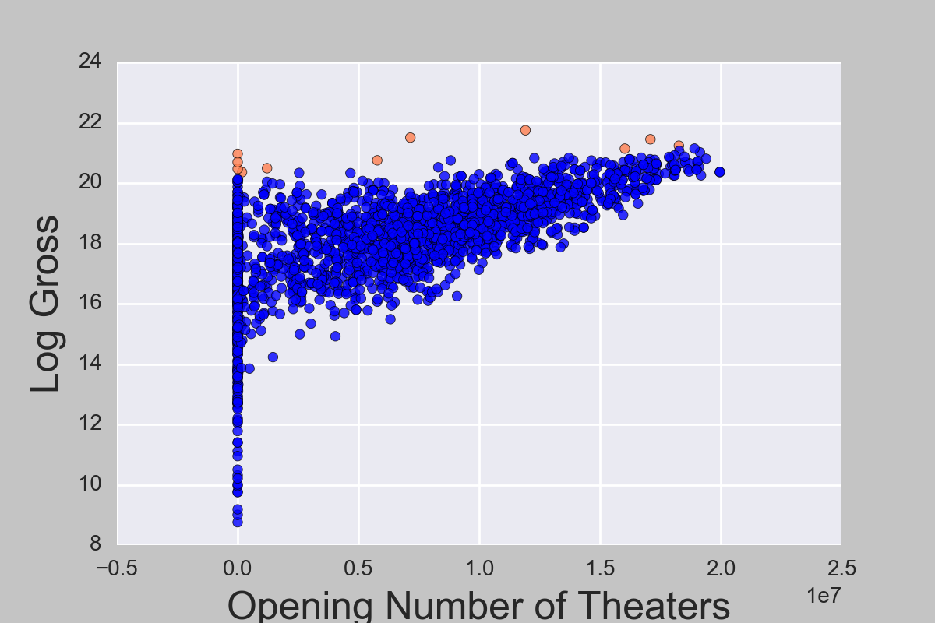
Feature Manipulations
Square of Opening Number of Theaters had greater correlation with log Gross.
Corr = 0.67

Slide 7

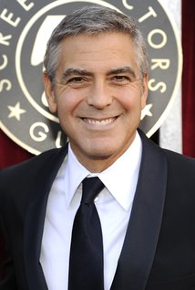
Feature Engineering
Actor Score:
IMDB 100 Hottest Actresses
IMDB 100 Hottest Actors

Slide 8
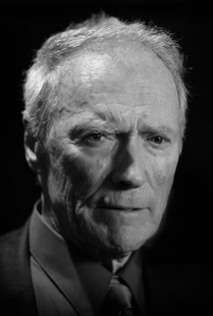
Feature Engineering
Director Score:
IMDB 25 Best Directors of All Time

Slide 9
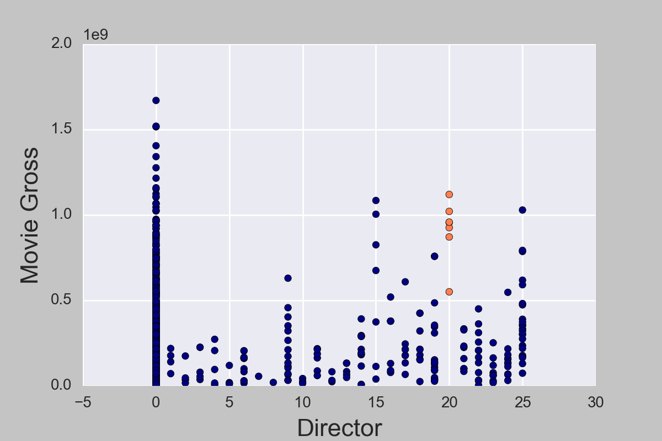
Movie Gross by Director:
Who is this?
⬇

Slide 10
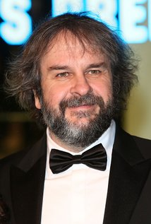
PETER JACKSON NEVER MADE A BAD MOVIE!
(IF YOU SAY EVILD DEAD IS BAD GTFO)

Slide 11
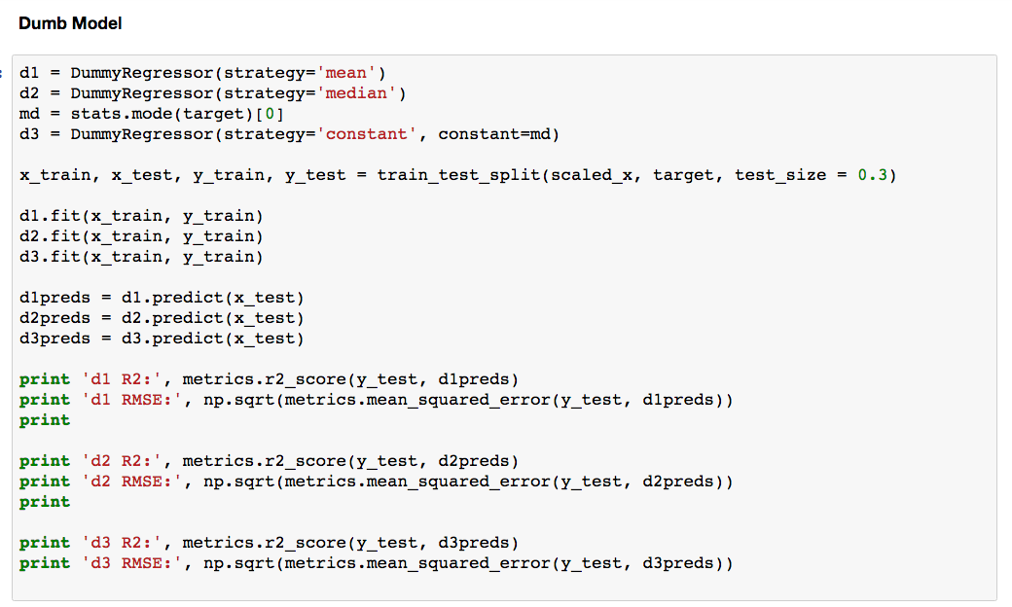



Results
Null Accuracy:
Notes:
Null Accuracy is our basline. We should be doing better than our Dummy Model.
The Null Scoes just tell us that this data is not great. There is a lot of variation and the relationships are weak.

Slide 12
Results & Interpretation
Explains 0.75% of the variance
Accuracy increases with budget
Actor Score somewhat predictive
Director Score not very predictive
Model heavily weights number of theaters

Slide 13
Actors
Took films that grossed more than $600 million
Counted the number of these movies that each actor was in.
The results could reveal certain actors who drive up movie revenue

Slide 14
Actors
Actor appearances in a film grossing more than $600 million:
Actor | Count
Ian McKellen | 9
Rupert Grint | 8
Emma Watson | 8
Orlando Bloom | 8
Daniel Radcliffe | 8
Billy Burke | 7
Gary Oldman | 7
Ashley Green | 7
Taylor Lautner | 7
Peter Facinelli | 7
Actor | Count
Kristen Stewart | 7
Kellan Lutz | 7
Jackson Rathbone | 7
Tyrese Gibson | 6
Elizabeth Reaser | 6
Eddie Murphy | 6
Scarlett Johansson | 6
Antonio Banderas | 6
Cameron Diaz | 6
Mike Myers | 6
Notes:
These actors mostly represent movie series/franchises aka Xmen, Harry Potter, Lord of the Rings, Twilight. Further investigation required to see if the actors are what makes the series great, or if the series is what makes the actor great.

Slide 15
Actors
Most Predictable Actors:
Table of actors and number of appearances in a movie which my model could predict to within 10 %
Actor | Count
Tom Hanks | 15
Liam Neeson | 13
Alec Baldwin | 12
Bruce Willis | 12
Julia Roberts | 11
Brad Pitt | 11
Stanley Tucci | 11
Eddie Murphy | 10
Elizabeth Banks | 10
Matt Damon | 10
Actor | Count
Jim Carrey | 10
Morgan Freeman | 9
Ben Affleck | 9
Jude Law | 9
Queen Latifah | 9
Cameron Diaz | 9
Richard Gere | 9
Tom Cruise | 9
Julianne Moore | 9
Denzel Washington | 9

Slide 16

Future Exploration
Error Examination
• Low Budget Films
Additional Features
• Google Trends
• Twitter
• Budget Breakdown
• Ratings
More Actor Metrics
• Weighted by Film Count
• Ratings

Slide 17
Rick Shapiro
https://www.facebook.com/rick.shapiro.5
https://github.com/rshap91
https://www.linkedin.com/in/rickshapirony

