Slide 1
AI and IoT-Enabled
Smart Office System with Cloud-Based Energy Optimization
Dynamic Bandwidth
Allocator
Office Energy
Optimizer
Smart Office
Intelligence
Shaethayine. R | IT22315700
Shaethayine. R | IT22315700
M.A.H.S. Thathsarani | IT22564672
Project Overview
An integrated AI and IoT-powered workplace system combining real-time employee stress detection, smart power and air quality monitoring, and dynamic network bandwidth allocation — all unified under a cloud-ready smart office platform.
SLIIT | BSc (Hons) CSNE | April 2026
1
Notes:
INTRODUCTION
The rapid advancement of Artificial Intelligence (AI), Machine Learning (ML), and the Internet of Things (IoT) has created new opportunities to transform traditional office environments into intelligent, adaptive workplaces. However, most organizations today still operate with disconnected systems — energy management, network management, and employee management are handled separately, with no awareness of each other.
This research presents the design and development of an AI and IoT-Enabled Smart Office System with Cloud-Based Energy Optimization — an integrated platform that brings together three intelligent subsystems to address the most pressing workplace challenges simultaneously.
The three core components of this system are:
1. Dynamic Bandwidth Allocator
A real-time AI-driven module that monitors each employee's workload (CPU, RAM, network usage) and dynamically adjusts their network bandwidth using Quality of Service (QoS) policies. High-workload employees receive priority bandwidth (25-50 Mbps), while idle employees are allocated less (2-10 Mbps), maximizing network efficiency across the office.
2. Office Energy Optimizer
An IoT-based monitoring system using ESP32 microcontrollers with PZEM-004T (power), DHT22 (temperature/humidity), and MQ2 (gas) sensors deployed across office floors. Data is transmitted securely via MQTT/TLS to HiveMQ Cloud. Machine learning models detect power anomalies (6 classes) and air safety hazards (7 classes) in real-time, triggering automated SMS alerts and n8n escalation workflows when critical conditions are detected.
3. Smart Office Intelligence Platform
A webcam-based system that detects employee stress levels in real-time using machine learning, classifies them as Low, Normal, or High, and automatically assigns tasks that match the employee's current mental state — preventing burnout and improving productivity. All interactions are managed through a unified WebSocket-powered dashboard accessible to both administrators and employees.
Together, these three systems form a unified, scalable, and cost-effective Smart Office platform that improves energy efficiency, network performance, and employee well-being — all through a single, integrated intelligent solution.

Slide 2
AI & IoT Smart Office System | SLIIT
Problem in Brief
Why smart offices need an integrated AI + IoT approach
The Core Problem
Research Gap
Modern offices face three critical yet disconnected challenges:
No existing system combines all three: energy, bandwidth, and stress
Existing tools address each problem in isolation
No real-time cross-module data sharing between components
Lack of WebSocket-based unified monitoring dashboard
⚡ Energy Waste
Office devices run without awareness of actual usage patterns. Overloads, standby losses, and air quality hazards go undetected, risking both equipment damage and employee health.
📡 Static Bandwidth
Proposed Solution
Network resources are allocated equally regardless of workload. High-priority tasks are bottlenecked while idle employees consume the same bandwidth.
Unified Smart Office Intelligence Platform
Real-time stress detection via webcam + ML
IoT energy + air monitoring with anomaly alerts
Dynamic QoS bandwidth allocation per employee
Single dashboard — admin + employee view
🧠 Ignored Employee State
Task management systems assign work without considering employee stress or cognitive load, causing burnout, reduced productivity, and inefficient resource use.
SLIIT | BSc (Hons) CSNE | April 2026
2
Notes:
PROBLEM STATEMENT
PROBLEM STATEMENT:
Traditional office environments rely on disconnected, manually-managed systems that lack the intelligence to respond to real-time conditions. This creates three critical, unaddressed challenges:
1. UNDETECTED ENERGY ANOMALIES
Office power systems operate without awareness of actual consumption patterns. Overloads, standby losses, and voltage issues go undetected until equipment is damaged. Air quality hazards such as heat buildup, humidity risks, and gas leaks are not monitored, posing health and safety risks to employees.
2. STATIC BANDWIDTH ALLOCATION
Network resources are distributed equally to all employees regardless of their actual workload. High-priority, demanding tasks compete with idle workstations for the same bandwidth, causing bottlenecks and reduced productivity. There is no mechanism to dynamically prioritize based on need.
3. EMPLOYEE MENTAL STATE IS IGNORED
Task management systems assign work purely based on availability or predefined roles — never considering an employee's real-time stress level or cognitive load. This leads to overloading stressed employees, increasing burnout risk, reducing output quality, and causing inefficient use of human resources.
RESEARCH GAP:
No existing system integrates all three challenges into one unified, intelligent platform. Existing solutions address each domain in isolation, with no cross-module data sharing, no real-time adaptive decision-making, and no unified monitoring dashboard connecting energy, network, and human factors.

Slide 3
AI & IoT Smart Office System | SLIIT
System Overview
Three integrated components forming the Smart Office Intelligence Platform
01
Dynamic Bandwidth Allocator
02
Office Energy Optimizer
03
Smart Office Intelligence
Shaethayine. R | IT22315700
Shaethayine. R | IT22315700
M.A.H.S. Thathsarani | IT22564672
Real-time CPU/RAM/network workload monitoring
Random Forest workload classifier (High/Medium/Low)
QoS policy enforcement via Linux Traffic Control
Flask REST API + WebSocket live dashboard
Integrates stress data from Smart Office module
ESP32 + PZEM-004T + DHT22 + MQ2 sensors
HiveMQ Cloud MQTT/TLS communication
Random Forest power anomaly detection (6 classes)
RF + Isolation Forest air safety model (7 classes)
SMS alerts (Twilio) + n8n automation workflows
Camera-based employee stress detection (CNN planned)
Stress-aware ML task allocation (Low/Normal/High)
FastAPI backend + Next.js + Tailwind frontend
WebSocket real-time communication
JWT auth + bcrypt encryption + SQLite
SLIIT | BSc (Hons) CSNE | April 2026
3
Notes:
WHO WILL BE BENEFITED BY THE SOLUTION
This Smart Office Intelligence Platform is designed to deliver measurable benefits to a wide range of stakeholders across modern organizational environments:
1. EMPLOYEES
Employees benefit most directly from this system. The stress detection and task allocation module ensures that employees are never overburdened when they are mentally fatigued. Tasks are assigned based on their real-time condition, reducing burnout and improving job satisfaction. The dynamic bandwidth allocation ensures that employees doing high-priority, demanding work always have sufficient network resources to perform effectively.
2. ADMINISTRATORS AND MANAGERS
Administrators gain a powerful, unified dashboard that gives them real-time visibility into employee stress levels, task progress, energy consumption, air quality, and network usage — all in one place. They can send camera access requests, monitor who is overloaded, reassign tasks, and respond to energy or safety alerts without leaving the dashboard. This dramatically reduces manual oversight effort.
3. HR PROFESSIONALS
Human Resource teams can use the stress monitoring and workload data generated by this system to identify employees who are consistently under high stress, enabling early intervention before burnout occurs. The system provides objective, data-driven insights that support fair workload distribution, performance evaluation, and employee well-being programs.
4. FACILITY AND OPERATIONS MANAGERS
The Office Energy Optimizer directly serves facility managers by providing real-time alerts for power overloads, standby losses, voltage issues, heat risks, humidity problems, and smoke detection. The automated n8n escalation workflows (voice call → WhatsApp → email) ensure that critical safety events are never missed, even outside working hours. Daily PDF energy reports are automatically emailed every morning for review.
5. IT AND NETWORK ADMINISTRATORS
IT teams benefit from the Dynamic Bandwidth Allocator, which automates network QoS enforcement without requiring manual configuration per user. The system monitors real-time network consumption and enforces bandwidth limits via Linux Traffic Control, ensuring fair and efficient use of the office network infrastructure with minimal IT intervention.
6. ORGANIZATIONS AND BUSINESSES (SMEs and Enterprises)
Organizations as a whole benefit through improved operational efficiency, reduced energy waste, lower risk of equipment damage from undetected anomalies, and a more productive, healthier workforce. The system is built on open-source, cost-effective technologies, making it accessible to small and medium enterprises (SMEs) as well as large enterprises. Its microservices architecture allows it to scale from a single floor to an entire multi-building campus.
7. RESEARCHERS AND DEVELOPERS
The integrated architecture of this platform — combining affective computing, IoT sensor networks, ML-based anomaly detection, and real-time QoS enforcement — provides a practical research framework for future work in smart workplace systems, Industry 4.0, and human-centered AI applications.

Slide 4
AI & IoT Smart Office System | SLIIT
Integrated System Architecture
How all three components connect in the Smart Office ecosystem
HARDWARE / IoT LAYER
ESP32 + PZEM-004T
(Power Sensor)
ESP32 + DHT22 + MQ2
(Air Quality Sensor)
Webcam
(Employee Camera)
Employee PC
(Workload Monitor)
COMMUNICATION & PROCESSING LAYER
HiveMQ Cloud
(MQTT/TLS)
Flask Backend
(Energy Optimizer)
Flask REST API
(Bandwidth Allocator)
FastAPI Backend
(Smart Office)
ML / AI MODELS LAYER
RF Power Model
(6 classes)
RF + Isolation Forest
(Air Safety, 7 classes)
RF Workload
Classifier
CNN / Stress
Detection Model
UNIFIED SMART DASHBOARD — Admin View | Employee View | Real-Time WebSocket Updates
SLIIT | BSc (Hons) CSNE | April 2026
4
Notes:
OBJECTIVES
MAIN OBJECTIVE:
To design and develop an integrated AI and IoT-enabled Smart Office Intelligence Platform that improves workplace productivity, employee well-being, and operational efficiency by combining real-time stress detection, intelligent task allocation, energy anomaly monitoring, and dynamic bandwidth management into a single unified system.
SUB-OBJECTIVES:
1. Stress Detection and Classification
To capture employee facial data via webcam and develop a machine learning model (CNN, planned with AffectNet and FER2013 datasets) that classifies employee stress levels into Low, Normal, and High categories in real-time with high accuracy.
2. Stress-Aware Task Allocation
To implement an intelligent task assignment engine that dynamically allocates tasks based on detected stress levels — assigning lighter tasks to stressed employees and more demanding tasks to employees with low stress — preventing burnout and optimizing productivity.
3. IoT Energy Monitoring and Anomaly Detection
To deploy ESP32-based sensor nodes (PZEM-004T, DHT22, MQ2) on office floors and develop ML models (Random Forest + Isolation Forest) that detect 6 classes of power anomalies and 7 classes of air safety hazards in real-time, with automated SMS and escalation alerts.
4. Dynamic Bandwidth Allocation
To monitor real-time employee workload metrics (CPU, RAM, network I/O) and train a Random Forest classifier that categorizes workload into High, Medium, and Low, enforcing corresponding QoS bandwidth limits (25-50 Mbps, 10-25 Mbps, 2-10 Mbps) via Linux Traffic Control.
5. Cross-Module Integration
To enable data sharing between the three modules via REST APIs — specifically, to pass detected stress level from the Smart Office module to the Bandwidth Allocator — so that bandwidth priority can factor in employee mental state alongside workload metrics.
6. Unified Real-Time Dashboard
To develop a WebSocket-based unified dashboard (admin + employee views) using FastAPI and Next.js that displays live stress levels, task assignments, energy readings, and bandwidth status across all three modules with minimal latency.
7. System Security and Reliability
To ensure secure user authentication via JWT tokens, password protection via bcrypt hashing, and reliable MQTT/TLS communication between IoT sensors and the cloud broker, maintaining data integrity and access control throughout the system.

Slide 5
AI & IoT Smart Office System | SLIIT
Dynamic Bandwidth Allocator
Component 1 | Shaethayine. R | IT22315700
Workload
Monitor
Feature
Engineering
RF Workload
Classifier , Regressor
QoS
Policy Engine
Linux TC
Enforcement
How It Works
Tech Stack
Data Collected per Employee:
Flask + Flask-SocketIO (backend REST API)
Random Forest Classifier + Linear Regressor
scikit-learn + NumPy + Pandas + joblib
SQLite database (bandwidth.db)
Linux Traffic Control (tc) for QoS
CPU usage (%), RAM usage (%), Disk I/O
Network I/O — upload & download bytes
Active applications count
Stress level (received from Smart Office API)
Time of day, day of week context
QoS Bandwidth Policy:
Partner Integration
Workload | Bandwidth | Priority
High | 25 – 50 Mbps | Highest (1)
Medium | 10 – 25 Mbps | Normal (2)
Low | 2 – 10 Mbps | Low (3)
Receives stress level from Smart Office module:
POST /api/stress_input
{ "employee_id": "EMP001", "stress_level": 78 }
API Endpoints: /api/employees | /api/predict | /api/simulate_tick | /api/stats
SLIIT | BSc (Hons) CSNE | April 2026
IT22315700 | Shaethayine. R
5

Slide 6
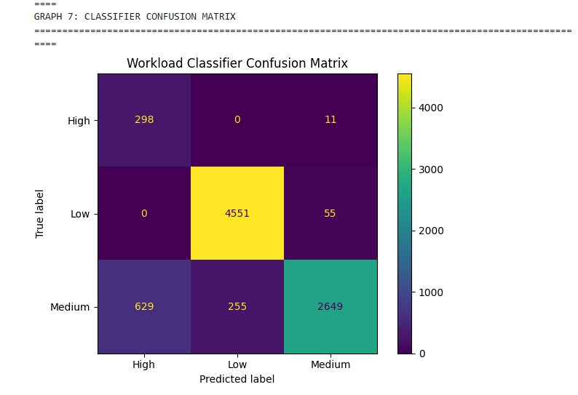
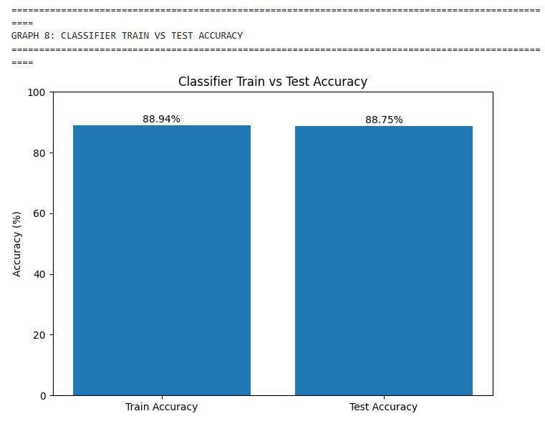
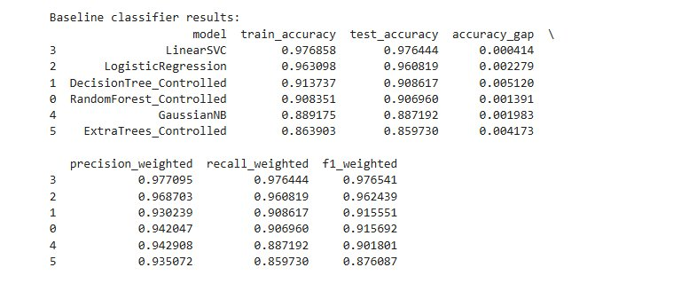
AI & IoT Smart Office System | SLIIT
Workload Classification — Results & Analysis
Random Forest Workload Classifier | 42,240 training samples | 20 employees × 30 days
Train Accuracy
Test Accuracy
Precision
Recall
F1 Score
Accuracy Gap
88.94%
88.75%
93.61%
88.75%
89.95%
0.19%
Key Observations
No significant overfitting (gap = 0.19%, within 5% threshold)
Low class: 4551/4606 correctly classified (excellent)
High class: slight confusion with Medium (309 samples vs 4606 Low — class imbalance)
Weighted avg F1 = 0.90 confirms overall strong performance
Winner: Random Forest (over LinearSVC, DT, GB, XGBoost, LR)
Workload Classifier Confusion Matrix
Train vs Test Accuracy
★ Final Winner: Random Forest | Test Acc: 88.75% | F1: 89.95%
SLIIT | BSc (Hons) CSNE | April 2026
IT22315700 | Shaethayine. R
6

Slide 7
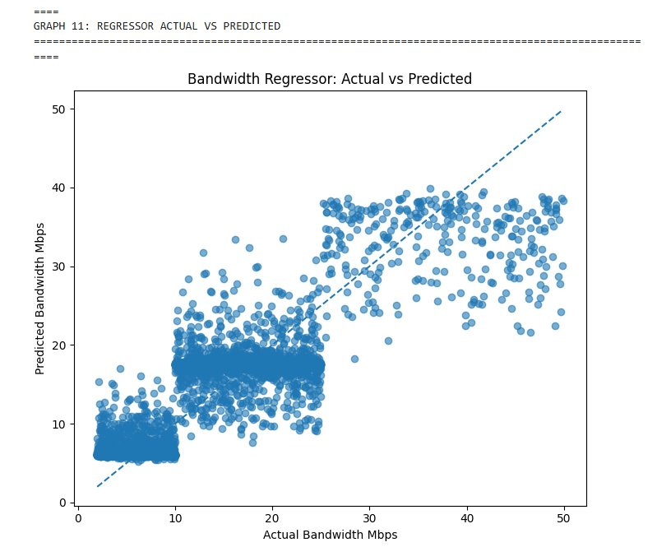
AI & IoT Smart Office System | SLIIT
Bandwidth Regressor — Results & Analysis
Predicts exact Mbps allocation per employee based on workload features
Train MAE
Test MAE
Train RMSE
Test RMSE
Train R²
Test R²
2.83 Mbps
3.09 Mbps
3.51 Mbps
4.01 Mbps
0.8201
0.7608
Analysis & Notes
R² Interpretation:
Train R² = 0.82 → model explains 82% of variance in training data
Test R² = 0.76 → generalises well to unseen data
Test MAE of 3.09 Mbps is acceptable given 2–50 Mbps range
Scatter Plot Interpretation:
Points near dashed line = accurate predictions
Clusters at 2–10 Mbps (Low) and 10–25 Mbps (Medium) are tight → good fit
Some spread at 25–50 Mbps (High) — fewer High samples
Model performs best for Low workload employees (majority class)
Bandwidth Regressor: Actual vs Predicted Mbps
SLIIT | BSc (Hons) CSNE | April 2026
IT22315700 | Shaethayine. R
7

Slide 8
AI & IoT Smart Office System | SLIIT
Office Energy Optimizer
Component 2 | Shaethayine.R | IT22315700 | IoT + ML Anomaly Detection
ESP32
Sensors
HiveMQ
MQTT/TLS
Flask
Backend
ML
Models
Alert
Engine
SMS +
Dashboard
Hardware & Communication
Alert System
ESP32 microcontroller (32-bit, WiFi-enabled)
PZEM-004T — voltage, current, power, frequency measurement
DHT22 — temperature & humidity sensor
MQ2 — gas sensor (smoke, LPG detection)
HiveMQ Cloud — MQTT over TLS (secure IoT messaging)
Multi-floor deployment: SensorDevice01 (Floor 1) + SensorDevice02 (Floor 2)
Alert Type | Severity | SMS?
overload_risk | Critical | ✓ Yes
smoke_suspected | Critical | ✓ Yes
combined_risk | Critical | ✓ Yes
heat_risk / voltage_issue | High | No
idle_waste / standby_loss | Warning | No
ML Models
Threshold Profiles
Power Model (Random Forest):
Demo Profile: SensorDevice01 (2.2–6W normal, >40W overload alert)
Demo Profile: SensorDevice02 (43–64W normal, >65W overload alert)
Production: Sigma-3 baseline for overload detection
Production: Relative MQ2 baseline for gas detection
n8n workflow: alert escalation → voice call → WhatsApp → email
Trained on 40,320 real sensor readings
6 classes: normal, idle_waste, standby_loss, abnormal_drop, overload_risk, voltage_issue
Air Safety Model (RF + Isolation Forest):
7 classes: normal, heat_risk, humidity_risk, air_quality_warning, smoke_suspected, combined_risk, combined_environment_risk
SLIIT | BSc (Hons) CSNE | April 2026
IT22315700 | Shaethayine.R
8

Slide 9
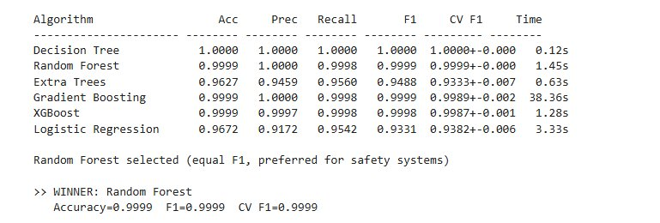
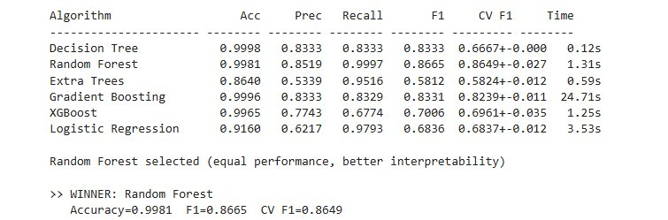
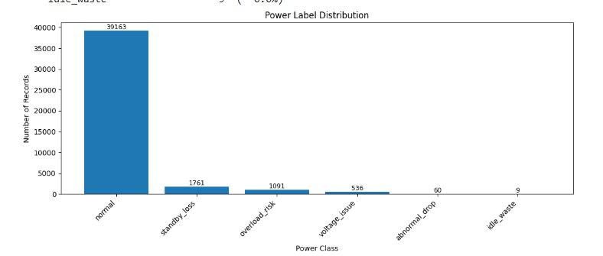
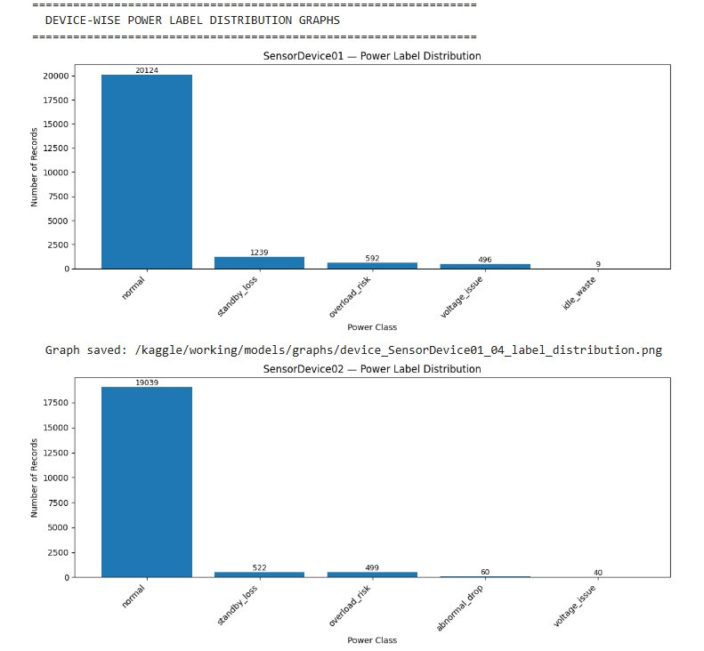
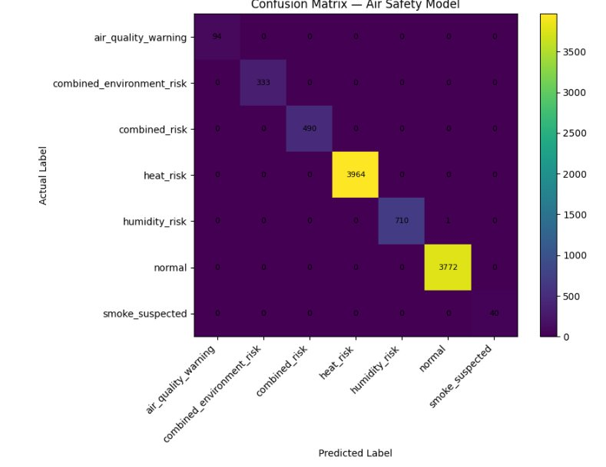
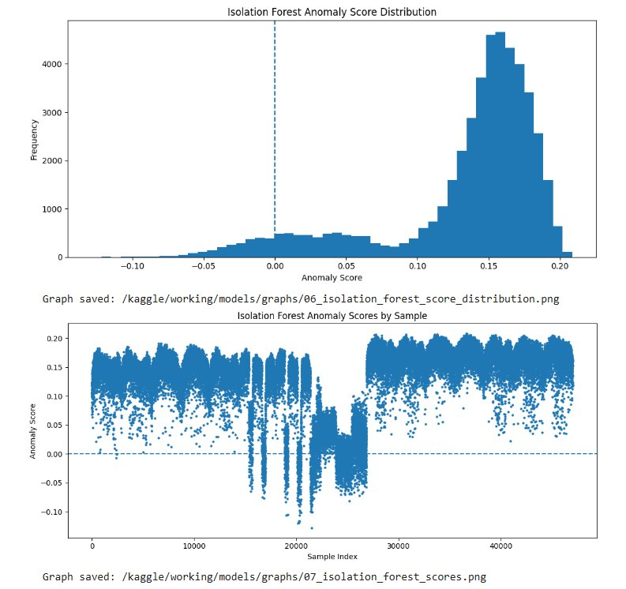
AI & IoT Smart Office System | SLIIT
Energy Optimizer — ML Results & Analysis
Power Model + Air Safety Model performance evaluation
Power Model — Algorithm Comparison
Air Safety Model — Algorithm Comparison
★ Winner: Random Forest | Acc=0.9999 | F1=0.9999 | CV F1=0.9999
★ Winner: Random Forest | Acc=0.9999 | F1=0.9999 | CV F1=0.9999
Power Label Distribution (Combined)
Device-Wise Distribution
Air Safety Confusion Matrix
Isolation Forest Score
SLIIT | BSc (Hons) CSNE | April 2026
IT22315700 | Shaethayine.R
9

Slide 10
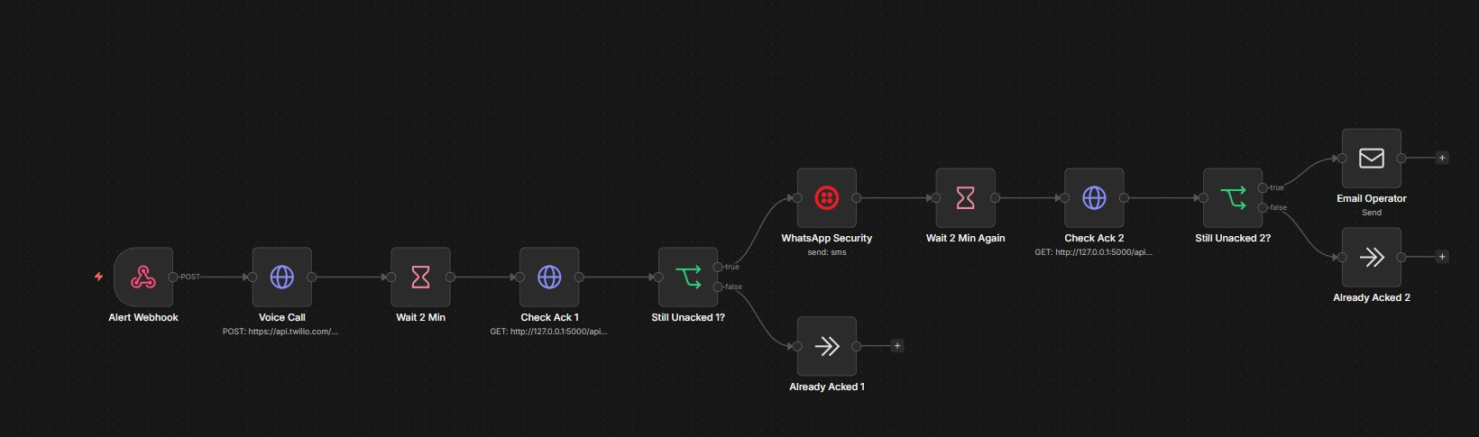
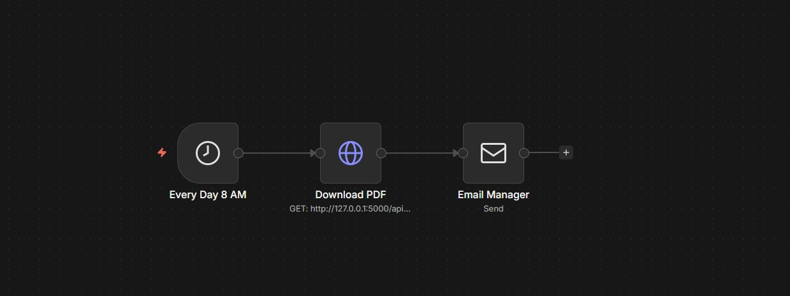
AI & IoT Smart Office System | SLIIT
n8n Automation Workflows — Energy Optimizer
Automated alert escalation + daily PDF reporting via n8n
Workflow 1: Alert Escalation (Critical Alerts → Voice Call → WhatsApp → Email)
① Alert Webhook triggered → ② Twilio Voice Call to operator → ③ Wait 2 min → ④ Check Acknowledgement (ACK) → If still unacked: ⑤ WhatsApp Security message → Wait 2 min → ⑥ Check ACK again → If still unacked: ⑦ Email Operator | If acked at any stage → End
Workflow 2: Daily PDF Report (Every Day 8 AM → Download PDF → Email Manager)
Automated daily energy summary report emailed to manager every morning at 8 AM — no manual intervention required.
SLIIT | BSc (Hons) CSNE | April 2026
IT22315700 | Shaethayine.R
10

Slide 11
AI & IoT Smart Office System | SLIIT
Smart Office Intelligence Platform
Component 3 | M.A.H.S. Thathsarani | IT22564672
Webcam
Input
FastAPI
Backend
Stress
ML Model
Task
Allocator
WebSocket
Layer
Next.js
Dashboard
Stress Detection Module
Task Allocation Module
Dashboard & Tech Stack
Webcam captures employee facial images in real-time
Face detection + preprocessing (resize, normalize)
ML model classifies stress into: Low / Normal / High
Placeholder model (~90% simulated acc) — CNN integration planned
AffectNet (~400K images) + FER2013 (~35K) datasets planned
Results visible on admin dashboard only (privacy-protected)
Stress level → workload category mapping
High stress → Low workload tasks assigned
Normal stress → Medium workload tasks assigned
Low stress → High workload tasks assigned
Rule-based decision engine (ML upgrade planned)
Automatic task rotation after completion
Admin: stress view, task mgmt, camera requests
Employee: assigned tasks, completion updates
WebSocket — instant real-time updates
FastAPI (BE) + Next.js + Tailwind (FE)
SQLite + SQLAlchemy ORM
JWT auth + bcrypt password hashing
Testing Results
Feature | Result
Login/Auth (JWT) | ✓ Pass
Camera Request | ✓ Pass
Task Display | ✓ Pass
Task Completion | ✓ Pass
WebSocket Updates | ✓ Pass
Test Case | Input | Result
TC1 | Neutral face | ✓ Normal
TC2 | Happy face | ✓ Low
TC3 | Angry/Sad | ✓ High
TC4 | Random input | ✓ Valid
Stress | Task Assigned | Result
Low | High Workload | ✓ Pass
Normal | Medium Workload | ✓ Pass
High | Low Workload | ✓ Pass
SLIIT | BSc (Hons) CSNE | April 2026
IT22564672 | M.A.H.S. Thathsarani
11

Slide 12
AI & IoT Smart Office System | SLIIT
Research Findings
Key outcomes from testing and evaluation across all three components
01 Effective Stress Detection
02 Improved Task Allocation
03 Energy Anomaly Detection
04 Intelligent QoS Enforcement
Camera-based ML model classifies employee stress (Low/Normal/High) in real-time. System architecture supports CNN upgrade with AffectNet data.
Stress-aware task assignment ensures high stress employees receive lighter workloads. Prevents burnout and improves overall productivity.
Power RF model detects 6 classes of anomalies on real sensor data. Air model detects 7 hazard classes including smoke and combined risks.
Bandwidth dynamically adjusts per employee: 25–50 Mbps (High), 10–25 Mbps (Medium), 2–10 Mbps (Low) — far superior to static allocation.
05 Real-Time Communication
06 n8n Automated Alerting
07 Integrated Platform
08 Feasible & Scalable
WebSocket implementation delivers instant updates across admin and employee dashboards. Camera requests, task updates and notifications work with minimal latency.
Critical energy alerts trigger escalation: voice call → WhatsApp → email chain. Daily PDF report emailed automatically at 8 AM every day.
All three components share data via REST APIs. No prior work has simultaneously combined stress detection + energy optimization + bandwidth allocation.
Built entirely on open-source tools. Microservices architecture allows independent scaling. Ready for cloud deployment (AWS/GCP).
SLIIT | BSc (Hons) CSNE | April 2026
12

Slide 13
AI & IoT Smart Office System | SLIIT
Results, Limitations & Future Improvements
Evaluation summary across all three components
Dynamic Bandwidth Allocator
Office Energy Optimizer
Smart Office Intelligence
✔ RESULTS
✔ RESULTS
✔ RESULTS
Train Acc: 88.94% | Test Acc: 88.75%
Precision: 93.61% | F1: 89.95%
Regressor Test R² = 0.7608
Test MAE: 3.09 Mbps
No overfitting (gap = 0.19%)
Power RF: Acc=99.99%, F1=0.9999
Air Safety RF: Acc=99.99%, F1=0.9999
6-class power + 7-class air detection
Real sensor data (40,320 readings)
SMS + n8n automation working
Stress detection: 4/4 test cases Pass
Task allocation: 3/3 scenarios Pass
Dashboard: 5/5 features Pass
WebSocket real-time comms confirmed
JWT + bcrypt security verified
⚠ LIMITATIONS
⚠ LIMITATIONS
⚠ LIMITATIONS
High workload class imbalance (only 309 High vs 4606 Low samples)
Linux TC enforcement — not cross-platform
Demo profile: only 2 sensor devices tested
MQ2 sensor prone to environmental drift
Not tested at production scale
Stress ML model is simulated (~90% sim. acc)
Not tested with large number of concurrent users
No integration with real IoT devices yet
→ FUTURE IMPROVEMENTS
→ FUTURE IMPROVEMENTS
→ FUTURE IMPROVEMENTS
SMOTE oversampling to fix class imbalance
Cloud-based QoS (AWS/Azure network policies)
More diverse training data per employee type
Multi-floor enterprise deployment
Cloud dashboard + historical trend analytics
Wearable device integration for air quality
Full CNN model with AffectNet/FER2013
Cloud deployment + horizontal scaling
Wearable + physiological signal integration
SLIIT | BSc (Hons) CSNE | April 2026
13

Slide 14
AI & IoT Smart Office System | SLIIT
Conclusion & Future Directions
Summary of contributions and roadmap for the Smart Office Intelligence Platform
Conclusion
Near-Term Future
What This Research Achieves:
Train full CNN model on AffectNet / FER2013
Deploy on AWS / GCP (cloud-native)
Integrate wearable devices (heart rate, GSR)
Mobile app for employees (React Native)
SMOTE oversampling for High workload class
First integrated system combining employee stress detection, IoT energy optimization, and AI bandwidth allocation
Demonstrated that AI and IoT can work together to create a fully adaptive, employee-centered office environment
Stress-aware task allocation reduces burnout risk — employees with high stress automatically receive lighter workloads
Energy anomaly detection with SMS escalation provides real-time safety for multi-floor office environments
Dynamic QoS enforcement ensures high-priority work always gets the bandwidth it needs
Unified WebSocket dashboard gives admins and employees a single real-time interface for all system activities
Scalable microservices architecture — each module can be deployed, updated, or replaced independently
Built entirely on open-source tools, making it cost-effective for SMEs and large enterprises alike
Long-Term Vision
Industry 4.0 / smart building full integration
Multi-tenant SaaS product offering
Federated learning for privacy-safe ML
Integration with HR systems (SAP, Workday)
Advanced privacy + data protection (GDPR)
Predictive maintenance for office equipment
"The Smart Office Intelligence Platform proves that modern AI, IoT, and real-time web technologies can together create an adaptive, efficient, and employee-centered workplace."
SLIIT | BSc (Hons) CSNE | April 2026
14

