Slide 1
IT4010 — Progress Presentation 2 (PP2)
AI-Enabled Smart Office System
with Cloud-Based Energy Optimization & Dynamic Bandwidth Allocation
Project ID: 25-26J-034 | BSc (Hons) IT — Computer Systems & Network Engineering
IT22315700
IT22564672
Shaethayine R
M.A.H.S. Thathsarani
IoT Energy Optimization
& Dynamic Bandwidth Allocation
Face-Based Stress Detection
& Intelligent Task Allocation
SLIIT Faculty of Computing | 25-26J-034 | PP2

Slide 2
Agenda
5 min overview + 30 min live demo
▶ Add One-Minute Video of Your Solution Here — show live system + dashboard
01
Problem & Motivation
30–45 sec — Why this system, who is affected, measurable pain points
02
Solution Overview (What We Built)
45–60 sec — 4 complete components, 90%+ completion status
03
System Architecture & Integration
60–90 sec — Architecture diagram, MQTT flow, Flask dashboard, API links
04
Commercialization / Impact
60–90 sec — Target market, value prop, cost estimate, rollout plan
05
Demo Plan + Member Roles
30–45 sec — End-to-end demo flow, who shows what, backup plan
SLIIT | 25-26J-034 | PP2

Slide 3
Problem Statement & Stakeholders
Context · Observed Issues · Why It Matters
Modern offices waste energy due to manual management. Employees have no real-time stress monitoring — burnout and productivity loss go undetected until too late.
⚡ Static Bandwidth
💡 Energy Wastage
Fixed rules cannot prioritise video calls, cloud tasks or critical processes during peak hours.
Lights, HVAC and devices stay active during low-occupancy periods. No IoT-based automation exists.
😓 No Stress Visibility
📋 Manual Task Allocation
Managers cannot detect employee stress in real time — burnout goes unnoticed until it's too late.
Task distribution ignores stress and workload intensity — causes uneven burden and reduced output.
Stakeholders — Employees • IT & Network Admins • Facility Managers • Business Owners • HR Teams
SLIIT | 25-26J-034 | PP2

Slide 4
Research Gap & Objectives (Recap)
Research Gap
No unified AI-driven platform currently combines real-time IoT energy sensing, face-based stress detection and adaptive bandwidth allocation in a single closed-loop smart office system.
IoT Energy Monitoring
Face-Based Stress Detection
O1
O4
Real-time power, voltage, temp, humidity & air via ESP32 sensors across office floors.
Camera + OpenCV + pre-trained ML detects Low/Normal/High stress from live facial data.
AI Energy Optimization
Intelligent Task Allocation
O2
O5
ML model classifies energy state → automated HVAC/lighting actions + Twilio SMS alerts.
Stress-aware scheduler assigns tasks — reduces burnout, rebalances workload in real time.
Dynamic Bandwidth Allocation
Unified Cloud Dashboard
O3
O6
Predict optimal bandwidth per process using task type, workload & congestion data.
Flask + SocketIO live dashboard with MQTT streams, energy trends & stress heatmaps.
SLIIT | 25-26J-034 | PP2

Slide 5
Solution Overview — What We Built
~90% completion — live system fully operational
Completion
90%
⚡ IoT Energy Optimizer
IT22315700
📡 Dynamic Bandwidth Allocation
IT22315700
ESP32 + PZEM-004T + DHT22 + MQ2 sensors
MQTT/TLS → HiveMQ Cloud every 5 seconds
Flask + SocketIO real-time dashboard
Multi-model pipeline: Task → Workload → Bandwidth
74.86% task classification accuracy
Regression R² > 0.80, 5-fold cross-validation
🎥 Face-Based Stress Detection
IT22564672
📋 Intelligent Task Allocation
IT22564672
Live camera → OpenCV face detection
Pre-trained ML: Low / Normal / High stress
Real-time label pushed to dashboard
Stress-aware task scheduler module
High stress → lighter tasks auto-assigned
Low stress → full demanding task queue
SLIIT | 25-26J-034 | PP2

Slide 6
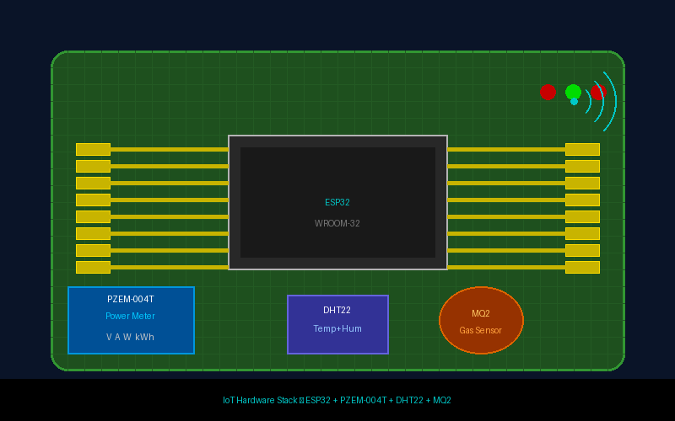
Component 1 — IoT-Based Energy Optimizer (Live System)
IT22315700 | Shaethayine R
ESP32 + PZEM-004T + DHT22 + MQ2
Hardware & Stack
⚡ PZEM-004T v3
Measures V, A, W, kWh — publishes every 5s
🌡️ DHT22
Temperature & humidity sensing
🌫️ MQ2 Gas Sensor
Air quality & gas/smoke detection
📶 HiveMQ Cloud
MQTT/TLS broker — topic: site_colombo
Data Flow
9 Alert Types Implemented:
Sensor
(5s)
→
ESP32
→
MQTT/TLS
→
Flask
→
Dashboard
⚡ Idle Waste
🔌 Standby Loss
🔥 Overload
📉 Abnorm. Drop
⚠️ Voltage Issue
🌡️ High Temp
💧 High Humidity
🌫️ Air Quality
🚨 Smoke/Gas
SLIIT | 25-26J-034 | PP2

Slide 7
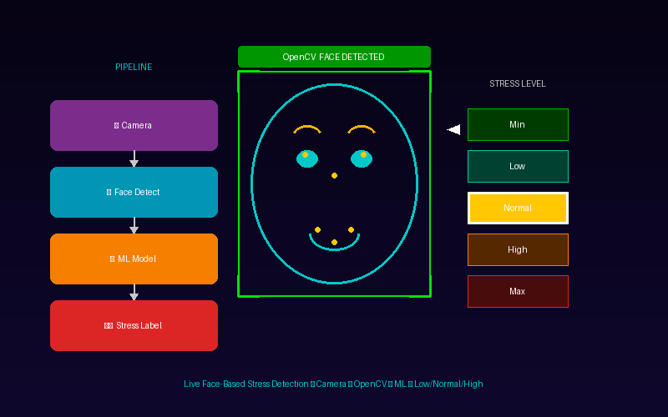
Component 2 — Stress Detection & Intelligent Task Allocation
IT22564672 | M.A.H.S. Thathsarani
Live Face-Based Stress Detection Demo
Stress → Task Allocation Rules
🟢 LOW STRESS
Assign demanding, deadline-critical & complex tasks
Full task queue enabled — max productivity mode
🟡 NORMAL STRESS
Balanced task mix — standard workload maintained
Monitor every cycle, no intervention needed
🔴 HIGH STRESS
Assign simple / light tasks only
Trigger manager alert + recommend break
Allocation Cycle:
Detect
Stress
→
Check
Queue
→
Apply
Rules
→
Assign
& Log
→
Re-check
Next Cycle
SLIIT | 25-26J-034 | PP2

Slide 8
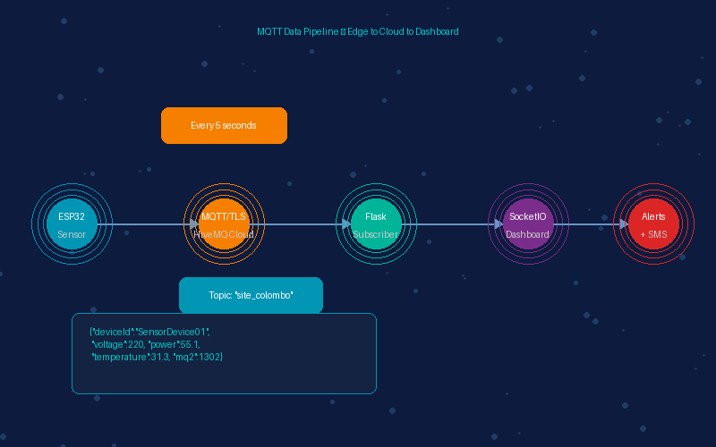
System Architecture & Integration
MQTT Data Pipeline — ESP32 Sensors → HiveMQ Cloud → Flask → SocketIO Dashboard
Hardware / Edge
Cloud & AI Processing
Output / Action
ESP32+PZEM
(V,A,W,kWh)
→
Energy Optimizer
→
Energy Alerts + SMS
ESP32+DHT22
(Temp+Hum)
→
Stress Detector
→
Stress Alert Dashboard
ESP32+MQ2
(Air Quality)
→
Task Allocator
→
Task Auto-Assignment
Camera+OpenCV
(Face frames)
→
Bandwidth Predictor
→
QoS/SD-WAN Rules
MQTT/TLS (HiveMQ Cloud) • Flask + SocketIO • SQLite DB • Twilio SMS • REST APIs • WiFiManager (ESP32)
SLIIT | 25-26J-034 | PP2

Slide 9
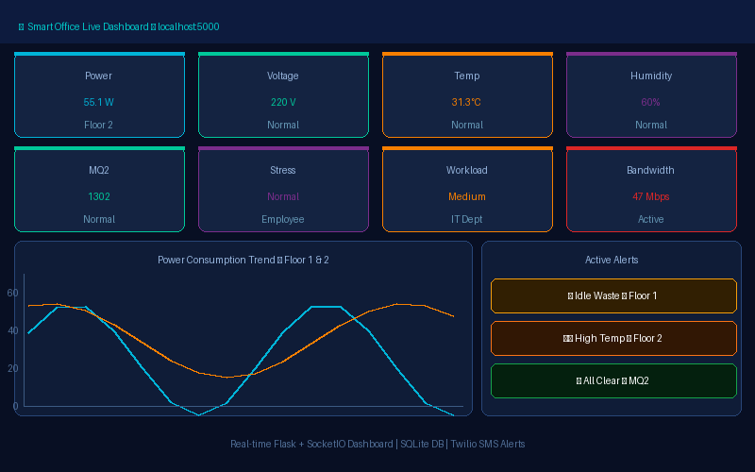
Live Dashboard — Real-Time Office Intelligence
Flask + SocketIO Dashboard — localhost:5000
Dashboard Views
⚡ Facility View
Energy/floor, overload/idle alerts, HVAC & lighting recommendations, Twilio SMS on critical events.
📡 IT View
Bandwidth per process, QoS decisions, congestion status, task type classification output.
🧠 Manager View
Employee stress heatmap, workload distribution, task allocation log, burnout risk flags.
SLIIT | 25-26J-034 | PP2

Slide 10
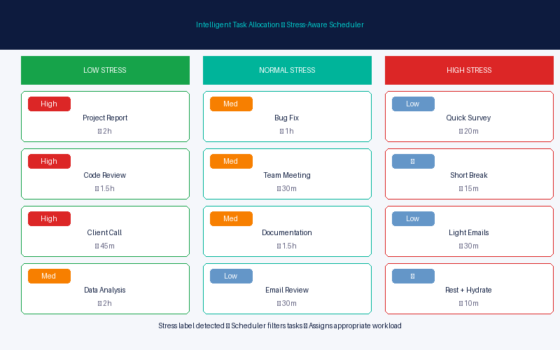
Intelligent Task Allocation — Stress-Aware Scheduler
How It Works
Stress-Aware Task Queue — Live Example
🟢 Low Stress
Full demanding task queue
Deadline-critical, complex work
🟡 Normal Stress
Balanced standard workload
Monitor each cycle, no action
🔴 High Stress
Light tasks only assigned
Manager alert + break recommended
✓ Auto-report generated per employee per shift
✓ Continuous adaptive loop — re-checks every detection cycle
SLIIT | 25-26J-034 | PP2

Slide 11
Commercialization / Impact
🎯 Target Market
💎 Value Proposition
Mid-to-large commercial offices, co-working spaces, corporate campuses, university buildings — any multi-floor managed office.
Only platform combining real-time IoT energy monitoring, AI stress detection and adaptive bandwidth allocation in one dashboard.
💰 Cost Estimate
📜 IP & Licensing
🚀 Adoption Plan
Hardware: ~$35/floor (ESP32+PZEM+DHT22+MQ2)
Software: 100% open-source (Flask, Python, MQTT)
Cloud: HiveMQ free tier (≤100 devices)
SMS: Twilio pay-as-you-go (~$0.01/msg)
Software: Copyright applicable to ML models
System licensable to facility management firms
White-label dashboard for enterprise clients
SaaS subscription model planned
Phase 1: 2-floor office pilot (current demo)
Phase 2: Full building 10+ floors
Phase 3: Multi-site cloud deployment
Phase 4: SaaS subscription model launch
SLIIT | 25-26J-034 | PP2

Slide 12
Demo Plan (30 min) — What We Will Show
1
Live ESP32 Sensor Feed
Shaethayine
Real MQTT data from Floor 1 & 2 publishing every 5s to HiveMQ Cloud — show broker dashboard.
2
Energy Dashboard Live
Shaethayine
Open Flask dashboard (localhost:5000) — power, voltage, temp, humidity, MQ2 charts updating live.
3
Trigger an Alert
Shaethayine
Simulate overload or high temp → show Twilio SMS sending + dashboard notification firing.
4
Face-Based Stress Demo
Thathsarani
Open camera → live face detection → ML outputs Low/Normal/High stress label in real time.
5
Task Allocation Demo
Thathsarani
Stress label changes → task queue auto-updates: High stress → lighter tasks; Low → full queue.
6
Bandwidth Prediction
Shaethayine
Input process data → model predicts optimal bandwidth % → show QoS decision output.
Backup: Recorded demo video + pre-loaded test data ready if hardware issues occur
SLIIT | 25-26J-034 | PP2

Slide 13
Q & A
Thank You
AI-Enabled Smart Office System with Cloud-Based Energy Optimization
Project ID: 25-26J-034 | SLIIT Faculty of Computing
IT22315700
IT22564672
Shaethayine R
M.A.H.S. Thathsarani
IoT Energy Optimizer & Bandwidth
Stress Detection & Task Allocation
SLIIT | 25-26J-034 | PP2

