Slide 1



AI -ENABLED SMART OFFICE
SYSTEM WITH CLOUD-BASED
ENERGY OPTIMIZATION
PROJECT ID : 25-26J-034
1

Slide 2

Introduction
This project proposes an AI-driven smart office intelligence system that improves employee productivity and network
resource utilization through integrated machine learning
solutions. The system analyzes employee activities to generate AI-based performance and activity reports, monitors workload
patterns to support real-time stress management, and optimizes task allocation through intelligent task scheduling and
monitoring. Based on these AI insights, the system dynamically allocates network bandwidth using machine learning models and a centralized network controller with QoS or SD-WAN policies,
ensuring that high-priority tasks receive sufficient bandwidth
while reducing congestion. A feedback mechanism continuously evaluates performance and network quality, enabling the system to adapt and improve over time, resulting in a scalable,
intelligent, and closed-loop smart office management solution.
2

Slide 3
RESEARCH PROBLEM
Static network bandwidth allocation that does not adapt to real-time employee workload or task priority
Network congestion and latency during critical tasks such as video conferencing and cloud access
Underutilization of available bandwidth during low-activity periods
Lack of AI-based visibility into employee activity and performance patterns
Absence of real-time monitoring of employee workload intensity and stress levels
Manual or rule-based task scheduling and monitoring, leading to uneven workload distribution
Limited real-time, data-driven insights for IT teams and management decision-making
3

Slide 4
It’s Impact
Reduced employee productivity and efficiency during high- priority tasks
Poor application performance and user experience during critical operations
Increased employee stress and burnout due to unbalanced task allocation
Delays in task completion and reduced collaboration effectiveness
Inefficient utilization of network and human resources
Higher operational effort for IT and network administrators
Difficulty scaling workplace and network management in growing organizations
4

Slide 5


Who Will Be Benefited by the Solution
Employees
Improved network performance for critical tasks Balanced workload and reduced stress
IT & Network Administrators
Automated, AI-driven bandwidth management
Better visibility into network usage and performance Management & Team Leaders
AI-based insights on employee activity and workload Data-driven task and performance decisions
Organizations / Institutions
Efficient use of network and human resources Improved productivity and scalability
5

Slide 6
Design Excellence of the Overall Solution
AI-Driven Modular Architecture
Integrates employee activity reporting, stress analysis, task scheduling, and intelligent network control into one system
Intelligent Workload & Task Analysis
Machine learning models analyze employee activity, task context, and workload intensity in real time
Dynamic Bandwidth Allocation (Core Contribution)
AI models automatically allocate network bandwidth using QoS / SD-WAN policies based on workload priority
Real-Time Monitoring & Feedback Loop
Continuously evaluates productivity and network performance to improve future decisions
Scalable & Practical Design
Modular components allow easy expansion, maintenance, and deployment in real office environments
5

Slide 7



THE AI-BASED SMART LIVE EMPLOYEE STRESS MANAGEMENT SYSTEM,SCHEDULING & MONITORING SYSTEM
Student Must add a professional photo to this cage
IT22564672 | M.A.H.S. THATHSARANI | 25 - 26J - 034
BSc (Hons) Degree in Information Technology specialization in Computer System & Network Engineering
IT22564672 |
M.A.H.S.THATHSARANI
|
25 - 26j - 034

Slide 8
knowledge gap & solutions
Knowledge Gap
Most workplaces cannot see stress levels in real time.
High-stress employees perform poorly, low/normal-stress employees may not get tasks properly.
Proposed Solution
No real-time monitoring - AI/ML based live detection
No automatic task assignment - Smart task allocation based on stress Manual reports only - Automated report generation
IT22564672 |
M.A.H.S.THATHSARANI
|
25 - 26j - 034

Slide 9

APPLICATIONS
Machine Learning models for classification (Low, Normal, High stress).
OpenCV / Computer Vision libraries for face detection and emotion recognition.
Cloud-based Database – store stress and task data.
Smart Dashboard – visualize stress analyses and reports and alerts.
IT22564672 |
M.A.H.S.THATHSARANI
|
25 - 26j - 034

Slide 10
METHOLOGY
Specific Objectives:
Detect employee stress (low, normal, high) using cameras.
Assign tasks based on stress levels for better performance.
Balance workload among employees.
Sub-Objectives:
Preprocess and analyze data for stress detection. Train ML models for accurate classification.
Map stress levels to tasks dynamically.
Monitor and adjust task assignments in real time. Improve productivity and reduce burnout.
IT22564672 |
M.A.H.S.THATHSARANI
|
25 - 26j - 034

Slide 11
IMPLEMENTATION
System Overview :
Camera captures employee facial expressions.
Local processor extracts stress-related features.
ML model classifies stress level (Low, Normal, High).
Results go to report generation and task scheduling module.
Real-World Scenario :
Place a camera in the workplace to monitor employees. Preprocess and analyze data for stress detection.
System calculates stress levels and automatically adjusts tasks. Managers see reports and alerts on the dashboard.
Helps balance workload, improve productivity, reduce burnout.
IT22564672 |
M.A.H.S.THATHSARANI
|
25 - 26j - 034

Slide 12

AI-DRIVEN WORKLOAD ANALYSIS AND DYNAMIC NETWORK BANDWIDTH ALLOCATION SYSTEM RESOURCE
ALLOCATION
Student Must add a professional photo to this cage
IT22315700 | Shaethayine.R | 25 - 26J - 034
BSc (Hons) Degree in Information Technology specialization in Computer System and Network Engineering
IT22315700 |
Shaethayine.R |
25 - 26j - 034

Slide 13
How the Solution Will Address the Sub-
Problem / Prototype
Solves the issue of static bandwidth allocation that ignores real-time workload changes
Collects user activity, task context, and network metrics as input features Model 1 identifies the current task type (e.g., video call, coding, file transfer) Model 2 classifies employee workload intensity as Low, Medium, or High
Model 3 predicts the optimal bandwidth (Mbps) required for the current task and workload
Bandwidth decisions are enforced through an SD-WAN / QoS controller
Model 4 evaluates post-allocation performance and feeds learning signals back to improve accuracy
This forms a closed-loop, adaptive bandwidth allocation prototype
IT22315700 |
Shaethayine.R |
25 - 26j - 034

Slide 14
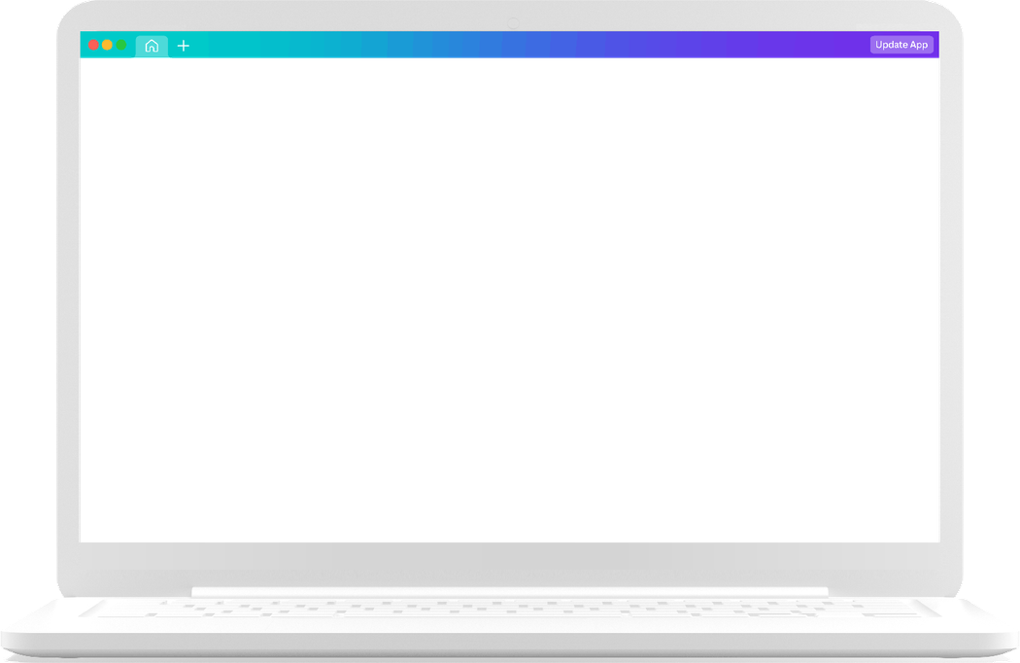






User Requirements Addressed by the
Solution
Stable and sufficient bandwidth for high-priority and time-critical tasks
Fair bandwidth allocation based on actual workload, not static limits Reduced network congestion and latency
Minimal manual intervention for IT administrators
Continuous adaptation to changing user activity and network conditions
IT22315700 |
Shaethayine.R |
25 - 26j - 034

Slide 15
DESIGN EXCELLENCE
Implements a multi-model AI architecture instead of a single monolithic model Separates intelligence into:
Task understanding
Workload classification Bandwidth prediction
Performance feedback and optimization
Uses machine learning regression instead of fixed lookup tables for bandwidth allocation
Introduces a closed-loop learning mechanism where network feedback improves future predictions Fully software-based and IoT-free, making it:
Cost-effective Scalable
Privacy-preserving
USER FEEDBACK ON PROTOTYPE
Improved application performance during high-workload scenarios Reduced latency during video conferencing and cloud-based tasks
Bandwidth allocation perceived as more fair and efficient than static methods Reduced need for manual bandwidth adjustments by IT teams
Positive response to the system’s adaptive and automated behavior
IT22315700 |
Shaethayine.R |
25 - 26j - 034

Slide 16
EVALUATE/PROVE THE SUCCESS
Performance Dashboards:
Use real-time dashboards to monitor energy consumption, network usage, and task allocation effectiveness.
5-fold cross-validation to ensure the AI models for task categorization and energy optimization perform reliably.
Target: Achieve >80% accuracy in classifying tasks and efficient resource allocation in real-time.
Target: Achieve >30% energy savings in office energy consumption compared to traditional setups.
DATA AVAILABILITY AND ETHICAL CLEARANCE
Data Availability:
Office environment data (temperature, occupancy, task data) collected via IoT sensors.
Workload data obtained from employee activity logs and task management software.
IT22315700 |
Shaethayine.R |
25 - 26j - 034

Slide 17
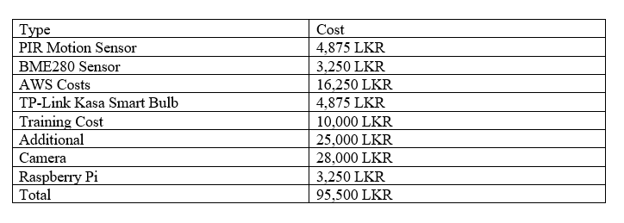
MARKET & V^{B}A^{U}L^{D}U^{G}E^{E}P^{T}R OPOSITION
Target Market: . Facility management companies,Real estate developers
Customer Profile: · Mid to large-sized businesses Value Proposition:Energy Efficiency: The system optimizes energy usage , Automation and Control
Intellectual Property Rights: Copyrights can be applied to the software code for the AI models , The system could be licensed to other companies
22

Slide 18
Q & A
24

