Slide 1
GT Tool Set
Yehonatan Sela CVL, PerC SW Q1 2017

Slide 2
General Flow
Host Client
Calibration
I
II
III
IV
V
Host Client
Extractor
Temporal Alignment
Spatial Alignment (Projection)
MW Specific
MW Comparator
Recorder
In | - Scenario (Use Case) - GT Source | - RSSDK file | - Folder Format - GT file/sequence | - Folder Format - GT file/sequence | - Folder Format - GT data | - MW format - MW related attributes
Out | - RSSDK file - GT file/sequence | - Folder Format | - Temporal aligned GT | - Projected GT (2D/3D) | - MW format - MW related attributes | - KPIs
Script between tools

Slide 3
Calibration Tool
Host-Client based
Windows OS Host
Reflection wrapper for Ground Truth source
Optotrak
Optitrack
Thermal (planned)
Kinect (planned)
etc.
Computing best calibration matrix based on chessboard shots

Slide 4
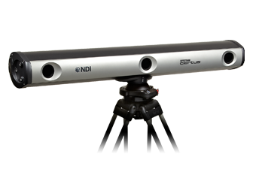

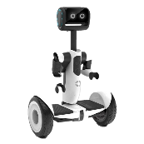
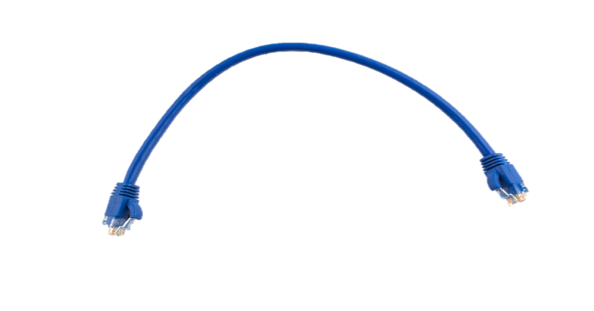



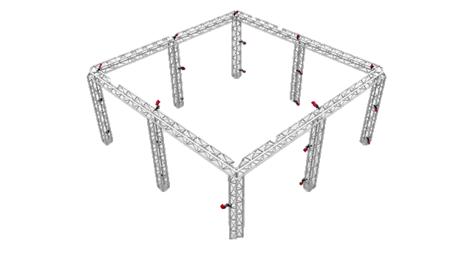
- Calibration matrix
Calibrator
Host app
Ground Truth Provider
OptotrakLibWrapper.dll
OptitrackLibWrapper.dll
ThermalLibWrapper.dll
…
Client app – Per Env.
Reflection
RSSDK Capture
Client Interaction
Host Interaction
initGTServer()
Compute camera pose
Compute calibration matrix
Choose best matrix
SendNextChessboardImage()
ShutdownGTServer()

Slide 5
Recorder Tools
Host-Client based
Windows OS Host
Reflection wrapper for Ground Truth source
Optotrak
Optitrack
Thermal (planned)
Kinect (planned)
etc.
RS Stream / Ground truth data stored on either side

Slide 6
- RSSDK file + metadata - Ground Truth file/sequence
Recorder
Host app
Client app – Per Env.
Ground Truth Provider
RSSDK Recorder
OptotrakLibWrapper.dll
OptitrackLibWrapper.dll
ThermalLibWrapper.dll
…
Reflection
Host Interaction
initGTServer()
StartRecordGT()
StopRecordGT()
Client Interaction
GetGTData()
GTDataBuffers()
SendStreamData()
ShutdownGTServer()

Slide 7
I
II
III
IV
V
Host Client
Extractor
Temporal Alignment
Spatial Alignment (Projection)
MW Specific
MW Comparator
Recorder
Input: RSSDK file
Output: Folder Format
Extractor
Tool per format (playback based)
General Parser
Windows RSSDK
Windows RSSDK
Librealsense (Linux)
Librealsense (Linux)
Android RSSDK
Android RSSDK
ROS bag
ROS bag

Slide 8
I
II
III
IV
V
Host Client
Extractor
Temporal Alignment
Spatial Alignment (Projection)
MW Specific
MW Comparator
Recorder
- Real Sense Folder Format - Ground Truth file/sequence
Temporal aligned Ground Truth
Temporal Alignment
Temporal Alignment Tool
Sync based on camera initial motion
Based on either IMU, FE, RGB
Fine tuning with motion start/stop
Solution for static camera

Slide 9
I
II
III
IV
V
Host Client
Extractor
Temporal Alignment
Spatial Alignment (Projection)
MW Specific
MW Comparator
Recorder
- Real Sense Folder Format - Ground Truth file/sequence - Calibration matrix
Projected Ground Truth (2D/3D)
Spatial Alignment
Temporal Alignment Tool
Sync based on camera initial motion
Based on either IMU, FE, RGB
Fine tuning with motion start/stop
Solution for static camera

Slide 10
I
II
III
IV
V
Host Client
Extractor
Temporal Alignment
Spatial Alignment (Projection)
MW Specific
MW Comparator
Recorder
- Real Sense Folder Format - Ground Truth file/sequence
KPIs
MW Specific Tools
Object Recognition
SLAM
Person Tracking
Run MW (Playback)
Run MW (Playback)
Run MW (Playback)
Convert data to XML format
Build GT Skeleton
Hands
Compute 3D location
Build GT Mask
Build GT bounding boxes
Run MW (Playback)
Compute all needed GT
Compute hand props

Slide 11
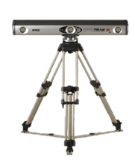
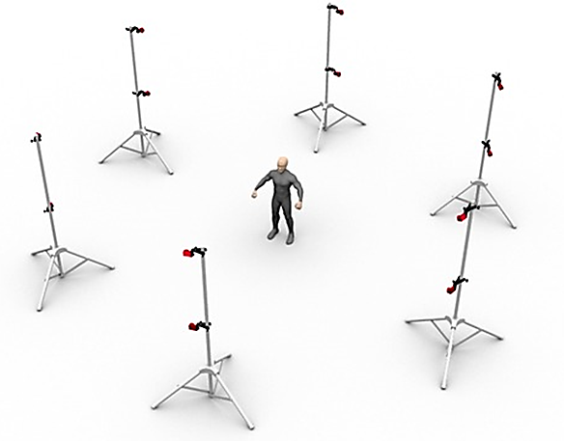
Tracking Systems
NDI Optotrak
Optitrack

Slide 12
WCF / HTTP service
C++
CLI/CLR
Hand-Eye Calibration Wrapper
Optotrak APIs wrapper
Optitrack APIs wrapper
Hand-Eye calibration Library
Optotrak Library
Optitrack Library
C#
3rd party
OpenCV
NDI drivers, OAPI, OpenCV
NatNet Utils

Slide 13
Recording Client/Server protocol
bool otInitEx(string param1, string param2, string param3, string param4, string param5)
void otStart(double timestamp)
void otStop()
List<OTPoseStruct> otGetPoseBuffer()
bool otShutdown()

Slide 14
Hand-eye calibration Client/Server protocol
bool otInitEx(string param1, string param2, string param3, string param4, string param5)
GhC HandEyeDetectCb(Stream image)
bool otShutdown()
ExtractCameraPose()
GetGTPose()
ComputeGHC()
Void SetCameraParams(width, height, fx, fy, px, py, distortion)

