Slide 1
Smart Farming System
1. Baig Asraful Islam
ID: -161-15-6895
2. Yusuf Hasan Rakib
ID: -161-15-7482
3. Kawser Ahmed
ID: -161-15-6809
Mohammad Jahangir Alam
Lecturer
Department of CSE
Daffodil International University
Thursday 05 December 2019

Slide 2


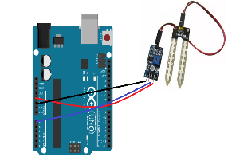
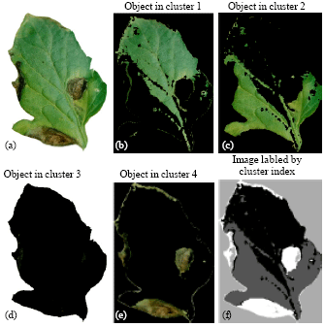







Main Activities
Developing low cost System with useful components.
Developing image processing feature using ML kit
Managing real-time online database using firebase.
Developing mobile app

Slide 3
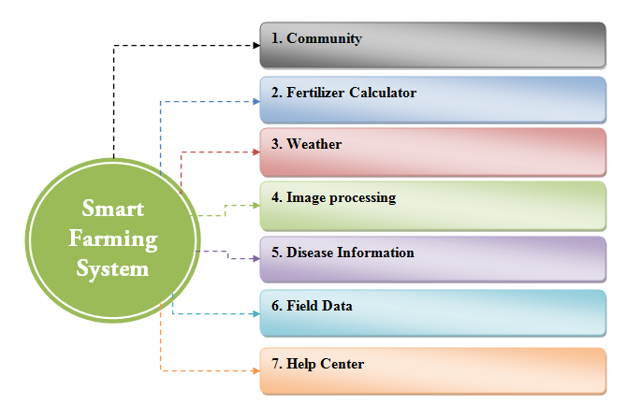
Our System Features

Slide 4
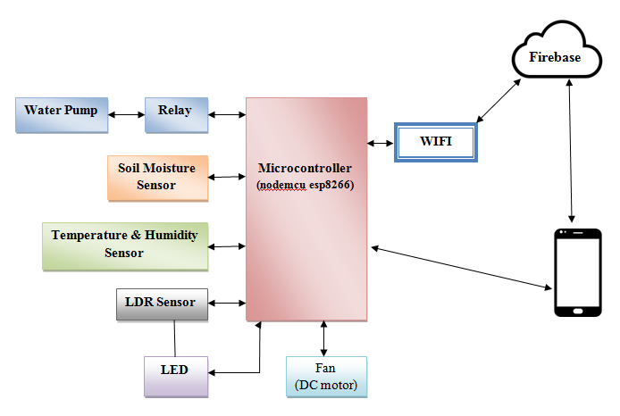
Components Connection Block Diagram

Slide 5
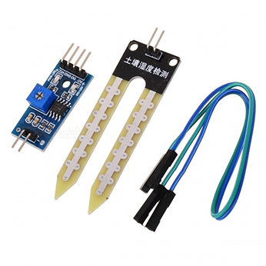
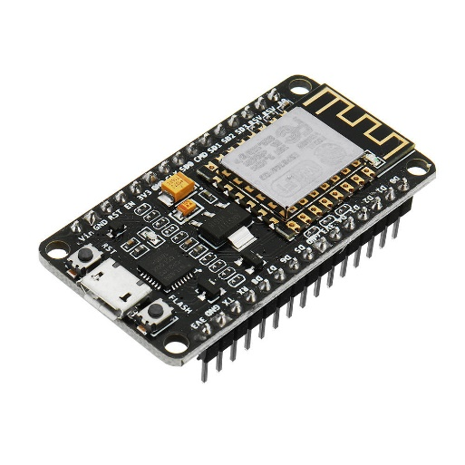
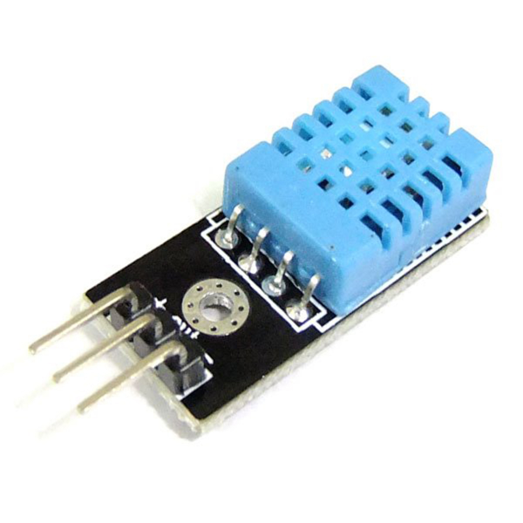
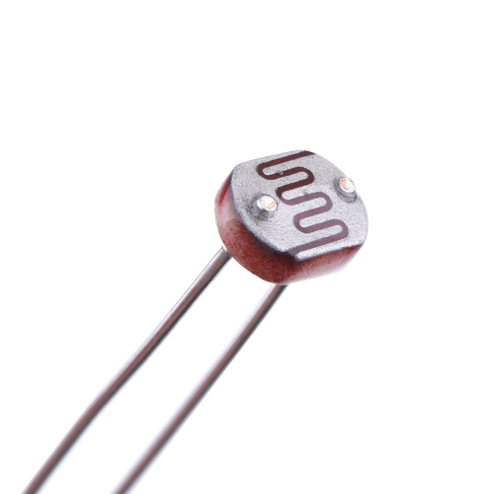
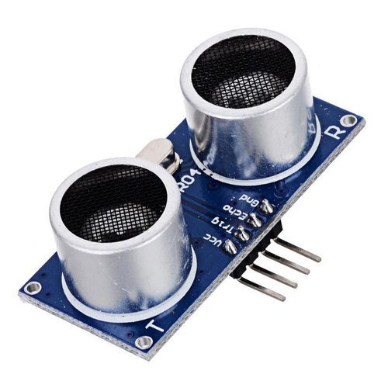
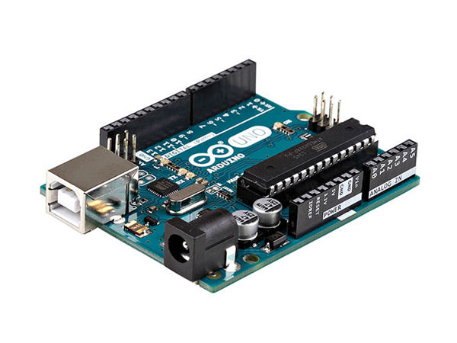
Implemented Components
Soil moisture sensor
Nodemcu esp8266
Temperature & Humidity sensor
Ultra Sonic sensor
Arduino
LDR (Light Dependent Resistor) sensor

Slide 6

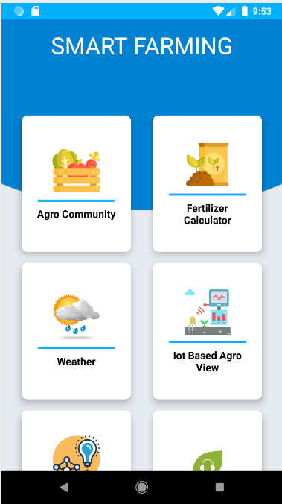
Smart Farming System
Features

Slide 7
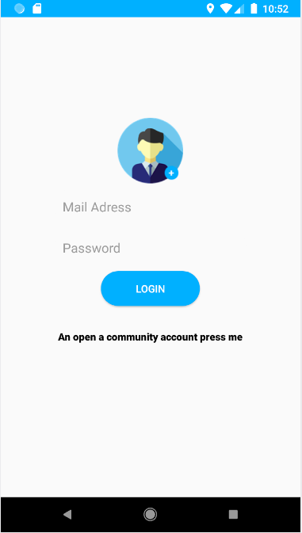
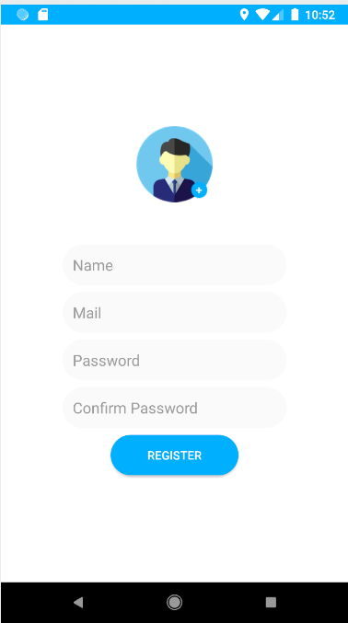
Community Login Registration
Smart IoT Farm Management

Slide 8
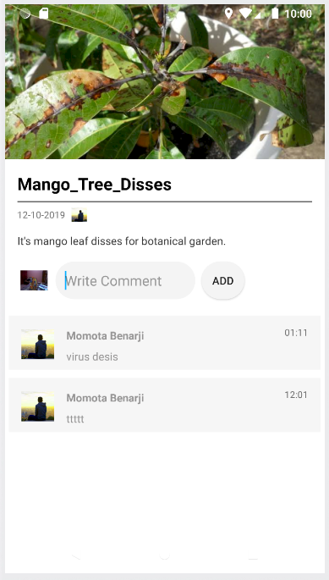
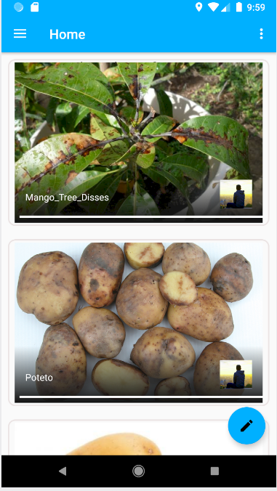
Community Screen
Smart farmer community
Post
Comment

Slide 9
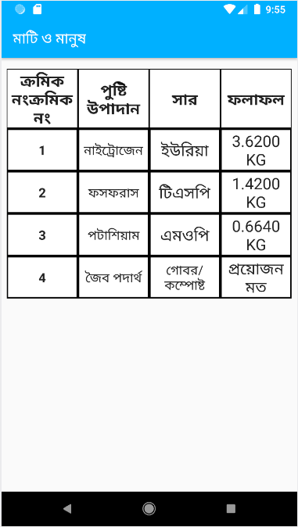
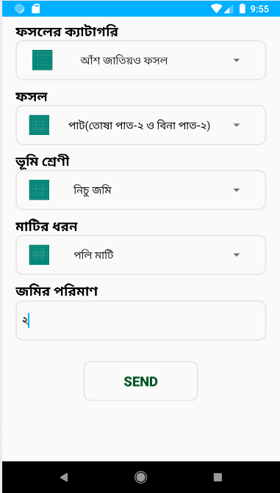
Soil Fertilizer Details
Crops and land criteria
Smart Fertilizer calculation

Slide 10
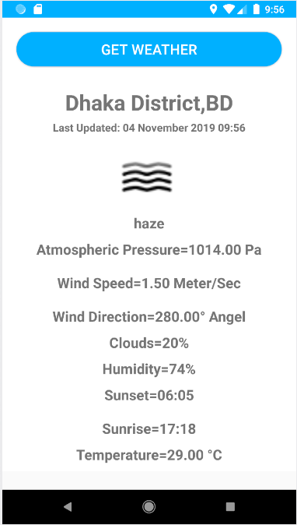
Weather Info
Real time field weather.

Slide 11
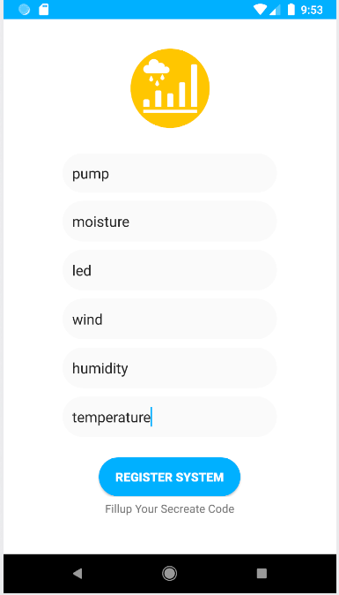
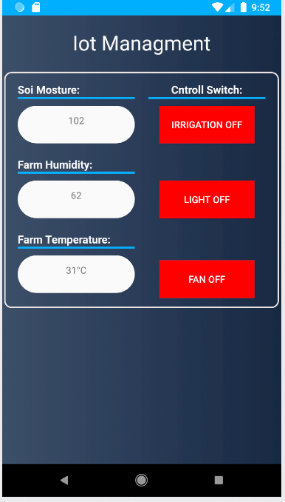
IoT Based Farm control and Detail list
Smart IoT Farm Management

Slide 12
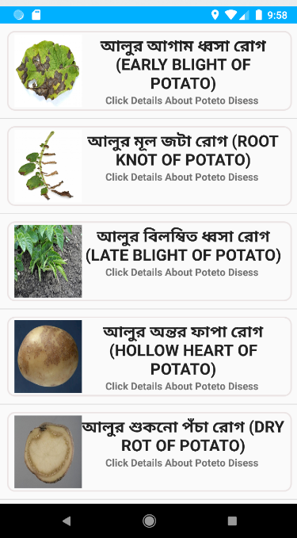
Agro Information Info
Disease Crops Information Details.

Slide 13
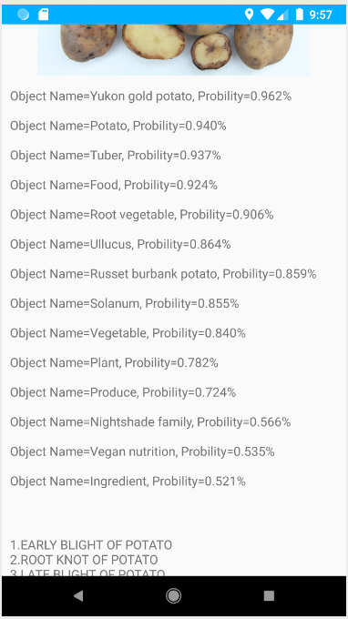
Agro Image Processing Info
Plant Image Processing Details.

Slide 14
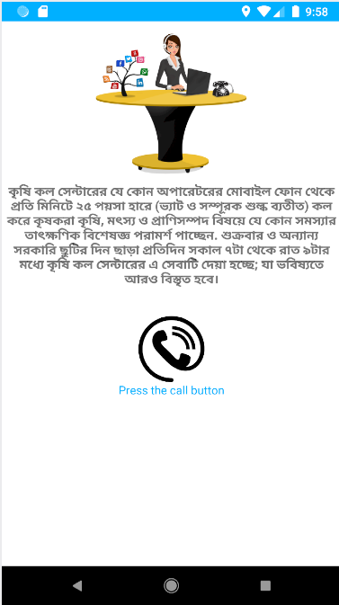
Agro Help Center Info
Agro Call Center

Slide 15
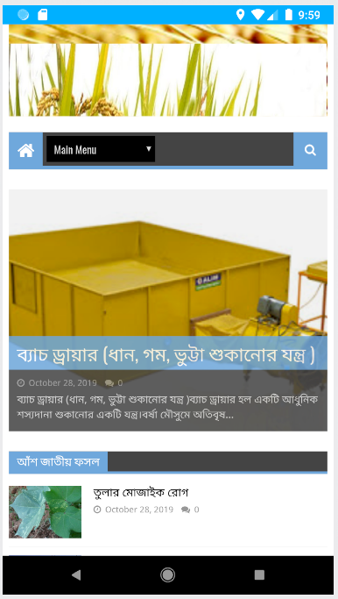
Website Info
More and details information
Google Site link
https://sites.google.com/view/smart-farming-system/home

Slide 16
Future Work
Some necessary expensive sensors can be added to make the project more accurate and easier.(like PH sensor)
Artificial intelligence can be added to detect and analyze the diseases of animals and crops.
A website can be created for more and recent information about agriculture.
A free seminar can be arranged to instruct farmers so that they can use this system efficiently.
An online marketing feature can be add to make sell easy for farmers.

Slide 17
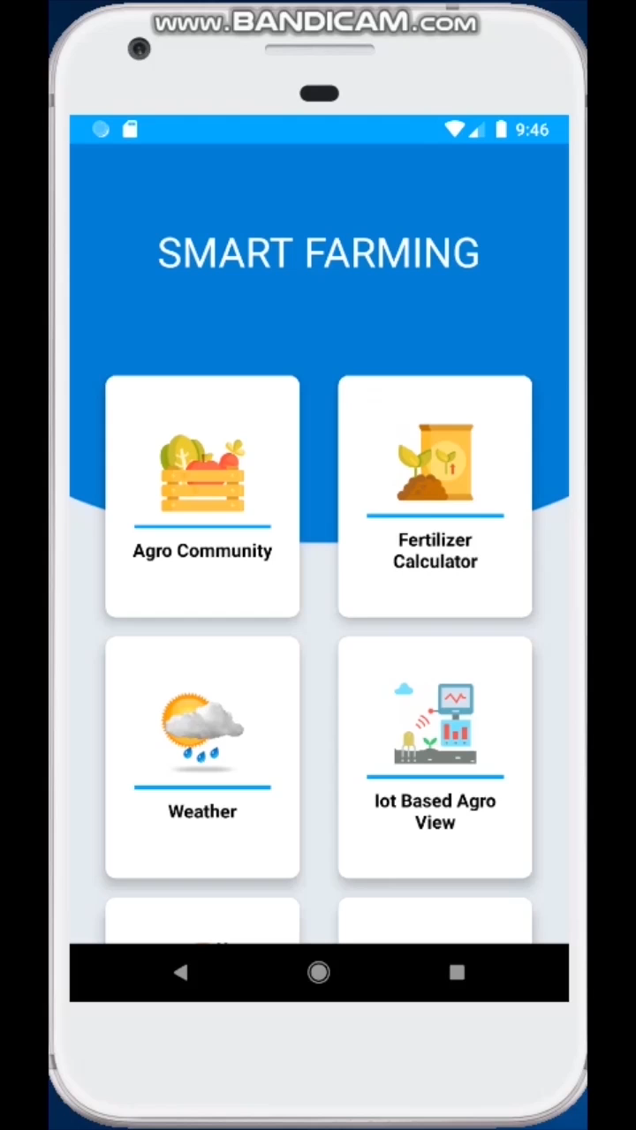
Project Video

