Slide 1
FOG & EDGE COMPUTING MODULE · PROJECT DECK
Drowsiness Detection
A Three-Tier Fog & Cloud Architecture
Camera (Vision)
Temperature
Humidity
Deployed on AWS Elastic Beanstalk
1 / 6

Slide 2
Understanding Fog & Edge Computing
Processing close to the source, cloud only for what matters
Edge
Fog
Cloud
At the sensor
Near the sensor
Far from the sensor
Data is born here
Cameras, mics, phones
Compute is limited
Latency = milliseconds
Intermediate node
Classifies, filters, fuses
Sends only results onward
Cuts bandwidth dramatically
Storage, dashboards, APIs
Scales horizontally
Durable, globally accessible
Highest latency
Why it matters: raw video is large and private — classified events (“DROWSY”) are tiny and safe. Do the heavy work near the source.
2 / 6

Slide 3
The Project — What We Built
A real-time driver drowsiness detection system that satisfies every requirement in the brief
Brief requirements — all met
Sensor streams
✓
3–5 sensor types
Camera, temperature, humidity
Camera (Vision)
✓
Configurable frequency
10 Hz / 1 Hz / 1 Hz
Webcam + OpenCV + MediaPipe
Sample 10 Hz · Dispatch 0.5 s
✓
Configurable dispatch
0.5 s / 5 s / 5 s
Temperature
✓
Fog node processes data
EAR, MAR, head pose + fusion
Simulated cabin °C
✓
Scalable web service
Flask + Gunicorn, autoscaling
Sample 1 Hz · Dispatch 5 s
✓
Responsive dashboard
Chart.js, polls every 1.5 s
Humidity
Public cloud deployment
AWS Elastic Beanstalk (EU-West-1)
Simulated cabin %
✓
Sample 1 Hz · Dispatch 5 s
3 / 6

Slide 4
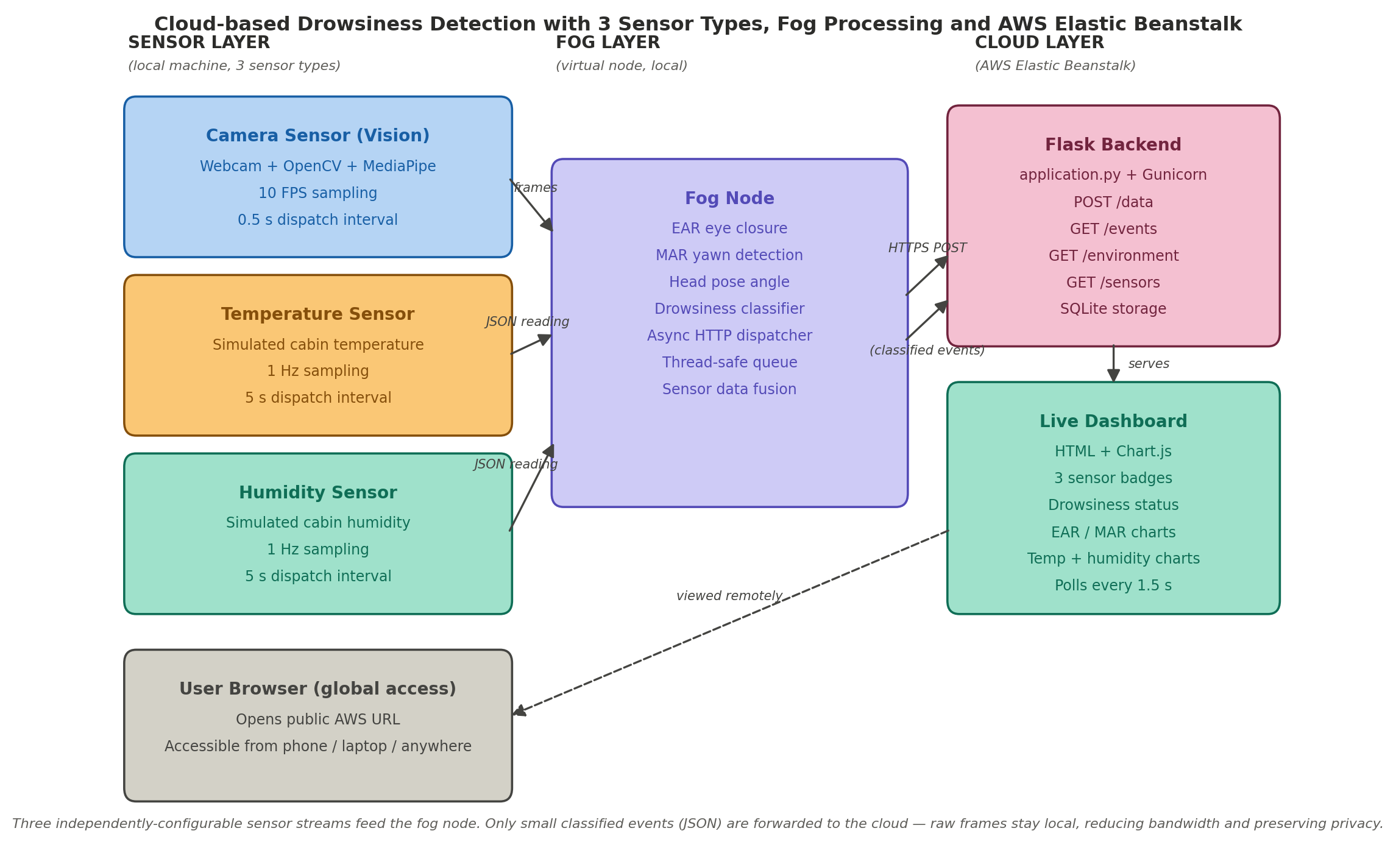
System Architecture
Three independently-configurable sensors · one fog node · one cloud backend
4 / 6

Slide 5
Implementation Highlights
Right tool for each tier · minimal coupling · cloud-friendly
SENSOR
FOG
FOG
MediaPipe Face Mesh
EAR + MAR + Head pose
Async HTTP dispatcher
468-point face landmarks on CPU at interactive rates. No custom ML model needed.
Rule-based classifier: EAR < 0.22 for 15 frames = eyes closed. MAR > 0.6 = yawn.
Thread-safe queue + background worker. Webcam never blocks on network.
CLOUD
CLOUD
UI
Flask + Gunicorn + SQLite
Elastic Beanstalk
Chart.js live dashboard
Small, clean web service. Four JSON endpoints serve sensors and dashboard.
Managed EC2, load balancer, autoscaling and CloudWatch — one eb deploy command.
EAR, MAR, temperature and humidity charts. Polls every 1.5 s for near-live view.
5 / 6

Slide 6
Results & Reflection
Live on AWS · sensors streaming · dashboard responsive
3
≈ 2s
100%
Sensor types
Detection latency
Requirements met
Key learnings
Fog computing is real engineering, not marketing — sending JSON instead of raw video changes the architecture
Elastic Beanstalk abstracts away EC2, load balancers and autoscaling — one command deploys everything
Clear separation of concerns (sensor/fog/cloud) makes swapping components (e.g. SQLite → DynamoDB) easy
Credential hygiene matters — dedicated IAM user, .gitignore for venv and secrets
Live demo: drowsiness-env.eba-nnmq8rw3.eu-west-1.elasticbeanstalk.com
6 / 6

