Slide 1

B S V Ramesh
HPCS C-DAC

Slide 2

A Linux distribution based on CentOS
Cluster on a DVD ( or set of CDs)
Goals of Rocks
  Make Clusters Easy
  Reduce dependence on system administrators by reducing system administration

Slide 3

Get a bunch of x86/x64 machines
Put 2 ethernet cards on one of them - This’ll be your front-end/head-node
Wire 'em up.
Download Rocks isos from www.rocksclusters.org
Burn a bunch of CDs or a DVD
Get started

Slide 4

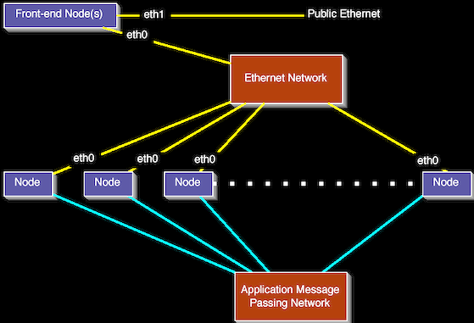

Slide 5

Rocks provides for installation of a cluster with minimum user interaction
Steps involved
  Boot from CD or DVD
  Answer a few questions
  Get favorite beverage
  You’re on your way to a full fledged cluster in 2 hours or less.

Slide 6

Rocks uses Redhat’s Kickstart mechanism for automated installs
Kickstart file generated and given to the installer
Installer follows instructions in Kickstart file.
Generation of Kickstart file done automatically by Rocks scripts

Slide 7
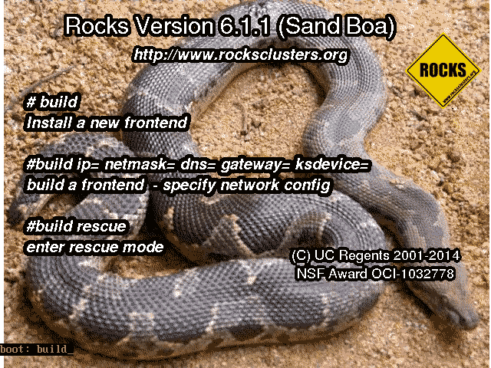

Slide 8
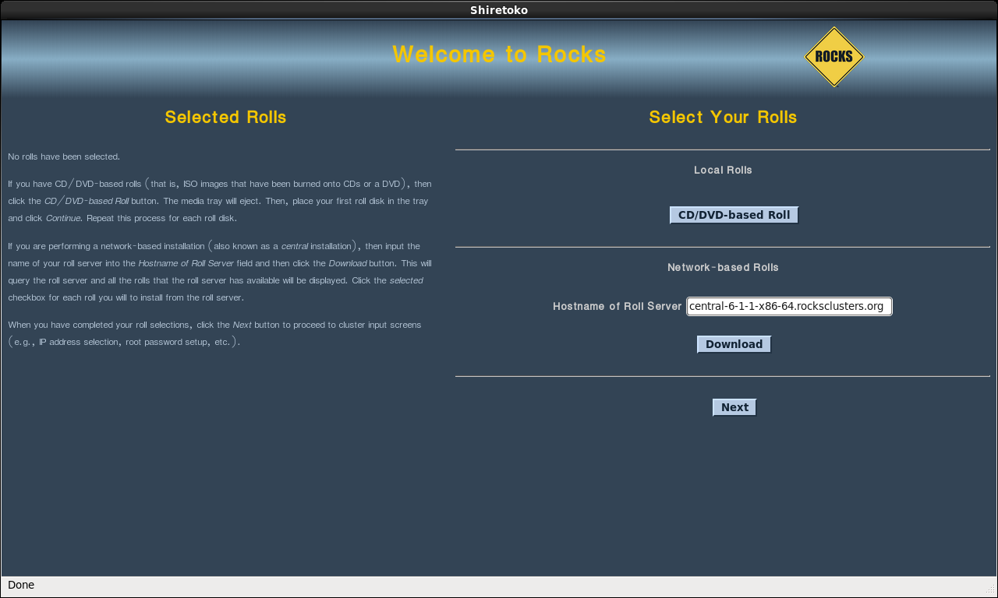
© 2008 UC Regents

Slide 9
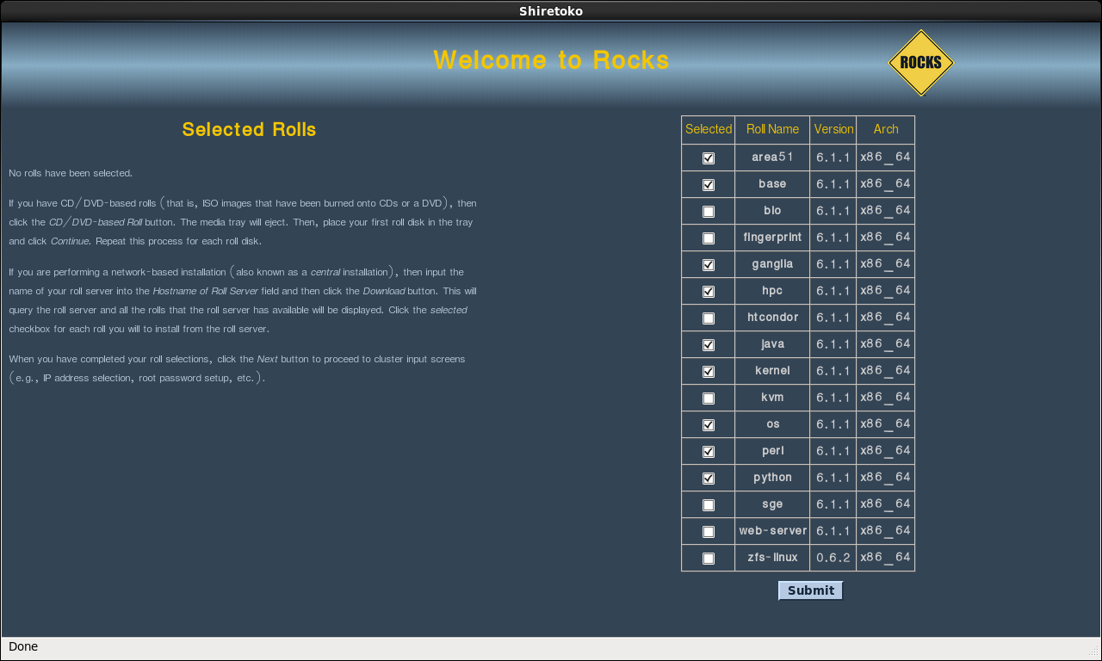

Slide 10
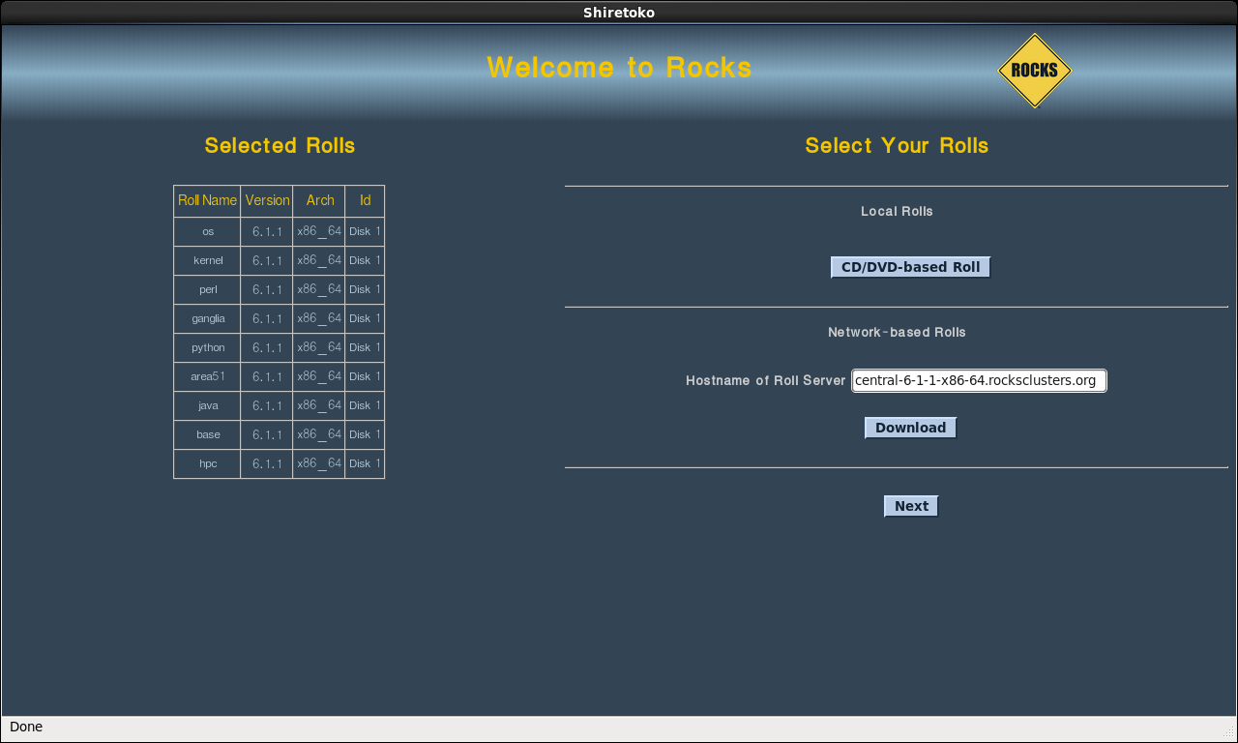

Slide 11
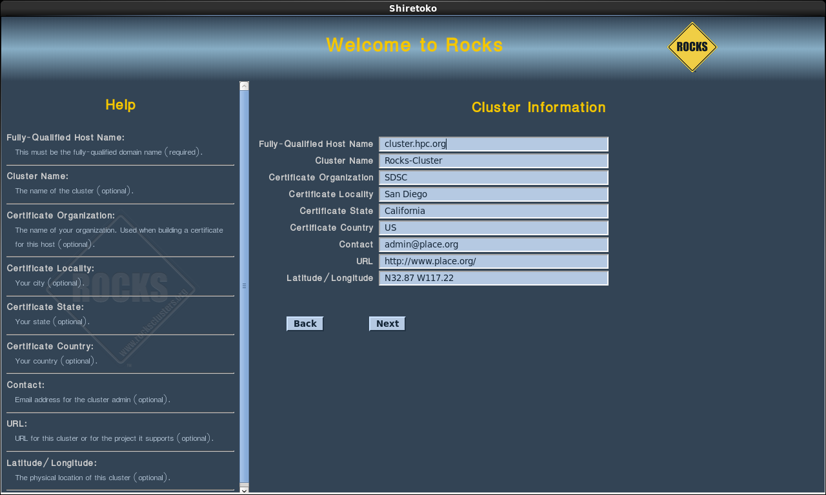

Slide 12
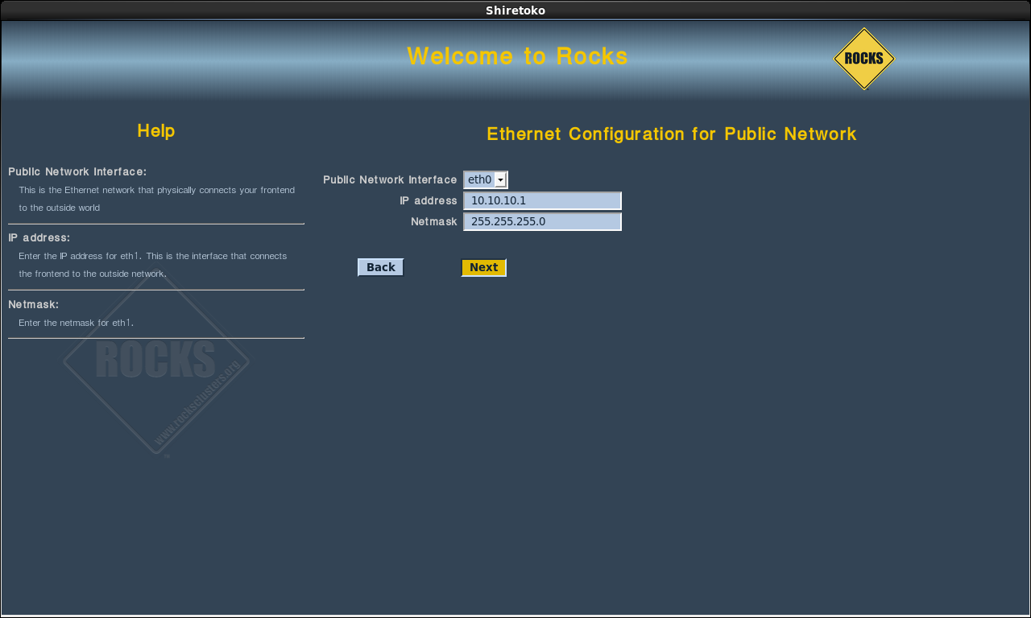

Slide 13
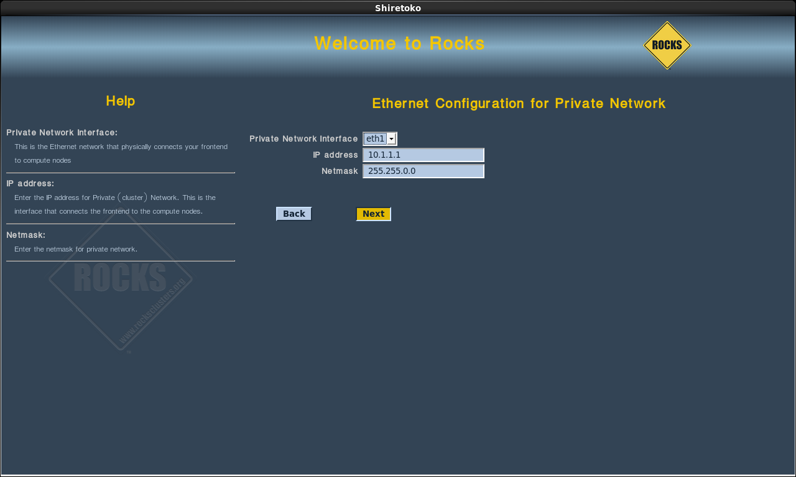

Slide 14
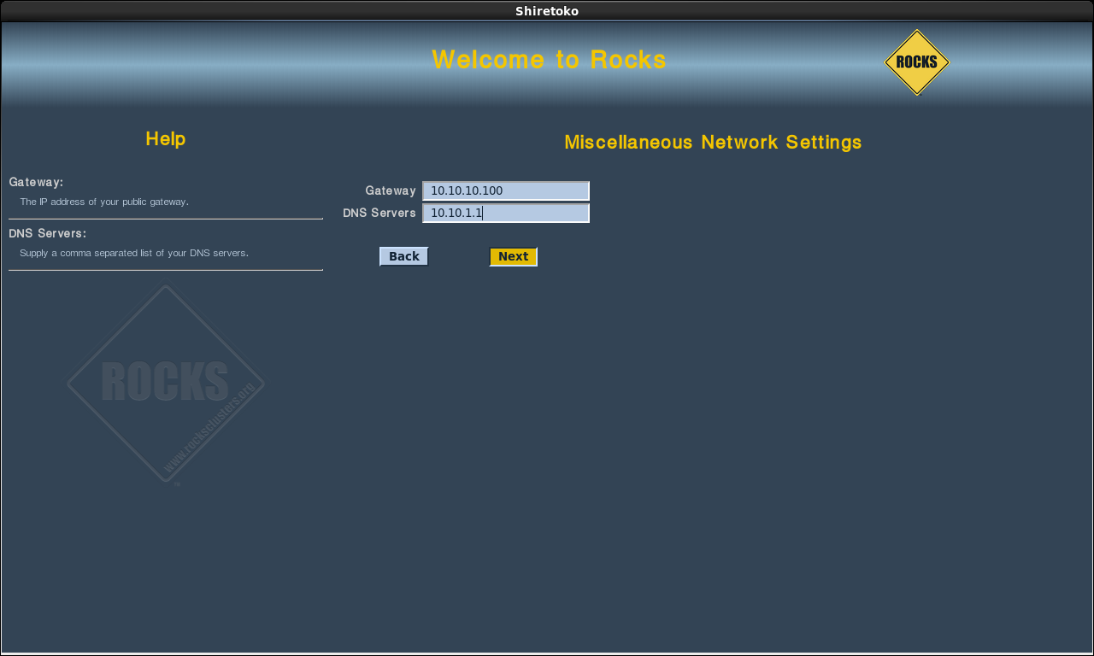

Slide 15
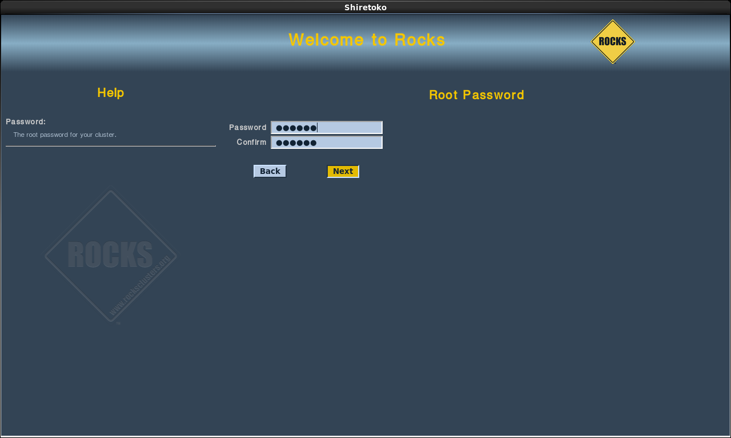

Slide 16
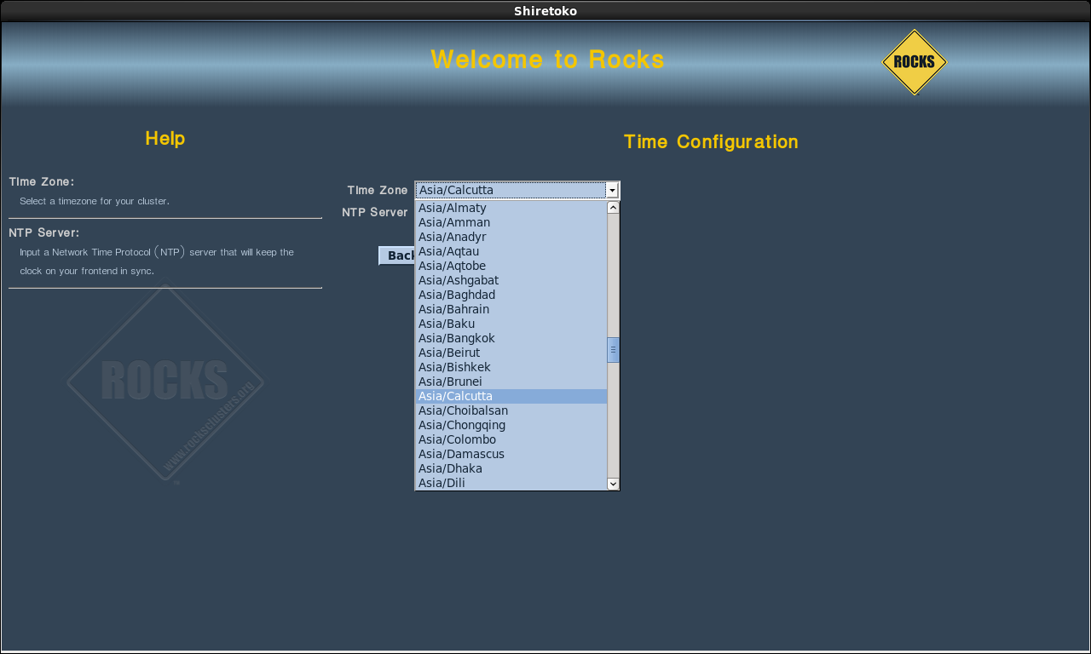

Slide 17
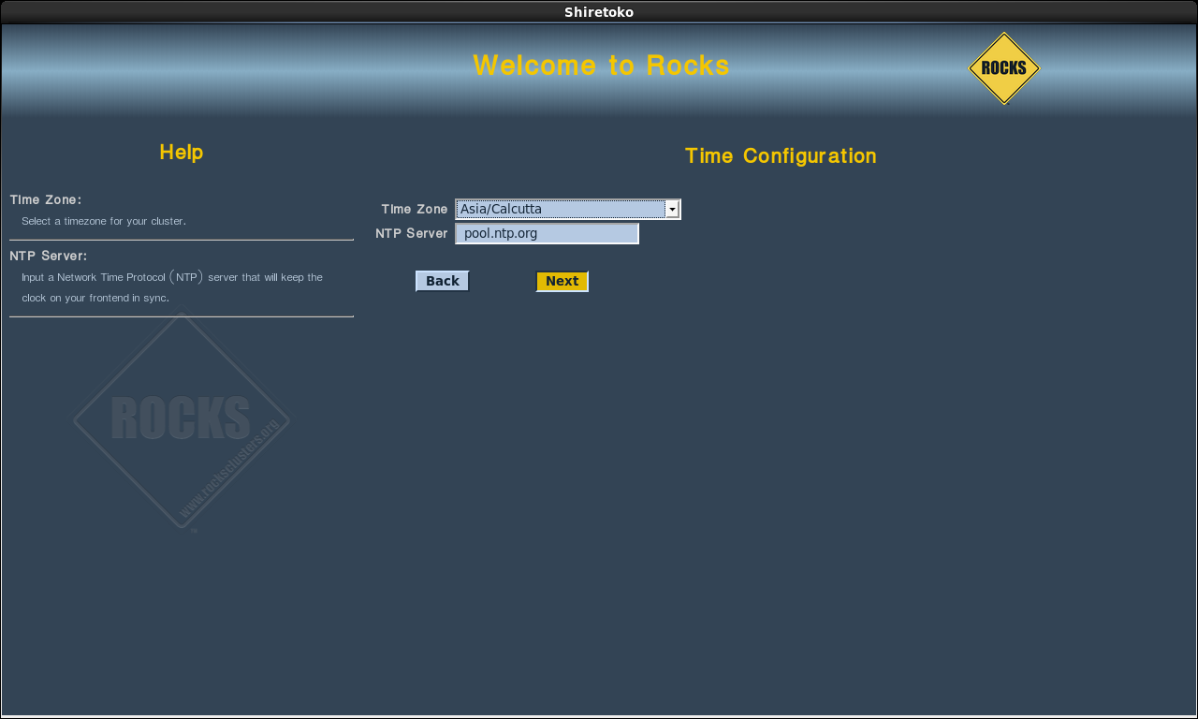

Slide 18
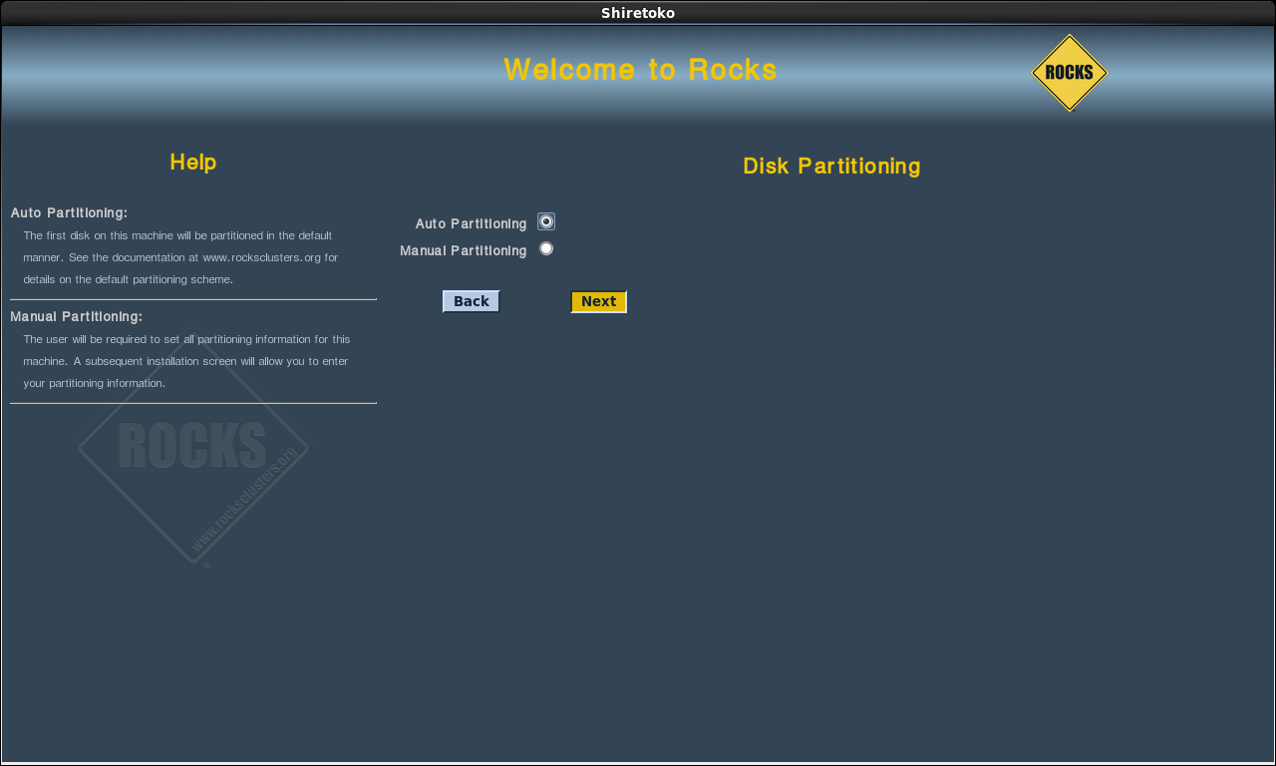

Slide 19
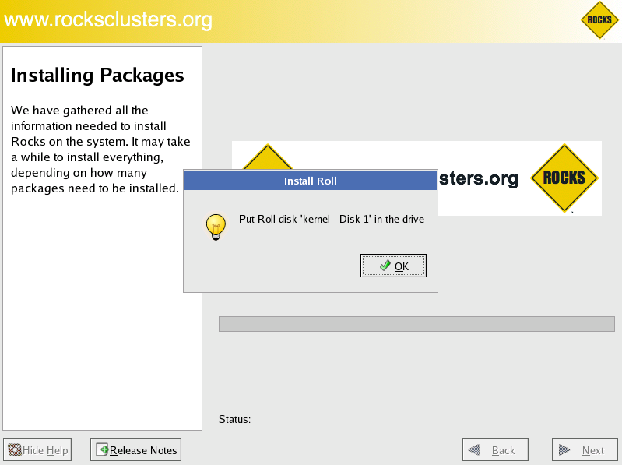

Slide 20
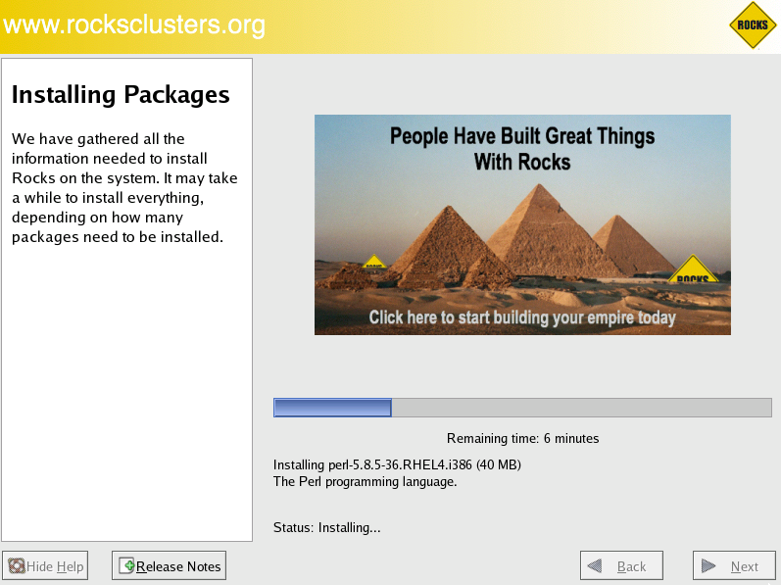

Slide 21


Slide 22

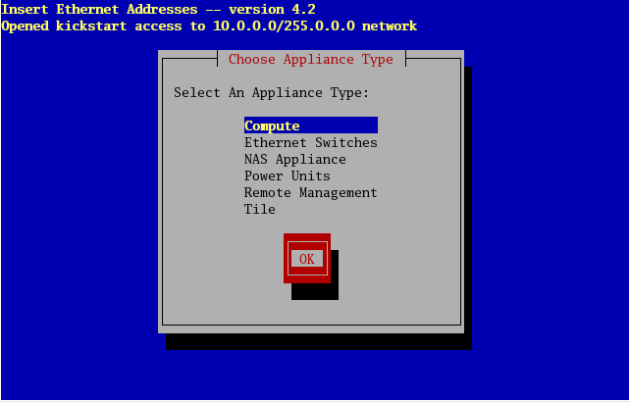

Slide 23
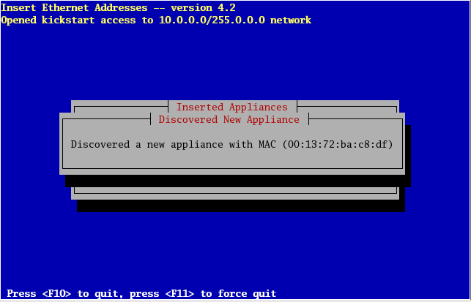

Slide 24
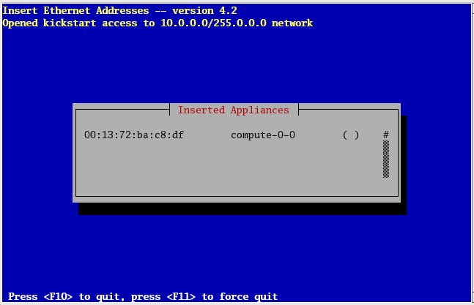

Slide 25
