Slide 1
Introduction
To
OpenMP
Open specification for Multi Processing
By:-
Sucheta Pawar
suchetap@cdac.in

Slide 2
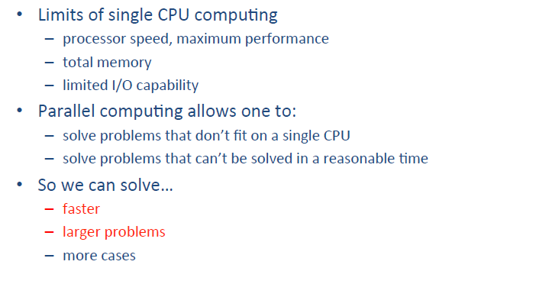

Slide 3

What is parallel Programming?
More than one paint brush!
Paint the fence faster..
…or paint a bigger fence
Paint brushes = cores

Slide 4

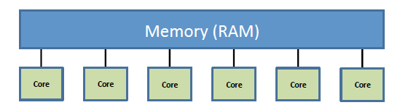
All cores share a common pool of memory (RAM)
The programming challenge is coordination:
how to avoid compe.ng for access to the same puzzle
pieces (in the memory)
Principal programming model:
  OpenMP • A single executable spawns independent threads and manages threads access to Data

Slide 5

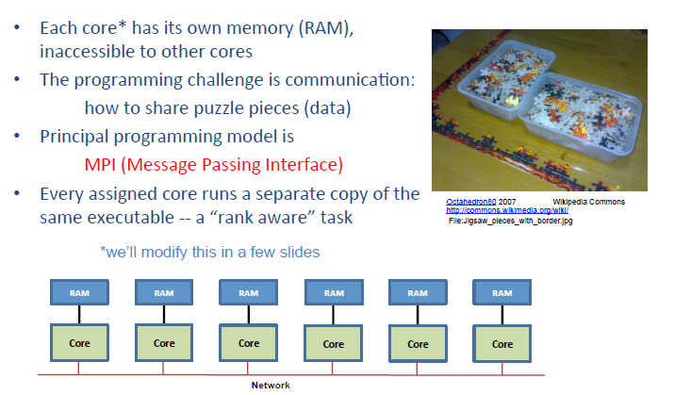

Slide 6
What is OpenMP?
How does OpenMP work?
OpenMP syntax
What’s new? OpenMP 3.0 Even newer: OpenMP 4.0

Slide 7


OpenMP follows….
Explicit Parallelism
Shared Memory

Slide 8



Developing a parallel Application
All is done only to get speedup
Think and have clear idea about program
?
for(i=0;i<=?;i++)
{ }
for( )
{ }
OpenMP stands here
Parallelization of code

Slide 9
Topics to be covered…
Introduction
Why OpenMP
History
What is OpenMP
OpenMP constructs
Pros and Cons

Slide 10
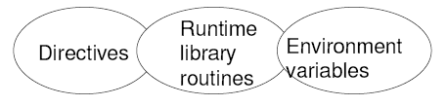
Introduction
It is an specification for
OpenMP is an Application Program Interface (API) for writing multi-threaded, shared memory parallelism.
Portable : Makes it easy to create multi-threaded programs in C,C++ and Fortran.

Slide 11
Introduction
OpenMP stands for Open specification Multi-Processing
An Application Programming Interface (API) for developing parallel programs for shared memory architectures
Three main components:
  Compiler directives
  Runtime library routines
  Environment variables
Standard specifies C, C++ and Fortran directives & API
http://www.openmp.org/ : specification, examples, tutorials and documentation.
Topics to be covered…
Topics to be covered…

Slide 12
OpenMP Features
Allows to
  Create and destroy threads
  Assign and distribute work to threads
  Specify which data is shared and which is private
Usage
  Directives, runtime routines and environment variables
  #include <omp.h>
  -l libomp.lib
  Compiler flag (i.e. -openmp for Intel Compiler)

Slide 13
Why OpenMP…?
Relatively easy to do parallelization for small parts of an application at a time.
Feasibility of scaling an application is proportionate to a large number of processors.
Standard and portable API.
Implemented incrementally.
It is not intrusive.
Supports data parallelism.

Slide 14
Topics to be covered…
Introduction
Why OpenMP
History
What is OpenMP
OpenMP constructs
Pros and Cons

Slide 15
History
First standard X3H5 in 1994
OpenMP Architecture review board(ARB) published its first standard, OpenMP for FORTRAN 1.0, in October of 1997.
1998 : version 1.0 of C/C++
2000 : version 2.0 of Fortran
2002 : version 2.0 of C/C++
2005 : version 2.5 of C/C++/Fortran
2008 : version 3.0 of C/C++/Fortran
2011: version 3.1 of C/C++/Fortran

Slide 16
Topics to be covered…
Introduction
Why OpenMP
History
What is OpenMP
OpenMP constructs
Pros and Cons

Slide 17
What Is OpenMP ?
Open Specificaion for MultiProcessing.
OpenMP is comprised of three complementary components:
A set of compiler directives used by the programmer to communicate with the compiler on parallelism.
2. A runtime library which enables the setting and querying of parallel parameters such as number of participating threads and the thread number.
3. A limited number of environment variables that can be used to define runtime system parallel parameters such as the number of threads.

Slide 18
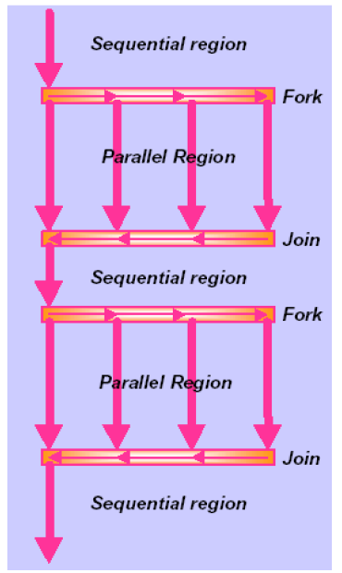
OpenMP – programming model
Programs begin as a single process: master thread
Master executes in serial mode until the parallel region construct is encountered
Master creates a team of parallel threads (fork) that simultaneously execute statements in the parallel region
After executing the parallel region, team threads synchronize and terminate (join), but master continues

Slide 19
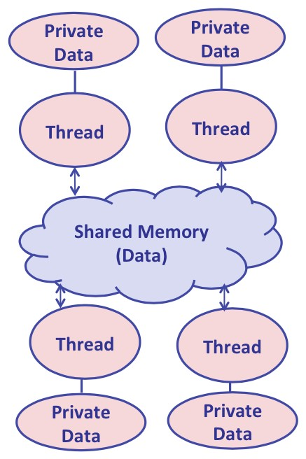
How Do Threads Communicate?
Every thread has access to global memory (shared)
All threads share the same address space
Threads communicate via global memory
Simultaneous updates to shared memory can create a race condition
Use mutual exclusion to avoid data sharing, but don’t use it too much!

Slide 20
OpenMP-Fortran Format
Format
Sentinel
!$OMP
C$OMP
*$OMP
Directive name
[clause..]
Example
!$OMP PARALLEL SHARED(ALPHA) PRIVATE(BETA)

Slide 21
OpenMP-C/C++ Format
Format
Sentinel
#pragma omp
Directive name
[clause..]
Example
#pragma omp parallel shared(alpha) private(beta)

Slide 22
OpenMP Code Structure
C / C++ - General Code Structure
#include <omp.h>
main ()
{
int var1, var2, var3;
Serial code
.
.
Beginning of parallel section. Fork a team of threads.
Specify variable scoping
#pragma omp parallel private(var1, var2) shared(var3)
{
Parallel section executed by all threads
.
.
All threads join master thread and disband
}
Resume serial code
}

Slide 23



How OpenMP is typically use
OpenMP is usually used to parallelize loops:
    Find your most time consuming loops.
    Split them up between threads.
void main()
{
double Res[1000];
for(int i=0;i<1000;i++)
{
do_huge_comp(Res[i]);
}
}
void main()
{
double Res[1000];
#pragma omp parallel
for(int i=0;i<1000;i++)
{
do_huge_comp(Res[i]);
}
}

Slide 24
Topics to be covered…
Introduction
Why OpenMP
History
What is OpenMP
OpenMP constructs
Pros and Cons

Slide 25
OpenMP constructs
OpenMP language
extensions
Parallel
control
structures
Work
Sharing
Data
Handling
Synchronization
Runtime
functions,
Env.
variables
Governs flow
of control in
the program
parallel directive
Distributes
work
amongst
threads
do/parallel do
and
Section directives
Scopes
variables
shared and
private
clauses
Coordinates
thread
execution
critical and
atomic directives
barrier directives
Runtime
environments
omp_set_num_threads( )
omp_get_thread_num( )
OMP_NUM_THREADS
OMP_SCHEDULE

Slide 26
Parallel Region Construct
A parallel region is a block of code that will be executed by multiple threads concurrently.
Fortran
!$OMP PARALLEL [ clause …..]
IF (Scalar_logical) expression
PRIVATE (list)
SHARED(list)
DEFAULT (PRIVATE | SHARED | NONE)
FIRSTPRIVATE (list) REDUCTION(operator: list)
block
!$OMP END PARALLEL

Slide 27
Parallel Region Construct
C/C++
#pragma omp parallel [ clause …..]
if (scalar_logical) expression
private (list)
shared(list)
default (shared | none)
firstprivate (list)
reduction(operator : list)
{
block
}
[Note:Default(private) not supported]

Slide 28
Parallel Region Construct
Number of threads can be set by three ways:
By library call ,by using environment variable & clause
OMP_NUM_THREADS = 3 =>Environment variable
omp_set_num_threads (3) =>library call
NUM_THREADS(3) =>Clause
PROGRAM HELLO
!$OMP PARALLEL
PRINT *, 'Hello World’
!$OMP END PARALLEL
END

Slide 29
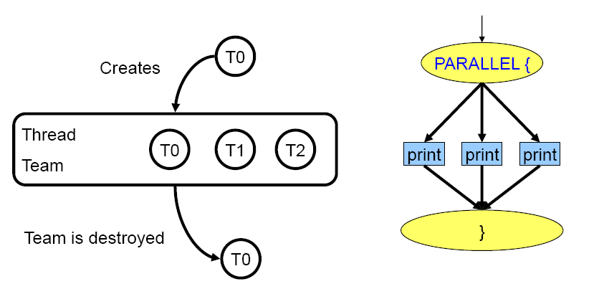
Parallel Region Construct

Slide 30
Work sharing constructs
It distribute execution of associated statement among the members of the team that encounter it.
Work sharing construct do not launch new threads.
There is no barrier upon entry to work-sharing construct.
There is an implied barrier at the end of a work-sharing construct.
Restriction
Must be enclosed within the parallel region for parallel execution.

Slide 31
Work sharing constructs
It is used to assign independent work to one or all of the threads.
i.e Organization of parallel work
for or do: used to split up loop iterations among the threads
sections: assigning consecutive but independent code blocks to different threads
single: block of code for single directive is executed by only one thread, a barrier is implied in the end.
master: similar to single, but the code block will be executed by the master thread only and no barrier implied in the end.

Slide 32
Detailed Syntax
Do Loop
!$omp do[clause clause[]…]
Do loop
!$omp end do
where each clause is one of
private(list)
firstprivate(list)
lastprivate(list)
reduction(operator: list)
ordered
schedule(kind, [chunk_size])
nowait

Slide 33
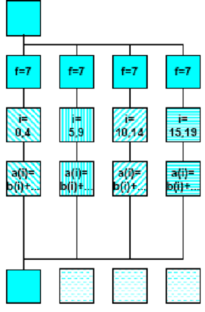
Work sharing Constructs
Do directive: divide iteration among threads
!$omp parallel private(f)
f=7
!$omp do
do I=0,20
a[i] = b[i] + f * (i+1)
end do
!$omp end do
!$omp end parallel
Implicit barrier at the end of the do loop, can be disabled
with the nowait clause

Slide 34
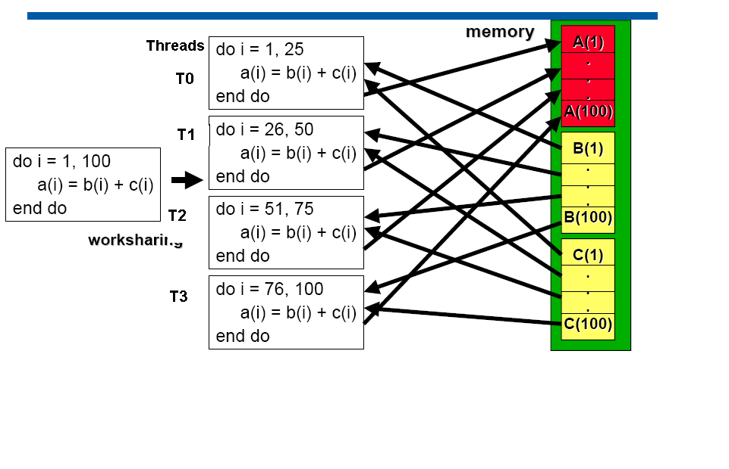
Work sharing Constructs

Slide 35
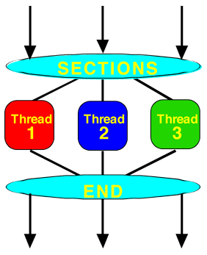
Work sharing Constructs
Section directive this directive gives different structured blocks to each thread.
!$omp parallel private(I)
!$omp sections
!$omp section
do I=1,20
a(I)=b(I)+c(I)
end do
!$omp section
do I=21,40
a(I)=b(I)-c(I)
end do
!$omp section
do I=41,60
a(I)=b(I)*c(I)
end do
!$omp end sections ; !$omp end parallel

Slide 36
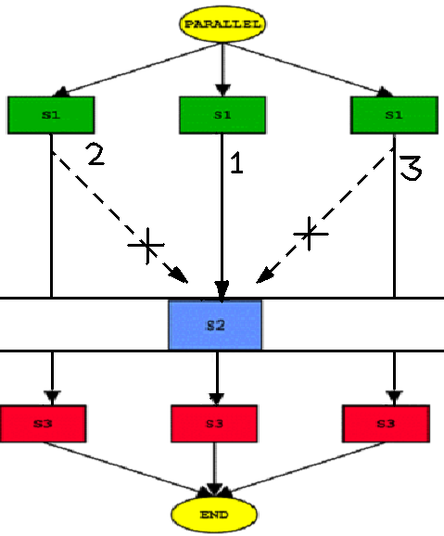
Work sharing Constructs
Single directive:designated section is executed by single thread only.
!$OMP PARALLEL
CALL S1
!$OMP SINGLE
CALL S2
!$OMP END SINGLE
CALL S3
!$OMP END PARALLEL

Slide 37
Data Scope Attribute Clause
SHARED: The data within a parallel region is shared, which means visible and accessible by all threads simultaneously and update modifies data for all threads.
PRIVATE: This means each thread will have a local copy and use it as a temporary variable declares variables to be private to each thread and not initialized upon entry to parallel region and
undefined upon exit from parallel region.
DEFAULT: allows the programmer to state that the default data scoping within a parallel region will be either shared, private, or none. The none option enforces the programmer to declare each variable in the parallel region as either shared or private.

Slide 38
Data Scope Attribute Clause
Data Scope Attribute Clause
FIRSTPRIVATE:
It performs initialization of private variables.
LASTPRIVATE:
    It performs finalization of private variables.
REDUCTION :
It performs a reduction on the variables subject to given operator.

Slide 39
Firstprivate clause
!$omp parallel firstprivate(list)
Firstprivate is the superset of the functionality provided by private clause.All the members of list are private(local to each thread) and initialized to the value in the preceding serial code.

Slide 40
Firstprivate-Example
Program on firstprivate
integer myid,i,j
integer omp_get_thread_num
i = 123;j = 455
call omp_set_num_threads(2)
!$omp parallel default(private)
myid=omp_get_thread_num()
print*,'myid =',myid,'i = ',i,'j = ',j
!$omp end parallel
print*,’I am in serial region’
!$omp parallel default(private) firstprivate(i,j)
myid=omp_get_thread_num()
print*,'myid=',myid, 'i=',i, 'j=',j
!$omp end parallel
end
Output
myid = 0 i = 0 j = 0
myid = 1 i = 0 j = 0
I am in serial region
myid= 0 i= 123 j= 455
myid= 1 i= 123 j= 455

Slide 41
Lastprivate clause
Like private within the parallel construct - each thread has its own copy.
Performs finalization of private variables
a[10]={0,1,2,3,4,5,6,7,8,9};
#pragma omp parallel default(none) private(myid,i) shared(lp)
{
myid=omp_get_thread_num();
#pragma omp for lastprivate(lp)
for(i=0;i<10;i++)
lp=a[i]+i;
printf("myid::%d sum::%d\n",myid,lp);
}
When the loop is finished, the value corresponding to the last iteration is stored in global master copy.(i.e lp=18)

Slide 42
Reduction clause
An operation that “combines” multiple elements to form a single result, such as a summation, is called a reduction operation. A variable that accumulates the result is called a reduction variable.
The REDUCTION clause performs a reduction on the variables that appear in its list.
A private copy for each list variable is created for each thread. At the end of the loop, the reduction operation is applied to all private copies of the shared variable, and the final result is written to the global shared variable.
Format: reduction(operator:variable)
with
    op= { + | * | -| .and. | .or.}

Slide 43
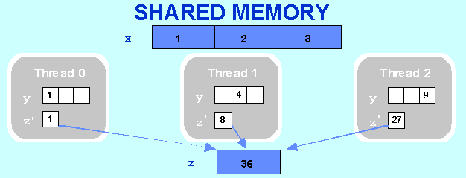
Reduction clause
Program on reduction
INTEGER x(3), y(3), z
!$OMP PARALLEL DEFAULT(PRIVATE),SHARED(x,z)
!$OMP DO REDUCTION(+: z)
DO k = 1, 3
x(k) = k
y(k) = k*k
z = z + x(k) * y(k)
END DO
!$OMP END DO
print *,'Inside z=',z
!$OMP END PARALLEL
print *,'Outside z=',z
end

Slide 44
Schedule clause
Schedule clause specifies how iterations of the loop are
divided among the threads of the team.
OpenMP supports four scheduling classes:
    static
    dynamic
    guided
    runtime
  Syntax is
  !$omp do schedule(type,[chunk size])

Slide 45
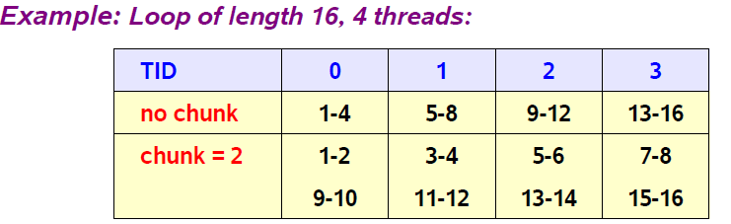
Schedule(continue…..)
schedule(static [,n])
Each thread is assigned chunks in a "round robin" fashion. This is known as block cyclic scheduling.
If n has not been specified, it will contain CEILING(number_of_iterations / number_of_threads) iterations.

Slide 46

Schedule(continue…..)
schedule(dynamic [,n])
If n has been specified, the iterations of a loop are divided into chunks containing n iterations each.
default chunk size is 1.
If a thread is asleep, its assigned work will be taken over by an active thread, once that other thread becomes available.
!$omp do schedule (dynamic)
do i=1,8
... (loop body) 1 2 3 4 5 6 7 8
end do
!$omp end do

Slide 47
Schedule(continue…..)
schedule(guided [,n])
  If you specify n, that is the minimum chunk size that the each thread should posses.The iterations of a loop are divided into chunks such that the size of each successive chunk is exponentially decreasing.
    The size of the initial chunk is
    CEILING(number_of_iterations / 2*number_of_threads) iterations. Subsequent chunks consist of CEILING(number_of_iterations_remaining / 2*number_of_threads) iterations.
    As each thread finishes a chunk, it dynamically obtains the next available chunk.
schedule(runtime)
      Determine the scheduling type at run time by the OMP_SCHEDULE environment variable

Slide 48
Example-schedule
Given the following information:
number of iterations = 1000, number of threads =2
using the GUIDED scheduling type, the chunk sizes would be as follows:
250 188 141 106 79 59 45 33 25 19 14 11 8 6 4 3 3 2 1 1 1 1
A possible scenario for the division of work could be:
    thread 1 executes chunks 1st 3th 5th 7th 9th
    thread 2 executes chunks 2nd 4th 6th 8th 10th

Slide 49
Synchronization Constructs
OpenMP has the following constructs which support synchronization.
critical directive
ordered directive
barrier
nowait clause
#pragma omp for nowait for C
!$omp end do nowait for fortran

Slide 50
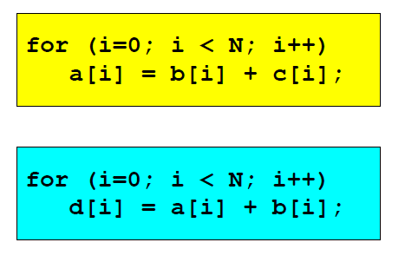
Barrier
Suppose we run each of these two loops in parallel over I
This May give us a wrong answer….
Why??

Slide 51
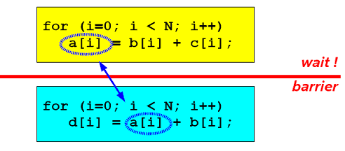
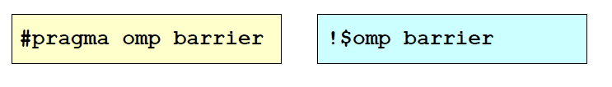
Barrier
We need to have updated all of a[] first, before using a[]
All threads wait at the barrier point and only continue when all threads have reached the barrier point

Slide 52
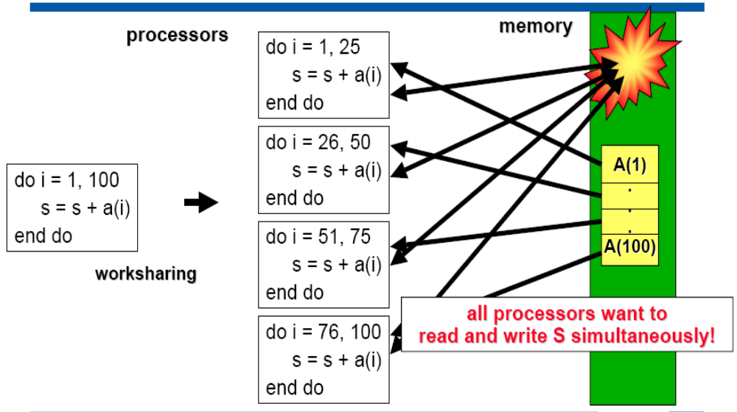
Synchronization Constructs

Slide 53
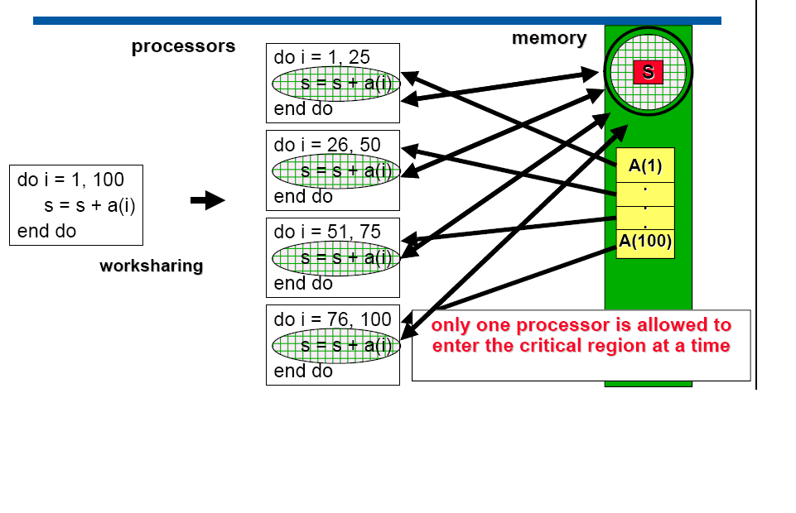
Synchronization Constructs

Slide 54
Critical directive
Enclosed code executed by all threads, but restricted to
only one thread at a time
C/C++:
#pragma omp critical [ ( name ) ]
structured-block
Fortran:
!$OMP CRITICAL [(NAME)]
structured block
!$OMP END CRITICAL
A thread waits at the beginning of a critical region until no
other thread in the team is executing a critical region with
the same name.

Slide 55
Ordered
Only one thread can execute an ORDERED construct at a time. Threads enter the ORDERED construct in the order of the loop iterations.
A thread will enter the ORDERED construct if all of the previous iterations have either executed the construct or will never execute the construct.
An ORDERED directive can only appear in the dynamic extent of the following directives:
DO or PARALLEL DO (Fortran)
For or parallel for (C/C++)

Slide 56
Ordered(continue…..)
PROGRAM
integer myid,omp_get_thread_num
call omp_set_num_threads(3)
!$OMP PARALLEL DO ORDERED
DO I = 1, 6,+1
!$OMP ORDERED
myid=omp_get_thread_num()
PRINT *,'I=',I,‘myid=',myid
!$OMP END ORDERED
END DO
END PROGRAM
Output:
I= 1 Myid= 0
I= 2 Myid= 0
I= 3 Myid= 1
I= 4 Myid= 1
I= 5 Myid= 2
I= 6 Myid= 2

Slide 57
Environment Variables
OMP_NUM_THREADS
sets the number of threads to use during execution
$ export OMP_NUM_THREADS=4
OMP_DYNAMIC
allow run time system to determine the number of threads
$ export OMP_DYNAMIC=TRUE
OMP_SCHEDULE
applies only to do/for and parallel do/for directives that have the schedule type RUNTIME
sets schedule type and chunk size for all such loop
$ export OMP_SCHEDULE=“STATIC, 4”

Slide 58
Environment variables and Library Calls
OMP_NESTED
Allow nesting of parallel region
$ export OMP_NESTED=TRUE
Runtime environment routines
  To control and query the parallel environment.
  The runtime function take precedence over the corresponding environment variables.
  Recommended to use under the control of conditional compilation.

Slide 59
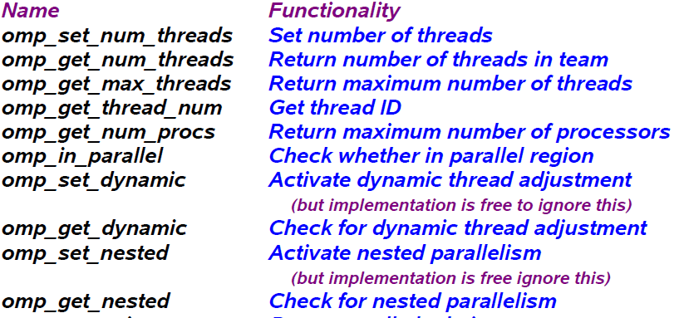
Runtime Library Overview

Slide 60
Compilation of OpenMP program
Using Intel Fortran or C compiler
$ ifort <program name> -openmp –o <name of executable>
$ icc <program name> -openmp –o <name of executable>
eg.
$ icc –openmp hello_world.c –o hello_world.out
Using GNU Fortran or C compiler
$ gfortran <program name> -fopenmp –o <name of executable>
$ gcc <program name> -fopenmp –o <name of executable>

Slide 61
Executing the OpenMP Program
Running a OpenMP Program
./ name of the executable
For example: running a hello world program
./ hello_world.out or ./a.out

Slide 62
Introduction
Why OpenMP
History
What is OpenMP
OpenMp constructs
Pros and Cons

Slide 63
Pros and Cons
Pros:
Simple to program.
Data layout and decomposition is handled automatically by directives.
Unified code for both serial and parallel applications
OpenMP programs are portable to a wide range of system.

Slide 64
Pros and Cons
Cons:
Requires a compiler that supports OpenMP.
Reliable error handling is missing.
Scalability is limited by memory architecture

Slide 65
References
Introduction to Parallel Computing by Ananth Grama
https://computing.llnl.gov/tutorials/openMP
http://en.wikipedia.org/wiki/OpenMP

Slide 66


