Slide 1
Predicting ACU Enrollment and Retention Rates Exceptional. Innovative. Artificial.
Rachael Shudde and Preston Werner

Slide 2
Project proposal
Question: Using data on high school students who have shown interest in ACU, can we reliably predict which students will attend ACU and also come back for two more semesters?

Slide 3
Progress report
Understand data
Narrowed down columns and rows
Produced preliminary summary statistics and graphs
Division of work:
Rachael: Comes to class, about 30% of the code
Preston: About 70% of code

Slide 4
Data and proposed solution
Admissions data from ACU office with 128 columns, over 550,000 rows
We are currently using about 58 rows and roughly 185,000 rows
Information ranging from SAT scores to family income
We are going to use sklearn and decision trees to make our model
We will compare our model to the one ACU currently uses
We are only using data for students who have inquired about ACU

Slide 5
Student data types
Suspect - ACU has has bought student name
Prospect - ACU has bought student name, student shown no interest, might possibly be a good fit for ACU
Inquiry – student shown interest in some way, from contacting ACU to attending a camp
Application – student has submitted application
Admitted – student has been admitted to ACU
Confirm – student confirms attendance by paying the deposit
Enroll – student is registered for classes
Deny – student is admitted but decides not to attend

Slide 6
Final product example
Input:
Name Age SAT Family Income City State Received Legacy
John Smith 17 1200 $35,000 Fresno CA 3/4/18 Yes
Output:
John Smith has a 56% chance of coming to ACU. His low family income and far distance
from ACU are the two factors that impact the low chance of attending.
Grade:
A+

Slide 7
Summary statistics
Female: 60%, Male: 40%
Mean income: $70,590 Median income: $63,587
Mean ACT: 22.5 Enrolled mean ACT: 23.3
Mean SAT: 1013 Enrolled mean SAT: 1058
Legacy Enrolled: 98% Not Legacy Enrolled: 32%

Slide 8
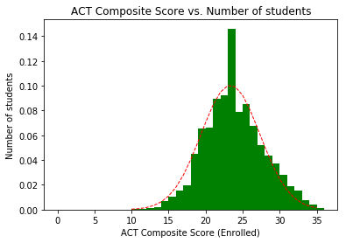
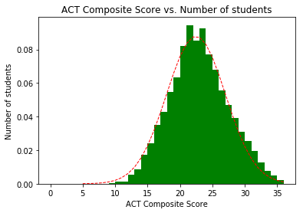

Slide 9
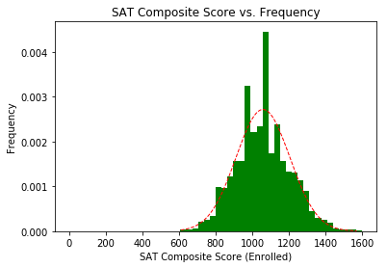
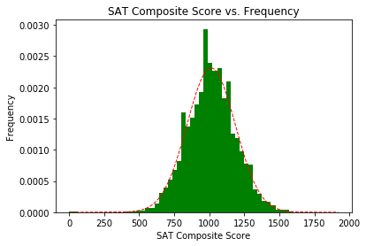

Slide 10
Location summary
State | Number Interested
TX | 147386
CA | 3760
OK | 2481
CO | 2464
TN | 2166
County | Number Interested
Tarrant | 15400
Harris | 14375
Dallas | 12798
Bexar | 9253
Collin | 6550
Country | Number Interested
USA | 176903
Mexico | 948
Honduras | 674
Hong Kong | 354
Nigeria | 319

Slide 11
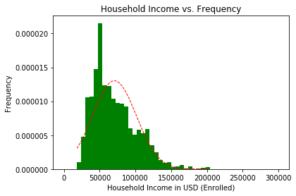
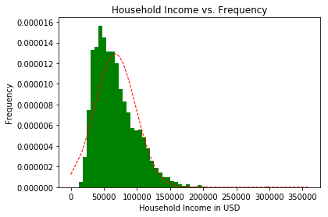

Slide 12
Next steps
By next Friday, we hope to have a preliminary decision tree trained, and we are hoping for 95% accuracy

