Slide 1
Predicting ACU Enrollment and Retention Rates Exceptional. Innovative. Artificial.
Rachael Shudde and Preston Werner

Slide 2
Project proposal
Question: Using data on high school students who have shown interest in ACU, can we reliably predict which students will attend ACU and also come back for two more semesters?

Slide 3
Progress report
Lots of emails
Trained decision tree and random forest
Decided which factors are the most important
Able to predict probability of attending for random admitted students we created
Division of work:
Rachael: Comes to class, less of the code
Preston: Does not come to class, more of the code

Slide 4
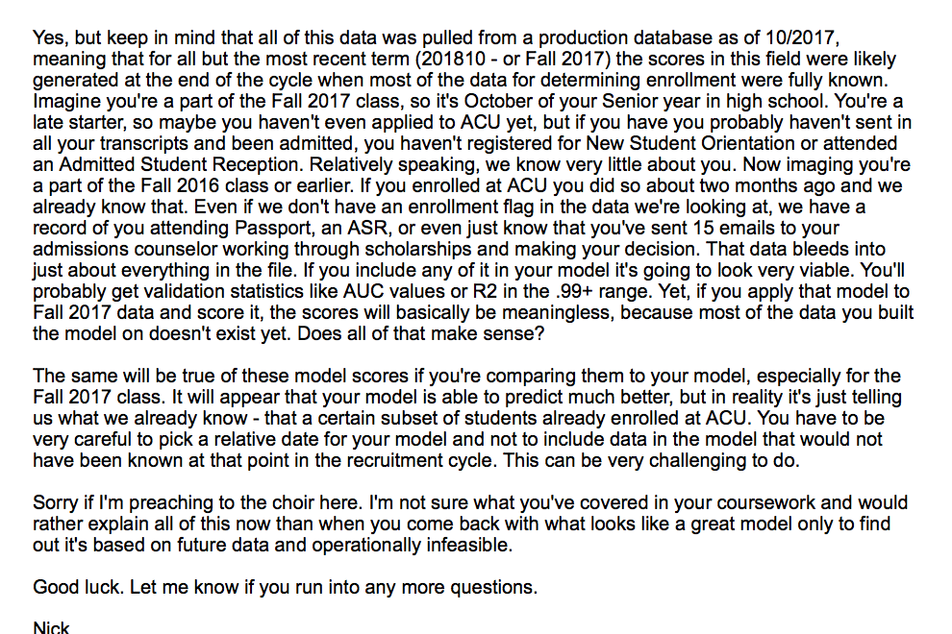
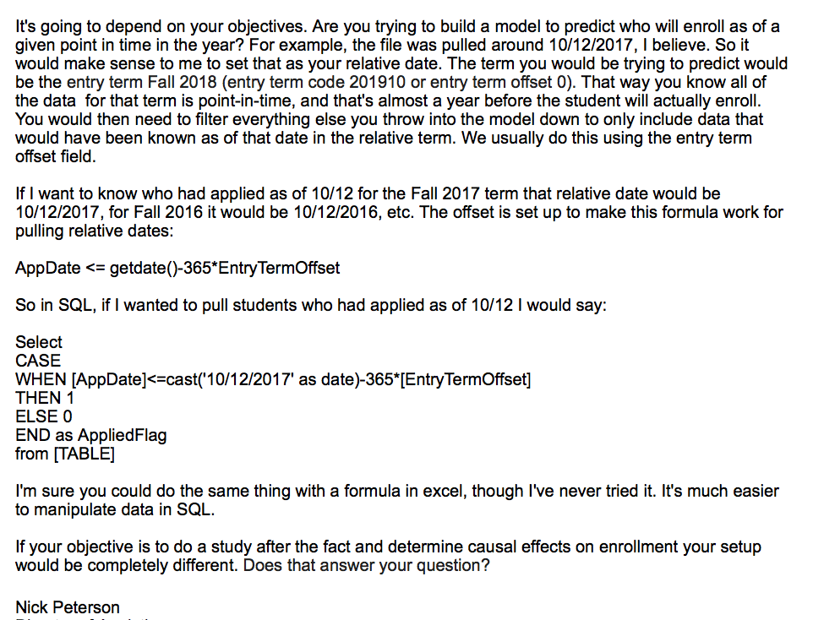

Slide 5
Decision tree vs. random forest
Decision tree score: 87%
Random forest score: 86%
Did not seem to change based on depth of tree
Still trying to adjust parameters to understand why our decision tree behaves oddly
Decision tree gives higher estimates for students who do attend

Slide 6
Feature importance ranking
Feature | Percentage Contribution
Visited | 40%
Qual_Rank | 25%
Qual_Familiarity | 15%
Core_Ind | 7%
ACU_Distance | 2%
CoC | 2%

Slide 7
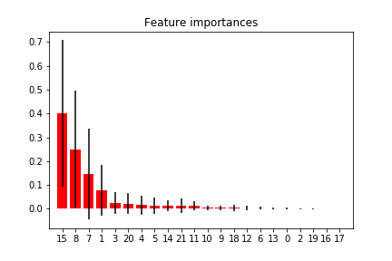

Slide 9
Decision tree vs. random forest
Decision tree | Random forest
0.32354778 | 0.34597865
0.44776119 | 0.35932121
0.03028947 | 0.17592436
0.44776119 | 0.42029307
0.32354778 | 0.25064223
0.32354778 | 0.23286293
0.44578313 | 0.47418406

Slide 10
Next steps
By next Friday, we hope to be able to identify why each student had a low score
We also hope to get rid of bugs causing low prediction values

