Slide 1
Predicting ACU Enrollment and Retention Rates Exceptional. Innovative. Artificial.
Rachael Shudde and Preston Werner

Slide 2
Research question
Question: Using data on high school students who are admitted to ACU, can we reliably predict which students will attend ACU?

Slide 3
Division of work
Code
Preston 60%
Rachael 40%
Power points and data meeting
Rachael
Graphs and visualization
Preston

Slide 4
Final product example
Input:
Name Age SAT Family Income City State Received Legacy
John Smith 17 1200 $35,000 Fresno CA 3/4/18 Yes
Output:
John Smith has a 56% chance of coming to ACU. His low family income and far distance
from ACU are the two factors that impact the low chance of attending.
Grade:
A+

Slide 5
Final project report
We ended being able to
Give a prediction of if an admitted student would come to ACU
Tell which of four factors might change their probability of coming to ACU
We ignored retention rate (hard to create testing data)

Slide 6
Original data and simplification
Admissions data from ACU office with 128 columns, over 550,000 rows
Information on all types of prospective students
Information ranging from SAT scores to family income
We ended up keeping 19 columns and 12,485 rows

Slide 7
Student data types
Suspect - ACU has has bought student name
Prospect - ACU has bought student name, student shown no interest, might possibly be a good fit for ACU
Inquiry – student shown interest in some way, from contacting ACU to attending a camp
Application – student has submitted application
Admitted – student has been admitted to ACU
Confirm – student confirms attendance by paying the deposit
Enroll – student is registered for classes
Deny – student is admitted but decides not to attend

Slide 8
Rows kept
Gender
Core_Ind
Parent_Same_Last_Name
ACU_Distance
Household Income
QUAL_Familiarity
QUAL_rank
HS_Size
HS_Rank Percent
HS GPA
HS_GPA
NUM_advanced_classes
ACT
Visited
Taylor County
US
Abilene
Church of Christ
Ethnicity

Slide 9
Summary statistics
Female: 60%, Male: 40%
Mean income: $70,590 Median income: $63,587
Mean ACT: 22.5 Enrolled mean ACT: 23.3
Mean SAT: 1013 Enrolled mean SAT: 1058
Legacy Enrolled: 98% Not Legacy Enrolled: 32%

Slide 10
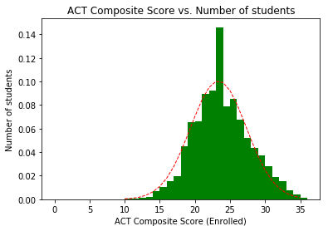
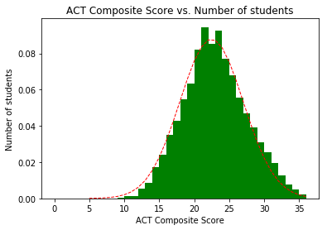

Slide 11
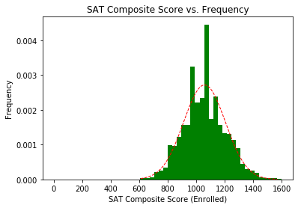
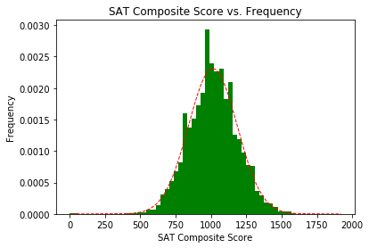

Slide 12
Location summary
State | Number Interested
TX | 147386
CA | 3760
OK | 2481
CO | 2464
TN | 2166
County | Number Interested
Tarrant | 15400
Harris | 14375
Dallas | 12798
Bexar | 9253
Collin | 6550
Country | Number Interested
USA | 176903
Mexico | 948
Honduras | 674
Hong Kong | 354
Nigeria | 319

Slide 13
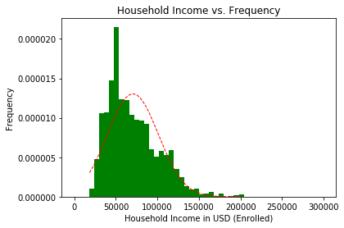
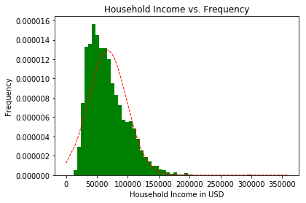

Slide 14
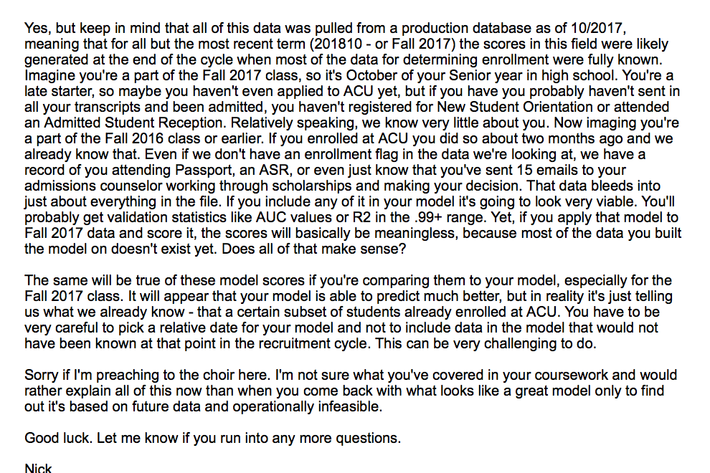
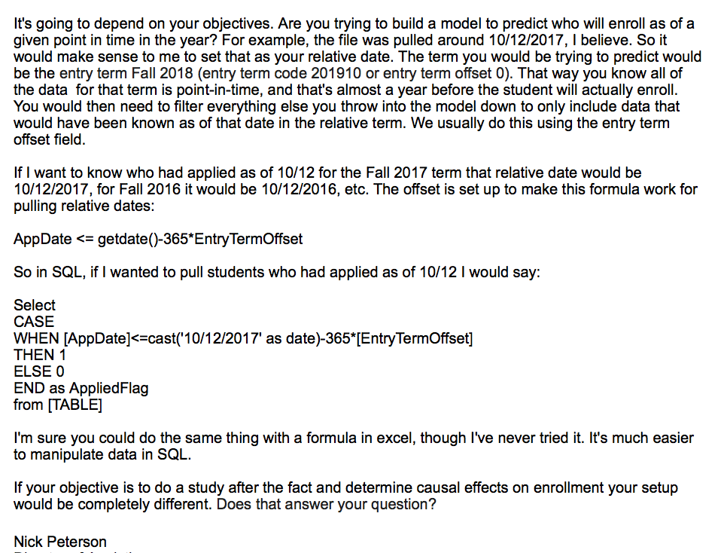

Slide 15
Decision tree
Decision tree score: 88%
We had the following parameters from a grid search:
Max depth: 4
Max leaf nodes: 13
Minimum samples in each leaf: 10
Minimum samples to split: 11

Slide 16
Feature importance ranking
Feature | Percentage Contribution
Visited | 40%
Qual_Rank | 25%
Qual_Familiarity | 15%
Core_Ind | 7%
ACU_Distance | 2%
CoC | 2%

Slide 17
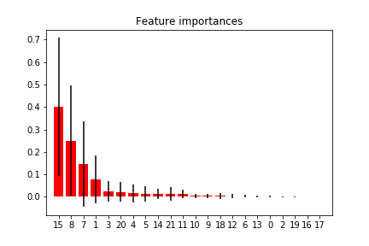

Slide 18
Confusion matrix
Predicted
191 True Positive | 202 False Negative | 393
115 False Positive | 1989 True Negative | 2104
306 | 2191 | 2497 Total
Actual

Slide 20
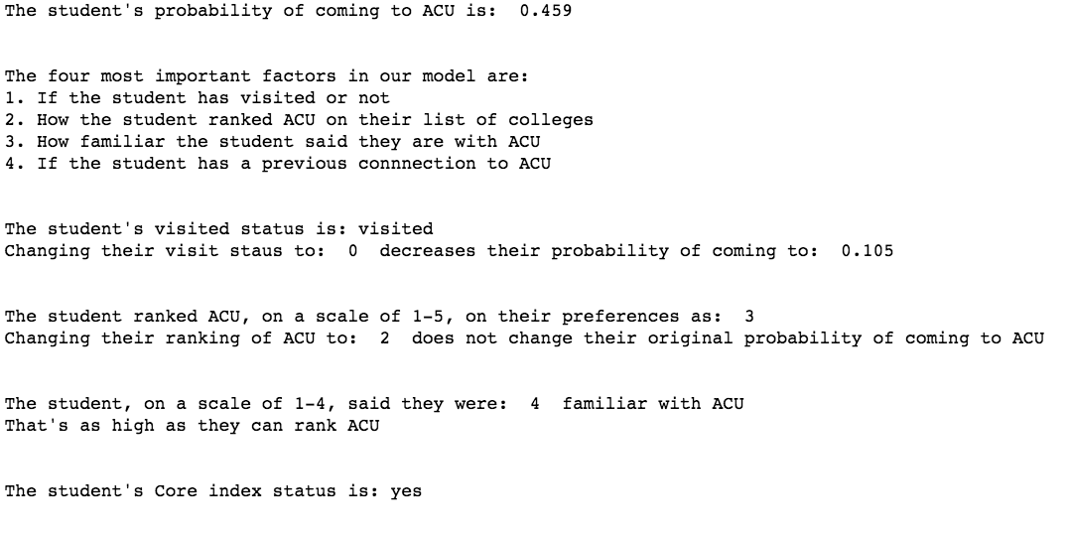

Slide 21
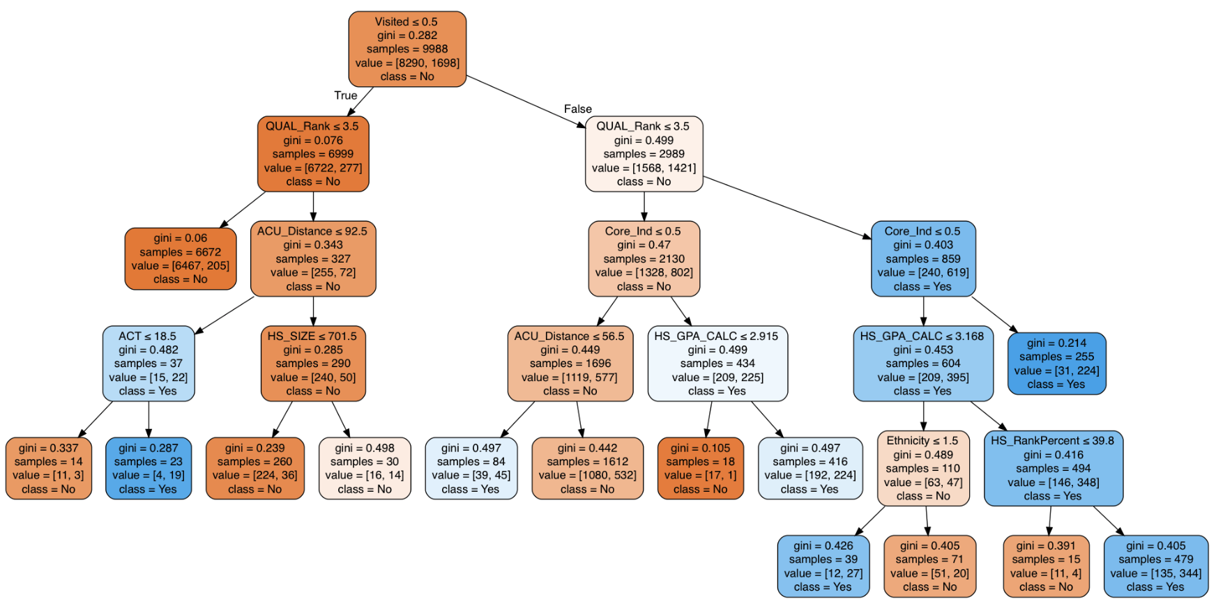

Slide 22
Things we might have done if there was more time
Figured out just what ACU’s models mean
Looked at retention rates for the first three semesters
Found data on how major impacts retention rates
Trained a neural network
Implemented a GUI

Slide 23
Lessons learned
Data is often messy and a lot of our decisions were arbitrary
Our model does not match what we initially thought, but it makes sense
ACU should mainly focus on encouraging campus visits
ACU should focus on getting students more informed about ACU
ACU should foster more relationships between alumni and potential students
We should get an A

