Slide 1

Predicting Loan Defaults
Team 6
Sibi Rajendran, Li Li, Ernest Stephenson

Slide 2
Project Overview
Lending Club is a U.S. peer-to-peer lending company founded in 2006
Used 2007-2011 loan data
Predicting loan status will help Lending Club to lower their default rate and become more profitable

Slide 3
Literature Review
Previous problems with Logistic regression:
Low accuracy and low specificity
Potential difficulties with KNN:
Computation time is large
Original data set:
42,538 observations and 110 predictors

Slide 4
Data Description & Wrangling
Trimmed number of predictors from 110 to 52 (NA cutoff 80%)
Reduced number of predictors from 52 to 18 (manual)
Examples of deleted predictors:
Zip code, employment title, description, application type, tax liens, bankruptcies
Examples of important predictors:
Loan amount, interest rate, employment length, homeownership, annual income, debt-to-income ratio, and number of open accounts

Slide 5
Feature Engineering
Created a binary response variable “is_bad” which indicates if the loan is default or not - originally 6 classes
Created new feature “time_since_first_credit” that is the earliest credit line minus the issue date.
New feature “perc_recv” as amount of principal received as of date divided by the loan amount (problem?)

Slide 6
Data Exploration

Slide 7
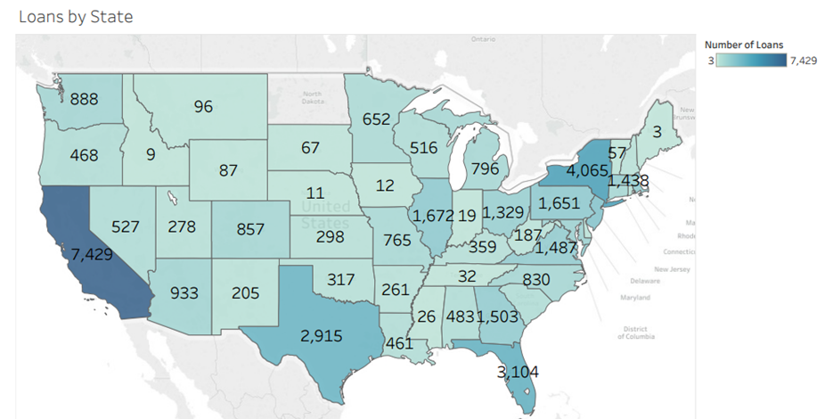

Slide 8
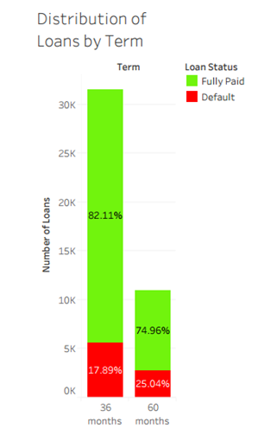

Slide 9
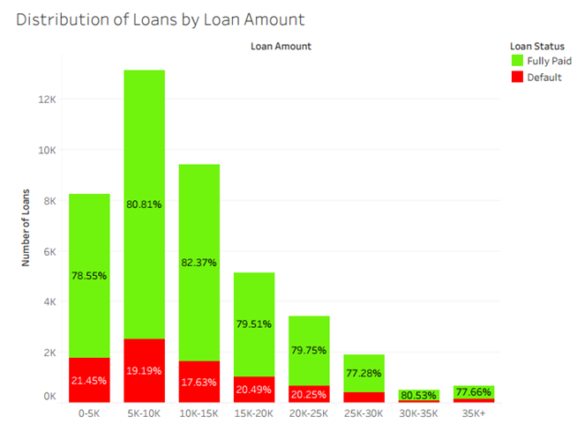

Slide 10
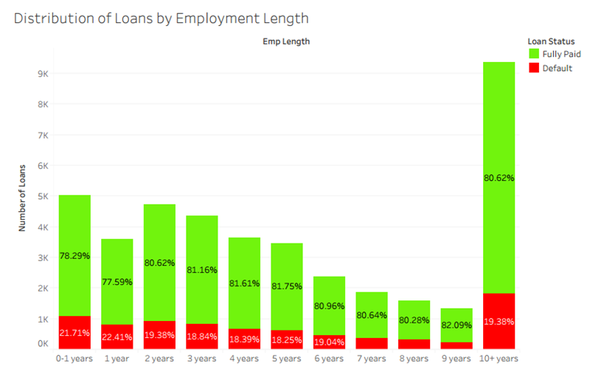

Slide 11
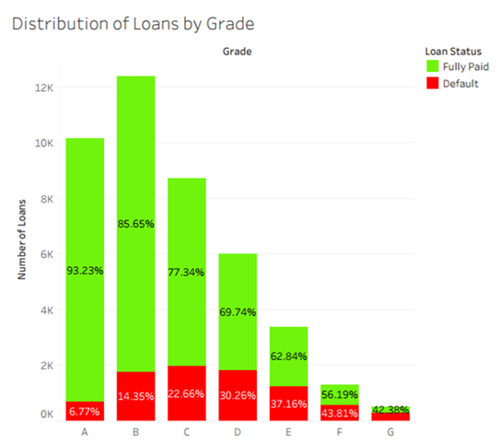

Slide 12
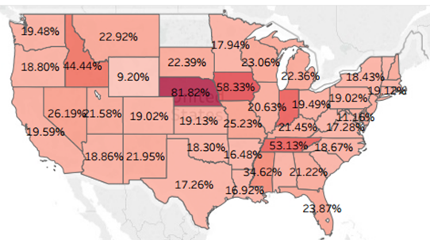


Slide 13
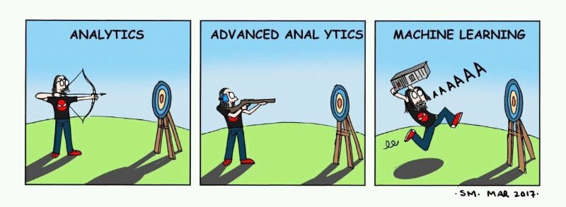

Slide 14
Prior Work on Modeling
Logistic Regression, Naive Bayes and SVM have been tried before.
Accuracy vs sensitivity vs specificity issues.
Averaging predictions : Benchmark accuracy : 60% Specificity : 0.4
Sensitivity : 0.6

Slide 15
Modeling, Validation and Tuning
Data split as 70:30 - training and testing.
Most available hyperparameters were tuned either through gridsearch and/or cross-validation.
Objective was to increase accuracy and specificity - profitable for LC.

Slide 16
Trees and Random Forests
Default parameters gave good accuracy (80%) at the cost of specificity(0.12)
Problem : High false positive rate / fail to predict enough defaults.
Solution : Tune class weights appropriately (say, 1:3 or threshold)

Slide 17
Important Features
Revolving Balance
Time since first credit
Issue date
Annual income
Sub-grade
Some of the important features. Time since first credit is a new feature.

Slide 18
eXtreme Gradient Boosting
Weak Classifiers + Boosting
Sequential improvement and optimization
Hyperparameters tuned : number of trees, learning rate, class scaling, maximum depth, regularization parameters

Slide 19
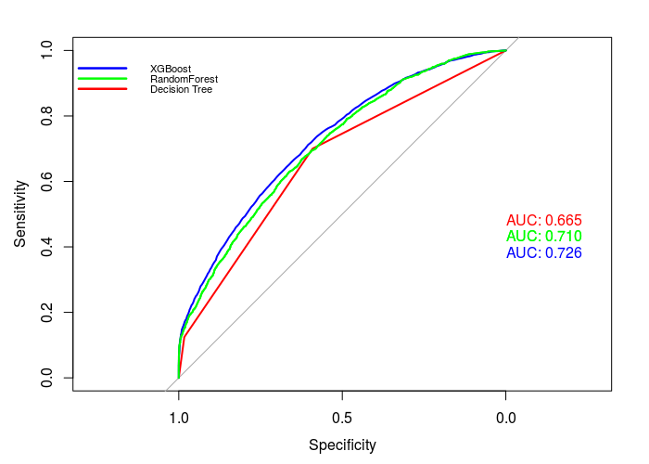
Comparison

Slide 20
Results
Algorithm | Accuracy | Sensitivity | Specificity
Decision Tree | 62% | 0.62 | 0.69
Random Forest | 67% | 0.66 | 0.65
XGBoost | 70% | 0.58 | 0.80

Slide 21
Strengths & Weaknesses
Strengths
Less computation time and flexible
Scalable to large datasets
XGBoost, the best model, is fast and has a lot of customizable parameter.
Weakness
Not easily interpretable(XGB, Random Forest)
Tuning might be difficult(XGB)

Slide 22
Future Scope
Include FICO score variable
Include more data from later years
More feature engineering
Create a web app that will take in parameters and output a credit risk probability

Slide 23
Conclusion
Tree based models have relatively better accuracy as compared to other models
When Lending Club uses the model, we want to assign each loan a probability for LC to make their own decision and not to just automatically accept or deny loans

Slide 24


Questions?

