Slide 1



04408C
99BCE8
D8E6F6
AAC6EC
CFE0F4
92B6E6
04408C
C6D9F2
699BDD
CADCF3
DFE8F6

Slide 2

04408C
Texto
04408C

Slide 4
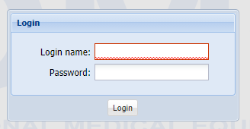
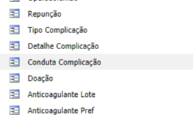


Slide 5



T W D
TWD
TRIMA WORKFLOW DESIGNER
TRIMA WORKFLOW DESIGNER
Twd
TWD
TWD
Trima Workflow Designer
Trima Workflow Designer
t
w
d
Trima Workflow Designer
t
w
d
Trima Workflow Designer

