Slide 1



99BCE8
D8E6F6
92B6E6
CFE0F4
92B6E6
04408C
C6D9F2
CADCF3
DFE8F6

Slide 3
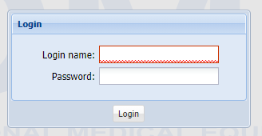

Slide 4



T W D
TWD
TRIMA WORKFLOW DESIGNER
TRIMA WORKFLOW DESIGNER
Twd
TWD
TWD
Trima Workflow Designer
Trima Workflow Designer
t
w
d
Trima Workflow Designer
t
w
d
Trima Workflow Designer

