Slide 1
Using Likely Program Invariants to Detect Hardware Errors
Swarup Kumar Sahoo, Man-Lap Li,
Pradeep Ramachandran, Sarita Adve,
Vikram Adve, Yuanyuan Zhou
Department of Computer Science
University of Illinois, Urbana-Champaign
swat@cs.uiuc.edu

Slide 2
Motivation
In-the-field hardware failures expected to be more pervasive
  Traditional solutions (e.g., nMR) too expensive
  Need low-cost in-field detection, diagnosis, recovery, repair
Two Key Observations
  Handle only hardware faults that propagate to software
  Fault-free case remains common, must incur low-overhead
Watch for software anomaly (symptoms)
  Observe simple symptoms for perm and transient faults [ASPLOS ‘08]
SWAT: SoftWare Anomaly Treatment
Notes:
Start with “as devices continue to scale.”

Slide 3
Motivation – Improving SWAT
SWAT error detection coverage is excellent [ASPLOS ‘08]
  Effective for faults affecting control-flow and most pointer values
SWAT symptoms ineffective, if only data values are corrupted
Non-negligible Silent Data Corruption (1.0% SDCs)
This work reduces SDCs for symptom-based detection
  Uses software level likely invariants
Notes:
Define SDCs
Say SDCs are unacceptable

Slide 4
Likely Program Invariants
Likely invariants: Properties which hold on all training inputs, expected to hold on others
ALU Fault
Register Fault
…
…
…
x = …
y = fun (x)
check( 0 <= y <= 100)
…
…
…
x = …
y = fun (x)
…
Training runs may determine “y” lies between 0 and 100
  Insert checks to monitor this likely invariant
A bit flip in ALU Value of “y” > 100
  Inserted checks will identify such faults
Notes:
While speaking, Connect to next slides – “expected to hold, but may not hold for all inputs”

Slide 5
False Positive Invariants
  False positive: Likely invariants which doesn’t hold for a particular input
…
y = sin (x)
check( 0 <= y <= 1)
…
…
y = sin (x)
…
Training runs may determine “y” lies between 0 and 1
For a particular input outside the training set
  Value of “y” may be < 0
  This violation is a false positive

Slide 6
Challenges
Previous work
  Likely invariants have been used for software debugging
  Some work on hardware faults, but only for transient faults
Challenge-1
  Are invariants effective for permanent faults?
    Which types of invariants?
Challenge-2
  How to handle false positive invariants efficiently for perm faults?
    Simple techniques like pipeline flush will not work – s/w level invs
    Will need some form of checkpoint, rollback/replay mechanism
      Expensive, cost of replay will depend on detection latency
    Rollback/replay on original core will not work with permanent faults
Notes:
Tie “s/w debugging” to SWAT design philosophy
Say why pipeline flush won’t work

Slide 7
Summary of Contributions
First work to use likely invariants to detect permanent faults
First method to handle false positives efficiently for software level invariant-based detections
  Leverages the SWAT hardware diagnosis framework [Li et al., DSN ’08]
Full-system simulation for realistic programs
SDCs reduces by nearly 74%

Slide 8
Outline
Motivation and Likely Program Invariants
Invariant-based detection Framework
Implementation Details
Experimental Results
Conclusion and Future Work

Slide 9
Invariant-based detection Framework
Which types of Invariants to use?
  Value-based: ranges, multiple ranges …?
  Address-based?
  Control-flow?
How to handle false positive invariants?

Slide 10
Which types of invariants to use?
Our focus on data value corruptions
  Need value-based invariants as a detection method
  Many possible invariants, we started with the simplest likely inv
Uses range-based likely invariants
  Checks of type MIN ≤ value ≤ MAX on data values
Advantages?
  Easily enforced with little overhead
  Easily and efficiently generated
  Composable, so training can be done in parallel
Disadvantages?
  Restrictive, does not capture general program properties
Notes:
Talk about, why we are choosing “likely”, not sound invariants – expensive static analysis, subset

Slide 11
How to identify false positives?
Assume rollback/restart mechanism, fault free core
Handling false positives for permanent faults
Inv Violation detected
Checkpoint
Execution in absence of any fault
Replay on a fault free core
from latest Checkpoint
  Inv Violation detected
False positive
Notes:
1- Deadlock, if firmware doesn’t store salse positive from latest checkpoint
2- What if a different inv gets violated
3- Non-determinism can delay the inv violation

Slide 12
How to limit false positives?
Train with many different inputs to reduce false positives
To limit the overhead due to rollback/replay
  We observe that some of the invariants are sound invariants
  Among the remaining invariants
    Very few static false positives for individual inputs
  Disable static invariants found to be false positive
    Maximum number of rollback <= number of static false positives
    Limits overhead (Max rollbacks found to be 7 for ref input in our apps)
  We still have most of the invariants enabled for effective detection

Slide 13
False Positive Detection Methodology
Modified SWAT diagnosis module [Li et al., DSN ‘08]
Invariant Violation detected
Rollback to previous checkpoint, restart on original core
Inv violation doesn’t recur
Inv violation recurs
    Transient h/w bug, or
    non-deterministic s/w bug
    Continue execution
    …
Deterministic s/w bug, False positive Inv, or Permanent h/w bug
Rollback, restart on different core
No violation
Violation
Permanent defect
in original core
Deterministic s/w bug,
False positive Inv
    Disable Invariants
    Continue execution
Start Diagnosis
Notes:
Make the tree balanced

Slide 14
Template of Invariant Checking Code
Insert checks after the monitored value is produced
An array indexed by the invariant-id is used
    Keeps track of found false positive invariants
if ( ( value < min ) or ( value > max ) )
{ / / This Invariant is violated
if ( FalsePosArray [Inv_Id] != true )
{ / / Invariant not yet disabled
if ( FalsePosArray [Inv_Id] != true )
{ / / Invariant not yet disabled
if ( isFalsePos ( Inv_Id ) ) / / Perform diagnosis
FalsePosArray [Inv_Id] = true ; / / Disable the invariant
// else hardware fault detected
if ( isFalsePos ( Inv_Id ) ) / / Perform diagnosis
FalsePosArray [Inv_Id] = true ; / / Disable the invariant
// else hardware fault detected
}
}
}

Slide 15
iSWAT: Invariant-based detection Framework
iSWAT = SWAT + Invariant-detection
SWAT symptoms [Li et al., ASPLOS ‘08]
  Fatal-Trap
  Application aborts
  Hangs
  High-OS

Slide 16
Outline
Motivation and Likely Program Invariants
Invariant-based detection Framework
Implementation Details
Experimental Results
Conclusion and Future Work

Slide 17
iSWAT: Implementation Details
iSWAT has two distinct phases
  Training phase
    Generation of invariant ranges using training inputs
  Code Generation phase
    Generation of binary with invariant checking code inserted
Notes:
Training phase

Slide 18
iSWAT: Training Phase
Invariant generation pass
  Extracts invariants from training runs
  Training set determined by accepted false positive rate
  Invariants for stores of Integers of 2/4/8 bytes, floats and doubles
Invariant Monitoring Code
Ranges
i/p #1
App
Compiler
Pass written in LLVM
------
------
App
------
------
.
.
.
Invariant Ranges
Training
Runs
Ranges
i/p #n
Invariant Generation

Slide 19
iSWAT: Code Generation Phase
Invariant insertion pass
  Inserts invariant checking code into binary
  Generated code monitors value ranges at runtime
Invariant Checking Code
App
Compiler
Pass written in LLVM
------
------
App
------
------
Invariant Ranges
Invariant Checking Code Generation

Slide 20
Outline
Motivation and Likely Program Invariants
Invariant-based detection Framework
Implementation Details
Experimental Results
Conclusion and Future Work

Slide 21
Methodology-1
Simics+GEMS* full system simulator: Solaris-9, SPARC V9
Stuck-at and bridging fault models
Structures
  Decoder, Integer ALU, Register bus, Integer register,
  ROB, RAT, AGEN unit, FP ALU
Five applications - 4 SpecInt and 1 SpecFP
  gzip, bzip2, mcf, parser, art
  Training inputs comprised of train, test, and external inputs
  Ref input used for evaluation
6400 total fault injections
  5 apps * 40 points per app * 4 fault models * 8 structures
*Thanks to WISC GEMS group
Notes:
Simics+GEMS
Thanks to WISC GEMS group

Slide 22
Methodology-2
Metrics
  False Positives
  SDCs
  Latency
  Overhead
  Faults injected for 10M instructions using timing simulation
  SDCs identified by running functional simulation to completion
  Faults not injected after 10M instr ⇒ act as intermittents
  Invariants not monitored after 10M ⇒ SDC conservative
  We consider faults identified after 10M instr as unrecoverable
Notes:
Say why not monitored

Slide 23
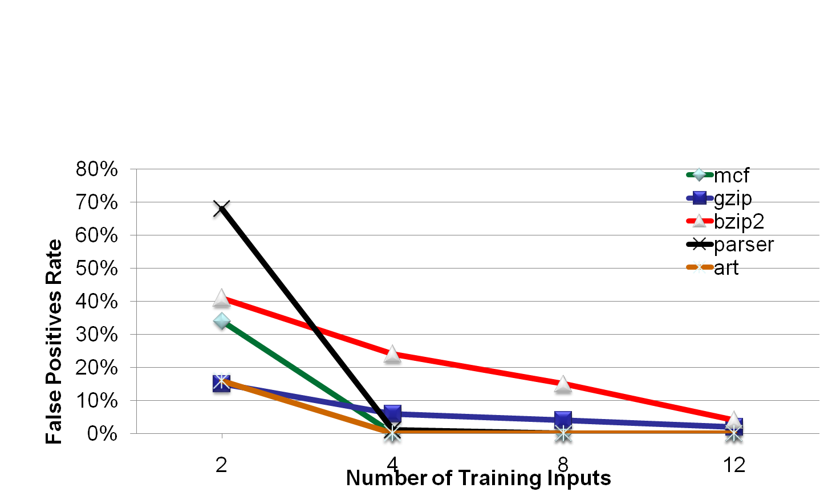
False positives
  False pos rate : % of static invariants that are false positives
  False positive rate < 5%
  Very few rollbacks to detect false pos (Max 7 for ref input)
  In the worst case, 231 rollbacks (for gzip)
Notes:
Def of static false positives

Slide 24
SDCs
 | Previous SWAT symptoms | Invariants | Unrecoverable | SDC
SWAT | 96% | N/A | 4.0% (168) | 0.74% (31)
iSWAT | 89% | 7.7% | 2.9% (120) | 0.19% (08)
  % of non-masked faults detected by each detection method
  iSWAT detects many undetected faults in SWAT In 10M instr
  Reduction in unrecoverable faults: 28.6%
  Reduction in SDCs: 74%
Notes:
Add and say % non-masked faults
Make 2 points after decimal

Slide 25
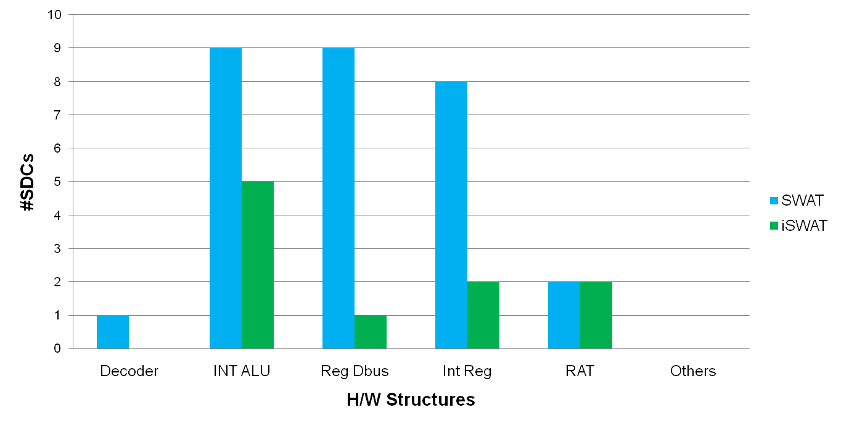
SDC Analysis - 1
Most effective in ALU, register, register bus units

Slide 26
SDC Analysis - 2
For remaining SDCs corrupted values still within range
  Faults result in slight value perturbations
  Can potentially be reduced with better invariants
  Most of the SDCs are due to bridging faults
  In SDC cases, value mismatches in lower-order bits
    In most cases in lowest 3 bits
Latency improvements are not significant
  There is 2%-3% improvement for various latency categories
  More sophisticated invariants are needed

Slide 27
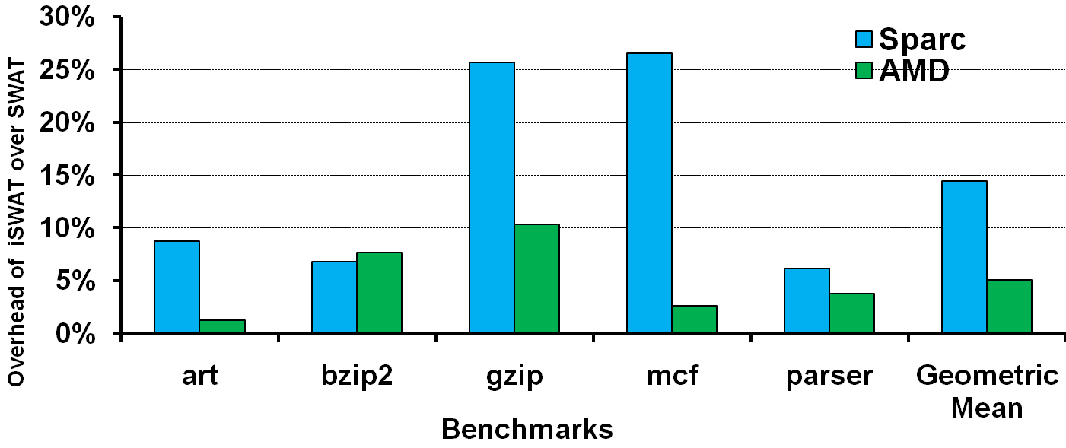
Overhead
Mean overhead on UltraSPARC-IIIi: 14%
Mean overhead on AMD Athlon: 5%
Not optimized
  overhead should be less due to parallelism

Slide 28
Summary of Results
False positive rate < 5% with only 12 training inputs
Reduction in SDCs: 74%
Low overhead: 5% to 14%

Slide 29
Conclusion and Future Work
Simple range-based value invariants
  Reduces SDCs significantly
  False positives are handled with low overhead
  Low checking overhead
Investigation of more sophisticated invariants
  More sophisticated value invariants
  Address-based and Control-flow based invariants
Monitoring of other program values
Strategy to select the most effective invariants
Exploring hardware support to reduce overhead
Notes:
Say what other values – stack/load/intermediates

Slide 30
Questions
Questions?

Slide 31
Back up slides

Slide 32
Coverage
 | Fatal-Trap-App | Fatal-Trap-OS | Hang-App | INV | High-OS | Unknown
SWAT | 22.4% | 25.4% | 0.8% | - | 23.3% | 3.0%
iSWAT | 21.2% | 24.3% | 0.5% | 5.8% | 21.1% | 2.1%
 | Fatal-Trap-App | Fatal-Trap-OS | Hang-App | INV | High-OS | Unknown
SWAT | 22.4% | 25.4% | 0.8% | - | 23.3% | 3.0%
iSWAT | 21.2% | 24.3% | 0.5% | 5.8% | 21.1% | 2.1%
 | Fatal-Trap-App | Fatal-Trap-OS | Hang-App | INV | High-OS | Unknown
SWAT | 22.4% | 25.4% | 0.8% | - | 23.3% | 3.0%
iSWAT | 21.2% | 24.3% | 0.5% | 5.8% | 21.1% | 2.1%
 | Fatal-Trap-App | Fatal-Trap-OS | Hang-App | INV | High-OS | Unknown
SWAT | 22.4% | 25.4% | 0.8% | - | 23.3% | 3.0%
iSWAT | 21.2% | 24.3% | 0.5% | 5.8% | 21.1% | 2.1%
 | Fatal-Trap-App | Fatal-Trap-OS | Hang-App | INV | High-OS | Unknown
SWAT | 22.4% | 25.4% | 0.8% | - | 23.3% | 3.0%
iSWAT | 21.2% | 24.3% | 0.5% | 5.8% | 21.1% | 2.1%
Coverage improvement of iSWAT over SWAT after 10M instructions
  iSWAT detects many undetected faults in SWAT In 10M instr
  Coverage improves from 96% → 97.2%
  Reduction in unknowns: 28.6%
  Most effective in ALU, register, register bus units

Slide 33
Latency of Detection
Latency | <1k | <10k | <100k | <1M | <10M
SWAT | 41.1% | 50.7% | 81.0% | 90.3% | 98.7%
iSWAT | 43.1% | 53.4% | 83.3% | 92.7% | 100.0%
Latency improvement of iSWAT over SWAT
  Latency improvements are not significant
  There is 2%-3% improvement for various latency categories
  More sophisticated invariants are needed

Slide 34
Comparisons
Racunas
  Uses hardware monitoring
  Only for transient faults
  Little checking overhead, but needs lot of hardware
  Lower coverage (50%-70%), as short detection latency is needed
Pattabiraman
  Only for transient faults
  No concrete solution for false positives
  45% h/w area overhead
  5% clock period slowdown
  Overhead of extra check instructions?

Slide 35
Cmparisons
Argus
  Only works for simple cores
  Technique doesn’t work with I/O, Interrupts, exceptions etc.
  Area overhead of nearly 17%
  Performance overhead 4%
  Some errors will go undetected
    Multi-bit errors with structures protected by parity
    Errors in unprotected areas
    Multiple-error scenarios
    Some memory access errors
    Errors hidden by aliasing
  Argus h/w is unprotected => can cause false positives
  Evaluation only with micro-benchmark
  Piece by piece solution rather than a uniform/integrated solution

