Slide 1
Application-Aware SoftWare AnomalyTreatment (SWAT) of Hardware Faults
Byn Choi, Siva Hari, Man-Lap (Alex) Li, Pradeep Ramachandran, Swarup Sahoo, Sarita Adve, Vikram Adve, Shobha Vasudevan, Yuanyuan Zhou
Department of Computer Science
University of Illinois at Urbana-Champaign
swat@cs.illinois.edu

Slide 2
Motivation
Hardware failures will happen in the field
Aging, soft errors, inadequate burn-in, design defects, …
⇒ Need in-field detection, diagnosis, recovery, repair
Reliability problem pervasive across many markets
Traditional redundancy (e.g., nMR) too expensive
Piecemeal solutions for specific fault model too expensive
Must incur low area, performance, power overhead
Need for low-cost solution for multiple failure sources

Slide 3
Observations
Need handle only hardware faults that propagate to software
Fault-free case remains common, must be optimized
Watch for software anomalies (symptoms)
Zero to low overhead “always-on” monitors
Diagnose cause after symptom detected
May incur high overhead, but rarely invoked
SWAT: SoftWare Anomaly Treatment

Slide 4
SWAT Framework Components
Detection: Symptoms of SW misbehavior, minimal backup HW
Recovery: Hardware checkpoint/rollback, output buffering
Diagnosis: Rollback/replay on multicore
Repair/reconfiguration: Redundant, reconfigurable hardware
Flexible control through firmware
Checkpoint
Checkpoint
Fault
Error
Symptom
detected
Recovery
Diagnosis
Repair

Slide 5
SWAT Overview
Today:
Even better SDC, latency
Recovery
Very low-cost detectors, 99% coverage
[ASPLOS’08, DSN’08]
Checkpoint
Checkpoint
Fault
Error
Symptom
detected
Recovery
Accurate fault modeling
[HPCA’09]
Diagnosis
Repair
Multithreaded workloads
[MICRO’09]
In-situ diagnosis
[DSN’08]
Notes:
Out-of-bound detectors, rr for app-aware
No new scheme, but lay foundation for future work
I would like to mention two pieces of recent work that I was involved in.
While detection and diagnosis assume single threaded enironment

Slide 6
This Talk - Contributions
Silent data corruptions (SDC)
Old: 67 out of 8960 faults SDCs
New: Virtually all are acceptable outputs
Application-aware metric
Detection latency
Order of magnitude latency reduction
App-aware metric + new out-of-bounds detector
Recovery
First results for I/O intensive server apps
Quantify I/O buffering: order of magnitude reduction
Motivate need for new checkpointing techniques

Slide 7
Baseline SWAT: Methodology
Detectors: Fatal Traps, Hangs, Kernel Panics, High OS
Microarchitecture-level fault injection
GEMS timing models + Simics full-system simulation
8 SPEC apps on OpenSolaris
Stuck-at and transient faults in 7 µarch structures
Simulate impact of fault in detail for 10M instructions
Fault
10M instr
If no symptom in 10M instr, run to completion
Timing simulation
Functional simulation
Masked, detected, or silent data corruption (SDC)

Slide 8
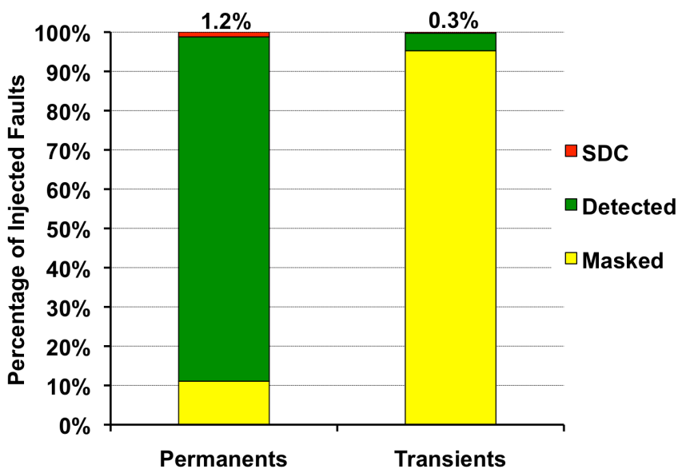
Baseline SWAT: Outcome of Fault Injections
Baseline SWAT has 67 SDCs (out of 8960 injections)

Slide 9
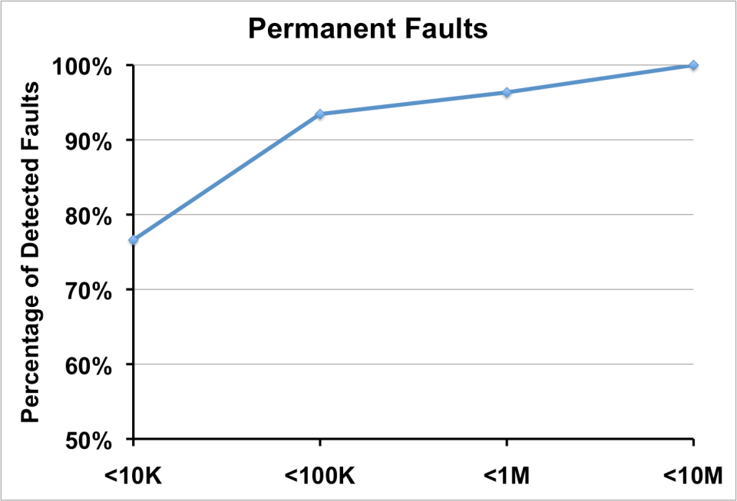
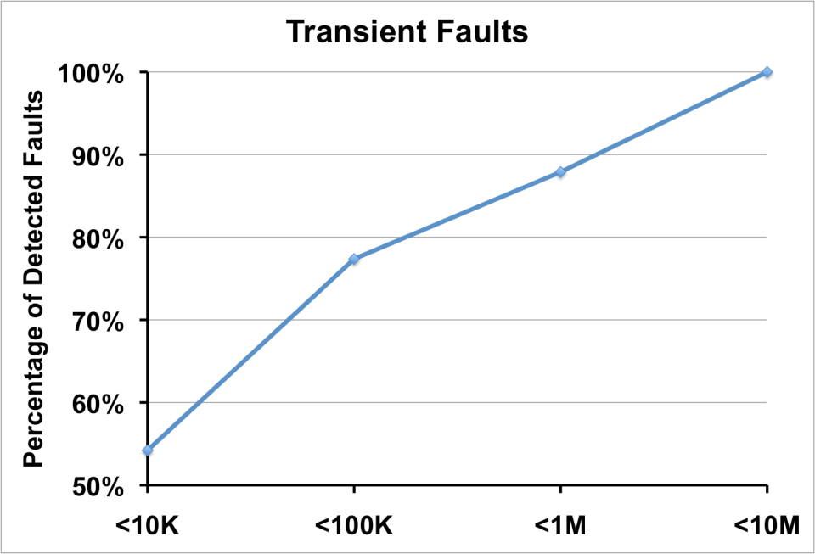
Baseline SWAT: Detection Latency
Baseline SWAT detects XYZ% of faults within 10M instructions
90+% within XYZ instructions
PRADEEP: can you give me the xyz numbers above – note that these need to be total for permanents and transients

Slide 10
Application-Aware SDC Analysis
SDCs occur due to faults that corrupt only data values
SWAT detectors catch other corruptions
How to detect these SDCs?
So far, SDC = output different from fault-free output
But most “SDC”s are actually acceptable outputs!
Some outputs are simply different solutions
Some have degraded quality, but only slightly
E.g., same cost place&route, acceptable PSNR, etc.
SWAT detectors cannot detect acceptable changes in output
should not

Slide 11
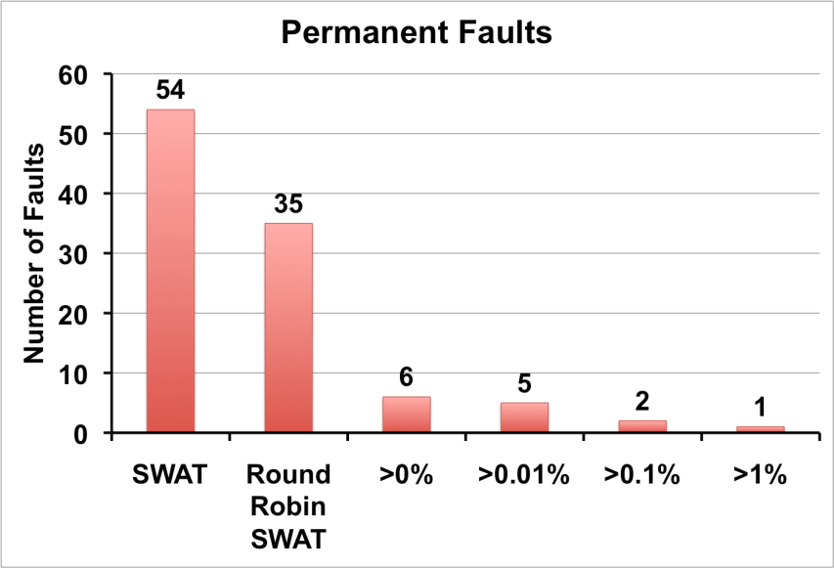
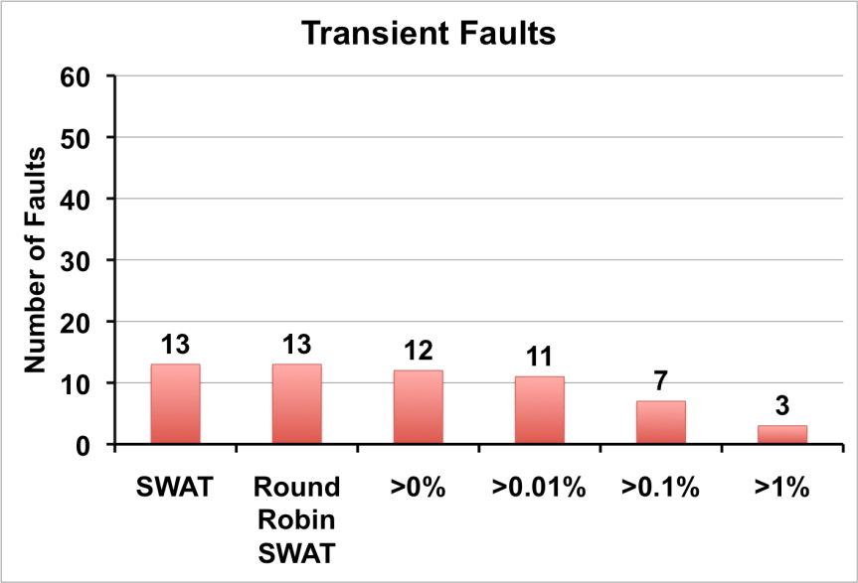
Analyzing Silent Data Corruptions
Only XYZ faults show >0% error from golden output
Only 1 fault confirmed for >1% error
Ongoing work: formalization of why/when SWAT works

Slide 12
Application Aware Latency
Traditionally, corrupted arch state in chkpt ⇒ unrecoverable
Periodic HW checkpoints record registers, memory
But software recovery is governed by corrupted SW state
Periodic
checkpoints
Rollback & Replay
Fault
detection
Application
Execution
Fault
Arch state
corruption
App state
corruption
Recovery Window
Recovery window governs chkpt interval, recovery overhead

Slide 13
Application Aware Out-of-Bounds Detector
Address faults may result in long detection latencies
Corrupt address unallocated but in valid page
Many data value corruptions before symptoms
Low-cost out-of-bounds detector for HW faults
Amortize resiliency cost with SW bug detectors
App Address Space
0x0
0x100000000
Empty
App Code
Size known at
compile time
Communicated
to hardware
Instrumented
malloc reports
arguments to hw
Globals
Heap
Libraries
Limits recorded
when function
Starts execution
Stack
0xffff… (2⁶⁴-1)
Reserved

Slide 14
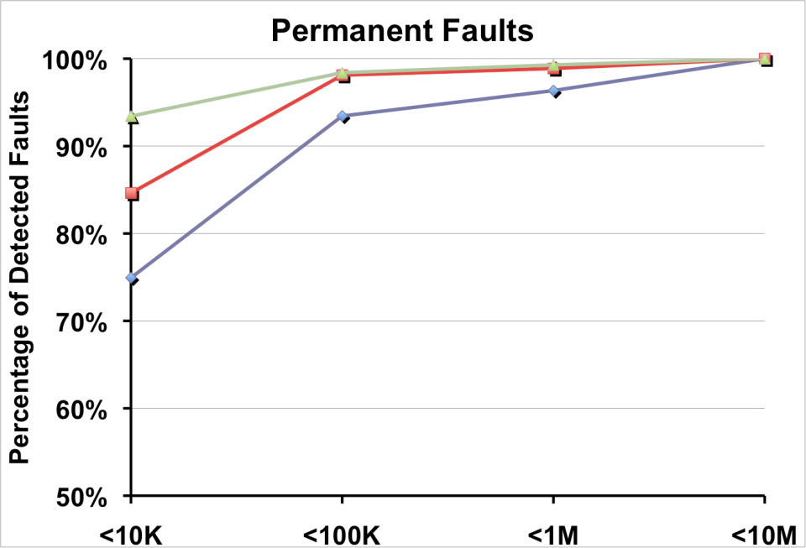
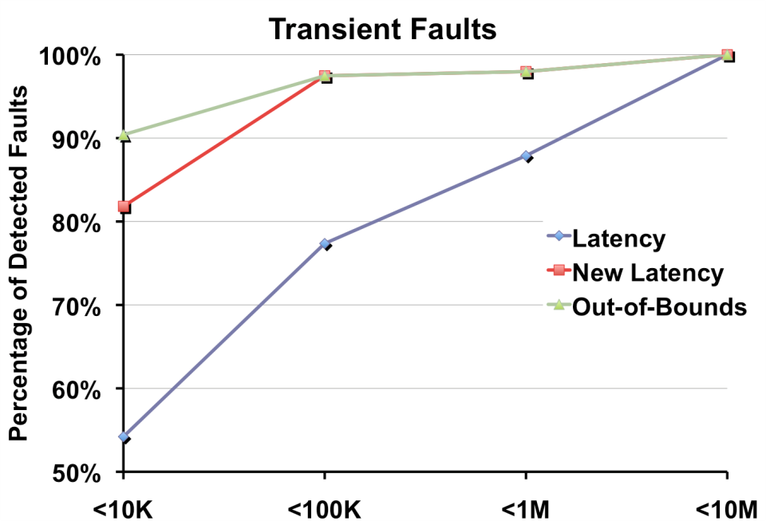
New Detection Latency
> 90% of detections recoverable in < 10K!
Impact on recovery?

Slide 15
SWAT Recovery
Recovery: After detection, mask effect of error
Checkpoint/replay
Rollback to pristine state, re-execute
I/O buffering
Prevent irreversible effects
Is I/O buffering required?
Previous software solutions vulnerable to hardware faults
Overheads for checkpointing and I/O buffering?
Long interval Short interval

Slide 16
What to Checkpoint and Buffer?
Console
CPU
CPU-to-device write
Host-PCI
bridge
Buffer
Memory
Device-to-memory write
SCSI
Controller
Network
Proc+Mem
Proc+AllMem
FullSystem
Proc+AllMem+OutBuf
Checkpointed state

Slide 17
What to Checkpoint, Buffer: Methodology
Need I/O intensive workloads
Apache, SSH daemon serving client requests on network
Fault injection and detection only at server
Simulated
Server
Simulated
Client
Fault
Application
Application
OS
OS
Hardware
Hardware
Simulated Network
Base SDC, latency similar to SPEC
Our focus: recovery
Simics
After detection, rollback to checkpoint, replay without fault
Recoverable, Detected Unrecoverable Error (DUE), SDC

Slide 18
What to Checkpoint, Buffer?
Need Output Buffering for full recovery!

Slide 19
What Should be the Checkpoint, Buffer Interval?
Checkpointing for 10M instr detection latency
Checkpoint intervals of 10M instr, need 2 chkpts
Checkpoint intervals of 1M instr, need 11 chkpts
Tension between I/O buffering and checkpointing
I/O buffering: shorter checkpoint intervals ⇒ Smaller buffer
Checkpointing (ReVive): shorter intervals ⇒ Larger overhead
Recovery
Point
detection
Need buffering for 20M instr
Recovery
Point
detection
Need buffering for 11M instr
Can we find a sweet spot?
Notes:
This slides talk about relationship among recovery intervals, checkpoint intervals, buffering storage

Slide 20
How Much Output Buffering?
Monitored CPU-to-device writes for different intervals
10k 100k 1M 10M 100M
Interval of 10M needs > 100K output buffer
10K needs < 1 K buffer!

Slide 21
How Much Checkpoint Overhead?
Used state of the art: ReVive
Effect of different cache sizes, intervals unknown
Metholodgy
16-core multicore system with shared L2
4 SPLASH parallel apps (worst-case for original ReVive)
Vary cache size between 256KB to 2048KB
Investigate effect of different system configurations
Vary checkpoint interval between 500K to 50M
Understand the optimal checkpoint intervals

Slide 22
Overhead of Hardware Checkpointing
Ocean
Intervals, cache sizes have large impact on performance
< 5M instruction intervals can have unacceptable overheads
But this requires 100 KB output buffer
Motivates cheaper checkpoint mechanisms exploiting low detection latencies

Slide 23
SWAT Summary
Today:
1 real SDC if degrade o/p by 1%
10K latency for 90+% recovery
1st analysis for server recovery
Very low-cost detectors, 99% coverage
[ASPLOS’08, DSN’08]
Checkpoint
Checkpoint
Fault
Error
Symptom
detected
Recovery
Accurate fault modeling
[HPCA’09]
Diagnosis
Repair
Multithreaded workloads
[MICRO’09]
In-situ diagnosis
[DSN’08]
Notes:
Out-of-bound detectors, rr for app-aware
No new scheme, but lay foundation for future work
I would like to mention two pieces of recent work that I was involved in.
While detection and diagnosis assume single threaded enironment

Slide 24
Ongoing and Future Work
Formalization of when/why SWAT works
Near zero cost recovery
More server/distributed applications
Other core and off-core parts, other fault models
Prototyping SWAT on FPGA
In collaboration with Austin/Bertacco

Slide 25
SDC Analysis
Fault in instruction
Opcode
Register
Names
Addresses
Data Values
Invalid
instrn
Value
corruption
Valid
instrn
Invalid
page
Valid
address
Address
corruption
Value
corruption
Unallocated
address
Control flow
corruption
Control flow
corruption
Value
corruption
Value
corruption

Slide 26
Fault
Bad arch state
Bad app state
Chkpt
Old latency

