Slide 1
The Imperative of Disciplined Parallelism: A Hardware Architect’s Perspective
Sarita Adve, Vikram Adve,
Rob Bocchino, Nicholas Carter, Byn Choi, Ching-Tsun Chou,
Stephen Heumann, Nima Honarmand, Rakesh Komuravelli, Maria Kotsifakou,
Pablo Montesinos, Tatiana Schpeisman, Matthew Sinclair, Robert Smolinski,
Prakalp Srivastava, Hyojin Sung, Adam Welc
University of Illinois at Urbana-Champaign, CMU, Intel, Qualcomm
denovo@cs.illinois.edu

Slide 2
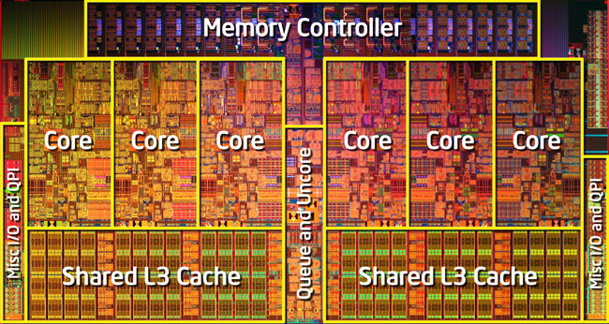
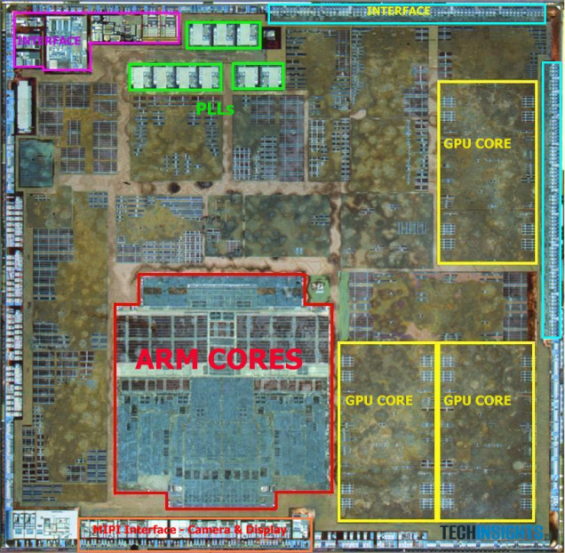
Silver Bullets for the Energy Crisis?
Parallelism
Specialization, heterogeneity, …
BUT large impact on
Software
Hardware
Hardware-Software Interface

Slide 3
Multicore Parallelism: Current Practice
Multicore parallelism today: shared-memory
Complex, power- and performance-inefficient hardware
Complex directory coherence, unnecessary traffic, ...
Difficult programming model
Data races, non-determinism, composability?, testing?
Mismatched interface between HW and SW, a.k.a memory model
Can’t specify “what value can read return”
Data races defy acceptable semantics
Fundamentally broken for hardware & software

Slide 4
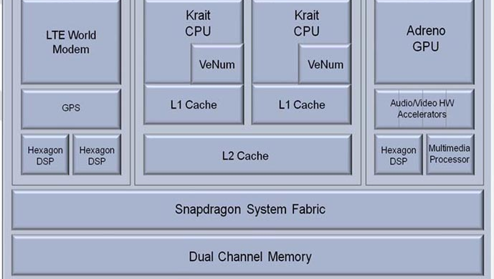
Specialization/Heterogeneity: Current Practice
A modern smartphone
CPU, GPU, DSP, Vector Units, Multimedia, Audio-Video accelerators
6 different ISAs
Even more broken
Incompatible
memory systems
7 different parallelism models

Slide 5
Energy Crisis Demands Rethinking HW, SW
How to (co-)design
Software?
Hardware?
HW / SW Interface?
Deterministic Parallel Java (DPJ)
DeNovo
Virtual Instruction Set Computing (VISC)
Focus on (homogeneous) parallelism

Slide 6
Multicore Parallelism: Current Practice
Multicore parallelism today: shared-memory
Complex, power- and performance-inefficient hardware
Complex directory coherence, unnecessary traffic, ...
Difficult programming model
Data races, non-determinism, composability?, testing?
Mismatched interface between HW and SW, a.k.a memory model
Can’t specify “what value can read return”
Data races defy acceptable semantics
Fundamentally broken for hardware & software

Slide 7
Multicore Parallelism: Current Practice
Multicore parallelism today: shared-memory
Complex, power- and performance-inefficient hardware
Complex directory coherence, unnecessary traffic, ...
Difficult programming model
Data races, non-determinism, composability?, testing?
Mismatched interface between HW and SW, a.k.a memory model
Can’t specify “what value can read return”
Data races defy acceptable semantics
Banish shared memory?
Fundamentally broken for hardware & software

Slide 8
Multicore Parallelism: Current Practice
Multicore parallelism today: shared-memory
Complex, power- and performance-inefficient hardware
Complex directory coherence, unnecessary traffic, ...
Difficult programming model
Data races, non-determinism, composability?, testing?
Mismatched interface between HW and SW, a.k.a memory model
Can’t specify “what value can read return”
Data races defy acceptable semantics
Banish wild shared memory!
Need disciplined shared memory!
Fundamentally broken for hardware & software

Slide 9
What is Shared-Memory?
Shared-Memory =
Global address space
+
Implicit, anywhere communication, synchronization

Slide 10
What is Shared-Memory?
Shared-Memory =
Global address space
+
Implicit, anywhere communication, synchronization

Slide 11
What is Shared-Memory?
Wild Shared-Memory =
Global address space
+
Implicit, anywhere communication, synchronization

Slide 12
What is Shared-Memory?
Wild Shared-Memory =
Global address space
+
Implicit, anywhere communication, synchronization

Slide 13
What is Shared-Memory?
Disciplined Shared-Memory =
Global address space
+
Implicit, anywhere communication, synchronization
Explicit, structured side-effects

Slide 14
Our Approach
Strong safety properties - Deterministic Parallel Java (DPJ)
No data races, determinism-by-default, safe non-determinism
Simple semantics, safety, and composability
Simple programming model AND
Complexity, performance-, power-scalable hardware
explicit effects +
structured
parallel control
Disciplined Shared Memory
Efficiency: complexity, performance, power - DeNovo
Simplify coherence and consistency
Optimize communication and storage layout

Slide 15
DeNovo Hardware Project
Rethink memory hierarchy for disciplined software
Started with Deterministic Parallel Java (DPJ)
End goal is language-oblivious interface
LLVM-inspired virtual ISA
Software research strategy
Started with deterministic codes
Added safe non-determinism
Ongoing: other parallel patterns, OS, legacy, …
Hardware research strategy
Homogeneous on-chip memory system
coherence, consistency, communication, data layout
Ongoing: heterogeneous systems and off-chip memory

Slide 16
DeNovo Hardware Project
Rethink memory hierarchy for disciplined software
Started with Deterministic Parallel Java (DPJ)
End goal is language-oblivious interface
LLVM-inspired virtual ISA
Software research strategy
Started with deterministic codes
Added safe non-determinism
Ongoing: other parallel patterns, OS, legacy, …
Hardware research strategy
Homogeneous on-chip memory system
coherence, consistency, communication, data layout
Similar ideas apply to heterogeneous and off-chip memory

Slide 17
DeNovo Hardware Project
Rethink memory hierarchy for disciplined software
Started with Deterministic Parallel Java (DPJ)
End goal is language-oblivious interface
LLVM-inspired virtual ISA
Software research strategy
Started with deterministic codes
Added safe non-determinism [ASPLOS’13]
Ongoing: other parallel patterns, OS, legacy, …
Hardware research strategy
Homogeneous on-chip memory system
coherence, consistency, communication, data layout
Similar ideas apply to heterogeneous and off-chip memory

Slide 18
Current Hardware Limitations
Complexity
Subtle races and numerous transient states in the protocol
Hard to verify and extend for optimizations
Storage overhead
Directory overhead for sharer lists
Performance and power inefficiencies
Invalidation, ack messages
Indirection through directory
False sharing (cache-line based coherence)
Bandwidth waste (cache-line based communication)
Cache pollution (cache-line based allocation)

Slide 19
Results for Deterministic Codes
Complexity
No transient states
Simple to extend for optimizations
Storage overhead
Directory overhead for sharer lists
Performance and power inefficiencies
Invalidation, ack messages
Indirection through directory
False sharing (cache-line based coherence)
Bandwidth waste (cache-line based communication)
Cache pollution (cache-line based allocation)
Base DeNovo
20X faster to verify vs. MESI

Slide 20
Results for Deterministic Codes
Complexity
No transient states
Simple to extend for optimizations
Storage overhead
No storage overhead for directory information
Performance and power inefficiencies
Invalidation, ack messages
Indirection through directory
False sharing (cache-line based coherence)
Bandwidth waste (cache-line based communication)
Cache pollution (cache-line based allocation)
Base DeNovo
20X faster to verify vs. MESI

Slide 21
Results for Deterministic Codes
Complexity
No transient states
Simple to extend for optimizations
Storage overhead
No storage overhead for directory information
Performance and power inefficiencies
No invalidation, ack messages
No indirection through directory
No false sharing: region based coherence
Region, not cache-line, communication
Region, not cache-line, allocation (ongoing)
Base DeNovo
20X faster to verify vs. MESI
Up to 79% lower memory stall time
Up to 66% lower traffic

Slide 22
Outline
Introduction
DPJ Overview
Base DeNovo Protocol
DeNovo Optimizations
Evaluation
Conclusion and Future Work

Slide 23
DPJ Overview
Deterministic-by-default parallel language [OOPSLA’09]
Extension of sequential Java
Structured parallel control: nested fork-join
Novel region-based type and effect system
Speedups close to hand-written Java
Expressive enough for irregular, dynamic parallelism
Supports
Disciplined non-determinism [POPL’11]
Explicit, data race-free, isolated
Non-deterministic, deterministic code co-exist safely (composable)
Unanalyzable effects using trusted frameworks [ECOOP’11]
Unstructured parallelism using tasks w/ effects [PPoPP’13]
Focus here on deterministic codes

Slide 24
DPJ Overview
Deterministic-by-default parallel language [OOPSLA’09]
Extension of sequential Java
Structured parallel control: nested fork-join
Novel region-based type and effect system
Speedups close to hand-written Java
Expressive enough for irregular, dynamic parallelism
Supports
Disciplined non-determinism [POPL’11]
Explicit, data race-free, isolated
Non-deterministic, deterministic code co-exist safely (composable)
Unanalyzable effects using trusted frameworks [ECOOP’12]
Unstructured parallelism using tasks w/ effects [PPoPP’13]
Focus here on deterministic codes

Slide 25
Regions and Effects
Region: a name for set of memory locations
Assign region to each field, array cell
Effect: read or write on a region
Summarize effects of method bodies
Compiler: simple type check
Region types consistent
Effect summaries correct
Parallel tasks don’t interfere
heap
LD
ST
ST
ST
ST
Type-checked programs are guaranteed determinism-by-default

Slide 26
Example: A Pair Class
class Pair {
region Blue, Red;
int X in Blue;
int Y in Red;
void setX(int x) writes Blue {
this.X = x;
}
void setY(int y) writes Red {
this.Y = y;
}
void setXY(int x, int y) writes Blue; writes Red {
cobegin {
setX(x); // writes Blue
setY(y); // writes Red
}
}
}
Region names have static scope (one per class)
Pair
Pair.Blue | X | 3
Pair.Red | Y | 42
Declaring and using region names

Slide 27
Example: A Pair Class
class Pair {
region Blue, Red;
int X in Blue;
int Y in Red;
void setX(int x) writes Blue {
this.X = x;
}
void setY(int y) writes Red {
this.Y = y;
}
void setXY(int x, int y) writes Blue; writes Red {
cobegin {
setX(x); // writes Blue
setY(y); // writes Red
}
}
}
Pair
Pair.Blue | X | 3
Pair.Red | Y | 42
Writing method effect summaries

Slide 28
Example: A Pair Class
class Pair {
region Blue, Red;
int X in Blue;
int Y in Red;
void setX(int x) writes Blue {
this.X = x;
}
void setY(int y) writes Red {
this.Y = y;
}
void setXY(int x, int y) writes Blue; writes Red {
cobegin {
setX(x);
setY(y);
}
}
}
Pair
Pair.Blue | X | 3
Pair.Red | Y | 42
Expressing parallelism

Slide 29
Example: A Pair Class
class Pair {
region Blue, Red;
int X in Blue;
int Y in Red;
void setX(int x) writes Blue {
this.X = x;
}
void setY(int y) writes Red {
this.Y = y;
}
void setXY(int x, int y) writes Blue; writes Red {
cobegin {
setX(x); // writes Blue
setY(y); // writes Red
}
}
}
Pair
Pair.Blue | X | 3
Pair.Red | Y | 42
Inferred effects
Expressing parallelism

Slide 30
Outline
Introduction
Background: DPJ
Base DeNovo Protocol
DeNovo Optimizations
Evaluation
Conclusion and Future Work

Slide 31
Memory Consistency Model
Guaranteed determinism ⇒ Read returns value of last write in sequential order
Same task in this parallel phase
Or before this parallel phase
Coherence
Mechanism
ST 0xa
ST 0xa
Parallel
Phase
LD 0xa

Slide 32
Cache Coherence
Coherence Enforcement
Invalidate stale copies in caches
Track one up-to-date copy
Explicit effects
Compiler knows all regions written in this parallel phase
Cache can self-invalidate before next parallel phase
Invalidates data in writeable regions not accessed by itself
Registration
Directory keeps track of one up-to-date copy
Writer updates before next parallel phase

Slide 33
Basic DeNovo Coherence [PACT’11]
Assume (for now): Private L1, shared L2; single word line
Data-race freedom at word granularity
L2 data arrays double as directory
Keep valid data or registered core id, no space overhead
L1/L2 states
Touched bit set only if read in the phase
registry
Invalid
Read
Valid
Write
Write
Registered

Slide 34
Example Run
class S_type {
X in DeNovo-region ;
Y in DeNovo-region ;
}
S _type S[size];
...
Phase1 writes { // DeNovo effect
foreach i in 0, size {
S[i].X = …;
}
self_invalidate( );
}
L1 of Core 1
L1 of Core 2
R | X₀ | V | Y₀
R | X₁ | V | Y₁
R | X₂ | V | Y₂
V | X₃ | V | Y₃
V | X₄ | V | Y₄
V | X₅ | V | Y₅
R | X₀ | V | Y₀
R | X₁ | V | Y₁
R | X₂ | V | Y₂
I | X₃ | V | Y₃
I | X₄ | V | Y₄
I | X₅ | V | Y₅
V | X₀ | V | Y₀
V | X₁ | V | Y₁
V | X₂ | V | Y₂
V | X₃ | V | Y₃
V | X₄ | V | Y₄
V | X₅ | V | Y₅
I | X₀ | V | Y₀
I | X₁ | V | Y₁
I | X₂ | V | Y₂
R | X₃ | V | Y₃
R | X₄ | V | Y₄
R | X₅ | V | Y₅
V | X₀ | V | Y₀
V | X₁ | V | Y₁
V | X₂ | V | Y₂
V | X₃ | V | Y₃
V | X₄ | V | Y₄
V | X₅ | V | Y₅
V | X₀ | V | Y₀
V | X₁ | V | Y₁
V | X₂ | V | Y₂
R | X₃ | V | Y₃
R | X₄ | V | Y₄
R | X₅ | V | Y₅
Registration
Registration
Shared L2
R | C1 | V | Y₀
R | C1 | V | Y₁
R | C1 | V | Y₂
R | C2 | V | Y₃
R | C2 | V | Y₄
R | C2 | V | Y₅
Ack
V | X₀ | V | Y₀
V | X₁ | V | Y₁
V | X₂ | V | Y₂
V | X₃ | V | Y₃
V | X₄ | V | Y₄
V | X₅ | V | Y₅
Ack
R = Registered
V = Valid
I = Invalid

Slide 35
Practical DeNovo Coherence
Basic protocol impractical
High tag storage overhead (a tag per word)
Address/Transfer granularity > Coherence granularity
DeNovo Line-based protocol
Traditional software-oblivious spatial locality
Coherence granularity still at word
no word-level false-sharing
“Line Merging”
Cache
Tag
 |  | V |  |  | V | R
V | V |  |  |  |  |  | V

Slide 36
Current Hardware Limitations
Complexity
Subtle races and numerous transient sates in the protocol
Hard to extend for optimizations
Storage overhead
Directory overhead for sharer lists
Performance and power inefficiencies
Invalidation, ack messages
Indirection through directory
False sharing (cache-line based coherence)
Traffic (cache-line based communication)
Cache pollution (cache-line based allocation)
✔
✔
✔
✔

Slide 37
Flexible, Direct Communication
Insights
1. Traditional directory must be updated at every transfer
DeNovo can copy valid data around freely
2. Traditional systems send cache line at a time
DeNovo uses regions to transfer only relevant data
Effect of AoS-to-SoA transformation w/o programmer/compiler

Slide 38
Flexible, Direct Communication
L1 of Core 1
L1 of Core 2
…
…
R | X₀ | V | Y₀ | V | Z₀
R | X₁ | V | Y₁ | V | Z₁
R | X₂ | V | Y₂ | V | Z₂
I | X₃ | V | Y₃ | V | Z₃
I | X₄ | V | Y₄ | V | Z₄
I | X₅ | V | Y₅ | V | Z₅
I | X₀ | V | Y₀ | V | Z₀
I | X₁ | V | Y₁ | V | Z₁
I | X₂ | V | Y₂ | V | Z₂
R | X₃ | V | Y₃ | V | Z₃
R | X₄ | V | Y₄ | V | Z₄
R | X₅ | V | Y₅ | V | Z₅
X₃
Y₃
Z₃
…
LD X₃
Shared L2
…
…
R | C1 | V | Y₀ | V | Z₀
R | C1 | V | Y₁ | V | Z₁
R | C1 | V | Y₂ | V | Z₂
R | C2 | V | Y₃ | V | Z₃
R | C2 | V | Y₄ | V | Z₄
R | C2 | V | Y₅ | V | Z₅
Registered
Valid
Invalid
…

Slide 39
Flexible, Direct Communication
Flexible, Direct Communication
L1 of Core 1
L1 of Core 2
…
…
R | X₀ | V | Y₀ | V | Z₀
R | X₁ | V | Y₁ | V | Z₁
R | X₂ | V | Y₂ | V | Z₂
V | X₃ | V | Y₃ | V | Z₃
V | X₄ | V | Y₄ | V | Z₄
V | X₅ | V | Y₅ | V | Z₅
R | X₀ | V | Y₀ | V | Z₀
R | X₁ | V | Y₁ | V | Z₁
R | X₂ | V | Y₂ | V | Z₂
I | X₃ | V | Y₃ | V | Z₃
I | X₄ | V | Y₄ | V | Z₄
I | X₅ | V | Y₅ | V | Z₅
I | X₀ | V | Y₀ | V | Z₀
I | X₁ | V | Y₁ | V | Z₁
I | X₂ | V | Y₂ | V | Z₂
R | X₃ | V | Y₃ | V | Z₃
R | X₄ | V | Y₄ | V | Z₄
R | X₅ | V | Y₅ | V | Z₅
X₃
LD X₃
X₄
…
X₅
…
Shared L2
…
R | C1 | V | Y₀ | V | Z₀
R | C1 | V | Y₁ | V | Z₁
R | C1 | V | Y₂ | V | Z₂
R | C2 | V | Y₃ | V | Z₃
R | C2 | V | Y₄ | V | Z₄
R | C2 | V | Y₅ | V | Z₅
Registered
Valid
Invalid
…

Slide 40
Current Hardware Limitations
Complexity
Subtle races and numerous transient sates in the protocol
Hard to extend for optimizations
Storage overhead
Directory overhead for sharer lists
Performance and power inefficiencies
Invalidation, ack messages
Indirection through directory
False sharing (cache-line based coherence)
Traffic (cache-line based communication)
Cache pollution (cache-line based allocation)
✔
✔
✔
✔
✔
✔
✔
ongoing

Slide 41
Outline
Introduction
Background: DPJ
Base DeNovo Protocol
DeNovo Optimizations
Evaluation
Complexity
Performance
Conclusion and Future Work

Slide 42
Protocol Verification
DeNovo vs. MESI word with Murphi model checking
Correctness
Six bugs in MESI protocol
Difficult to find and fix
Three bugs in DeNovo protocol
Simple to fix
Complexity
15x fewer reachable states for DeNovo
20x difference in the runtime

Slide 43
Performance Evaluation Methodology
Simulator: Simics + GEMS + Garnet
System Parameters
64 cores
Simple in-order core model
Workloads
FFT, LU, Barnes-Hut, and radix from SPLASH-2
bodytrack and fluidanimate from PARSEC 2.1
kd-Tree (two versions) [HPG 09]

Slide 44
MESI Word (MW) vs. DeNovo Word (DW)
FFT
LU
Barnes
kdFalse
kdPadded
bodytrack
fluidanimate
radix
DW’s performance competitive with MW

Slide 45
MESI Line (ML) vs. DeNovo Line (DL)
FFT
LU
Barnes
kdFalse
kdPadded
bodytrack
fluidanimate
radix
DL about the same or better memory stall time than ML
DL outperforms ML significantly with apps with false sharing

Slide 46
Optimizations on DeNovo Line
FFT
LU
Barnes
kdFalse
kdPadded
bodytrack
fluidanimate
radix
Combined optimizations perform best
Except for LU and bodytrack
Apps with low spatial locality suffer from line-granularity allocation

Slide 47
Network Traffic
FFT
LU
Barnes
kdFalse
kdPadded
bodytrack
fluidanimate
radix
DeNovo has less traffic than MESI in most cases
DeNovo incurs more write traffic
due to word-granularity registration
Can be mitigated with “write-combining” optimization

Slide 48
Network Traffic
FFT
LU
Barnes
kdFalse
kdPadded
bodytrack
fluidanimate
radix
DeNovo has less or comparable traffic than MESI
Write combining effective

Slide 49
L1 Fetch Bandwidth Waste
Most data brought into L1 is wasted
40—89% of MESI data fetched is unnecessary
DeNovo+Flex reduces traffic by up to 66%
Can we also reduce allocation waste?
Region-driven data layout

Slide 50
Current Hardware Limitations
Complexity
Subtle races and numerous transient sates in the protocol
Hard to extend for optimizations
Storage overhead
Directory overhead for sharer lists
Performance and power inefficiencies
Invalidation, ack messages
Indirection through directory
False sharing (cache-line based coherence)
Traffic (cache-line based communication)
Cache pollution (cache-line based allocation)
✔
✔
✔
✔
✔
✔
✔
ongoing

Slide 51
Current Hardware Limitations
Complexity
Subtle races and numerous transient sates in the protocol
Hard to extend for optimizations
Storage overhead
Directory overhead for sharer lists
Performance and power inefficiencies
Invalidation, ack messages
Indirection through directory
False sharing (cache-line based coherence)
Traffic (cache-line based communication)
Cache pollution (cache-line based allocation)
✔
✔
✔
Region-Driven Memory Hieararchy
✔
✔
✔
✔
ongoing

Slide 52
Conclusions and Future Work (1 of 2)
Strong safety properties - Deterministic Parallel Java (DPJ)
No data races, determinism-by-default, safe non-determinism
Simple semantics, safety, and composability
Simple programming model AND
Complexity, performance-, power-scalable hardware
explicit effects +
structured
parallel control
Disciplined Shared Memory
Efficiency: complexity, performance, power - DeNovo
Simplify coherence and consistency
Optimize communication and storage layout

Slide 53
Conclusions and Future Work (2 of 2)
DeNovo rethinks hardware for disciplined models
For deterministic codes
Complexity
No transient states: 20X faster to verify than MESI
Extensible: optimizations without new states
Storage overhead
No directory overhead
Performance and power inefficiencies
No invalidations, acks, false sharing, indirection
Flexible, not cache-line, communication
Up to 79% lower memory stall time, up to 66% lower traffic
ASPLOS’13 paper adds safe non-determinism

Slide 54
Conclusions and Future Work (3 of 3)
Broaden software supported
Pipeline parallelism, OS, legacy, …
Region-driven memory hierarchy
Also apply to heterogeneous memory
Global address space
Region-driven coherence, communication, layout
Hardware/Software Interface
Language-neutral virtual ISA
Parallelism and specialization may solve energy crisis, but
Require rethinking software, hardware, interface
The Disciplined Parallel Programming Imperative

