Slide 1

DeNovo: A Software-Driven Rethinking of the Memory Hierarchy
Sarita Adve
with
Vikram Adve, Rob Bocchino, Nicholas Carter, Byn Choi,
Ching-Tsun Chou, Stephen Heumann, Nima Honarmand,
Rakesh Komuravelli, Maria Kotsifakou,
Tatiana Schpeisman, Matthew Sinclair, Robert Smolinski,
Prakalp Srivastava, Hyojin Sung, Adam Welc
University of Illinois, Intel, EPFL
denovo@cs.illinois.edu
sarita.adve@epfl.ch

Slide 2
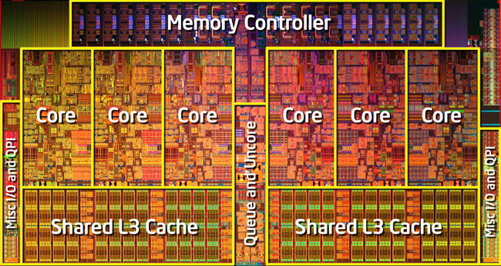
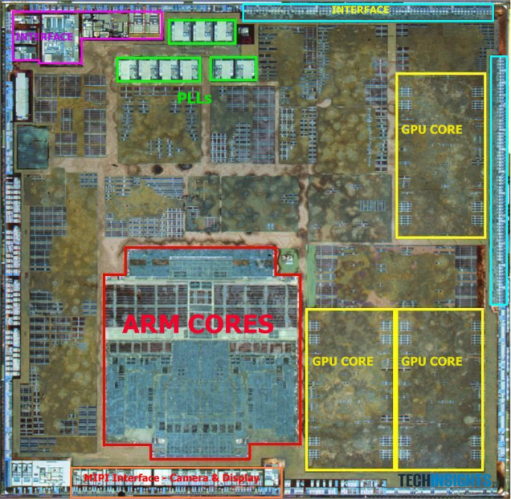
Silver Bullets for the Energy Crisis?
Parallelism
Specialization, heterogeneity, …
BUT large impact on
Software
Hardware
Hardware-Software Interface

Slide 3
Multicore Parallelism: Current Practice
Multicore parallelism today: shared-memory
Complexity-, power-, and performance-inefficient hardware
Complex directory coherence, unnecessary traffic, ...
Difficult programming model
Data races, non-determinism, composability?, testing?
Mismatched interface between HW and SW, a.k.a memory model
Can’t specify “what value can read return”
Data races defy acceptable semantics
Fundamentally broken for hardware & software

Slide 4
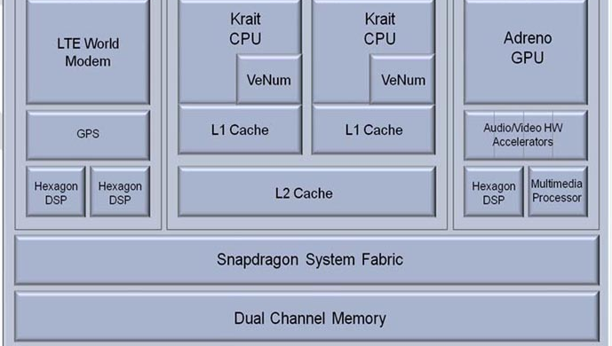
Specialization/Heterogeneity: Current Practice
A modern smartphone
CPU, GPU, DSP, Vector Units, Multimedia, Audio-Video accelerators
6 different ISAs
Even more broken
Incompatible
memory systems
7 different parallelism models

Slide 5
Energy Crisis Demands Rethinking HW, SW
How to (co-)design
Software?
Hardware?
HW / SW Interface?
Deterministic Parallel Java (DPJ)
DeNovo
Virtual Instruction Set Computing (VISC)
Other implications of energy crisis (another talk)
SWAT: SoftWare Anomaly Treatment
A software-driven approach to hardware reliability

Slide 6
Memory Hierarchy Inefficiencies
Caches: SW-oblivious
Power: TLB/Tags
Cache lines sub-optimal
Scratchpads, FIFOs, …
Explicit data movement
Complex protocols
Directory storage
Traffic: Invalidation, Acks, …
Cache lines ⇒ false sharing
Coherence & Consistency
Storage
Communication
Indirection through directory
Cache lines sub-optimal
Complexity-, power-, and performance-inefficient hardware

Slide 7
Memory Hierarchy Inefficiencies
Caches: SW-oblivious
Power: TLB/Tags
Cache lines sub-optimal
Scratchpads, FIFOs, …
Explicit data movement
Complex protocols
Directory storage
Traffic: Invalidation, Acks, …
Cache lines ⇒ false sharing
Banish shared memory?
Coherence & Consistency
Storage
Communication
Indirection through directory
Cache lines sub-optimal
Complexity-, power-, and performance-inefficient hardware

Slide 8
Memory Hierarchy Inefficiencies
Caches: SW-oblivious
Power: TLB/Tags
Cache lines sub-optimal
Scratchpads, FIFOs, …
Explicit data movement
Complex protocols
Directory storage
Traffic: Invalidation, Acks, …
Cache lines ⇒ false sharing
Banish wild shared memory!
Coherence & Consistency
Storage
Need disciplined shared memory!
Communication
Indirection through directory
Cache lines sub-optimal
Complexity-, power-, and performance-inefficient hardware

Slide 9
What is Shared-Memory?
Coherence
Storage
Shared-Memory =
Global address space
+
Implicit, anywhere communication, synchronization
Comm

Slide 10
What is Shared-Memory?
Coherence
Storage
Shared-Memory =
Global address space
+
Implicit, anywhere communication, synchronization
Comm

Slide 11
What is Shared-Memory?
Coherence
Storage
Wild Shared-Memory =
Global address space
+
Implicit, anywhere communication, synchronization
Comm

Slide 12
What is Shared-Memory?
Coherence
Storage
Wild Shared-Memory =
Global address space
+
Implicit, anywhere communication, synchronization
Comm

Slide 13
What is Shared-Memory?
Coherence
Storage
Disciplined Shared-Memory =
Global address space
+
Implicit, anywhere communication, synchronization
Explicit, structured side-effects
Comm
How to build disciplined shared-memory software?
If software is more disciplined, can hardware be more efficient?

Slide 14
The DeNovo Approach
Software
DPJ: Determinism
OOPSLA’09
Disciplined non-determinism
POPL’11
Unstructured synchronization
⇒ OS, Legacy
Coherence
Storage
Hardware
DeNovo: Coherence, Comm
PACT’11 best paper, TACO’14
DeNovoND
ASPLOS’13, Top picks’14
DeNovoSync (in review)
Comm
DeNovoH for heterogeneous systems: Coherence, Comm, Storage
Stash: Have your scratchpad and cache it too (in review)

Slide 15
Coherence/Communication Inefficiencies
Complexity
Subtle races and numerous transient states in the protocol
Hard to verify and extend for optimizations
Storage overhead
Directory overhead for sharer lists
Performance and power inefficiencies
Invalidation, ack messages
Indirection through directory
False sharing (cache-line based coherence)
Network traffic (cache-line based communication)

Slide 16
Results for Deterministic Codes
Complexity
No transient states
Simple to extend for optimizations
Storage overhead
Directory overhead for sharer lists
Performance and power inefficiencies
Invalidation, ack messages
Indirection through directory
False sharing (cache-line based coherence)
Network traffic (cache-line based communication)
Base DeNovo
20X faster to verify vs. MESI

Slide 17
Results for Deterministic Codes
Complexity
No transient states
Simple to extend for optimizations
Storage overhead
No storage overhead for directory information
Performance and power inefficiencies
Invalidation, ack messages
Indirection through directory
False sharing (cache-line based coherence)
Network traffic (cache-line based communication)
Base DeNovo
20X faster to verify vs. MESI

Slide 18
Results for Deterministic Codes
Complexity
No transient states
Simple to extend for optimizations
Storage overhead
No storage overhead for directory information
Performance and power inefficiencies
No invalidation, ack messages
No indirection through directory
No false sharing: region based coherence
Base DeNovo
20X faster to verify vs. MESI
Up to 77% lower memory stall time
Up to 71% lower traffic

Slide 19
Deterministic Parallel Java (DPJ) Overview
Structured parallel control
Fork-join parallelism
Region: name for set of memory locations
Assign region to each field, array cell
Effect: read or write on a region
Summarize effects of method bodies
Compiler: simple type check
Region types consistent
Effect summaries correct
Parallel tasks don’t interfere (race-free)
LD
ST
ST
ST
ST
heap
Type-checked programs guaranteed determinism (sequential semantics)

Slide 20
Memory Consistency Model
Guaranteed determinism ⇒ Read returns value of last write in sequential order
Same task in this parallel phase
Or before this parallel phase
Coherence
Mechanism
ST 0xa
ST 0xa
Parallel
Phase
LD 0xa

Slide 21
Cache Coherence
Coherence Enforcement
Invalidate stale copies in caches
Track one up-to-date copy
Explicit effects
Compiler knows all writeable regions in this parallel phase
Cache can self-invalidate before next parallel phase
Invalidates data in writeable regions not accessed by itself
Registration
Directory keeps track of one up-to-date copy
Writer updates before next parallel phase

Slide 22
Basic DeNovo Coherence [PACT’11]
Assume (for now): Private L1, shared L2; single word line
Data-race freedom at word granularity
No transient states
No invalidation traffic, no false sharing
No directory storage overhead
L2 data arrays double as directory
Keep valid data or registered core id
Touched bit: set if word read in the phase
Read
Invalid
Read
Valid
Write
Write
Registered
Read, Write
registry

Slide 23
Example Run
class S_type {
X in DeNovo-region ;
Y in DeNovo-region ;
}
S _type S[size];
...
Phase1 writes { // DeNovo effect
foreach i in 0, size {
S[i].X = …;
}
self_invalidate( );
}
L1 of Core 1
L1 of Core 2
R | X₀ | V | Y₀
R | X₁ | V | Y₁
R | X₂ | V | Y₂
V | X₃ | V | Y₃
V | X₄ | V | Y₄
V | X₅ | V | Y₅
R | X₀ | V | Y₀
R | X₁ | V | Y₁
R | X₂ | V | Y₂
I | X₃ | V | Y₃
I | X₄ | V | Y₄
I | X₅ | V | Y₅
V | X₀ | V | Y₀
V | X₁ | V | Y₁
V | X₂ | V | Y₂
V | X₃ | V | Y₃
V | X₄ | V | Y₄
V | X₅ | V | Y₅
I | X₀ | V | Y₀
I | X₁ | V | Y₁
I | X₂ | V | Y₂
R | X₃ | V | Y₃
R | X₄ | V | Y₄
R | X₅ | V | Y₅
V | X₀ | V | Y₀
V | X₁ | V | Y₁
V | X₂ | V | Y₂
V | X₃ | V | Y₃
V | X₄ | V | Y₄
V | X₅ | V | Y₅
V | X₀ | V | Y₀
V | X₁ | V | Y₁
V | X₂ | V | Y₂
R | X₃ | V | Y₃
R | X₄ | V | Y₄
R | X₅ | V | Y₅
Registration
Registration
Shared L2
R | C1 | V | Y₀
R | C1 | V | Y₁
R | C1 | V | Y₂
R | C2 | V | Y₃
R | C2 | V | Y₄
R | C2 | V | Y₅
Ack
V | X₀ | V | Y₀
V | X₁ | V | Y₁
V | X₂ | V | Y₂
V | X₃ | V | Y₃
V | X₄ | V | Y₄
V | X₅ | V | Y₅
Ack
R = Registered
V = Valid
I = Invalid

Slide 24
Decoupling Coherence and Tag Granularity
Basic protocol has tag per word
DeNovo Line-based protocol
Allocation/Transfer granularity > Coherence granularity
Allocate, transfer cache line at a time
Coherence granularity still at word
No word-level false-sharing
“Line Merging”
Cache
Tag
 |  | V |  |  | V | R
V | V |  |  |  |  |  | V

Slide 25
Current Hardware Limitations
Complexity
Subtle races and numerous transient sates in the protocol
Hard to extend for optimizations
Storage overhead
Directory overhead for sharer lists (makes up for new bits at ~20 cores)
Performance and power inefficiencies
Invalidation, ack messages
Indirection through directory
False sharing (cache-line based coherence)
Network traffic (cache-line based communication)
✔
✔
✔
✔

Slide 26
Flexible, Direct Communication
Insights
1. Traditional directory must be updated at every transfer
DeNovo can copy valid data around freely
2. Traditional systems send cache line at a time
DeNovo uses regions to transfer only relevant data
Effect of AoS-to-SoA transformation w/o programmer/compiler

Slide 27
Flexible, Direct Communication
L1 of Core 1
L1 of Core 2
…
…
R | X₀ | V | Y₀ | V | Z₀
R | X₁ | V | Y₁ | V | Z₁
R | X₂ | V | Y₂ | V | Z₂
I | X₃ | V | Y₃ | V | Z₃
I | X₄ | V | Y₄ | V | Z₄
I | X₅ | V | Y₅ | V | Z₅
I | X₀ | V | Y₀ | V | Z₀
I | X₁ | V | Y₁ | V | Z₁
I | X₂ | V | Y₂ | V | Z₂
R | X₃ | V | Y₃ | V | Z₃
R | X₄ | V | Y₄ | V | Z₄
R | X₅ | V | Y₅ | V | Z₅
X₃
Y₃
Z₃
…
LD X₃
Shared L2
…
…
R | C1 | V | Y₀ | V | Z₀
R | C1 | V | Y₁ | V | Z₁
R | C1 | V | Y₂ | V | Z₂
R | C2 | V | Y₃ | V | Z₃
R | C2 | V | Y₄ | V | Z₄
R | C2 | V | Y₅ | V | Z₅
Registered
Valid
Invalid
…

Slide 28
Flexible, Direct Communication
Flexible, Direct Communication
L1 of Core 1
L1 of Core 2
…
…
R | X₀ | V | Y₀ | V | Z₀
R | X₁ | V | Y₁ | V | Z₁
R | X₂ | V | Y₂ | V | Z₂
V | X₃ | V | Y₃ | V | Z₃
V | X₄ | V | Y₄ | V | Z₄
V | X₅ | V | Y₅ | V | Z₅
R | X₀ | V | Y₀ | V | Z₀
R | X₁ | V | Y₁ | V | Z₁
R | X₂ | V | Y₂ | V | Z₂
I | X₃ | V | Y₃ | V | Z₃
I | X₄ | V | Y₄ | V | Z₄
I | X₅ | V | Y₅ | V | Z₅
I | X₀ | V | Y₀ | V | Z₀
I | X₁ | V | Y₁ | V | Z₁
I | X₂ | V | Y₂ | V | Z₂
R | X₃ | V | Y₃ | V | Z₃
R | X₄ | V | Y₄ | V | Z₄
R | X₅ | V | Y₅ | V | Z₅
X₃
LD X₃
X₄
…
X₅
…
Shared L2
…
R | C1 | V | Y₀ | V | Z₀
R | C1 | V | Y₁ | V | Z₁
R | C1 | V | Y₂ | V | Z₂
R | C2 | V | Y₃ | V | Z₃
R | C2 | V | Y₄ | V | Z₄
R | C2 | V | Y₅ | V | Z₅
Registered
Valid
Invalid
…

Slide 29
Current Hardware Limitations
Complexity
Subtle races and numerous transient sates in the protocol
Hard to extend for optimizations
Storage overhead
Directory overhead for sharer lists (makes up for new bits at ~20 cores)
Performance and power inefficiencies
Invalidation, ack messages
Indirection through directory
False sharing (cache-line based coherence)
Network traffic (cache-line based communication)
✔
✔
✔
✔
✔
✔
✔

Slide 30
Evaluation
Verification: DeNovo vs. MESI word w/ Murphi model checker
Correctness
Six bugs in MESI protocol: Difficult to find and fix
Three bugs in DeNovo protocol: Simple to fix
Complexity
15x fewer reachable states for DeNovo
20x difference in the runtime
Performance: Simics + GEMS + Garnet
64 cores, simple in-order core model
Workloads
FFT, LU, Barnes-Hut, and radix from SPLASH-2
bodytrack and fluidanimate from PARSEC 2.1
kd-Tree (two versions) [HPG 09]

Slide 31
Memory Stall Time for MESI vs. DeNovo
M=MESI D=DeNovo Dopt=DeNovo+Opt
FFT
LU
Barnes-Hut
kd-false
kd-padded
bodytrack
fluidanimate
radix
DeNovo is comparable to or better than MESI
DeNovo + opts shows 32% lower memory stalls vs. MESI (max 77%)

Slide 32
Network Traffic for MESI vs. DeNovo
M=MESI D=DeNovo Dopt=DeNovo+Opt
FFT
LU
Barnes-Hut
kd-false
kd-padded
bodytrack
fluidanimate
radix
DeNovo has 36% less traffic than MESI (max 71%)

Slide 33
The DeNovo Approach
Software
DPJ: Determinism
OOPSLA’09
Disciplined non-determinism
POPL’11
Unstructured synchronization
⇒ OS, Legacy
Coherence
Storage
Hardware
DeNovo: Coherence, Comm
PACT’11 best paper, TACO’14
DeNovoND
ASPLOS’13, Top picks’14
DeNovoSync (in review)
Comm
DeNovoH for heterogeneous systems: Coherence, Comm, Storage
Stash: Have your scratchpad and cache it too (in review)

Slide 34
DPJ Support for Disciplined Non-Determinism
Non-determinism comes from conflicting concurrent accesses
Isolate interfering accesses as atomic
Enclosed in atomic sections
Atomic regions and effects
Disciplined non-determinism
Race freedom, strong isolation
Determinism-by-default semantics
DeNovoND converts atomic statements into locks
.
.
.
LD
ST
.
.
.

Slide 35
Memory Consistency Model
Non-deterministic read returns value of last write from
Before this parallel phase
Or same task in this phase
Or in preceding critical section of same lock
self-invalidations as before
single core
.
.
.
ST 0xa
ST 0xa
Parallel
Phase
Critical
Section
LD 0xa
.
.

Slide 36
Coherence for Non-Deterministic Data
Coherence Enforcement
Invalidate stale copies in private cache
Track up-to-date copy
When to invalidate?
Between start of critical section and read
What to invalidate?
Regions with “atomic” effects written in preceding critical sections
Track writes w/ small (256b) Bloom filter signature, Xfer with lock
Registration
Writer updates registry before next critical section

Slide 37
Evaluation of MESI vs. DeNovoND (16 cores)
DeNovoND execution time comparable or better than MESI
DeNovoND has 33% less traffic than MESI (67% max)
No invalidation traffic
Reduced load misses due to lack of false sharing

Slide 38
The DeNovo Approach
Software
DPJ: Determinism
OOPSLA’09
Disciplined non-determinism
POPL’11
Unstructured synchronization
⇒ OS, Legacy
Coherence
Storage
Hardware
DeNovo: Coherence, Comm
PACT’11 best paper, TACO’14
DeNovoND
ASPLOS’13, Top picks’14
DeNovoSync (in review)
Comm
DeNovoH for heterogeneous systems: Coherence, Comm, Storage
Stash: Have your scratchpad and cache it too (in review)

Slide 39
Unstructured Synchronization
Many programs use arbitrary, unstructured synchronization
Michael-Scott non-blocking queue
void queue.enqueue(value v):
node *w := new node(v, null)
ptr t, n
loop
t := tail
n := t->next
if t == tail
if n == null
if (CAS(&t->next, n, w)) break;
else CAS(&tail, t, n)
CAS(&tail, t, w)
New node
to be inserted
Synchronization
Reads to
tail and tail->next
CAS to
tail and tail->next
Accesses to data still ordered by synchronization (data-race-free)
Can use static self-invalidation or signatures
But what about synchronization accesses?

Slide 40
Unstructured Synchronization
Problem: Synchronization accesses are inherently racy
Rely on writer-initiated invalidations
Reader-initiated invalidations
What to invalidate, when to invalidate?
Every read?
Every read to non-registered state
Register all sync reads (to enable future hits)
Concurrent readers?
Back off (delay) read registration
.
.
.
CAS
LD
ST
LD
.
.
.
ST
REL
LD
CAS

Slide 41
Unstructured Synch: Execution Time on 64 Cores
DeNovoSync reduces execution time by 28% over MESI (max 49%)
MESI’s high invalidation overhead vs.
DeNovo’s fast point-to-point registration transfer

Slide 42
Unstructured Synch: Network Traffic on 64 Cores
DeNovo reduces traffic by 44% vs. MESI (max 61%) for 11 of 12 cases
Centralized barrier
Many concurrent readers hurt DeNovo (and MESI)
Should use tree barrier even with MESI

Slide 43
The DeNovo Approach
Software
DPJ: Determinism
OOPSLA’09
Disciplined non-determinism
POPL’11
Unstructured synchronization
⇒ OS, Legacy
Coherence
Storage
Hardware
DeNovo: Coherence, Comm
PACT’11 best paper
DeNovoND
ASPLOS’13, Top picks’14
DeNovoSync (in review)
Comm
DeNovoH for heterogeneous systems: Coherence, Comm, Storage
Stash: Have your scratchpad and cache it too (in review)

Slide 44
Conclusions and Future Work
DeNovo rethinks memory hierarchy
for disciplined models
For deterministic codes
Complexity: no transients, 20X faster to verify, extensible
Storage overhead: no directory overhead
Performance, power: No inv/acks, false sharing, indirection, …
Up to 77% lower memory stall time, up to 71% lower traffic
Benefits even for non-determinism and unstructured synchs
Future
Run full OS, legacy codes
Heterogeneous memory structures and consistency models
Virtual ISA for heterogeneous systems
Coherence
Storage
Comm

