Slide 1
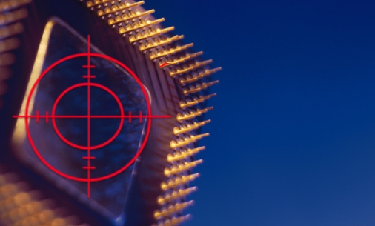
Hardware Fault Recovery for I/O Intensive Applications
Pradeep Ramachandran, Intel Corporation,
Siva Kumar Sastry Hari, NVDIA
Manlap (Alex) Li, Latham and Watkins LLP
Sarita V. Adve, University of Illinois at Urbana Champaign
*This work was done when Pradeep, Siva, and Alex were
at the University of Illinois at Urbana Champaign

Slide 2
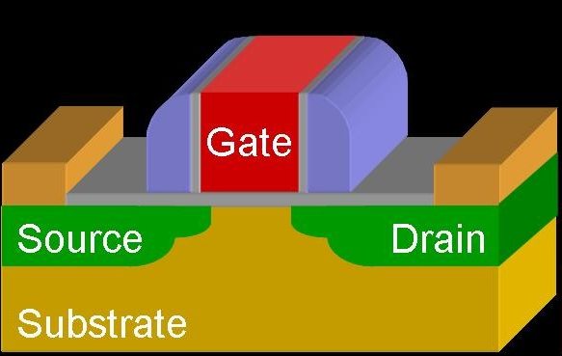
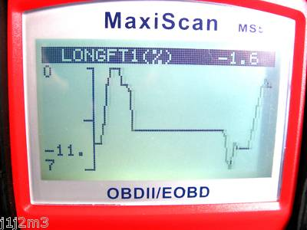
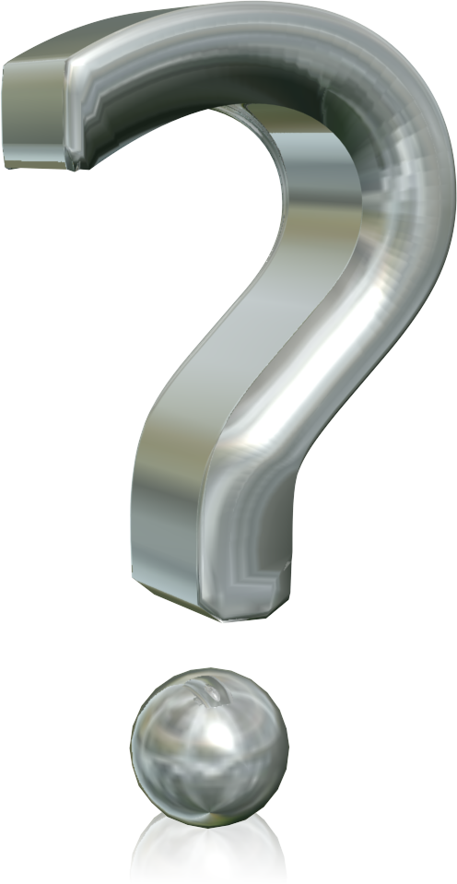
Battling the Dark Side of Moore’s Law
Hardware will fail in the field for a variety of reasons
Need in-the-field solutions for detection, diagnosis, and recovery
Must incur low-cost => traditional redundancy solutions too expensive!
SWAT: A low-cost solution to handle unreliable HW
Key: Handle only HW faults that affect SW, near-zero impact to fault-free exec
Detect faults with near-zero cost monitors for SW anomaly, smart HW recovery
This paper: A closer look at fault recovery with low-cost detection
Wear-out failures
(Devices are weaker)
Transient errors
(High-energy particles )
Intermittent
fault
… and so on

Slide 3
Components of SWAT
Detection: Low-cost monitors for anomalous SW behavior
E.g., fatal traps from protection violation, div by zero [ASPLOS’08, DSN‘08, ASPLOS‘12]
Diagnosis: Identifies faulty core, uarch block [DSN‘08, MICRO’09]
Recovery w/o IO: Leverage existing sol for core/mem chkpt, rollback
Recovery with IO not handled; also ignored by most other prior work
Intricate relationship between detection and recovery not considered
Checkpoint interval = maximum detection latency
Chkpt
Symptom
detection
Recovery
Chkpt
Fault
Error
Diagnosis

Slide 4
Contributions of This Paper
HW technique for fault recovery in the presence of external IOs
Existing recovery solutions mostly ignore the “output commit” problem
Low overhead to fault-free exec ⇒ detection latency <100K instructions
New definition of detection latency to be more relevant to recovery
@100K instructions, only 80% of faults detected with existing definition!
Existing definition conservative ⇒ high-overhead to fault-free execution
Combined evaluation of low-cost fault detection & recovery solution
SWAT recovers the system for 94% of injected faults @ 100K instr, 0.2% SDC rate

Slide 5
Agenda
Motivation and Contributions
Recovery in the presence of external IO
A new definition of detection latency
Combined evaluation of detection and recovery
Conclusions

Slide 6


Output Buffering
External outputs need to be delayed until guaranteed to be fault-free
Once committed, they cannot be rolled-back
Previous solution: Buffer outputs in dedicated SW [Revive I/O]
No HW changes, exploit semantics of SW-level output for efficiency
Outputs vulnerable as buffering SW runs on faulty HW
Our solution: Buffer external outputs in dedicated HW
SW output maps to multiple dependent HW stores ⇒ potentially high overheads
Solution should require no changes to device HW
Buffered outputs should not be vulnerable to HW faults
Notes:
Don’t say anything about challenges. These are just key questions that need to be answered here

Slide 7
Architecture of HW Output Buffer
CPU communicates with devices through I/O loads & stores
HW buffer buffers outputs until next checkpoint or IO fence
Committed outputs verified fault-free and drained in parallel to regular execution
Buffered outputs protected through ECC checks
Special handling during DMA transfer to device to protect output while draining
CPU-centric implementation with no changes to IO devices
Memory
Bus
Memory
$
CPU
Device
OUTPUT
BUFFER
Device
Device
IO Bus

Slide 8
Operations of HW Output Buffer
Fault-free Operation
Outputs verified as fault-free at second subsequent checkpoint
Recovery Operation
Determined by
Maximum Detection latency
Dev
St 1
Dev
St 2
Dev
St 3
Drain Stores
in background
St 1
Buffer Stores
to Devices
St 2
Fault
Detection
Dev
St 1
Dev
St 2
Dev
St 3
Buffer
Buffer
Rollback Arch state
St 1
St 1
Discard st3
St 2
St 2
Continue execution from this point
Restore Devices
Notes:
Rely on the fact that device outputs are idempotent

Slide 9
Measuring Fault-free Overheads
Buffering outputs imparts overheads to fault-free execution
Outputs to clients delayed ⇒ performance overhead
HW to store buffered outputs ⇒ area overhead
Simulated a fault-free client-server system to measure overheads
Focused on I/O intensive workloads to study fault free overheads
sshd, apache, mysql, squid w/ multiple request and server threads
SIMICS full-system simulator
Simulated Server
Simulated Client
HW
Output
Buffer
CPU
CPU
Network
Devices
Latency = 0.1ms
Devices

Slide 10
Performance Overhead from Output Buffering
Chkpt interval of 1M inst (~1ms) => perf impact of 5X! Grows with chkpt interval!
Practical chkpt interval <100K inst (~100us); perf overhead of <5% on fault-free exec
Notes:
Remember that here there is no opal/ruby. Practicality of this is limited.

Slide 11
Connecting Detection and Recovery
Checkpoint interval determined by maximum detection latency
Recovery results ⇒ checkpoint interval ≤100K instructions
<5% performance overhead, <2KB area overhead
SWAT detection results ⇒ only 80% detected in 100K instructions
Need to reduce latency to enable practical solution
Shortcoming identified only when components combined, ignored in prior work
Strategy
New low-cost HW detector for out-of-bounds accesses (details in paper)
Re-look at detection latency for recovery; previous definitions too conservative

Slide 12
Agenda
Motivation and Contributions
Recovery in the presence of external IO
A new definition of detection latency
Combined evaluation of detection and recovery
Conclusions

Slide 13
A New Definition for Detection Latency
Traditional def: Hard latency = arch state corruption to detection
But do all faults that corrupt arch state make system unrecoverable?
Key observation: Software may tolerate some corruptions!
E.g., a used only for a>0 changes from 5 to 10
New definition: Soft latency = SW state corruption to detection
Checkpoint interval should be based on new definition
Fault
Bad arch state
Bad SW state
Detection
Recoverable
chkpt
Recoverable
chkpt
Hard latency
Soft Latency
Notes:
Although our evaluation of new latency is using periodic rollbacks, a real system does not have to do this.

Slide 14
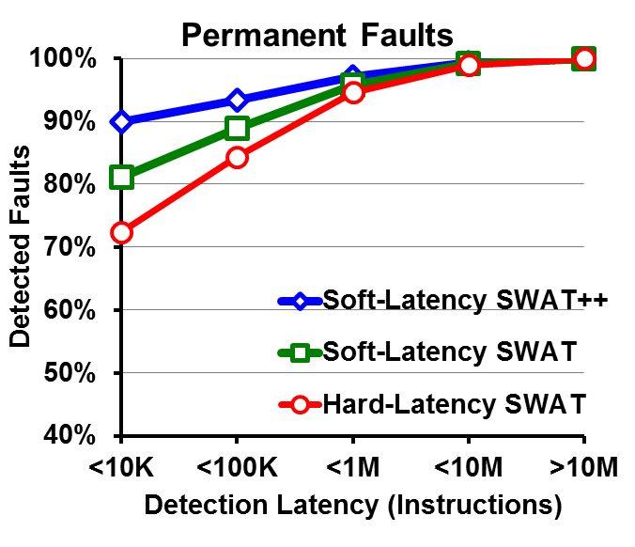
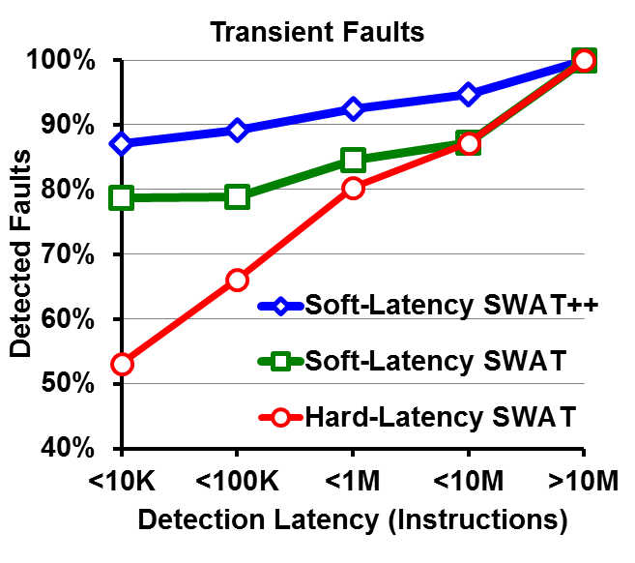
Hard-Latency vs Soft-Latency to Determine Checkpoint Interval
For any targeted detection rate, detection latency w/ Hard-latency >> w/ Soft-latency
⇒ Hard-latency may result in unnecessarily high chkpt intervals, high overheads

Slide 15
Agenda
Motivation and Contributions
Recovery in the presence of external IO
A new definition of detection latency
Combined evaluation of detection and recovery
Conclusions

Slide 16
Evaluating SWAT Detection + Recovery with IO Devices
µarch-level fault injections into simulated server CPU
Focused on server workloads due to heavy I/O
Detection: Simulate faults for 10M instructions with SWAT detectors
Recovery: Restore system after detection with different chkpt intervals
Rollback CPU & memory, restore devices, replay buffer outputs
SIMICS full-system simulator
Fault
Simulated Server
Simulated Client
HW
Output
Buffer
CPU
CPU
Network
Devices
Latency = 0.1ms
Devices
Notes:
Mention how we can implement device restoration and how we do it in our implementation. Should we instead put a separate slide for this?

Slide 17
SWAT Detection + Recovery Results
94% of faults detected and recovered at chkpt interval of 100K instructions
Only 44/18,000 injected faults (0.2%) cause Silent Data Corruptions (SDCs)

Slide 18
Conclusions
Key challenge: Low-cost solution for reliable exec on unreliable HW
Emerging low-cost sol. for detection, recovery, diagnosis, like SWAT
But recovery in the presence of IO ignored ⇒ limited applicability
This paper presents
Low-cost HW solution for recovery with IO; <5% perf, <2KB area overhead
New definition of detection latency that reduces overheads to fault-free exec
Eval of detection + recovery; only 0.2% of faults cause SDC @ above overheads
On-going work: Eliminate SDCs by leveraging application properties

Slide 19
Hardware Fault Recovery for I/O Intensive Applications
Pradeep Ramachandran, Intel Corporation
Siva Kumar Sastry Hari, NVDIA
Manlap (Alex) Li, Latham and Watkins LLP
Sarita V. Adve, University of Illinois at Urbana Champaign
*This work was done when Pradeep, Siva, and Alex were
at the University of Illinois at Urbana Champaign

Slide 20
backup

Slide 21
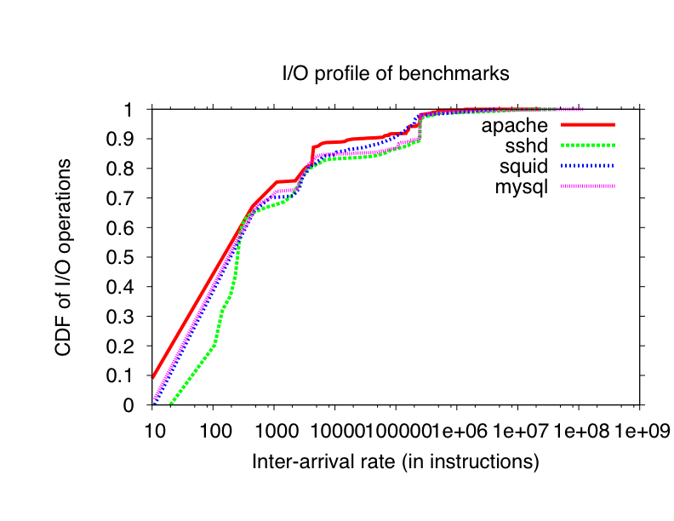
I/O Characteristics of Server Workloads
Application | Data Transferred | Average Rate | % I/O wait
apache | 38MB | 9.5MBps | 76.5%
sshd | 19MB | 2.5MBps | 24.3%
squid | 20MB | 11.6MBps | 69.5%
mysql | 7.5MBps | 1.05MBps | 71.1%

Slide 22
Importance of I/O for Fault Recovery
No device recovery, output buffering reduces recoverability by 89%

Slide 23
Measuring Soft Latency vs Hard Latency
Identify uarch state corruption easy ⇒ hard latency easily measurable
Measuring soft latency ⇒ need to identify when SW state is corrupted
But identifying SW state corruption is hard!
Need to know how faulty value used by application, and if it affects output
Measure soft latency by rolling back to older checkpoints
Only for analysis, not required in reality
Fault
Bad arch state
Bad SW state
Detection
Chkpt
Chkpt
Symptom
Rollback &
Replay
Fault effect
masked
Rollback &
Replay
Soft latency

