Slide 1
Approximate Computing: (Old) Hype or New Frontier?
Sarita Adve
University of Illinois, EPFL
Acks: Vikram Adve, Siva Hari, Man-Lap Li, Abdulrahman Mahmoud, Helia Naemi, Pradeep Ramachandran, Swarup Sahoo, Radha Venkatagiri, Yuanyuan Zhou

Slide 2
What is Approximate Computing?
Trading output quality for resource management?
Exploiting applications’ inherent ability to tolerate errors?
Old?
GRACE [2000-05] rsim.cs.illinois.edu/grace
SWAT [2006- ] rsim.cs.illinois.edu/swat
Many others
Or something new?
Approximate computing through the lens of hardware resiliency …

Slide 3
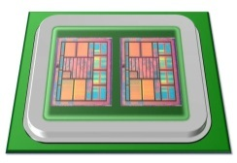
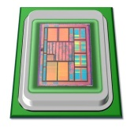
Motivation
Overhead (perf., power, area)
Redundancy
Goal: High reliability at low-cost
Reliability

Slide 4
SWAT: A Low-Cost Reliability Solution
Need handle only hardware faults that affect software
⇒ Watch for software anomalies (symptoms)
Zero to low overhead “always-on” monitors
Diagnose cause after anomaly detected and recover
May incur high overhead, but invoked infrequently
⇒ SWAT: SoftWare Anomaly Treatment

Slide 5
SWAT Framework Components
Detection: Monitor symptoms of software misbehavior
Diagnosis: Rollback/replay on multicore
Recovery: Checkpoint/rollback or app-specific action on acceptable errors
Repair/reconfiguration: Redundant, reconfigurable hardware
Flexible control through firmware
Checkpoint
Checkpoint
Fault
Error
Anomaly
detected
Recovery
Diagnosis
Repair

Slide 6
SWAT Framework Components
Detection: Monitor symptoms of software misbehavior
Diagnosis: Rollback/replay on multicore
Recovery: Checkpoint/rollback or app-specific action on acceptable errors
Repair/reconfiguration: Redundant, reconfigurable hardware
Flexible control through firmware
Checkpoint
Checkpoint
How to bound silent (escaped) errors?
When is an error acceptable (at some utility) or unacceptable?
How to trade silent errors with resources?
How to associate recovery actions with errors?
Fault
Error
Anomaly
detected
Recovery
Diagnosis
Repair

Slide 7
Advantages of SWAT
Handles only errors that matter
Oblivious to masked error, low-level failure modes, software-tolerated errors
Low, amortized overheads
Optimize for common case, exploit software reliability solutions
Customizable and flexible
Firmware control can adapt to specific reliability needs
Holistic systems view enables novel solutions
Software-centric synergistic detection, diagnosis, recovery solutions
Beyond hardware reliability
Long term goal: unified system (HW+SW) reliability
Systematic trade off between resource usage, quality, reliability

Slide 8
SWAT Contributions (for in-core hw faults)
Fault Detection
Very low cost detectors [ASPLOS’08, DSN’08]
Bound silent errors [ASPLOS’12, DSN’12]
Identify error outcomes: Relyzer, GangES [ISCA’14]
Fault Recovery
Handling I/O [TACO’15]
Chkpt
Fault
Error
Symptom
detected
Recovery
Chkpt
Error modeling
SWAT-Sim [HPCA’09]
FPGA-based [DATE’12]
Diagnosis
Repair
In-situ Diagnosis [DSN’08]
Trace-based µarch diagnosis
mSWAT [MICRO’09]
Multicore detection & diagnosis
Complete solution for in-core faults, evaluated for variety of workloads

Slide 9
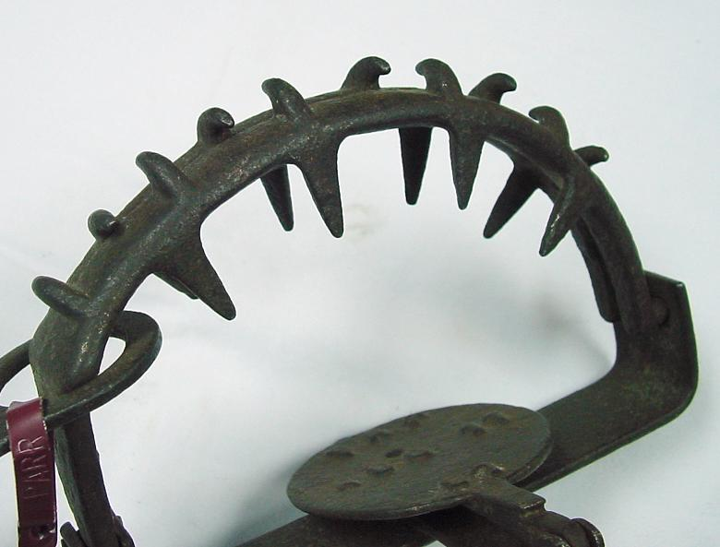




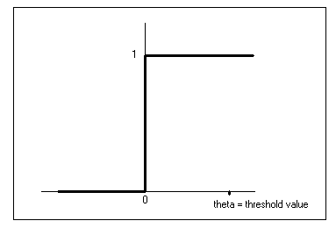
SWAT Fault Detection
Simple monitors observe anomalous SW behavior [ASPLOS’08, MICRO’09]
Very low hardware area, performance overhead
Fatal Traps
Hangs
Kernel Panic
High OS
App Abort
Out of Bounds
Division by zero,
RED state, etc.
Simple HW hang
detector
OS enters panic
state due to fault
High contiguous
OS activity
App abort due
to fault
Flag illegal addresses
SWAT firmware

Slide 10
Evaluating SWAT Detectors So Far
Full-system simulation with out-of-order processor
Simics functional + GEMS timing simulator
Single core, multicore, distributed client-server
Apps: Multimedia, I/O intensive, & compute intensive
Errors injected at different points in app execution
µarch-level error injections (single error model)
Stuck-at, transient errors in latches of 8 µarch units
~48,000 total errors

Slide 11
Error Outcomes
Transient error
.
.
.
.
.
.
.
.
.
APPLICATION
APPLICATION
APPLICATION
Symptom
Output
Output
Output
Output
Symptom detectors (SWAT):
Fatal traps, kernel panic, etc.
Masked
Detection
Silent Data Corruption (SDC)
Acceptable Unacceptable
(w/ some quality)

Slide 12
SWAT SDC Rates
SWAT detectors effective
<0.2% of injected µarch errors give unacceptable SDCs (109/48,000 total)
BUT hard to sell empirically validated, rarely incorrect systems

Slide 13
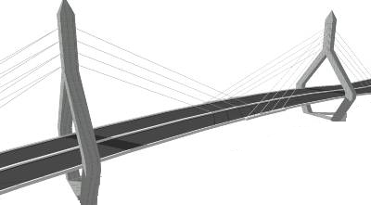
Challenges
Goals:
Full reliability at low-cost
Accurate reliability evaluation
Tunable reliability vs. quality vs. overhead
Redundancy
Overhead (perf., power, area)
How?
Very high
reliability at low-cost
Tunable
reliability
SWAT
Reliability

Slide 14
Research Strategy
Towards an Application Resiliency Profile
For a given instruction what is the outcome of an error?
For now, focus on a transient error in single bit of register
Convert SDCs into (low-cost) detections for full reliability and quality
OR let some acceptable or unacceptable SDCs escape
Quantitative tuning of reliability vs. overhead vs. quality

Slide 15
Challenges and Approach
Determine error outcomes for all application-sites
Cost-effectively convert (some) SDCs to Detections
How?
Complete app
resiliency evaluation
Impractical, too many injections
>1,000 compute-years for one app
.
.
APPLICATION
Challenge: Analyze all errors with few injections
Output
How?
SDC-causing
error
.
.
.
APPLICATION
Error Detection
APPLICATION
Challenges:
What to use?
Where to place?
How to tune?
Error Detectors
Output

Slide 16
Relyzer: Application Resiliency Analyzer [ASPLOS’12]
Pilots
Equivalence Classes
Relyzer
Prune error sites
Application-level
error (outcome) equivalence
Predict error outcome if possible
Inject errors for remaining sites
.
.
.
.
.
APPLICATION
APPLICATION
Output
Output
Can list virtually all SDC-causing instructions

Slide 17
Def to First-Use Equivalence
Fault in first use is equivalent to fault in def ⇒ prune def
r1 = r2 + r3
r4 = r1 + r5
…
If there is no first use, then def is dead ⇒ prune def
Def
First use

Slide 18
Control Flow Equivalence
Insight: Errors flowing through similar control paths may behave similarly
CFG
X
Errors in X that take path behave similarly
Heuristic: Use direction of next 5 branches

Slide 19
Store Equivalence
Insight: Errors in stores may be similar if stored values are used similarly
Heuristic to determine similar use of values:
Same number of loads use the value
Loads are from same PCs
PC
PC1
PC2
Instance 1
Load
Load
Store
Memory
Instance 2
Load
Load
Store
PC
PC1
PC2

Slide 20
Relyzer
Relyzer: A tool for complete application resiliency analysis
Employs systematic error pruning using static & dynamic analysis
Currently lists outcomes of masked, detection, SDC
3 to 6 orders of magnitude fewer error injections for most apps
99.78% error sites pruned, only 0.004% sites represent 99% of all sites
GangES speeds up error simulations even further [ISCA’14]
Can identify virtually all SDC causing error sites
What about unacceptable vs. acceptable SDC? Ongoing
.
.
Relyzer
.
.
APPLICATION
APPLICATION
Output
Output

Slide 21
Can Relyzer Predict if SDC is Acceptable?
Equivalence
Classes
Pilots
Pilot = Acceptable SDC ⇒
All faults in class = Acceptable SDCs ???
Pilot = Acceptable SDC with quality Q ⇒
All faults in class = Acceptable SDCs with quality Q ???

Slide 22
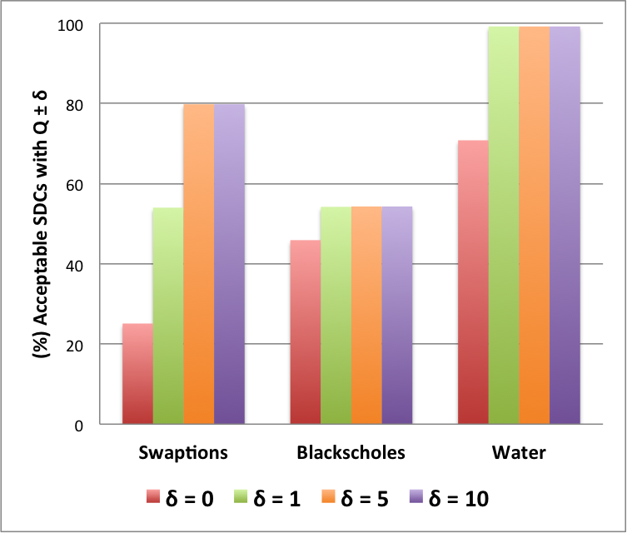
PRELIMINARY Results for Utility Validation
Pilot = Acceptable SDC with quality Q ⇒
All faults in class = Acceptable SDCs with quality Q ???
Studied several quality metrics
E.g., E = abs(percentage average relative error in output components),
capped to 100%
Q = 100 - ⎡E⎤ (> 100% error gives Q=0, 1% gives Q=99)
± δ

Slide 23
Research Strategy
Towards an Application Resiliency Profile
For a given instruction what is the outcome of a fault?
For now, focus on a transient fault in single bit of register
Convert SDCs into (low-cost) detections for full reliability and quality
OR let some acceptable or unacceptable SDCs escape
Quantitative tuning of reliability vs. overhead vs. quality

Slide 24
SDCs → Detections [DSN’12]
What to
-
SDC-causing fault sites
protect?
Low
-
cost detectors
Many errors propagate to
Where to place?
few program values
How to
Protect?
What detectors?
Program
-
level properties tests
Uncovered
Selective instruction
-
level duplication
fault
-
sites?

Slide 25
Insights for Program-level Detectors
Goal: Identify where to place the detectors and what detectors to use
Placement of detectors (where)
Many errors propagate to few program values
End of loops and function calls
Detectors (what)
Test program-level properties
E.g., comparing similar computations and checking value equality

Slide 26
Loop Incrementalization
C Code
ASM Code
Array a, b;
For (i=0 to n) {
. . .
a[i] = b[i] + a[i]
. . .
}
A = base addr. of a
B = base addr. of b
L: load r1 ← [A]
. . .
load r2 ← [B]
. . .
store r3 → [A]
. . .
add A = A + 0x8
add B = B + 0x8
add i = i + 1
branch (i<n) L

Slide 27

Loop Incrementalization
C Code
ASM Code
Array a, b;
For (i=0 to n) {
. . .
a[i] = b[i] + a[i]
. . .
}
A = base addr. of a
B = base addr. of b
L: load r1 ← [A]
. . .
load r2 ← [B]
. . .
store r3 → [A]
. . .
add A = A + 0x8
add B = B + 0x8
add i = i + 1
branch (i<n) L
Collect initial values of A, B, and i
SDC-hot app sites
What: Property checks on A, B, and i
Diff in A = Diff in B
Diff in A = 8 $×$Diff in i
Where: Errors from all iterations propagate here in few quantities
No loss in coverage - lossless

Slide 28
Registers with Long Life
Some long lived registers are prone to SDCs
For detection
Duplicate the register value at its definition
Compare its value at the end of its life
No loss in coverage - lossless
R1 definition
Copy
Use 1
Life
time
Use 2
.
.
.
Compare
Use n

Slide 29
Converting SDCs to Detections: Results
Discovered common program properties around most SDC-causing sites
Devised low-cost program-level detectors
Average SDC reduction of 84%
Average cost of 10%
New detectors + selective duplication = Tunable resiliency at low-cost
Found near optimal detectors for any SDC target

Slide 30

Identifying Near Optimal Detectors: Naïve Approach
Example: Target SDC coverage = 60%
Overhead = 10%
SDC coverage
Sample 1
50%
SFI
Overhead = 20%
Sample 2
65%
Bag of detectors
SFI
Tedious and time consuming

Slide 31
Identifying Near Optimal Detectors: Our Approach
1. Set attributes, enabled by Relyzer
2. Dynamic programming
Constraint: Total SDC covg. ≥ 60%
Objective: Minimize overhead
Detector
SDC Covg.= X%
Overhead = Y%
Selected Detectors
Bag of detectors
Overhead = 9%
Obtained SDC coverage vs. Performance trade-off curves [DSN’12]

Slide 32
SDC Reduction vs. Overhead Trade-off Curve
Pure Redundancy
Our detectors + Redundancy
(For Relyzer identified SDCs)
24%
18%
90%
99%
Consistently better over pure instruction-level duplication (w/ Relyzer)
But overhead still significant for very high resilience
Remove protection overhead for acceptable (bounded) quality loss?

Slide 33
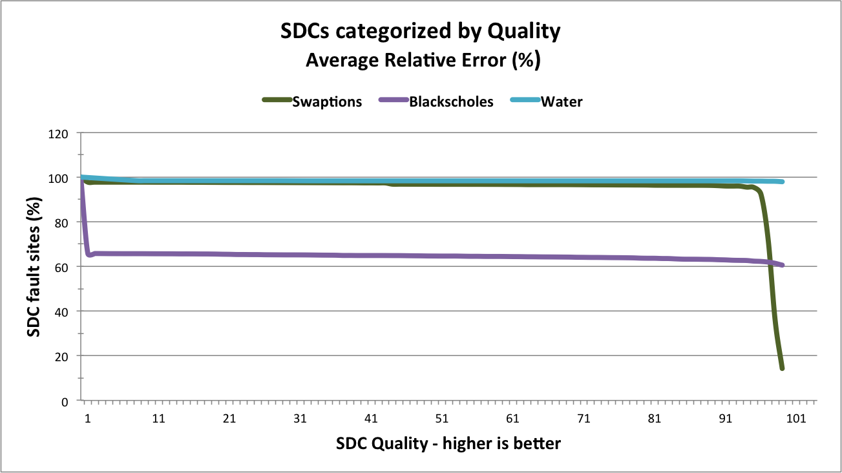
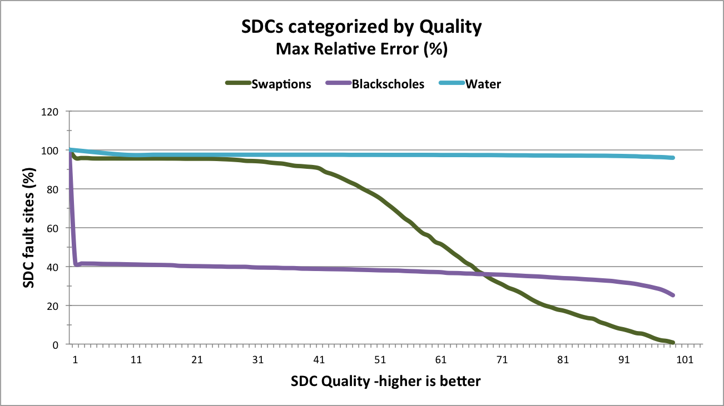
Understanding Quality Outcomes with Relyzer (Prelim Results)
Promising potential, but quality metric and application dependent
Can use to quantitatively tune quality vs. reliability vs. resources

Slide 34
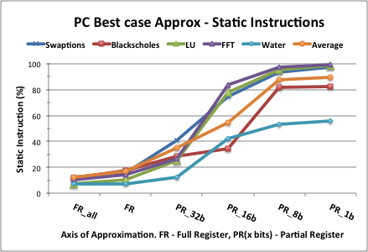
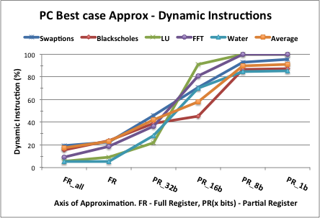
Quality Outcomes – An Instruction-Centric View
Systems operate at higher granularity than error sites: Instruction?
When is an instruction approximable?
Which errors in instruction should result in acceptable outcome?
All? Single-bit errors in all register bits? Single-bit errors in subset of bits?
When is an outcome acceptable?
Best case : all errors that are masked or produce SDCs are acceptable

Slide 35
So - (Old) Hype or New Frontier?
SWAT inherently implies quality/reliability relaxation aka approx. computing
Key: Bound quality/reliability loss? (Subject to resource constraint)
Can serve as enabler for widespread adoption of resilience approach
Especially if automated
Some other open questions
Instruction vs. data-centric?
Resiliency profiles and analysis at higher granularity?
How to compose?
Impact on recovery?
Other fault models?
Software doesn’t ship with 100% test coverage, why should hardware?

Slide 36
Summary
SWAT symptom detectors: <0.2% SDCs at near-zero cost
Relyzer: Systematically find remaining SDC-causing app-sites
Convert SDCs to detections with program-level detectors
Tunable reliability vs. overhead
Ongoing: Add tunable quality, Relyzer validations promising
Overhead (perf., power, area)
Very high
reliability at low-cost
Tunable
reliability
SWAT
Reliability

