Slide 1
Debunking and Deconstructing Moore’s Law
Sarita Adve
University of Illinois / EPFL
sadve@illinois.edu

Slide 2
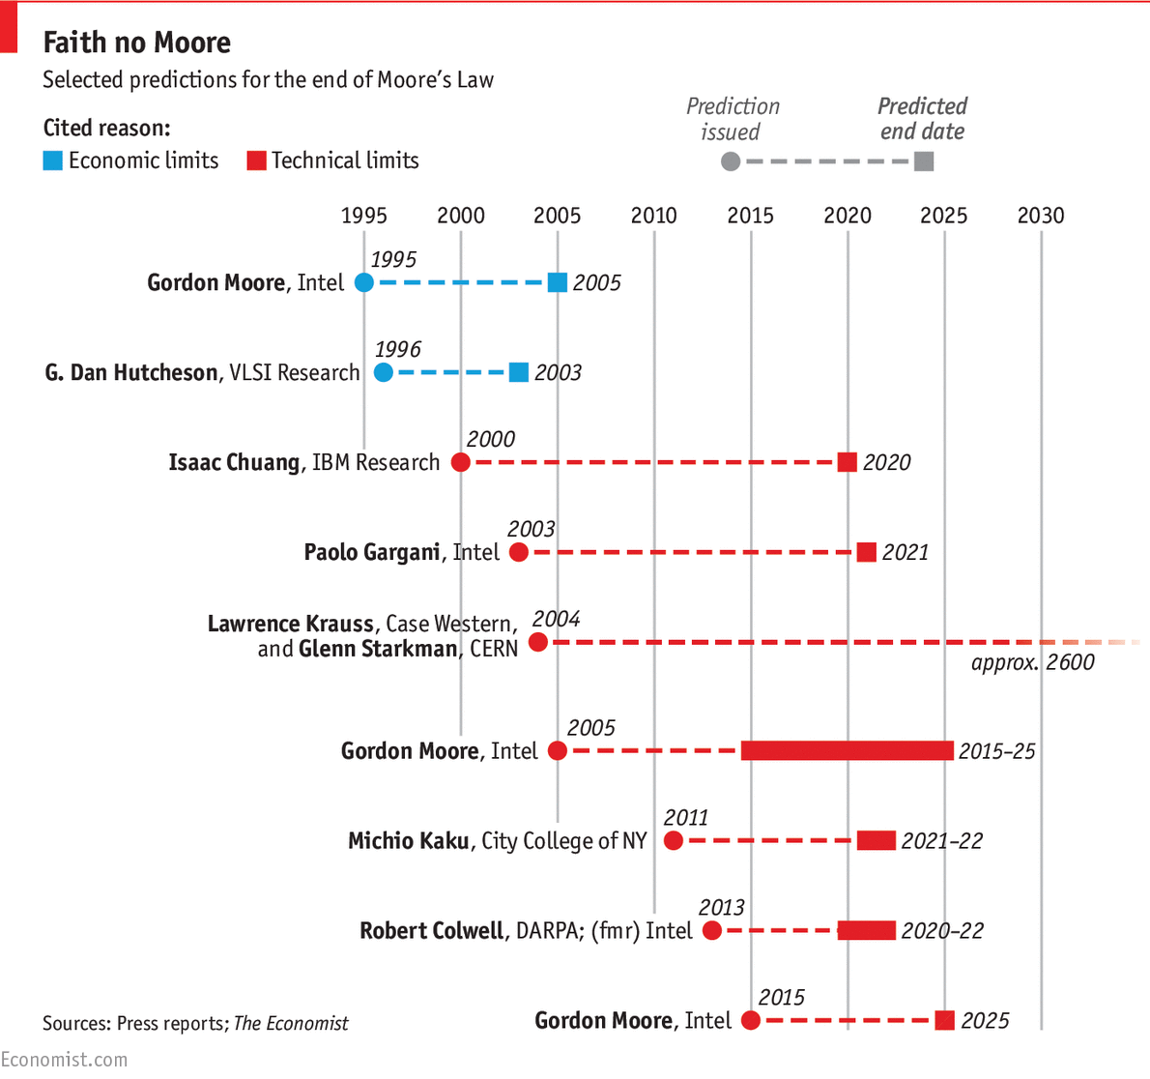
Moore’s Law, Dennard Scaling Dead, Dying, Will Die, …

Slide 3
A New Era
o
More with Mo re
More with Less
^
Need new roadmap: A Less Law of Computing

Slide 4
More With Less
Hardware
Waste
Software
Abstraction
Useful work
Less Law: Waste Will Decay Exponentially
Remove waste: Efficiency
Focus on less: Specialization
Cut corners: Approximate
Hardware
Software
Abstraction (Architecture)
OR …

Slide 5
Less is More
Computers are everywhere
Laps, hands, skin, clothes, things, …
Limits for on-chip, but aggregate compute unlimited
Unlimited opportunities, exponentials abound
But no longer just the processor
It’s the system stupid!

Slide 6
Recent Turing Awards in Architecture
Chuck Thacker: Alto system (PC revolution)
Processor, Memory, Display, Mouse, Ethernet
Fred Brooks: The definition of architecture (System 360)

Slide 7
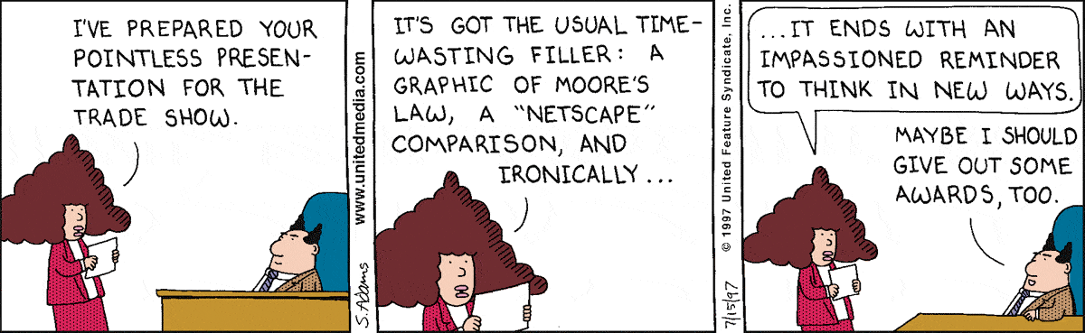
Exciting New Era
What will be the next system?
What will be the next architecture (abstraction)?
Who here will win the Turing award?

