Slide 1

GangES: Gang Error Simulation for Hardware Resiliency Evaluation
Siva Hari¹, Radha Venkatagiri², Sarita Adve², Helia Naeimi³
¹NVIDIA Research, ²University of Illinois at Urbana-Champaign, ³Intel Labs

Slide 2
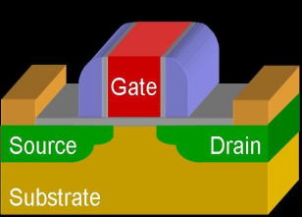
Motivation
Transient (soft) errors are important
Need in-field low-cost reliability solution
Application level solutions are low cost
Error simulations are commonly used for resiliency evaluation
Soft Error
Output
Output
Output
Output
Output
Output
Output
Output
Output
Output
Output
Goal: Reduce the number of full error simulations

Slide 3
State-of-the-art to Reduce Number of Simulations
Relyzer reduces number of simulations [ASPLOS’12]
BUT significant number of simulations remain
Need ~1750 CPU hours per app
Notes:
Move this to the beginning of contributions?
Relyzer is not a contribution

Slide 4
Contributions (1/2)
GangES: Gang Error Simulator to speed up full error simulations
Output
Output
Output
Output
Output
Output
Output
Output
Output
Output
Output

Slide 5
Contributions (1/2)
GangES: Gang Error Simulator to speed up full error simulations
Challenges: identifying when and what to compare
Leverage program structure
Shorter simulations ⇒ Faster results
57% wall-clock time savings over Relyzer for our workloads
Output
Output
Output
Output
Output
Output
Output
Output
Output
Output
Output

Slide 6
Contributions (2/2)
Do we need error simulations at all?
Alternative is using program analysis for resiliency evaluation
Example: lifetime, fan-out
Challenge: Hard to determine their accuracy
Relyzer + GangES enables evaluating program analyses based techniques
Found little correlation ⇒ Relyzer + GangES is best alternative
Notes:
Now we have fast error simulation techniques, gives us results faster -> enables us to do this study

Slide 7
Outline
Motivation and contributions
GangES: Gang Error Simulator
Design
Evaluation
Evaluating program analysis based techniques
Summary and future directions
Next

Slide 8
Error Outcomes
Error-free
execution
Erroneous executions
Silent Data
Corruption (SDC)
Masked
Detection
Detection
Output
Output
Output
X

Slide 9
Full Error Simulations are Time Consuming
Simulating several errors to application completion can be slow
System
State
System
State
System
State
. . .
..
.
..
.
..
.
Output
Output
Output

Slide 10
Full Error Simulations are Time Consuming
Simulating several errors to application completion can be slow
System
State
System
State
System
State
. . .
..
.
..
.
..
.
Output
Output
Output
How to shorten individual simulations and reduce redundancy?

Slide 11
Ganging Error Simulations
Gang Error Simulations
Compare executions to terminate early
System
State
System
State
System
State
. . .
..
..
..
Output
Output
Output

Slide 12
Ganging Error Simulations
Gang Error Simulations
Compare executions to terminate early
System
State
System
State
System
State
. . .
..
..
..
Early terminations ⇒ simulation time savings
Challenges:
When to compare?
What state to compare?
Output
Output
Output

Slide 13
Identifying Comparison Points
Leverage program structure: SESE (single-entry-single-exit) regions
All data will flow through the exit point
a
1
b
d
2
e
9
c
3
10
Control-flow
edges
4
11
12
SESE regions
5
6
13
7
14
8
15
16
Notes:
Motivate data will flow better – good points for comparison, all errors will flow though this point

Slide 14
Identifying State to Compare
Comparing full memory + processor state is expensive
Memory
State
Proc.
State
Memory
State
Proc.
State
..
..
Output
Output

Slide 15
Identifying State to Compare
Comparing full memory + processor state is expensive
Touched memory state
Collected from same point
Stored incrementally
Live processor register state (including PC)
Collected by looking ahead
Memory
State
Proc.
State
Memory
State
Proc.
State
..
..
Time
All registers
–
registers written to
before being read
Output
Output

Slide 16
Gang Error Simulation Algorithm
Gang error sites to check for equivalence
Start from a checkpoint
All injection runs start from the beginning of a group
Start of a gang
Injection 1
Injection 2
Typical group size in our framework was 100-1000
State for comparison:
(live) processor registers
+
touched memory locations
SESE exit 1
SESE exit 2
SESE exit 3
Notes:
Explain the gang

Slide 17
Gang Error Simulation Algorithm
Gang error sites to check for equivalence
Start from a checkpoint
Start of a gang
Injection 1
Injection 2
Injection 3
X
SESE exit 1
X
X
=
X
SESE exit 2
=
SESE exit 3
Only one error injection needs full simulation in this example

Slide 18
Methodology for GangES
Eight applications from Parsec and SPLASH2
Error model: single bit flips in integer architectural registers (one at a time) at dynamic instructions
Employed after Relyzer
Implemented in architecture simulator (Simics)

Slide 19
Efficacy of GangES: Wall Clock Time Savings
57% of the wall clock time saved for our workloads

Slide 20
Savings from Equalized Simulations
92% of equalized simulations require 3,025 instructions to be executed

Slide 21
Outline
Motivation and contributions
GangES: Gang Error Simulator
Design
Evaluation
Evaluating program analysis based techniques
Summary and future directions
Next

Slide 22
Evaluating Program Analysis Based Techniques
Relyzer + GangES still requires non-negligible time
Are there faster alternatives?
Program analysis based techniques for error vulnerability
Lifetime (average, aggregate) per instruction
Fanout (average, aggregate) per instruction
Dynamic instruction count
Are these effective in finding SDCs?
⇒ Relyzer + GangES enables this evaluation
W_{i}
R_{i}
R_{i}
W_{i}
Lifetime
Notes:
Higher the metric value the more vulnerable the instruction is

Slide 23
Evaluation Methodology
Five applications from Parsec and SPLASH2
Error model: single bit flips in destination integer architectural registers
Collected metric information using architectural simulator (Simics)
Employed Relyzer + GangES as golden model
Direct correlation of metrics with Relyzer +GangES
Combination of metrics
Linear
Linear combination on polynomials
Compare effectiveness of detectors added by Relyzer+GangES vs. simpler metrics
Low correlation,
No common model is
effective for our apps

Slide 24
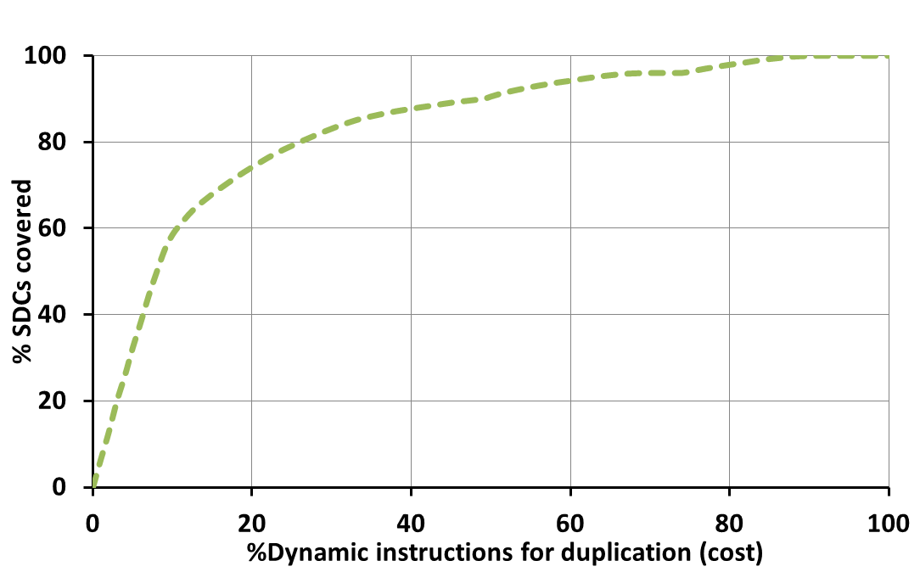
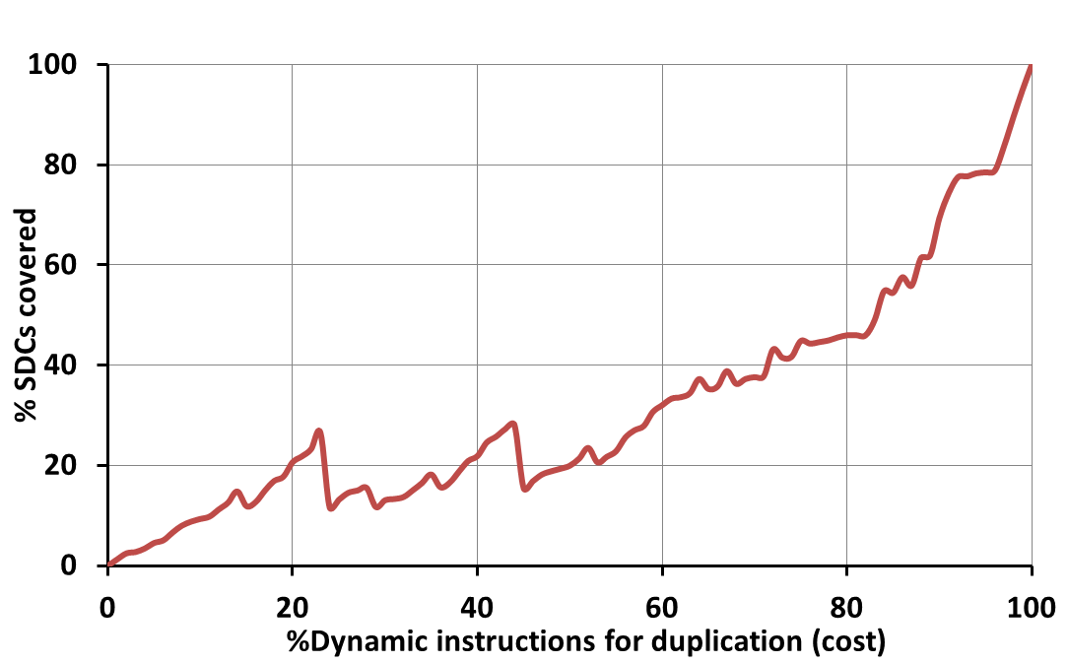
Results: Simple Metrics are Non-trivial
Comparing the effectiveness of adding duplication based detectors
Unable to adequately predict an instruction’s vulnerability to SDCs
⇒ Relyzer + GangES is much needed
Water: Fanout (agg) (Corr. Coeff. = 0.4)
Significant difference
Coverage of
detectors selected
using metric
Relyzer + GangES

Slide 25
Summary and Future Directions
GangES: Effective in reducing error simulation time
57% average wall clock time savings over Relyzer for our workloads
Only 36% of input error sites need full application simulation
Evaluated several program analyses based techniques
Unable to adequately predict an instruction’s vulnerability to SDCs
⇒ Relyzer + GangES is much needed
Future direction:
More (multi-threaded) applications, error models
Approaches to compact the state collected for comparison
Other program analyses based techniques

Slide 26
Thank You

Slide 27
Backup

Slide 28
Relyzer vs. GangES
Relyzer is practical with 72 hrs of running time for 8 applications
90% of time is spent in error injections
Error sites in different dynamic instances of one static instruction
Relyzer
.
.
.
Error sites from pruned
instances of an instruction
GangES
.
.
.
.
Reducing full
app executions
Error sites in different instructions in a block
Error sites that need full application execution
Notes:
This seems unnecessary

Slide 29





SWAT: A Low-Cost Reliability Solution
Need handle only hardware errors that propagate to software
Error-free case remains common, must be optimized
⇒ Watch for software anomalies (symptoms)
Zero to low overhead “always-on” monitors
Effective on SPEC, Server, and Media workloads
<0.6% µarch errors escape detectors & corrupt application output (SDC)
Fatal Traps
Hangs
Kernel Panic
App Abort
Out of Bounds
Division by zero,
RED state, etc.
Simple HW hang
detector
OS enters panic
state due to error
App abort due
to error
Flag illegal addresses

Slide 30
Significance of Comparing Live Processor State
21% more wall clock time savings

Slide 31
Efficacy of GangES:
36%
39%
25%
Only 36% of error sites need full simulations

Slide 32
Why remaining?

Slide 33
Relyzer: Application Reliability Analyzer
Pilots
Equivalence Classes
Relyzer
Prune error sites
Application-level error equivalence
Predict error outcomes
Injections for remaining sites
.
.
.
.
.
APPLICATION
APPLICATION
Output
Output
Can find SDCs from virtually all application sites

Slide 34
Pruning Results
99.78% of error sites are pruned
3 to 6 orders of magnitude pruning for most applications
For mcf, two store instructions observed low pruning (of 20%)
Overall 0.004% error sites represent 99% of total error sites

Slide 35
Approach: Fast Simulation Framework
Leverage program structure: SESE (single-entry-single-exit) regions*
All data will flow through the exit point
Check for corruption in limited state (live registers + touched memory)
a
Program Structure Tree (PST)
1
b
d
a
2
e
9
c
3
10
b
d
1
16
4
11
12
5
6
13
c
2
8
15
e
7
14
8
15
3
5
6
4
7
9
11
10
12
..
14
16
Control-flow edges
SESE regions
SESE Region
Other instructions
*R. Johnson et al. The program structure tree: computing control regions in linear time. SIGPLAN Not., 1994

Slide 36
Results: Simple Metrics are Non-trivial
Low correlation between metrics and Relyzer for studied metrics except dyn. Inst
Lifetime (agg) | Fanout (agg) | Lifetime (av) | Fanout (av) | Dyn. Inst.
Poor (< 0.26) | Poor-Fair (0.21 – 0.56) | Poor (< 0.06) | Poor (< 0.05) | Poor-Good (0.27 – 0.82)
Notes:
This graph is stale – need to update it

Slide 37
Application Resiliency Evaluation Alternatives
Approach | Accuracy | Speed | Application coverage
Error injection | High | Low | Low
Program analysis | Hard to determine | High | High
Hybrid injection + analysis | High | Moderate | High
Our focus

Slide 38
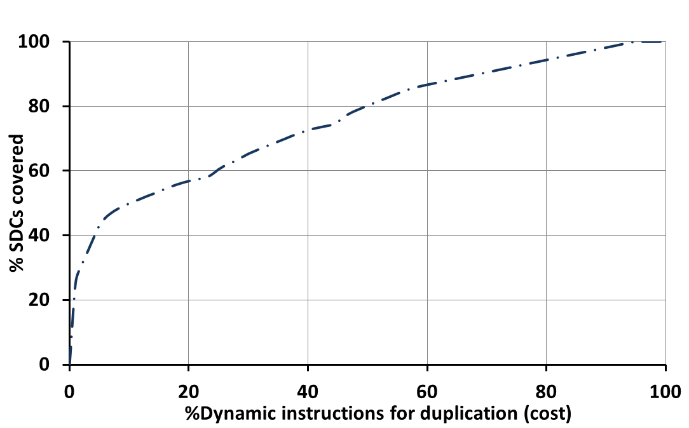
Results: Simple Metrics are Non-trivial
Comparing the effectiveness of adding duplication based detectors
Unable to adequately predict an instruction’s vulnerability to SDCs
⇒ Relyzer + GangES is much needed
Water: Fanout (agg) (Corr. Coeff. = 0.4)
Significant difference
Relyzer + GangES
Predicted coverage of detectors selected using metric
Actual coverage of
detectors selected
using metric
Notes:
Read the paper again

