Slide 1
Chapter 2 – Instruction-Level Parallelism and its Exploitation (Part 1)
ILP vs. Parallel Computers
Dynamic Scheduling (Section 2.5)
Dynamic Branch Prediction (Section 2.3)
Hardware Speculation and Precise Interrupts (Section 2.6)
Multiple Issue (Section 2.7)
Static Techniques (Section 2.2, 2.7)
Putting it Together (Section 2.10, mini-projects)
Notes:
Lecture notes for CS 333 - Chapter 3, part 1
Sarita Adve

Slide 2
ILP vs. Parallel Computers
Instruction-Level Parallelism (ILP)
  Instructions of single process (or thread) executed in parallel
  Parallel components must appear to execute in sequential program order
Parallel Computers or Multiprocessors
  Program divided into multiple processes (or threads)
  Instructions of multiple threads executed in parallel
  Typically also involves ILP within each thread
  No a priori sequential order between parallel threads
Notes:
Lecture notes for CS 333 - Chapter 3, part 1
Sarita Adve

Slide 3
Dynamic Scheduling - Basics
The situation:
DIV.D F0, F2, F4
ADD.D F10, F0, F8
MULT.D F6, F6, F14
The problem:
  ADD stalls due to RAW hazard
  MULT stalls because ADD stalls
Example
1 2 3 4 5 6 7 8
DIV.D IF ID E/ E/ E/ E/ MEM WB
ADD.D IF ID ** ** ** E+ E+
MULT.D IF ** ** ** ID E* why stall?
In-order execution limits performance
Notes:
Lecture notes for CS 333 - Chapter 3, part 1
Sarita Adve

Slide 4
Dynamic Scheduling - Basics (Cont.)
Solutions
  Static Scheduling
  Dynamic Scheduling
Static Scheduling (Software)
  Compiler reorganizes instructions
  +
  +
  (Will see more later)
Dynamic Scheduling (Hardware)
  Hardware reorganizes instructions
  +
  +
Notes:
Lecture notes for CS 333 - Chapter 3, part 1
Sarita Adve

Slide 5
Dynamic Scheduling - Basics (Cont.)**
Solutions
  Static Scheduling
  Dynamic Scheduling
Static Scheduling (Software)
  Compiler reorganizes instructions
  + Simpler hardware
  +
  (Will see more later)
Dynamic Scheduling (Hardware)
  Hardware reorganizes instructions
  +
  +
Notes:
Lecture notes for CS 333 - Chapter 3, part 1
Sarita Adve

Slide 6
Dynamic Scheduling - Basics (Cont.)**
Solutions
  Static Scheduling
  Dynamic Scheduling
Static Scheduling (Software)
  Compiler reorganizes instructions
  + Simpler hardware
  + Can use more powerful algorithms
  (Will see more later)
Dynamic Scheduling (Hardware)
  Hardware reorganizes instructions
  +
  +
Notes:
Lecture notes for CS 333 - Chapter 3, part 1
Sarita Adve

Slide 7
Dynamic Scheduling - Basics (Cont.)**
Solutions
  Static Scheduling
  Dynamic Scheduling
Static Scheduling (Software)
  Compiler reorganizes instructions
  + Simpler hardware
  + Can use more powerful algorithms
  (Will see more later)
Dynamic Scheduling (Hardware)
  Hardware reorganizes instructions
  + Handles dependences unknown at compile time
  +
Notes:
Lecture notes for CS 333 - Chapter 3, part 1
Sarita Adve

Slide 8
Dynamic Scheduling - Basics (Cont.)**
Solutions
  Static Scheduling
  Dynamic Scheduling
Static Scheduling (Software)
  Compiler reorganizes instructions
  + Simpler hardware
  + Can use more powerful algorithms
  (Will see more later)
Dynamic Scheduling (Hardware)
  Hardware reorganizes instructions
  + Handles dependences unknown at compile time
  + Software is more portable
Notes:
Lecture notes for CS 333 - Chapter 3, part 1
Sarita Adve

Slide 9
Dynamic Scheduling - Basics (Cont.)
In-order execution - Static
  Instructions sent to execution units sequentially
  Stall instruction i + 1 if instruction i stalls for lack of operands
Out-of-order execution - Dynamic
  Send independent instructions to execution units as soon as possible
Notes:
Lecture notes for CS 333 - Chapter 3, part 1
Sarita Adve

Slide 10
Dynamic Scheduling Basics (Cont.)
Original simple pipeline
  ID – decode, check all hazards, read operands
  EX – execute
Dynamic pipeline
  Split ID (“issue to execution unit”) into two parts
    Check for structural hazards
    Wait for data dependences
  New organization (conceptual):
    Issue – decode, check structural hazards, read ready operands
    ReadOps – wait until data hazards clear, read operands, begin execution
    Issue stays in-order; ReadOps/beginning of EX is out-of-order
Notes:
Lecture notes for CS 333 - Chapter 3, part 1
Sarita Adve

Slide 11
Dynamic Scheduling Basics (Cont.)**
Original simple pipeline
  ID – decode, check all hazards, read operands
  EX – execute
Dynamic pipeline
  Split ID (“issue to execution unit”) into two parts
    Check for structural hazards
    Wait for data dependences
  New organization (conceptual):
    Issue – decode, check structural hazards, read ready operands
    ReadOps – wait until data hazards clear, read operands, begin execution
    Issue stays in-order; ReadOps/beginning of EX is out-of-order
Issue
Dispatch
Notes:
Lecture notes for CS 333 - Chapter 3, part 1
Sarita Adve

Slide 12
Dynamic Scheduling Basics (Cont.)
Dynamic scheduling can create WAW, WAR hazards, and imprecise exceptions
WAW hazards with dynamic scheduling
  DIV.D F0, F2, F4
  ADD.D F10, F0, F8
  MUL.D F10, F8, F14
WAR hazards with dynamic scheduling
  DIV.D F0, F2, F4
  ADD.D F10, F0, F8
  MUL.D F8, F8, F14
Can always stall,
  but more aggressive solution with register renaming
Notes:
Lecture notes for CS 333 - Chapter 3, part 1
Sarita Adve

Slide 13
Register Renaming - Tomasulo’s Algorithm
Registers are Names for data values
  Think of register specifiers as tags
  NOT storage locations
  Tomasulo's algorithm exploited above in IBM 360/91
WAW hazards:
  DIV.D F0, F2, F4
  ADD.D F10, F0, F8
  MUL.D F10, F8, F14
WAR hazards:
  DIV.D F0, F2, F4
  ADD.D F10, F0, F8
  MUL.D F8, F8, F14
Notes:
Lecture notes for CS 333 - Chapter 3, part 1
Sarita Adve

Slide 14
Some History - IBM 360/91
Fast 360 for scientific code
  Completed in 1967
  Predates cache memories
Pipelined, rather than multiple, functional units (FU)
  We will assume multiple functional units
360 had register memory instructions, we don’t
Notes:
Lecture notes for CS 333 - Chapter 3, part 1
Sarita Adve

Slide 15
Register Renaming - Tomasulo’s Algorithm
Tomasulo’s algm uses reservation stations for register renaming
Instruction is “issued” to a reservation station
A pending operand is designated via a tag
  Tag = reservation station that will provide the operand
Reservation station with pending instruction fetches and buffers the operand when it becomes available
All FUs place output on the common data bus (CDB) with tag
Waiting reservation station gets the data from the CDB (register bypass)
Notes:
Lecture notes for CS 333 - Chapter 3, part 1
Sarita Adve

Slide 16
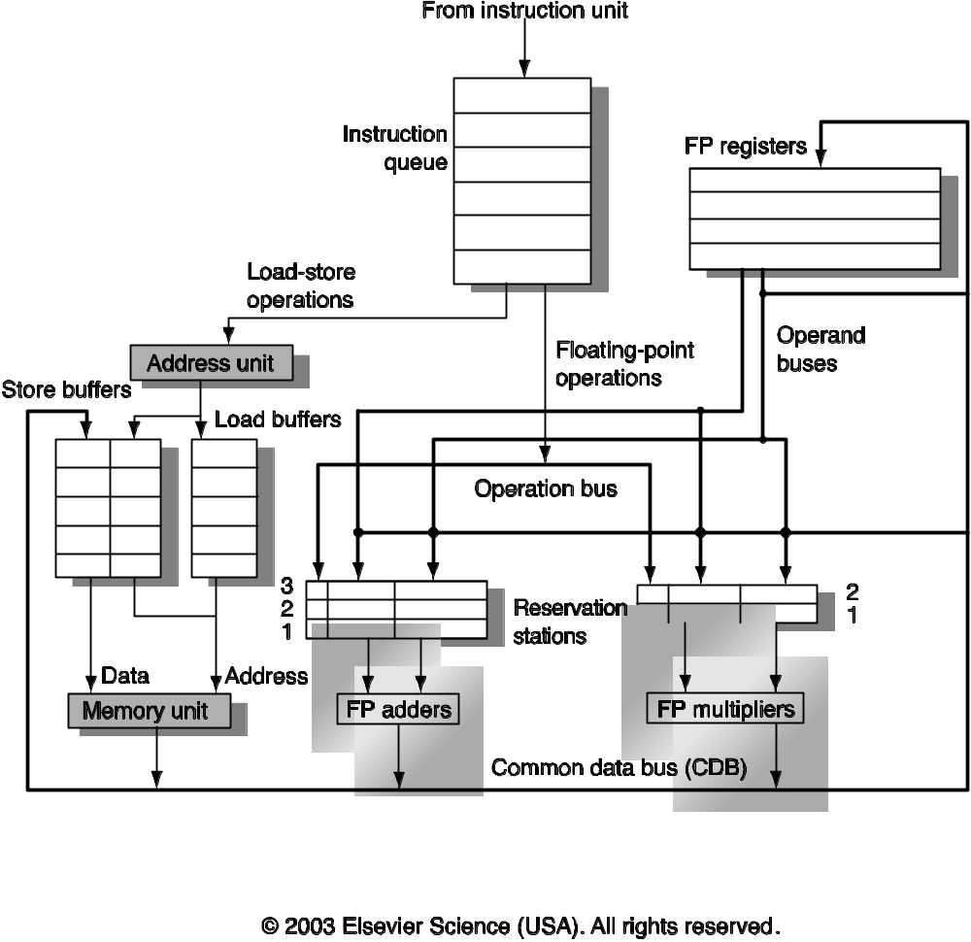
Tomasulo’s Algorithm - Implementation
Extend simple pipeline as example for Tomasulo's algorithm
  Assume multiple FUs
* This figure has been taken from Computer Architecture, A Quantitative Approach, 3rd Edition Copyright 2003 by Elsevier Inc. All rights reserved. It has been used with permission by Elsevier Inc.
Notes:
Lecture notes for CS 333 - Chapter 3, part 1
Sarita Adve

Slide 17
Tomasulo’s Algorithm – Implementation**
Extend simple pipeline as example for Tomasulo's algorithm
  Assume multiple FUs
Figure 2.9 The basic structure of a MIPS floating-point unit using Tomasulo’s algorithm. Instructions are sent from the instruction queue from which they are issued in FIFO order. The reservation stations include the operation and the actual operands, as well as information used for detecting and resolving hazards. Load buffers have three functions: hold the components of the effective address until it is computed, track outstanding loads that are waiting on the memory, and hold the results of completed loads that are waiting for the CDB. Similarly, store buffers have three functions: hold the components of the effective address until it is computed, hold the destination memory addresses of outstanding stores that are waiting for the data value to store, and hold the address and value to store until the memory unit is available. All results from either the FP units or the load unit are put on the CDB, which goes to the FP register file as well as to the reservation stations and store buffers. The FP adders implement addition and subtraction, and the FP multipliers do multiplication and division.
* This figure has been taken from Computer Architecture, A Quantitative Approach, 3rd Edition Copyright 2003 by Elsevier Inc. All rights reserved. It has been used with permission by Elsevier Inc.
Notes:
Lecture notes for CS 333 - Chapter 3, part 1
Sarita Adve

Slide 18
Our Tomasulo Pipeline
3-stage Execution (ignore IF and MEM)
Issue Get instruction from queue
ALU Op: Check for available reservation station
Load/Store: Check for available load/store buffer
If not, stall due to structural hazard
Execute If operands available, execute operation
If not, monitor CDB for operand
Write If CDB available, write it on CDB
If not, stall
Notes:
Lecture notes for CS 333 - Chapter 3, part 1
Sarita Adve

Slide 19
Our Tomasulo Pipeline, cont
Reservation Stations
  Handle distributed hazard detection and instruction control
Everything, except store buffers, has a tag
  4-bit tag specifies reservation station or load buffer
  Specifies which FU will produce result
Register specifier is used to assign tags
  THEN IT'S DISCARDED!
  Register specifers are ONLY used in ISSUE
Notes:
Lecture notes for CS 333 - Chapter 3, part 1
Sarita Adve

Slide 20
Our Tomasulo Pipeline, cont
Reservation Stations
  Op Opcode
  Q_{j} ,Q_{k} Tag Fields
  V_{j} ,V_{k} Operand values
  Busy Currently in use
Register File and Store Buffer
  Q_{i} Tag Field
  Busy Currently in use
Load and Store Buffers
  Busy Currently in use
  A Address
Notes:
Lecture notes for CS 333 - Chapter 3, part 1
Sarita Adve

Slide 21
Tomasulo Example
Example code
  L.D F6,34(R2)
  L.D F2,45(R3)
  MULT.D F0,F2,F4
  SUB.D F8,F6,F2
  DIV.D F10,F0,F6
  ADD.D F6,F8,F2
Notes:
Lecture notes for CS 333 - Chapter 3, part 1
Sarita Adve

Slide 22
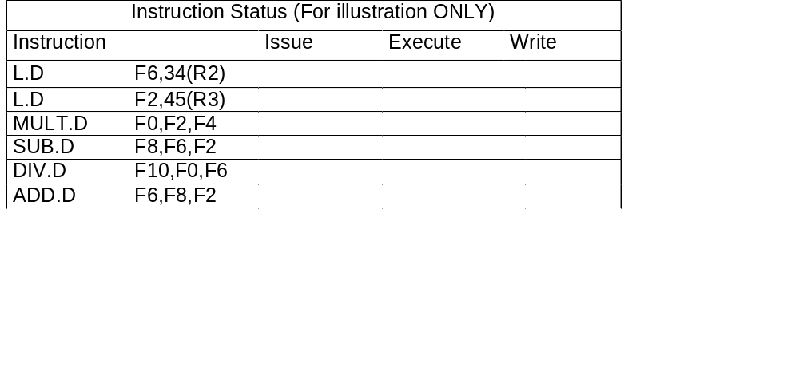
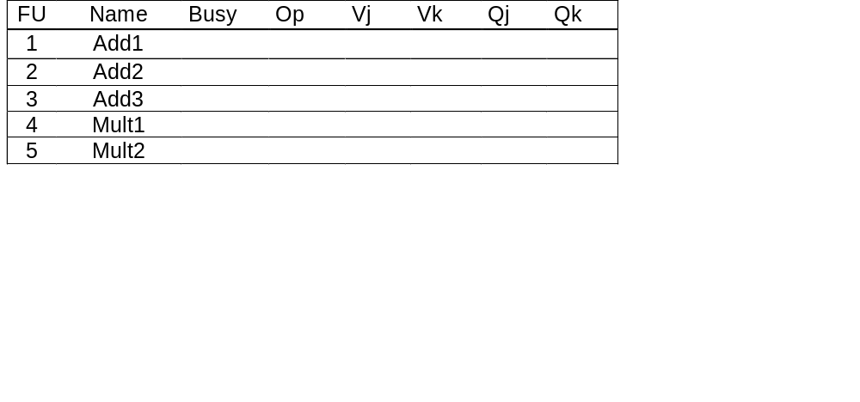
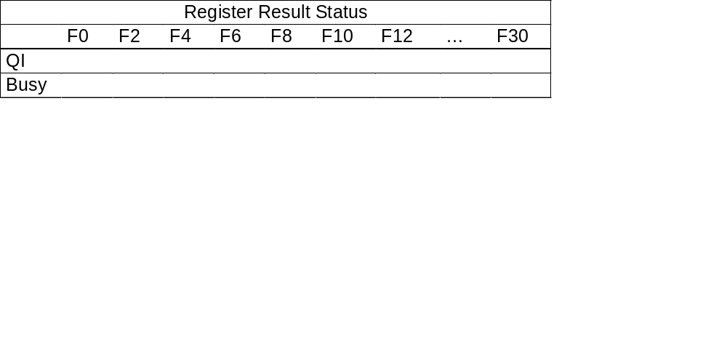
Tomasulo Example
Notes:
Lecture notes for CS 333 - Chapter 3, part 1
Sarita Adve

Slide 23
Tomasulo Example
Notes:
Lecture notes for CS 333 - Chapter 3, part 1
Sarita Adve

Slide 24
Tomasulo Example
Notes:
Lecture notes for CS 333 - Chapter 3, part 1
Sarita Adve

Slide 25
Variations on Tomasulo Example**
What if the last ADD is replaced with ADD.D F10, F8, F2?
What if we add another instruction at the end: ADD.D F6, F0, F2?
Notes:
Lecture notes for CS 333 - Chapter 3, part 1
Sarita Adve

Slide 26
Tomasulo, cont.
Out-of-order loads and stores?
CDB is a bottleneck
  Could duplicate
  Increases the required hardware
Complex implementation
Notes:
Lecture notes for CS 333 - Chapter 3, part 1
Sarita Adve

Slide 27
Tomasulo, cont**
Out-of-order loads and stores?
  What about WAW, RAW, and WAR hazards?
    Compare all load addresses w/ address in store buffers
    Compare all store addresses w/ address in load/store buffers
      Stall if they match
CDB is a bottleneck
  Could duplicate
  Increases the required hardware
Complex implementation
Notes:
Lecture notes for CS 333 - Chapter 3, part 1
Sarita Adve

Slide 28
Tomasulo, cont.
Advantages
Distribution of hazard detection
Elimination of WAR and WAW stalls
Common Data Bus
+ Broadcasts results to multiple instructions, bypasses registers
- Central bottleneck
    Could duplicate (increases required hardware)
Register Renaming
+ Eliminates WAR and WAW Hazards
+ Allows dynamic loop unrolling
Especially important with only 4 registers
- Requires many associative lookups
Notes:
Lecture notes for CS 333 - Chapter 3, part 1
Sarita Adve

Slide 29
Loops with Tomasulo’s Algorithm
Consider the following example:
FORTRAN:
DO I = 1, N
C[I] = A[I] + s * B[I]
ASSEMBLY:
L.D F0, A(R1)
L.D F2, B(R1)
MUL.D F2, F2, F4 /* s in F4 */
ADD.D F2, F2, F0
S.D C(R1), F2
Branch code
What would Tomasulo’s algorithm do?
Notes:
Lecture notes for CS 333 - Chapter 3, part 1
Sarita Adve

