Slide 1
Chapter 2 – Instruction-Level Parallelism and its Exploitation – Part 2
√ ILP vs. Parallel Computers
√ Dynamic Scheduling (Sections 2.5)
Dynamic Branch Prediction (Section 2.3)
Hardware Speculation and Precise Interrupts (Section 2.6)
Multiple Issue (Section 2.7)
Static Techniques (Section 2.2, 2.7)
Putting it Together (Section 2.10)
Notes:
Lecture notes for CS 433 - Chapter 2, part 2
Sarita Adve

Slide 2
Dynamic Branch Prediction
Reducing penalties from control dependences
Basic idea
  Hardware guesses
  Whether branch will be taken/not taken
  Where the branch will go
Especially important for multiple issue processors
Desirable properties
  Good prediction rate
  Make correct prediction fast
  Don't slow too much on misprediction
Notes:
Lecture notes for CS 433 - Chapter 2, part 2
Sarita Adve

Slide 3
Branch Prediction Buffer
Maintain a buffer with prediction bits
Index buffer with LSBs of branch instruction PC
Predict based on indexed bit, change bit on misprediction
Accessed in ID stage (not useful for simple 5-stage pipeline)
Limitation of 1-bit predictor?
Prediction bit
1
1
0
1
LSBs of PC
0
1
Notes:
Lecture notes for CS 433 - Chapter 2, part 2
Sarita Adve

Slide 4
Variations on Branch Prediction Buffer
Variations
  n-bit predictor
  Correlating predictors
  Tournament predictors
Notes:
Lecture notes for CS 433 - Chapter 2, part 2
Sarita Adve

Slide 5
N-bit Predictor
Contains n-bit saturating counter
Count up if taken, down if not taken
Predict taken if ≥ 2**(n-1); predict not taken if < 2**(n-1)
2-bit good for loops
Notes:
Lecture notes for CS 433 - Chapter 2, part 2
Sarita Adve

Slide 6
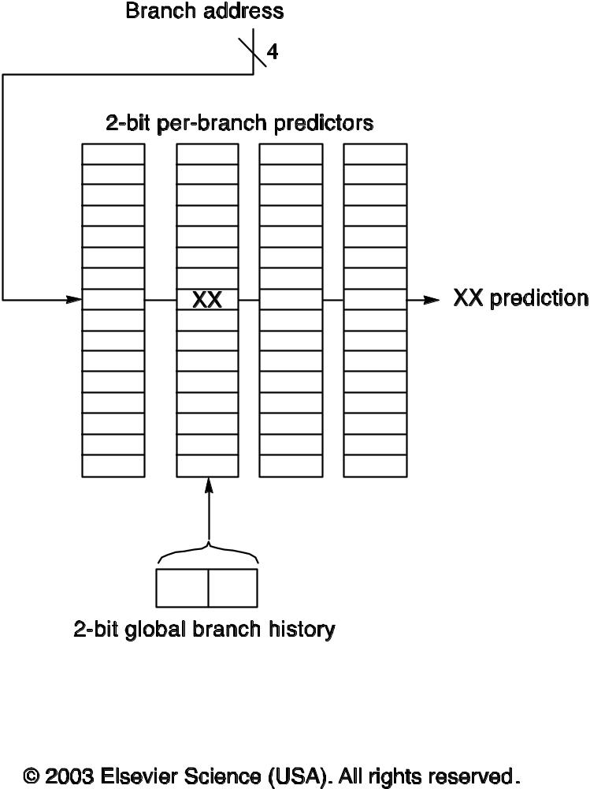
Correlating Predictors: (m,n) Predictor
Use outcome of previous m branches and n-bit predictors
For each branch, the prediction buffer contains
  An entry for each possible history of previous m branches
  Each entry is an n-bit predictor
* This figure has been taken from Computer Architecture, A Quantitative Approach, 3rd Edition Copyright 2003 by Elsevier Inc. All rights reserved. It has been used with permission by Elsevier Inc.
Notes:
Lecture notes for CS 433 - Chapter 2, part 2
Sarita Adve

Slide 7
Correlating Predictors: (m,n) Predictor**
Use outcome of previous m branches and n-bit predictors
For each branch, the prediction buffer contains
  An entry for each possible history of previous m branches
  Each entry is an n-bit predictor
Figure 3.14 A(2,2) branch-prediction buffer uses a 2-bit global history to choose from among four predictors for each branch address. Each predictor is in turn a 2-bit predictor for that particular branch. The branch-prediction buffer shown here has a total of 64 entries; the branch address is used to choose four of these entries, and the global history is used to choose one of the four. The 2-bit global history can be implemented as a shifter register that simply shifts in the behavior of a branch as soon as it is known.
* This figure has been taken from Computer Architecture, A Quantitative Approach, 3rd Edition Copyright 2003 by Elsevier Inc. All rights reserved. It has been used with permission by Elsevier Inc.
Notes:
Lecture notes for CS 433 - Chapter 2, part 2
Sarita Adve

Slide 8
Correlating Predictors (Cont.)
(1,1) predictor
  Prediction based on 1 previous branch,
  1 bit predictor
Number of prediction entries per branch = ??
Number of bits per prediction entry = ??
Notes:
Lecture notes for CS 433 - Chapter 2, part 2
Sarita Adve

Slide 9
Correlating Predictors (Cont.)**
(1,1) predictor
  Prediction based on 1 previous branch,
  1 bit predictor
Number of prediction entries per branch = 2
(first for previous branch taken, second for not taken)
Number of bits per prediction entry = 1
(because 1 bit predictor)
Notes:
Lecture notes for CS 433 - Chapter 2, part 2
Sarita Adve

Slide 10
Correlating Predictors Example
Loop:
  If a == 1 /* b1 */
  a = 0
  If a == 0 /* b2 */
  …
Let a = 1, 3, 1, 3, 1, 3, …
Notation: N=not taken; T=taken
Initialize (1,1) prediction buffer entries of b2 to NT
  (1st entry for previous branch taken, 2nd for not taken)
Direction of b1:
Direction of b2:
History at b2:
Prediction entries of b2:
Prediction for b2:
Notes:
Lecture notes for CS 433 - Chapter 2, part 2
Sarita Adve

Slide 11
Correlating Predictors Example**
Loop:
  If a == 1 /* b1 */
  a = 0
  If a == 0 /* b2 */
  …
Let a = 1, 3, 1, 3, 1, 3, …
Notation: N=not taken; T=taken
Initalize (1,1) prediction buffer entries of b2 to NT
  (1st entry for previous branch taken, 2nd for not taken)
Direction of b1: T, N, T, N, T, N, T, N, …
Direction of b2:
History at b2:
Prediction entries of b2:
Prediction for b2:
Notes:
Lecture notes for CS 433 - Chapter 2, part 2
Sarita Adve

Slide 12
Correlating Predictors Example**
Loop:
  If a == 1 /* b1 */
  a = 0
  If a == 0 /* b2 */
  …
Let a = 1, 3, 1, 3, 1, 3, …
Notation: N=not taken; T=taken
Initalize (1,1) prediction buffer entries of b2 to NT
  (1st entry for previous branch taken, 2nd for not taken)
Direction of b1: T, N, T, N, T, N, T, N, …
Direction of b2: T, N, T, N, T, N, T, N, …
History at b2:
Prediction entries of b2:
Prediction for b2:
Notes:
Lecture notes for CS 433 - Chapter 2, part 2
Sarita Adve

Slide 13
Correlating Predictors Example**
Loop:
  If a == 1 /* b1 */
  a = 0
  If a == 0 /* b2 */
  …
Let a = 1, 3, 1, 3, 1, 3, …
Notation: N=not taken; T=taken
Initalize (1,1) prediction buffer entries of b2 to NT
  (1st entry for previous branch taken, 2nd for not taken)
Direction of b1: T, N, T, N, T, N, T, N, …
Direction of b2: T, N, T, N, T, N, T, N, …
History at b2: T, N, T, N, T, N, T, N, …
Prediction entries of b2: NT,
Prediction for b2:
Notes:
Lecture notes for CS 433 - Chapter 2, part 2
Sarita Adve

Slide 14
Correlating Predictors Example**
Loop:
  If a == 1 /* b1 */
  a = 0
  If a == 0 /* b2 */
  …
Let a = 1, 3, 1, 3, 1, 3, …
Notation: N=not taken; T=taken
Initalize (1,1) prediction buffer entries of b2 to NT
  (1st entry for previous branch taken, 2nd for not taken)
Direction of b1: T, N, T, N, T, N, T, N, …
Direction of b2: T, N, T, N, T, N, T, N, …
History at b2: T, N, T, N, T, N, T, N, …
Prediction entries of b2: NT, TT, TN, TN, TN, TN, TN, TN, …
Prediction for b2: N, T, T, N, T, N, T, N, …
Notes:
Lecture notes for CS 433 - Chapter 2, part 2
Sarita Adve

Slide 15
Tournament Predictor
Combine multiple predictors with a selector
Selector typically two bit saturating counter
  Increment when predicted predictor correct, other incorrect
Notes:
Lecture notes for CS 433 - Chapter 2, part 2
Sarita Adve

Slide 16
Tournament Predictor Example - Alpha 21264
Uses 4K 2-bit counters to choose from global and local predictor
Global predictor
  4K entries of 2-bit predictors
  Indexed by history of last 12 branches
Local predictor is a two-level predictor
  History table with 1K 10-bit entries (for that branch)
    Each entry gives 10 most recent branch outcomes
  Indexes table of 1K entries with 3-bit counters
Total of 29K bits
Misprediction rate
  SPECfp95 – 1 per 1000
  SPECint95 – 11.5 per 1000
Notes:
Lecture notes for CS 433 - Chapter 2, part 2
Sarita Adve

Slide 17
Branch Prediction Buffer (Cont.)
Limitations
  May use bit from wrong PC
  Target must be known when branch resolved
Notes:
Lecture notes for CS 433 - Chapter 2, part 2
Sarita Adve

Slide 18
Branch Target Buffer or Cache
Store target PC along with prediction
Accessed in IF stage
Next IF stage uses target PC
  No bubbles on correctly predicted taken branch
Must store tag
More state
Can remove not-taken branches?
Notes:
Lecture notes for CS 433 - Chapter 2, part 2
Sarita Adve

Slide 19
Branch Target Buffer or Cache**
Store target PC along with prediction
Accessed in IF stage
Next IF stage uses target PC
  No bubbles on correctly predicted taken branch
Must store tag
More state
Can remove not-taken branches?
  N-bit predictors must update state for not-taken branches
Notes:
Lecture notes for CS 433 - Chapter 2, part 2
Sarita Adve

Slide 20
Branch Target Buffer or Cache**
Store target PC along with prediction
Accessed in IF stage
Next IF stage uses target PC
  No bubbles on correctly predicted taken branch
Must store tag
More state
Can remove not-taken branches?
  N-bit predictors must update state for not-taken branches
  Maintain branch prediction buffer to remove NT branches from target buffer (PowerPC 620)
Notes:
Lecture notes for CS 433 - Chapter 2, part 2
Sarita Adve

Slide 21
Branch Target Cache With Target Instruction
Store target instruction along with prediction
Send target instruction instead of branch into ID
Zero cycle branch - branch folding
Used for unconditional jumps
Notes:
Lecture notes for CS 433 - Chapter 2, part 2
Sarita Adve

Slide 22
Return Address Stack
Hardware stack for addresses for returns
Call pushes return address in stack
Return pops the address
Perfect prediction if stack length ≥ call depth
Notes:
Lecture notes for CS 433 - Chapter 2, part 2
Sarita Adve

Slide 23
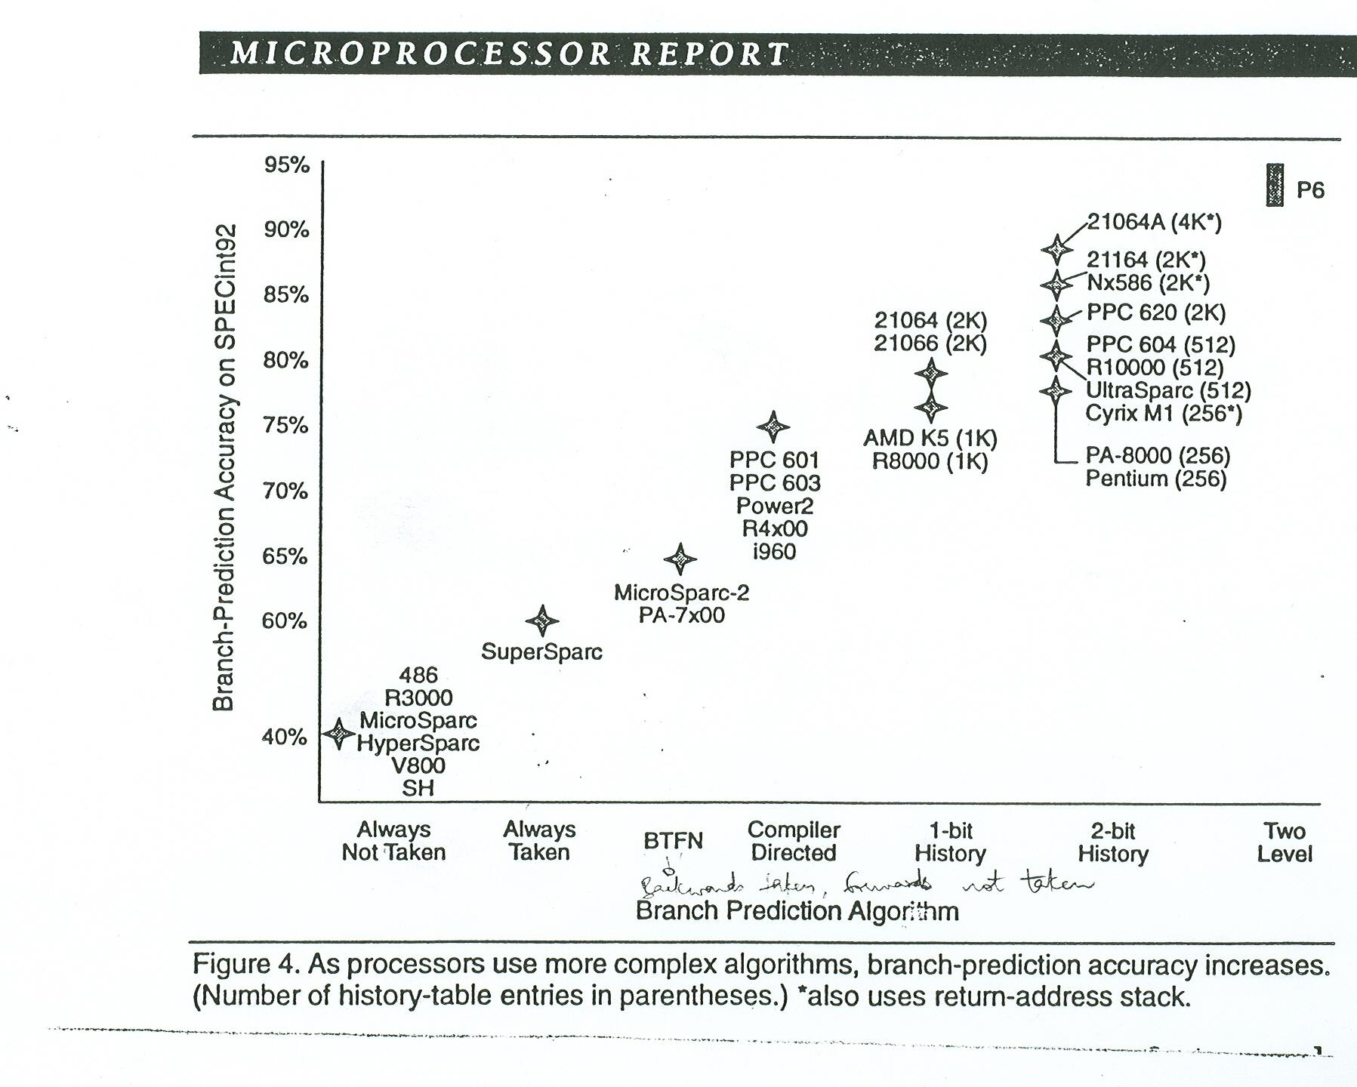
Branch Prediction Accuracy**
Notes:
Lecture notes for CS 433 - Chapter 2, part 2
Sarita Adve

Slide 24
Speculative Execution
How far can we go with branch prediction?
  Speculative fetch?
  Speculative issue?
  Speculative execution?
  Speculative write?
Notes:
Lecture notes for CS 433 - Chapter 2, part 2
Sarita Adve

Slide 25
Speculative Execution
Allows instructions after branch to execute before knowing if branch will be taken
Must be able to undo if branch is not taken
Often try to combine with dynamic scheduling
Key insight: Split Write stage into Complete and Commit
  Complete out of order
    No state update
  Commit in order
    State updated (instruction no longer speculative)
Use reorder buffer
Notes:
Lecture notes for CS 433 - Chapter 2, part 2
Sarita Adve

Slide 26
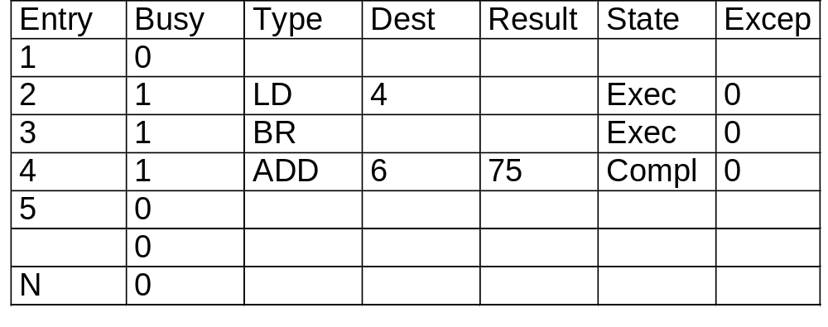
Reorder Buffer
Overview
  Instructions complete out-of-order
  Reorder buffer reorganizes instructions
  Modify state in-order
Instruction tag now is reorder buffer entry
head
tail
Notes:
Lecture notes for CS 433 - Chapter 2, part 2
Sarita Adve
Consequently, we develop a new cache organization where on-chip SRAM memory can be dynamically partitioned into different modules that can then be reassigned to other processor activities to achieve higher performance benefits.
As shown in the figure here, instead of current organizations which view the on-chip SRAM as a black-box that can be used only for caches, we now view the on-chip SRAM memory as a collection of dynamically partitionable modules that can be used for multiple activities including caches as before, but also including other new activities such as prediction table lookup, program-controlled memory, etc.
The two main parts with such an organization are of course -- first how can we cost-effectively design such a partitionable cache organization, and second, what are the different processor activities that can use this available SRAM area to achieve performance benefits. In the next few slides, we will try to address these two issues.

Slide 27
Re-order Buffer Pipeline
Issue:
Execute:
Complete:
Commit:
Notes:
Lecture notes for CS 433 - Chapter 2, part 2
Sarita Adve

Slide 28
Re-order Buffer Pipeline**
Issue:
  Allocate reorder buffer entry (RB) and reservation station (RS)
  Make RS and register result status point to RB
  Read operands from registers or reorder buffer if available
Execute:
Complete:
Commit:
Notes:
Lecture notes for CS 433 - Chapter 2, part 2
Sarita Adve

Slide 29
Re-order Buffer Pipeline**
Issue:
  Allocate reorder buffer entry (RB) and reservation station (RS)
  Make RS and register result status point to RB
  Read operands from registers or reorder buffer if available
Execute:
  Execute when operands available
  (Monitor CDB if not available)
Complete:
Commit:
Notes:
Lecture notes for CS 433 - Chapter 2, part 2
Sarita Adve

Slide 30
Re-order Buffer Pipeline**
Issue:
  Allocate reorder buffer entry (RB) and reservation station (RS)
  Make RS and register result status point to RB
  Read operands from registers or reorder buffer if available
Execute:
  Execute when operands available
  (Monitor CDB if not available)
Complete:
  Write result to CDB, RB entry pointed to by RS, other RS waiting for this operand (no write in register file)
Notes:
Lecture notes for CS 433 - Chapter 2, part 2
Sarita Adve

Slide 31
Re-order Buffer Pipeline (Cont.)**
Commit: When instruction reaches head of reorder buffer:
  Write result in register file (for all but branch and store)
  For store, do memory write
  For branch,
    if mispredict, flush all entries in reorder buffer and restart
  Make RB entry free
Notes:
Lecture notes for CS 433 - Chapter 2, part 2
Sarita Adve

Slide 32
Re-order Buffer Drawback
Operands need to be read from reorder buffer or registers
Alternative: Rename registers
Notes:
Lecture notes for CS 433 - Chapter 2, part 2
Sarita Adve

Slide 33
Rename Registers + Reorder Buffer
Many current machines
  More physical registers than logical registers
  Reorder buffer does not have values
  Read all values from registers
Rename mechanism
  Rename map stores mapping from logical to physical registers
    (Logical register Rl mapped to physical register Rp)
    On issue, Rl mapped to Rp-new
    On completion, write to Rp-new
    On commit, old mapping of Rl discarded (free Rp-old)
    On misprediction, new mapping of Rl discarded (free Rp-new)
Notes:
Lecture notes for CS 433 - Chapter 2, part 2
Sarita Adve

Slide 34
Precise Interrupts Again
Precise interrupts hard with dynamic scheduling
Consider our canonical code fragment:
  LF F6,34(R2)
  LF F2,45(R3)
  MULTF F0,F2,F4
  SUBF F8,F6,F2
  DIVF F10,F0,F6
  ADDF F6,F8,F2
What happens if DIVF causes an interrupt?
ADDF has already completed
Out-of-order completion makes interrupts hard
But reorder buffer can help!
Notes:
Lecture notes for CS 433 - Chapter 2, part 2
Sarita Adve

Slide 35
Reorder Buffer for Precise Interrupts
Notes:
Lecture notes for CS 433 - Chapter 2, part 2
Sarita Adve

Slide 36
Reorder Buffer for Precise Interrupts**
Take interrupt only after instruction reaches the head of the reorder buffer
Flush all remaining instructions and restart
Ok since no registers updated or stores sent to memory
Notes:
Lecture notes for CS 433 - Chapter 2, part 2
Sarita Adve

Slide 37
Beyond Pipelining
Limits on Pipelining
  Latch overheads & signal skew
  Unpipelined instruction issue logic (Flynn limit: CPI ≥ 1)
Two techniques for parallelism in instruction issue
  Superscalar or multiple issue
    Hardware determines which of next n instructions can issue in parallel
    Maybe statically or dynamically scheduled
  VLIW – Very Long Instruction Word
    Compiler packs multiple independent operations into an instruction
Notes:
Lecture notes for CS 433 - Chapter 2, part 2
Sarita Adve

Slide 38
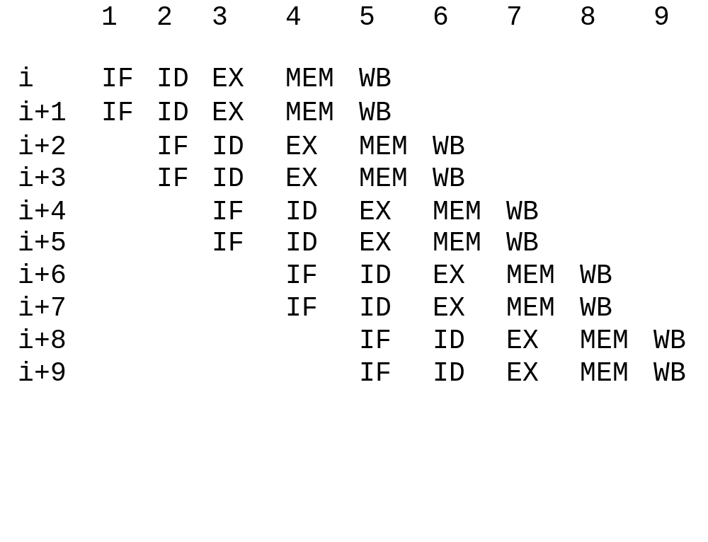
Simple 5-Stage Superscalar Pipeline
Notes:
Lecture notes for CS 433 - Chapter 2, part 2
Sarita Adve

Slide 39
Superscalar, cont.
IF Parallel access to I-cache
  Require alignment?
ID Replicate logic
  Fixed-length instructions?
  HANDLE INTRA-CYCLE HAZARDS
EX Parallel/pipelined (as before)
MEM > 1 per cycle?
  If so, hazards & multi-ported D-cache
WB Different register files?
Multi-ported register files?
Progression: Integer + floating-point
Any two instructions
Any four instructions
Any n instructions?
Notes:
Lecture notes for CS 433 - Chapter 2, part 2
Sarita Adve

Slide 40
Example Superscalar
Assume two instructions per cycle
  One integer, load/store, or branch
  One floating point
Could require 64-bit alignment and ordering of instruction pair.
I F I F F I
I F F I F I
OK NOT NOT
OK OK
Best case
  CPI = 0.5
  But ....
Notes:
Lecture notes for CS 433 - Chapter 2, part 2
Sarita Adve

Slide 41
Superscalar (Cont.)
Hazards are a big problem
Loads
  Latency is 1 cycle
  Was 1 instruction
  NOW 3 instructions
Branches
  NOW 3 instructions
Floating point loads and stores
  May cause structural hazards
  Additional ports?
  Additional stalls?
Parallelism required =
Notes:
Lecture notes for CS 433 - Chapter 2, part 2
Sarita Adve

Slide 42
Superscalar (Cont.)**
Hazards are a big problem
Loads
  Latency is 1 cycle
  Was 1 instruction
  NOW 3 instructions
Branches
  NOW 3 instructions
Floating point loads and stores
  May cause structural hazards
  Additional ports?
  Additional stalls?
Parallelism required = superscalar degree x operation latency
Notes:
Lecture notes for CS 433 - Chapter 2, part 2
Sarita Adve

Slide 43
Static Techniques for ILP - VLIW Processors
VLIW = Very Long Instruction Word Processors
Static multiple issue
  Compiler packs multiple independent operations into an instruction
  Like horizontal microcode
Versus Superscalar
Notes:
Lecture notes for CS 433 - Chapter 2, part 2
Sarita Adve

Slide 44
VLIW Processors**
VLIW = Very Long Instruction Word Processors
Static multiple issue
  Compiler packs multiple independent operations into an instruction
  Like horizontal microcode
Versus Superscalar
  + Issue logic simpler
  + Potentially exploit more parallelism
Notes:
Lecture notes for CS 433 - Chapter 2, part 2
Sarita Adve

Slide 45
VLIW Processors**
VLIW = Very Long Instruction Word Processors
Static multiple issue
  Compiler packs multiple independent operations into an instruction
  Like horizontal microcode
Versus Superscalar
  + Issue logic simpler
  + Potentially exploit more parallelism
  - Code size explosion
  Complex compiler
  - Binary compatibility difficult across generations
Notes:
Lecture notes for CS 433 - Chapter 2, part 2
Sarita Adve

Slide 46
VLIW Processors**
VLIW = Very Long Instruction Word Processors
Static multiple issue
  Compiler packs multiple independent operations into an instruction
  Like horizontal microcode
Versus Superscalar
  + Issue logic simpler
  + Potentially exploit more parallelism
  - Code size explosion
  Complex compiler
  Binary compatibility difficult across generations
Recent VLIWs overcome some problems (e.g., Intel/HP IA-64, TI C6)
Notes:
Lecture notes for CS 433 - Chapter 2, part 2
Sarita Adve

Slide 47
Limitations of Multi-Issue Machines
Inherent limitations of ILP
Difficulties in building hardware
  Increase ports to registers
  Increase ports to memory
  Duplicate FUs
  Decoding in superscalar and impact on clock rate
Limitations specific to VLIW
  Code size, binary compatibility
Notes:
Lecture notes for CS 433 - Chapter 2, part 2
Sarita Adve

Slide 48
Compiler Techniques to Expose ILP
Many compiler techniques exist
  Several used for multiprocessors as well
  Our focus on techniques specifically for ILP
Notes:
Lecture notes for CS 433 - Chapter 2, part 2
Sarita Adve

Slide 49
Loop Unrolling
Add scalar to vector
Loop: L.D F0, 0(R1)
    stall
    ADD.D F4, F0, F2
    stall
    stall
    S.D 0(R1), F4
    DSUBUI R1, R1, #8
    stall
    BNEZ R1, Loop
    stall
With scheduling
Loop: L.D F0, 0(R1)
DSUBUI R1, R1, #8
ADD.D F4, F0, F2
stall
BNEZ R1, Loop ; Assume delayed branch
S.D 8(R1), F4
Notes:
Lecture notes for CS 433 - Chapter 2, part 2
Sarita Adve
.

Slide 50
Loop Unrolling
Unrolling the loop
Loop: L.D F0, 0(R1)
ADD.D F4, F0, F2
S.D 0(R1), F4
L.D F6, -8(R1)
ADD.D F8, F6, F2
S.D -8(R1), F8
L.D F10, -16(R1)
ADD.D F12, F10, F2
S.D -16(R1), F12
L.D F14, -24(R1)
ADD.D F16, F14, F2
S.D -24(R1), F16
DSUBUI R1, R1, #32
BNEZ R1, Loop; Assume delayed branch
Rename registers
Remove some branch overhead (calculate intermediate values)
Notes:
Lecture notes for CS 433 - Chapter 2, part 2
Sarita Adve

Slide 51
Loop Unrolling
Scheduling the loop for simple pipeline
Loop: L.D F0, 0(R1)
L.D F6, -8(R1)
L.D F10, -16(R1)
L.D F14, -24(R1)
ADD.D F4, F0, F2
ADD.D F8, F6, F2
ADD.D F12, F10, F2
ADD.D F16, F14, F2
S.D 0(R1), F4
S.D -8(R1), F8
S.D -16(R1), F12
DSUBUI R1, R1, #32
BNEZ R1, Loop ; Assume delayed branch
S.D 8(R1), F16
How to schedule for multiple issue?
Notes:
Lecture notes for CS 433 - Chapter 2, part 2
Sarita Adve
The goals of this work is to address these questions. Specifically, we focus on future database and media processing workloads and identify two main goals -- first, to obtain a detailed quantitative understanding of the behavior of these workloads, specifically focusing on the effectiveness of state-of-the-art systems for these workloads. Second, to use the insights from the first part to propose and evaluate new architectural techniques targeted at these workloads.

Slide 52
Software Pipelining
Pipeline loops in software
Pipelined loop iteration
  Executes instructions from multiple iterations of original loop
  Separates dependent instructions
Less code than unrolling
Notes:
Lecture notes for CS 433 - Chapter 2, part 2
Sarita Adve

Slide 53
Software Pipelining – Example
sum = 0.0;
for (i=1; i<=N; i++) { ; sum = sum + a[i]*b[i]
load a[i] ; Ai
load b[i] ; Bi
mult ab[i] ; *i
add sum[i] ; +i
}
sum = 0.0;
START-UP-BLOCK
for (i=3; i<=N; i++) {
load a[i] ; Ai
load b[i] ; Bi
mult ab[i-1] ; *i-1
add sum[i-2] ; +i-2
}
FINISH-UP-BLOCK
LOOP
START-UP i=3 ... i=N FINISH-UP
-------- --- --- ---------
A1 A2 A3 Ai AN
B1 B2 B3 Bi BN
*1 *2 *i-1 *N-1 *N
+1 +i-2 +N-2 +N-1 +N
Notes:
Lecture notes for CS 433 - Chapter 2, part 2
Sarita Adve

Slide 54
Global Scheduling
Loop unrolling and software pipelining work well for straightline code
What if code has branches?
Global scheduling techniques
  Trace scheduling
Notes:
Lecture notes for CS 433 - Chapter 2, part 2
Sarita Adve

Slide 55
Trace Scheduling
Compiler predicts most frequently executed execution path (trace)
Schedules this path and inserts repair code for mispredictions
Notes:
Lecture notes for CS 433 - Chapter 2, part 2
Sarita Adve

Slide 56
Trace Scheduling - Example
b[i] = ``old’’
a[i] =
if (a[i] == 0) then
  b[i] = ``new’’; common case
else
  X
endif
c[i] =
Until done
  Select most common path - a trace
  Schedule trace across basic blocks
  Repair other paths
trace to be scheduled: repair code:
b[i] = ``old'' A: restore old b[i]
a[i] = X
b[i] = ``new'' maybe recalculate c[i]
c[i] = goto B
if (a[i] != 0) goto A
B:
Notes:
Lecture notes for CS 433 - Chapter 2, part 2
Sarita Adve

Slide 57
Hardware Support to Expose Compile-Time ILP
Compiler scheduling limited by knowledge of branch behavior
Hardware support to help compiler
  Predicated (or guarded or conditional) instructions
  Hardware support for compiler speculation
Notes:
Lecture notes for CS 433 - Chapter 2, part 2
Sarita Adve

Slide 58
Predicated Instructions
Used to convert control dependence to data dependence
Instruction executed based on a predicate (or guard or condition)
If condition is false, then no result write or exceptions
Notes:
Lecture notes for CS 433 - Chapter 2, part 2
Sarita Adve

Slide 59
Predicated Instructions (Cont.)
Example
  if (condition) then {
    A = B;
  }
  ...
Convert to:
  R1 ← result of condition evaluation
  A = B predicated on R1
  ...
Hardware can schedule instructions across the branch
Alpha, MIPS, PowerPC, SPARC V9, x86 (Pentium) have conditional moves
IA-64 has general predication - 64 1-bit predicate bits
Limitations
  Takes a clock even if annulled
Notes:
Lecture notes for CS 433 - Chapter 2, part 2
Sarita Adve

Slide 60
Hardware Support for Compiler Speculation
Successful compiler scheduling requires
  Preservation of exception behavior on speculation
  Mechanism to speculatively reorder memory operations
Notes:
Lecture notes for CS 433 - Chapter 2, part 2
Sarita Adve

Slide 61
Hardware for Preserving Exception Behavior
What if there is an exception on a speculative instruction?
Distinguish between two classes of exceptions
  (1) Indicate program error and require termination (e.g., protection violation)
  (2) Can be handled and program resumed (e.g., page fault)
Type (2) can be handled immediately even for speculative instructions
Type (1) requires more support
  Poison bits
Notes:
Lecture notes for CS 433 - Chapter 2, part 2
Sarita Adve

Slide 62
Poison Bits
Hardware support
  A poison bit for each register
  A speculation bit for each instruction
If a speculative instruction sees an exception
  it sets poison bit of destination
If a speculative instruction sees poison bit set for source
  it propagates poison bit to its destination
If normal instruction sees poison bit for source, takes exception
Normal instruction resets poison bit of destination register
Notes:
Lecture notes for CS 433 - Chapter 2, part 2
Sarita Adve

Slide 63
Hardware for Memory Speculation
How to reorder memory ops if compiler is not sure of addresses?
Consider moving a load
  Insert a special check instruction at original location of load
  When load is executed, hardware saves its address
  If there is a store to L’s address before the check instruction
    Redo load
    Branch to fix up code if other instructions already used load’s value
Notes:
Lecture notes for CS 433 - Chapter 2, part 2
Sarita Adve

Slide 64
Putting it Together**
See lecture
Notes:
Lecture notes for CS 433 - Chapter 2, part 2
Sarita Adve

