Slide 1

Cross-Layer Adaptation for Quality-Aware and Energy-Efficient Next Generation Mobile Multimedia Devices
Klara Nahrstedt
klara@cs.uiuc.edu
Department of Computer Science
University of Illinois at Urbana-Champaign
Joined work with Wanghong Yuan, and PIs of NSF ITR Sarita Adve, Doug Jones, Robin Kravets
GRACE

Slide 2

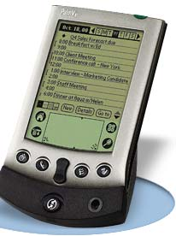



Motivation
Mobile devices
    Running multimedia apps (e.g., MP3 players, DVD players)
    Running on general purpose systems
  Demanding quality requirements
    System resources: high performance
    OS: predictable resource management
  Limited battery energy
    System resources: low power consumption
    OS: energy as first-class resource

Slide 3
New Opportunities
Adaptability of software and hardware
  Multimedia applications
    Multiple Quality levels: quality vs. resource usage
    Statistical performance requirements (e.g., meeting 96% of guarantees)
      Soft guarantees from OS
  Hardware components
    Multiple operating states: performance vs. power (e.g., mobile processors Intel’s XSacle, AMD’s Athlon, Transmeta’s Crusoe)
    Reducing CPU voltage can reduce CPU energy consumption substantially

Slide 4
Goal for Next Generation Mobile Devices
Take advantage of new opportunities adaptability
Address new challenges quality provision and energy saving
1. Design a cross-layer adaptation framework
  Each layer adapts to changes
  All layers adapt cooperatively
    for system-wide optimal configuration
  OS support for such coordinated cross-layer adaptation

Slide 5
Outline
Motivation
Existing Approaches
GRACE Cross-Layer Adaptation Framework
Evaluation
Conclusion

Slide 6
Layered Adaptation
Application
Network Protocols
Operating System
Architecture and Hardware
Each adaptive layer must make several decisions affecting
  all resources - time, energy, bandwidth
  other layers

Slide 7
Layered Adaptation
Application
Which video compression technique?
How much compression?
Network Protocols
Operating System
Architecture and Hardware
Each adaptive layer must make several decisions affecting
  all resources - time, energy, bandwidth
  other layers

Slide 8
Layered Adaptation
Application
Which video compression technique?
How much compression?
Network Protocols
How much error correction for wireless channel?
Which congestion control protocols for wired network?
Operating System
Architecture and Hardware
Each adaptive layer must make several decisions affecting
  all resources - time, energy, bandwidth
  other layers

Slide 9
Layered Adaptation
Application
Which video compression technique?
How much compression?
Network Protocols
How much error correction for wireless channel?
Which congestion control protocols for wired network?
Operating System
How to allocate resources to multiple applications?
How to allocate among components of the same application?
Architecture and Hardware
Each adaptive layer must make several decisions affecting
  all resources - time, energy, bandwidth
  other layers

Slide 10
Layered Adaptation
Application
Which video compression technique?
How much compression?
Network Protocols
How much error correction for wireless channel?
Which congestion control protocols for wired network?
Operating System
How to allocate resources to multiple applications?
How to allocate among components of the same application?
Architecture and Hardware
Which processor, cache, memory configuration?
Which frequency, voltage?
Each adaptive layer must make several decisions affecting
  all resources - time, energy, bandwidth
  other layers

Slide 11
State of the Art
Quality or energy aware adaptation
  Hardware layer
    Dynamic power management (e.g., Simunic01,Benini00)
    Dynamic voltage scaling - DVS (e.g., Ishihaa98, Pering00, Pillai01)
      Common mechanism to save CPU energy;
      Important characteristics of CMOS-based processors - lower frequency enables lower voltage and yields a quadratic energy reduction)
      Effectiveness of DVS dependent on predictions of application CPU demands
  OS layer
    Soft-real-time scheduling (e.g., Bavier00, Banachowski02)
    Task-based Speed and Voltage Scheduling (e.g., Lorch01, Lorch03)
  Application layer
    Trade off quality for resource usage (e.g., Flinn01, Chandra02)
  Network layer
    Power Management (e.g., Krashinsky02)
    Energy-aware routing and transmission (e.g., Kravets98,Gomez03)

Slide 12
What Is Missing
Most current work adapts a single layer
Some jointly adapt two layers, BUT one layer drives adaptation (e.g., application controls video coding and network error correction)
Applications
Applications
Applications
Applications
OS/Network
OS/Network
OS/Network
OS/Network
Hardware
Hardware
Hardware
Hardware
(a) hardware adaptation
(b) OS adaptation
(c) app. adaptation
(d) OS/app. adaptation
For our target mobile systems, we need
Applications
OS/Network
Hardware
cross-layer adaptation

Slide 13
Cross-layer != Simple Combination
Combination is not straightforward
  Adaptations may be in conflict
    E.g., CPU slows down, while apps increase demand
  Various adaptation objectives
    E.g., maximizing quality vs. minimizing energy
  Different adaptation costs and impact
    E.g., OS adaptation for small variations, application adaptation for large variations
Consider integration and coordination !

Slide 14
Outline
Motivation
Existing approaches
GRACE Cross-Layer Adaptation Framework
Evaluation
Conclusion

Slide 15
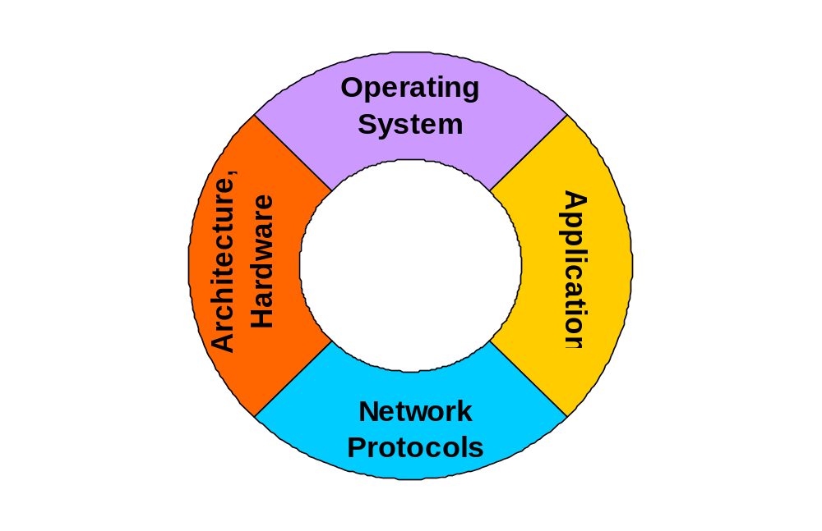
GRACE
Global Resource Adaptation via CoopEration
Current approaches
GRACE
Application
Network Protocols
Operating System
Coordinator
Architecture, Hardware
System divided into layers
Adapt 1 or 2 layers
Global community
All adapt cooperatively via
coordinator
S. Adve et al. “The Illinois GRACE Project: Global Resource Adaptation through CoopEration”, Workshop on
Self-Healing Adaptive and self-MANaged Systems, 2002

Slide 16
Global and Internal Adaptation
Global
Internal
Triggers: rare, coarse-grain
  Application joins or leaves
  Large usage change
  Large availability change
Triggers: frequent, fine-grain
  Small usage change
Adaptation: Via coordinator
  Determine a system-wide
  optimal configuration
Adaptation: Each layer adapts locally
  Respect the global
  configuration
Cost: expensive
Cost: cheap

Slide 17
GRACE Architecture (First Version)
adapt
Application
Application
App Adaptor
Application
Application
QoS Level Options
QoS level
schedule
Coordinator
CPU
allocation
Soft-Real-Time Scheduling
OS
residual energy
CPU
frequency
Adjusted CPU demand
Battery
Monitor
CPU Speed
Adaptor
adapt
CPU
Hardware
W. Yuan, K. Nahrstedt, et al “Design and Evaluation of a Cross-Layer Adaptation Framework for Mobile
Multimedia Systems”, SPIE Multimedia Computing and Networking (MMCN), 2003

Slide 18
OS Role in GRACE
GRACE-OS:
  Coordinator
    Coordinate in cooperative manner hardware, OS, and application layers
  Soft real-time scheduling framework
    Support multimedia application quality requirements
    Adapt internal scheduling
    Monitor and react to variations in CPU usage
Integrates dynamic voltage scaling (DVS) into soft-real-time (SRT) scheduling
Uses stochastic scheduling and allocation based on statistical performance requirements and probability distribution of cycle demands of individual application tasks
Estimates demand distribution of tasks via online profiling and estimations
Finds speed schedule for each task based on probabilistic distribution of the task’s cycle demands (this speed schedule enables each job of a task to start slowly and accelerate as the job progresses)
Decides how fast to execute applications in addition to when and how long to execute them

Slide 19
Outline
Motivation
Existing approaches
GRACE Cross-Layer Adaptation Framework
  GRACE Architecture
  Global coordination
  Soft real-time scheduling (Internal Adaptation)
Evaluation
Conclusion

Slide 20
System Models
Adaptive periodic multimedia application
  Multiple QoS levels, {q₁, …, q_{m}}
    Utility u(q)
    CPU demand: period P(q) and cycle C(q)
    Statistical performance requirement: probability to meet deadlines °ρ
Adaptive processor
  Multiple speeds, {f₁, …, f_{max}}
    Frequency f
    Power p(f)
Battery
  Desired lifetime T^{life} and residual energy E^{res}

Slide 21
Coordination Problem
Mediate three layers to find
  QoS level for each application
  CPU allocation for each application
  CPU frequency
to maximize overall system utility
under CPU and energy constraints

Slide 22
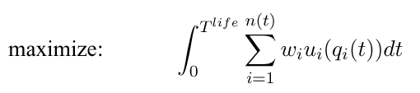


Constrained Optimization
(accumulated system utility)
(CPU constraint: EDF schedulability)
(energy constraint: last for desired lifetime)

Slide 23
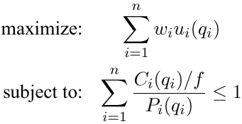


Heuristic Approaches
Energy-greedy
Utility-greedy
Guarantee desired lifetime
Maximize current utility
NP-hard problems – can be mapped to multi-choice Knapsack problem; use dynamic programming
with complexity O(mlogm), with m Quality Levels

Slide 24
Coordination Protocol
(5.2) adapt QoS parameters
App Adaptor
application
utility demand
(5.1) coordinated QoS level
Coordinator
(6.1) coord. allocation
SRT CPU Scheduler
(2)
residual energy
(3) optimization
(4.1) coordinated speed
Battery
Monitor
CPU Speed
Adaptor
(4.2) adapt speed
CPU

Slide 25
Outline
Motivation
Existing approaches
GRACE Cross-Layer Adaptation Framework
  GRACE Architecture
  Global coordination
  Soft real-time scheduling (Internal Adaptation)
Evaluation
Conclusion

Slide 26
Soft-Real-Time Scheduling
Multimedia tasks (processes or threads)
performance requirements
(via system calls)
monitoring
scheduling
Stochastic SRT Scheduler
GRACE-OS
Profiler
demand distribution
time allocation
CPU Speed Adaptor
(Stochastic DVS)
speed scaling
CPU

Slide 27
SRT Scheduling Framework
Profiler
  monitors cycle usage of individual tasks
  derives probability distribution of their cycle demands from cycle usage
Stochastic SRT scheduler
  allocates cycles to task
  schedules them to deliver performance guarantees,
  performs SRT scheduling based on the statistical performance requirements and demand distribution
Speed adaptor
  adjusts CPU speed dynamically to save energy
W. Yuan, K. Nahrstedt, “Energy-Efficient Soft Real-Time CPU Scheduling for Mobile Multimedia Systems”,
ACM Symposium on Operating Systems Principles (SOSP), 2003

Slide 28
Demand Estimation (1)
1. Kernel-based online profiling
  Measure cycles between switch-in (in) and switch-out (out)
  Accurate with small overhead
in
out
in
finish/out
c1
c2
c3
c4
cycles
c2 – c1
c4 – c3
cycles for the job = (c2 – c1) + (c4 – c3)
Measured cycles are kept in cycle counter of the process control block of each task.

Slide 29

Demand Estimation (2)
2. Histogram for probability distribution
  Group profiled cycles
    Use profiling window of n jobs with cycles [C_{min}, C_{max}]
    Partition profiling window into r equal-sized groups (C_{min} = b₀ < b₁ <…<b_{r}=C_{max})
    Let n_{i} be number of cycle usage that falls into i^{th} group (n_{i}/n – probability that task’s cycle demands are in between b_{i-1} and b_{i})
  Count occurrence in each group
distribution function P[X<=x]
1
P[X<=b_{i}] =
cumulative
probability
C_{min}=b₀
b₁
b₂
b_{i}
b_{r-1}
b_{r}=C_{max}
cycle demand

Slide 30

Demand Estimation (3)
3. Determine amount of cycles C allocated to each task
  Statistical performance requirement ρ of a task
    Meet ρ percent of deadlines so that
    Search task’s histogram to find smallest b_{m} with P[X ≤b_{m}] ≥ ρ
statistical performance requirement ρ
cumulative
probability
C_{min}=b₀
b₁
b₂
b_{r-1}
b_{r}=C_{max}
cycle demand C

Slide 31
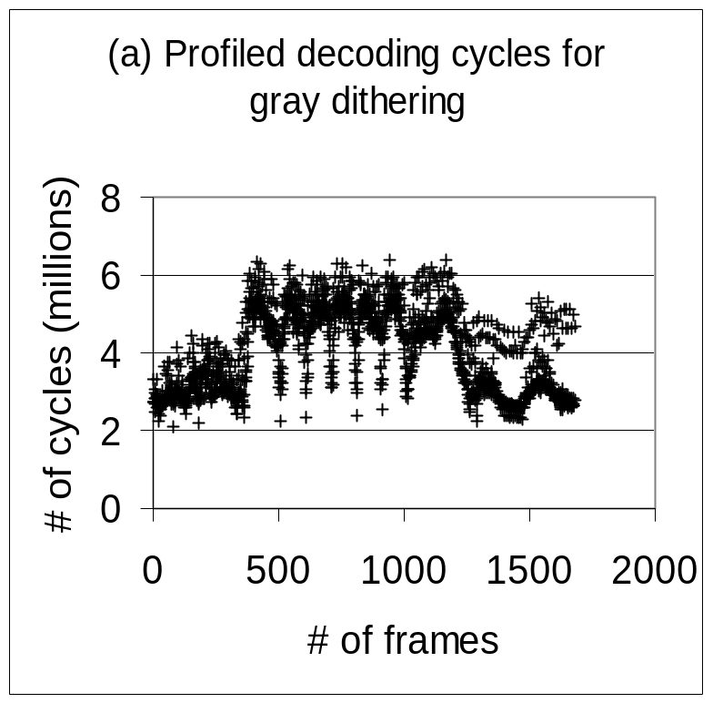
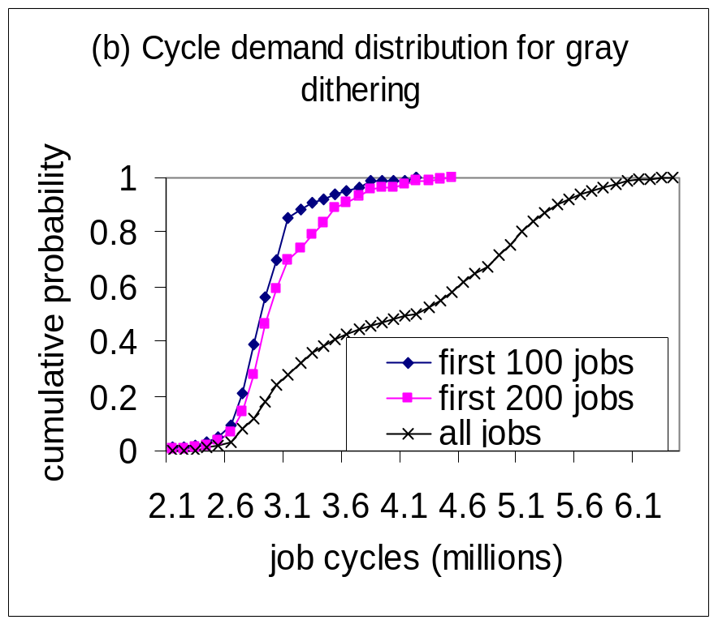
Demand Estimation
Probability distribution is more stable,
but changes slowly and smoothly

Slide 32
Stochastic SRT Scheduling
(Speed-Aware EDF Scheduling)
Variable speed constant bandwidth server(VS-CBS)
  Maximum budget C -- Period P
  Budget c -- Deadline d
Hierarchical scheduling
  SRT scheduler selects earliest-deadline VS-CBS
  VS-CBS executes the application
    Decrease budget c by # of consumed cycles
    If c=0, then c = C and d = d + P
Stochastic SRT scheduling determines which task to execute, when and how long

Slide 33
Stochastic DVS Scheduling
Dynamic speed scaling policy:
  GRACE-OS starts a job at a lower speed and accelerate as it progresses
Speed Schedule for each task
  Each point (x,y) in schedule specifies that a job accelerates to the speed y when it uses x cycles
  Speed list is sorted in ascending order of cycle number x
  We calculate speed schedule based on task’s demand distribution (similar to techniques proposed by Lorch/Smith and Gruian)

Slide 34
Stochastic DVS (Example)
cycle:
speed:
0
100 MHz
1 x 10⁶
120 MHz
2 x 10⁶
180 MHz
3 x 10⁶
300 MHz
(a) Speed schedule with four scaling points
speed (MHz)
120
100
job₁'s cycles=1.6x10 ⁶
10
15
time (ms)
180
speed (MHz)
120
100
job₂'s cycles = 2.5 x 10 ⁶
10
18.3
21.1
time (ms)
300
speed (MHz)
180
120
100
job₃'s cycles = 3.9 x 10 ⁶
10
18.3
23.8
26.8
time (ms)
(b) Speed scaling for three jobs using speed schedule in (a)

Slide 35
Outline
Motivation
Existing approaches
GRACE Cross-Layer Adaptation Framework
Evaluation
Conclusion

Slide 36
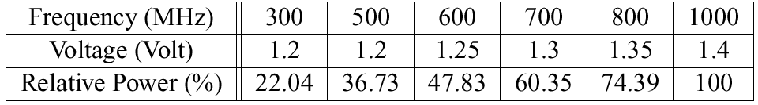
GRACE-OS Implementation
Hardware: HP N5470 laptop
  AMD Athlon processor, six speeds
p ∝ freq x volt²

Slide 37
Implementation: Software
Adaptive applications
w/ application adaptor
message queue
application
coordinator
middleware
system call
GRACE-OS
Standard
Linux scheduler
SRT -DVS modules
SRT scheduling
PowerNow module
hook
Linux kernel

Slide 38
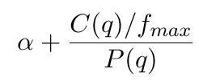
Experiments
Application: MPEG video player
  Video: 4Dice (352 x 240 pixels, 1679 frames)
  QoS parameters (dithering method, frame rate)
    Dithering: gray, ordered, and color2
    Frame rate: 20, 25, and 33 fps
  Nine QoS levels
    Utility function
Utility for SRT mode
Utility for QoS level q

Slide 39
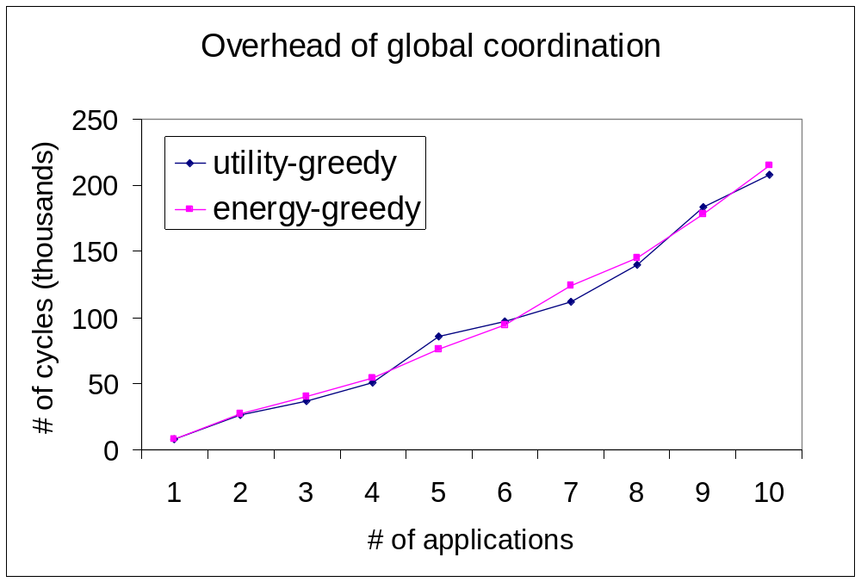
Global Coordination Overhead

Slide 40
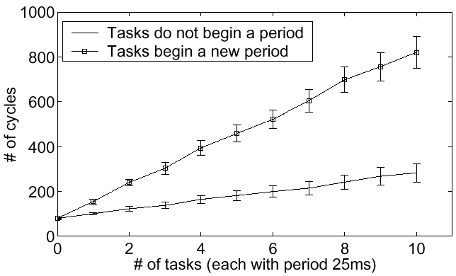
SRT Scheduling Overhead

Slide 41
Comparison w/ Other Policies
CPU speed
App QoS
internal simplified adaptation
None
  No-adapt highest highest no
Single-layer
  CPU-only adapt highest no
  App-only highest adapt single app no
Uncoordinated multi-layers
  App-CPU adapt adapt single app no
  App-OS highest adapt all apps no
  App-OS-CPU adapt adapt all apps no
Cross-layer
  Utility-greedy adapt adapt all apps yes
  Energy-greedy adapt adapt all apps yes

Slide 42
Methodology
Start a player every 12 seconds
  Each exits after finishing 4Dice video
Normalized energy measurement
  Normalized energy = time * relative power
    If 300 MHz for 1 second, energy is 1 * 22% = 0.22
Battery
  Desired lifetime 900 seconds
  Initial battery energy: 300, 600, 900, and 1200

Slide 43
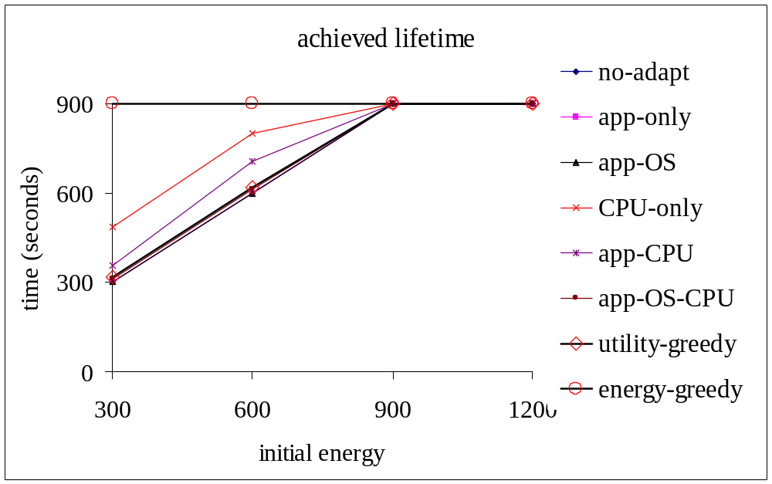
Compare Lifetime

Slide 44
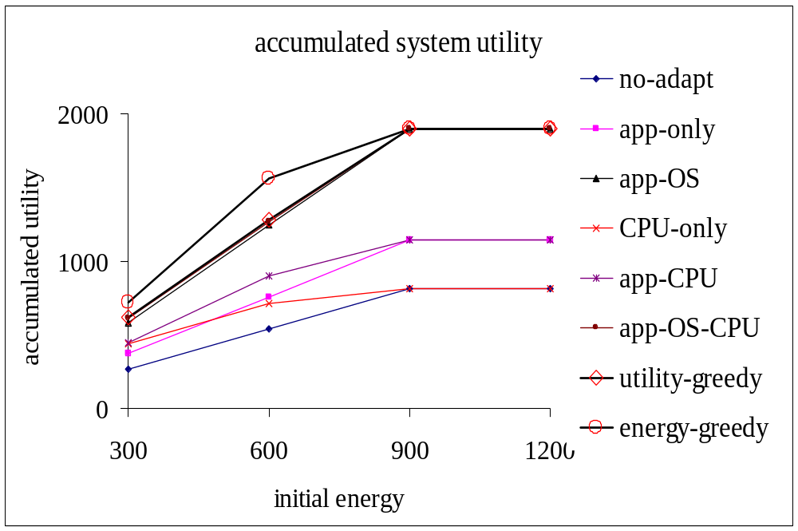
Compare Utility

Slide 45
Process Group Management in Cross-Layer Adaptation
Deadline miss ratio
Normalized CPU energy
of the hyper-video
Consumption
(hyper-video 4 mpgplay)
5
180
4
130.2
120
3
normalized energy
80.8
70.7
miss ratio (%)
2
60
1.2
1.4
1
0
0
Static
GRACE
GRACE
GRACE -1
GRACE -grp
CPU
-1
-grp
W. Yuan, K. Nahrstedt, “Process Group Management in Cross-Layer Adaptation”, SPIE Multimedia
Computing and Networking (MMCN), 2004

Slide 46
Outline
Motivation
Existing approaches
GRACE Cross-Layer Adaptation Framework
Evaluation
Conclusion

Slide 47
Lessons Learned So Far
GRACE
Coordinate cross-layer adaptation for energy saving and Quality provision
Consider stochastic real-time scheduling for soft-real time applications
  Statistical performance requirement and probability distribution of demand
  Integration of SRT and DVS
Build real systems and test-beds for experimental validation (GRACE-OS is first implementation of OS resource manager for cross-layer adaptation in Linux)

Slide 48
Acknowledgements
NSF ITR Funding CCR 02-055638
NSF CISE EIA 99-72884
GRACE Group – Sarita Adve, Douglas Jones, Robin Kravets, Wanghong Yuan, Albert F. Harris, Christopher J. Hughes, Daniel Grobe Sachs,Ruchira Sasanka, Jayanth Srinivasan
Contact: grace@cs.uiuc.edu

