Slide 1

BUFFERING APPROACH FOR ENERGY SAVING IN VIDEO SENSORS
Wanghong Yuan, Klara Nahrstedt
Department of Computer Science
University of Illinois at Urbana-Champaign
{wyuan1, klara}@cs.uiuc.edu

Slide 2
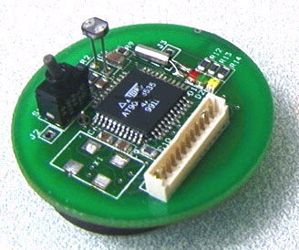

Motivation
Video sensors become popular
Capture images
Encode to frames
Transmit to center
Processing
Center
Saving battery energy !

Slide 3
Opportunities
Hardware level: performance vs. power
  Sleep, idle, active
  Switch into lower-power sleep
  Multiple frequencies/voltages (E∝fV²)
  Slow down to avoid idle
Application level
  Encoding and transmission slack

Slide 4
Challenges
period
CPU
NIC
encoding
encoding
transmission
transmission
Potentially
  Avoid CPU slack
  Sleep NIC when idle
However
  Cannot avoid all slack Wait for transmission
  NIC slack shorter than sleep cost (e.g., 40ms for WaveLAN)

Slide 5

Naïve Approach
period
period
f_{max}
enc
slack
CPU
NIC
tran
slack
One frame per period
  CPU: highest speed
  NIC: no sleep in slack
Energy:
Energy:

Slide 6

DVS Approach
f_{max}
slow down
f_{dvs}
CPU
NIC
enc
enc
tran
CPU
  Slow down to shorten slack
  But, still some slack !
Less !
Energy:

Slide 7
Buffering Approach
Why: Save both CPU and NIC energy
  Avoid all CPU slack
  Put idle NIC to sleep
How: Buffering
  Encode one frame per period
  Timely, no data loss
  Buffer and send frames in bursts
  Accumulated slack > sleep cost

Slide 8
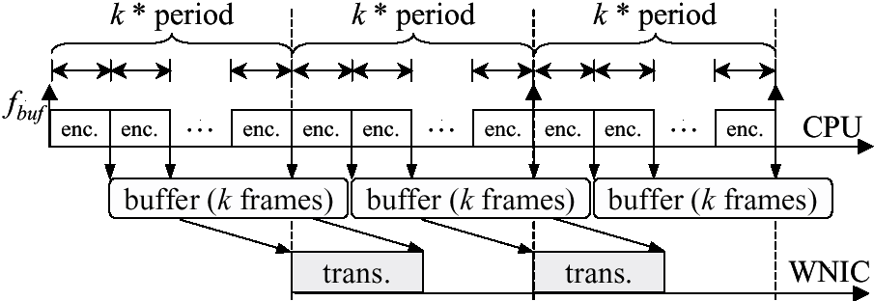

Buffering Approach
CPU Energy:
Less !
NIC Energy:

Slide 9


Experiment
H263 frames
Sender
(HP Pavilion)
Receiver
(IBM ThinkPad)
Athlon CPU
DVS, implemented
WaveLan
Sleep, simulated
Speed: 300 – 1000MHz
Power: 0.22 – 1 Watt
Trans power: 1.5 W
Idle power: 1 W
Sleep power: 0.1 W
Sleep cost: 40 ms

Slide 10
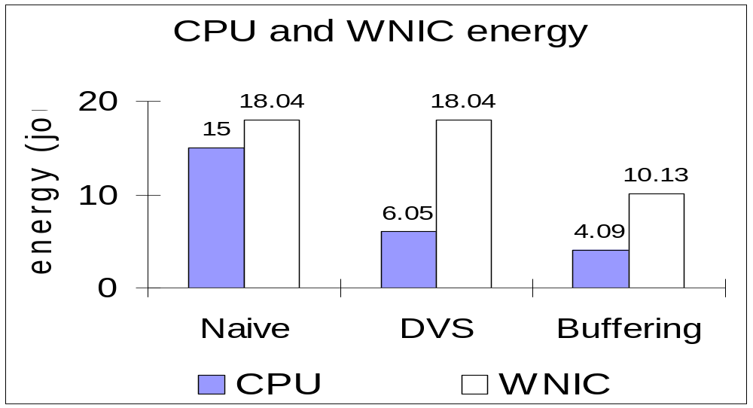
Results: Energy
Save CPU energy by 32% - 83%
Save NIC energy by 44%

Slide 11
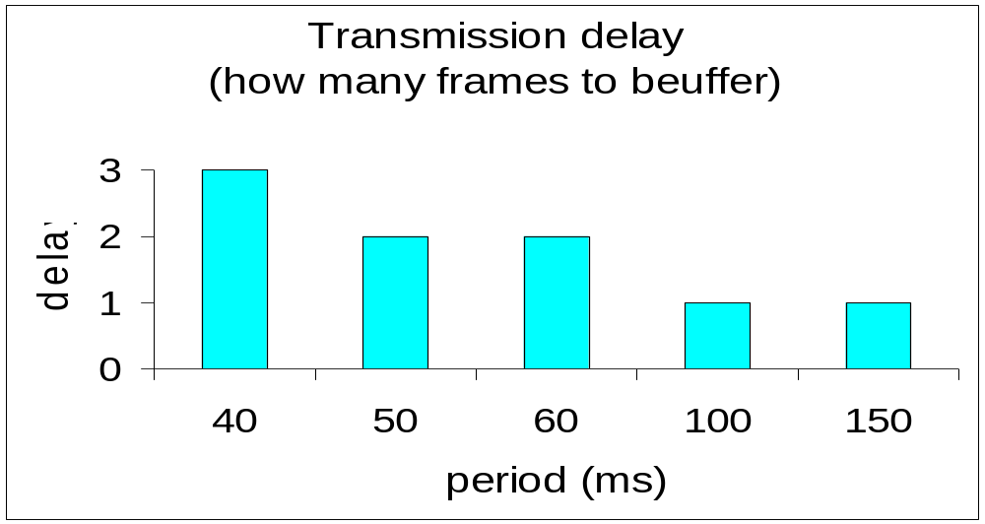
Results: Delay
Need to buffer only 1-3 frames

Slide 12
Conclusion
Part of the Illinois GRACE project
Cross-layer adaptation
  All layers are adaptive
  Cooperate
For energy saving
http://rsim.cs.uiuc.edu/grace/
Operating
System
Architecture,
Hardware
Coordinator
Application
Network
Protocols

