Slide 1
Energy-Efficient Soft Real-Time CPU Scheduling for
Mobile Multimedia Systems
GRACE
Wanghong Yuan, Klara Nahrstedt
Department of Computer Science
University of Illinois at Urbana-Champaign

Slide 2
Mobile Multimedia Devices
Challenges
  Manage resources to save energy while supporting multimedia quality
    CPU
Opportunities
  Dynamic frequency/voltage scaling (DVS)
  Applications release job periodically and meet deadline statistically (e.g., 95%)

Slide 3
GRACE-OS
Enhanced CPU scheduler
  Soft real-time scheduling + DVS
    Which application, when, how long, how fast
  Stochastic scheduling decisions
    Minimize energy while supporting quality
Part of cross-layer adaptation framework
GRACE

Slide 4
Architecture
Multimedia Applications
monitoring
stochastic requirements
scheduling
SRT Scheduler
demand distribution
GRACE-OS
Profiler
time constraint
Speed Adaptor
speed scaling
CPU

Slide 5
Three Subproblems
Profiler: demand prediction
  Basis for scheduling and DVS
SRT scheduler: stochastic scheduling
  Which app, when, and how long to execute
Speed adaptor: stochastic DVS
  How fast to execute

Slide 6
Demand Prediction
Online profiling and estimation
  1. Count number of cycles used by each job
  2. Group and count occurrence frequency
1
CDF
F(x) = P [X ≤ x]
cumulative
probability
C_{min}=b₀
b₁
b₂
b_{r-1}
b_{r}=C_{max}

Slide 7
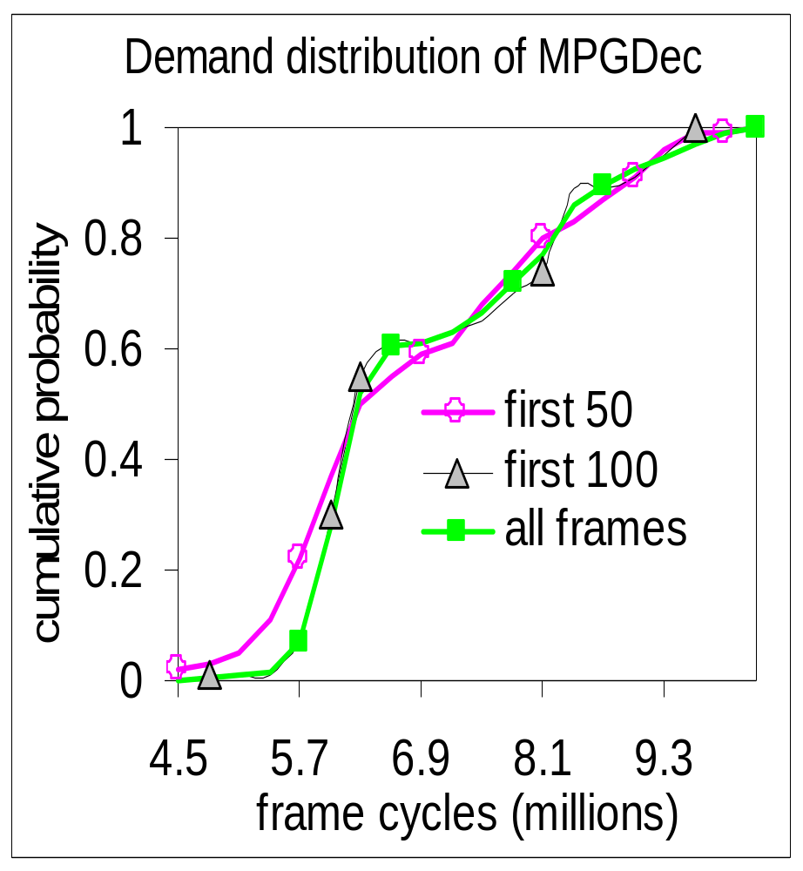
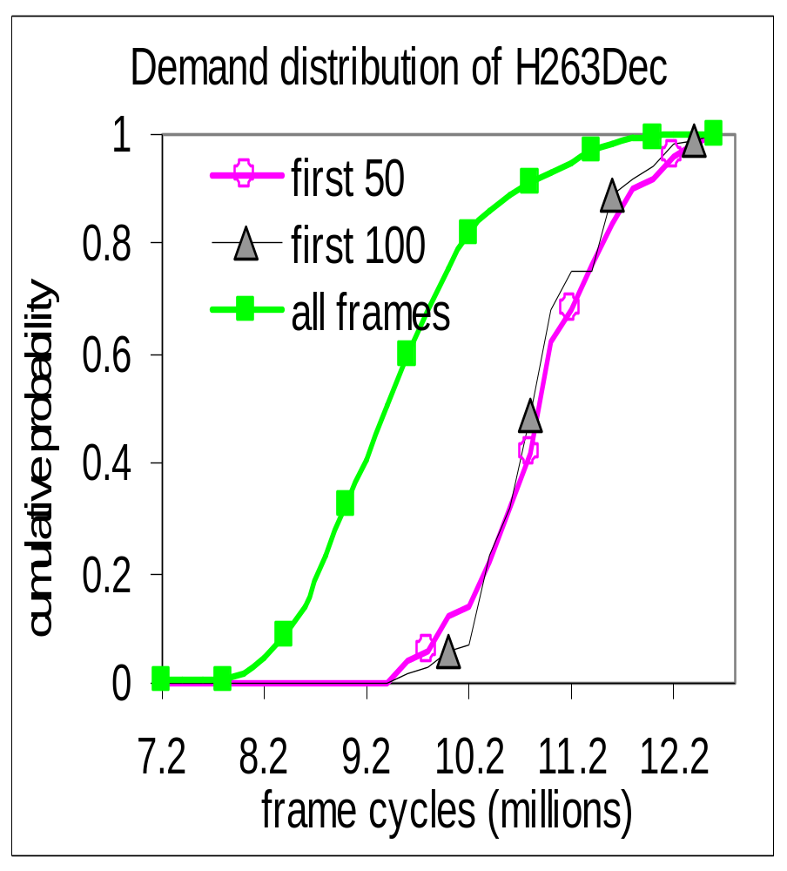
Observations
Demand distribution is stable or changes slowly

Slide 8
Three Subproblems
1. Profiler: demand prediction
  Basis for scheduling and DVS
2. SRT scheduler: stochastic scheduling
  Which app to execute, when, and how long
3. Speed adaptor: stochastic DVS
  How fast to execute

Slide 9
Stochastic Allocation
How many cycles to allocate per job?
Application requires α percent of deadlines
⇒ Each job meets deadline with probability α
⇒ Allocate C cycles, such that F(C)=P[X≤C] ≥ α
1
α
cumulative
probability
F(x)
b₀
b₁
b₂
C
b_{r-1}
b_{r}

Slide 10
Scheduling
Earliest deadline first (EDF) scheduling
  Allocate cycle budget per job
  Execute job with earliest deadline and +budget
  Charge budget by number of cycles consumed
    Preempt if budget is exhausted
Which job to execute, when, how long

Slide 11
Three Subproblems
1. Profiler: demand prediction
  Basis for scheduling and DVS
2. SRT scheduler: stochastic scheduling
  Which app to execute, when, and how long
3. Speed adaptor: stochastic DVS
  How fast to execute

Slide 12
How Fast ?
Intuitively, uniform speed
  Minimum energy if use the allocated exactly
However, jobs use cycles statistically
  Often complete before using up the allocated
  Potential to save more energy
  ⇒ Stochastic DVS

Slide 13

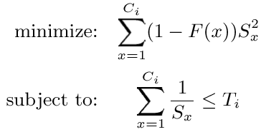
Stochastic DVS
For each job
  Allocate time
  Find speed S_{x} for each allocated cycle x
    Time is 1/S_{x} and energy is (1 - F(x))S²_{x}
such that

Slide 14
Speed Schedule
Piece-wise approximation
  Uniform speed within group
  Change speed at group boundaries, b₀,…,b_{k}
Speed schedule
  List of points (cycle b_{i}, speed S_{bi})
  Change speed to S_{bi} at b_{i} cycles

Slide 15
Example
cycle:
speed:
0
100 MHz
1 x 10⁶
200 MHz
2 x 10⁶
400 MHz
400
5x
10⁵
speed (MHz)
200
10⁶
2x
10⁵
100
10⁶
10⁶
Job 1
2.5x10⁶ cycles
Job 2
1.2x10⁶ cycles

Slide 16
Three Subproblems
1. Profiler: demand prediction
  Basis for scheduling and DVS
2. SRT scheduler: stochastic scheduling
  Which app to execute, when, and how long
3. Speed adaptor: stochastic DVS
  How fast to execute

Slide 17
SRT + DVS
context switch
Store speed for switched-out
New speed for switched-in
speed up
within job
A1
new job
B1
speed
A1
A1
A1
A2
B1
execution

Slide 18
Implementation
Hardware: HP N5470 laptop
  Athlon CPU (300, 500, 600, 700, 800, 1000MHz)
    Round speed schedule to upper bound
GRACE-OS: extension to Linux kernel 2.4.18
  716 lines of C code
system
call
process
control
block
SRT-DVS modules
PowerNow speed scaling
Soft real-time scheduling
standard
Linux
scheduler

Slide 19
Evaluation
Compare GRACE-OS with schemes performing deterministic allocation or DVS
 |  | DVS
 |  | uniform | reclamation | stochastic
allocation | worst-case | wrsUni | wrsRec | wrsSto
 | stochastic | stoUni | stoRec | GRACE-OS

Slide 20

Metrics
Quality evaluation
  Deadline miss ratio
    Applications require to meet 95%
Energy evaluation
  CPU time distribution at speeds [Flautner02]
    More time in low speeds ⇒ better
  Normalized energy

Slide 21
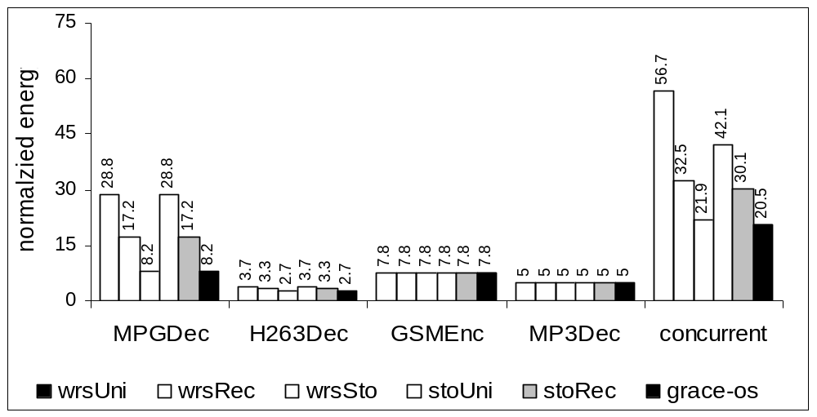
Normalized Energy
GRACE-OS consumes least energy
However, limited due to few speed options

Slide 22
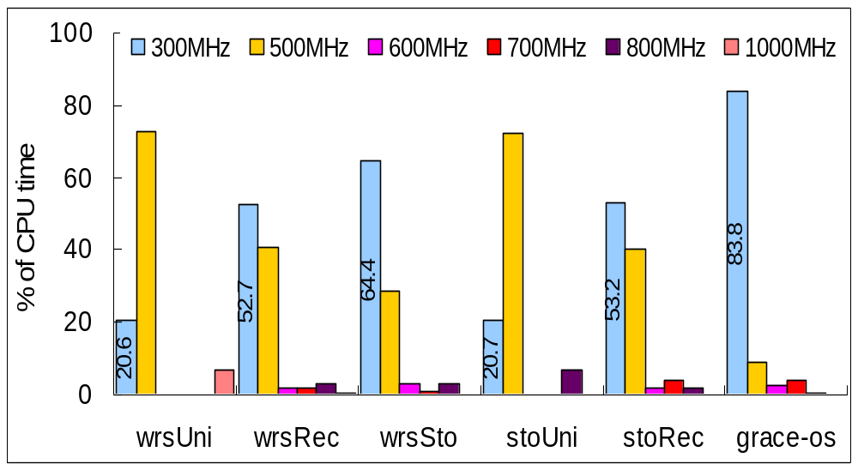
Time Distribution (concurrent run)
GRACE-OS spends most busy time at lowest

Slide 23
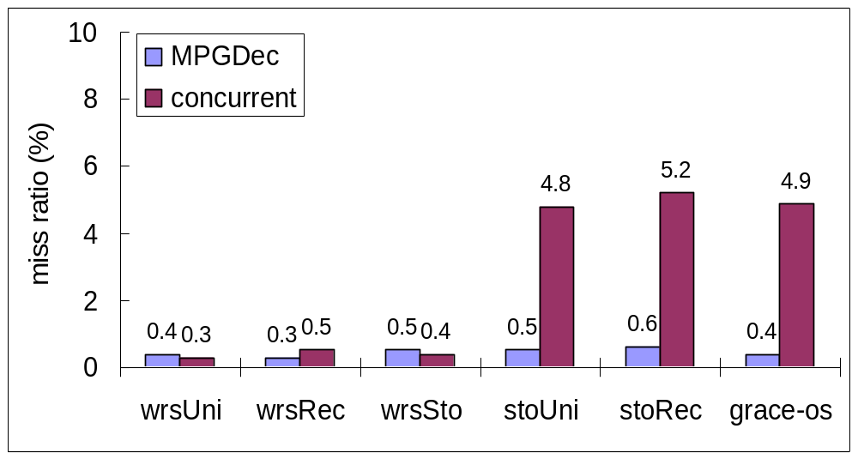
Deadline Miss Ratio
GRACE-OS bounds miss ratio

Slide 24
Conclusion
GRACE-OS
  Energy-efficient soft real-time scheduler
Lessons
  Effective for multimedia applications
    Periodic with stable demand distribution
  Limited by few speed options
Future work
  Extension to manage network bandwidth
  GRACE http://rsim.cs.uiuc.edu/grace

Slide 25
Backup
Power P(s) ∝ s³ Energy E(s) ∝ s²
1
deadline
deadline
1/2
speed
t
2t
t
2t
E = p(1) x t = t
E = p(1/2) x 2t
= (1/2)³ x 2t
= t/4

