Slide 1

Integrating Fine-Grained Application Adaptation with Global Adaptation for Saving Energy
GRACE
Vibhore Vardhan, Daniel G. Sachs, Wanghong Yuan, Albert F. Harris,
Sarita V. Adve, Douglas L. Jones, Robin H. Kravets, and Klara Nahrstedt
  Computer Science and Electrical & Computer Engineering
University of Illinois at Urbana-Champaign
http://www.cs.uiuc.edu/grace

Slide 2
Motivation
Goal: Energy efficient mobile multimedia systems
Opportunity: Dynamic resource variations
  Use adaptation to respond to changes
  Adapt all system layers
    Hardware, network, operating system, application, …
  All layers must adapt cooperatively
    to minimize energy
    while meeting current resource constraints
GRACE – Global Resource Adaptation through CoopEration

Slide 3
Challenges in Cross-Layer Adaptation - I
  What to adapt? When to adapt?
Ideally: All layers, all apps Frequently

Slide 4
Challenges in Cross-Layer Adaptation - I
  What to adapt? When to adapt?
Ideally: All layers, all apps Frequently
Expensive

Slide 5
Challenges in Cross-Layer Adaptation - I
  What to adapt? When to adapt?
Ideally: All layers, all apps Frequently
Prior work: All layers, all apps (GRACE-1) Infrequent
Expensive

Slide 6
Challenges in Cross-Layer Adaptation - I
  What to adapt? When to adapt?
Ideally: All layers, all apps Frequently
Prior work: All layers, all apps (GRACE-1) Infrequent
One app or one system layer Frequent
Expensive

Slide 7
Challenges in Cross-Layer Adaptation - I
  What to adapt? When to adapt?
Ideally: All layers, all apps Frequently
Prior work: All layers, all apps (GRACE-1) Infrequent
One app or one system layer Frequent
GRACE solution = hierarchical adaptation
  Three adaptation levels: global, per-app, and internal
  infrequent frequent but limited scope
Expensive

Slide 8
Challenges in Cross-Layer Adaptation - II
Implementing cross-layered hierarchical adaptation is difficult
  Multiple adaptations
  Multiple time-granularities
  What information to expose at each layer?
  How and when to communicate information between layers?
  ⇒ Interfaces need to be well designed

Slide 9
Contributions
Implementation of hierarchical adaptation on a real system
Significant energy savings from hierarchical adaptation

Slide 10
Overview
GRACE hierarchy
  Global
  Per-application
  Internal
System layers and adaptations for GRACE-2
Adaptation algorithms
Results
Summary

Slide 11
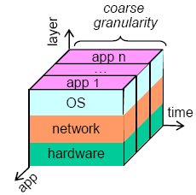
Global Adaptation
Adapts all applications and system layers
Goal: For all apps,
…
  choose app, CPU, network, … configuration such that
  minimize system energy
  subject to CPU, network, … constraints
Expensive – triggered on large changes
  e.g., app enters or exits
Adapts for long-term resource demands

Slide 12
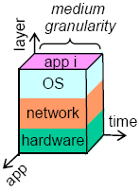
Per-Application Adaptation
Considers one application at a time - adapts all layers
Global adaptation decision = resource allocation
Goal: For a single app,
choose app, CPU, network, … configuration such that
minimize system energy
subject to CPU, network, … allocation from global
adaptation
Triggered every frame
Adapts for resource demand for next frame

Slide 13

Internal Adaptation
Adapts single system layer several times per frame
Not visible to rest of the system
Respects resource allocation from global

Slide 14
Overview
GRACE hierarchy
System layers and adaptations for GRACE-2
Adaptation algorithms
Results
Summary

Slide 15
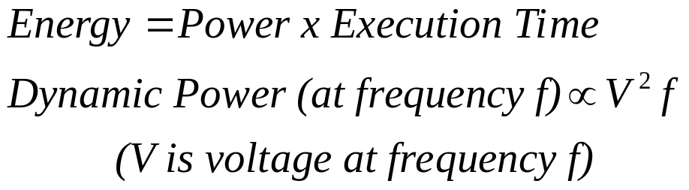
The CPU Layer
CPU adaptation:
  DVFS on Pentium-M processor
  Processor has discrete DVFS points
  Emulate continuous DVFS [Ishihara 98]
Adaptation decisions at global and per-app level
CPU energy model used by adaptation algorithm

Slide 16
The Application Layer
Adaptive H.263 encoder [Sachs 99]
  Adaptation decisions at global and per-app level
Adaptation
  Trade-off between network and CPU energy
  Choice between more or less compression
  Drop DCT and motion search based on adaptive thresholds
  No impact on user perception

Slide 17
The OS Scheduler Layer
Earliest-deadline first soft real-time scheduler
  Enforces budget allocations for CPU time, bandwidth
  Adapted at global and internal level
Scheduler supports budget sharing [Caccamo 00]
  Unused budget shared between applications
  Reduces number of deadline misses

Slide 18
The Network Layer
Non-adaptive network layer – not implemented
  Fixed (available) network bandwidth for each experiment
  2 Mbps to 11 Mbps in 802.11b WLAN
Network energy model used by adaptation algorithm

Slide 19
Adaptations in GRACE-2
Layer | Adaptation | Hierarchy Level
 |  | Global | Per-app | Internal
CPU | Dynamic voltage and frequency scaling (DVFS) | √ | √ | X

Slide 20
Adaptations in GRACE-2
Layer | Adaptation | Hierarchy Level
 |  | Global | Per-app | Internal
CPU | Dynamic voltage and frequency scaling (DVFS) | √ | √ | X
Application | Drop DCT and motion estimation computations based on adaptive thresholds | √ | √ | X

Slide 21
Adaptations in GRACE-2
Layer | Adaptation | Hierarchy Level
 |  | Global | Per-app | Internal
CPU | Dynamic voltage and frequency scaling (DVFS) | √ | √ | X
Application | Drop DCT and motion estimation computations based on adaptive thresholds | √ | √ | X
Scheduler | Change CPU time, network bandwidth budget | √ | X | √

Slide 22
Overview
GRACE hierarchy
System layers and adaptations for GRACE-2
Adaptation algorithms
Results
Summary

Slide 23
Global Adaptation (1 of 2)
Invoked on large changes in system – e.g., application enters/exits
Goal: For all apps,
  …
  choose app + CPU config
  minimize CPU + network energy
  subject to CPU and network bandwidth constraints
MMKP problem – solved using heuristics and brute force

Slide 24
Global Adaptation (2 of 2)
App 1
App k
App config 1
CPU config 1
…
CPU config m
App config n
CPU config 1
…
CPU config m
…
…
CPU time, network bytes
(long-term history,
95th percentile)
Global controller
CPU, network allocation

Slide 25
Per-app Adaptation (1 of 2)
Invoked at start of an application frame
Goal: For a single app
  choose app + CPU config
  minimize CPU + network energy
  subject to CPU, network allocation from global adaptation

Slide 26
Per-app Adaptation (2 of 2)
App i
App config 1
CPU config 1
…
CPU config m
App config n
CPU config 1
…
CPU config n
…
CPU time, network bytes
(short-term history,
linear predictor)
Per-app controller
choose app, CPU config

Slide 27
GRACE-2 System – Architecture (1/3)
Application
Network
Monitor
Adaptor
Predictor
CPU
Per-app Controller
allocated time, bandwidth
long-term
resource demands
Monitor
Global Controller
Monitor
Adaptor
allocated time, bandwidth, energy
OS Scheduler
Monitor
Global controller in action

Slide 28
GRACE-2 System – Architecture (2/3)
Application
Network
Monitor
Adaptor
Predictor
CPU
app config
next frame’s resource demands
frequency
Per-app Controller
allocated time, bandwidth
long-term
resource demands
Monitor
Global Controller
Monitor
Adaptor
allocated time, bandwidth, energy
OS Scheduler
Monitor
Per-app controller in action

Slide 29
GRACE-2 System – Architecture (3/3)
Application
Network
Monitor
Adaptor
Predictor
CPU
app config
next frame’s resource demands
frequency
status: energy; miss, overrun
Per-app Controller
allocated time, bandwidth
long-term
resource demands
Monitor
Global Controller
Monitor
cycles usage
Adaptor
bandwidth
allocated time, bandwidth, energy
OS Scheduler
Monitor
frequency
OS scheduler in action

Slide 30
GRACE-2 System – Implementation
Implemented on ThinkPad R40 laptop and Linux 2.6.8-1
  Everything except network is implemented
All results include global adaptation in all layers
  Global saves average 32% energy over base system

Slide 31
Experimental Methodology
Evaluated remote sensing, teleconferencing type applications
  Combinations of speech and video encoders and decoders
    Multiple encoders and/or decoders per workload
    Standard video and audio input streams
  Only H.263 video encoder is adaptive

Slide 32
Experimental Methodology - Workloads
Evaluated remote sensing, teleconferencing type applications
  Combinations of speech and video encoders and decoders
    Multiple encoders and/or decoders per workload
    Standard video and audio input streams
  Only H.263 video encoder is adaptive
4 resource constraints (vary period, bandwidth ⇒ 16 workloads)
  Unconstrained
  Only CPU Constrained
  Only Network Constrained
  Both Constrained

Slide 33
Experimental Methodology - Energy
Measured entire system energy using sampling power supply
  Including display, disk, memory system
  Modeled network energy added to measurements
Isolated CPU+network energy with CPU, network models
  Models applied to implemented system
  First set of results based on these models

Slide 34
Overview
GRACE hierarchy
System layers and adaptations for GRACE-2
Adaptation algorithms
Results
  CPU + network
  System
Summary

Slide 35
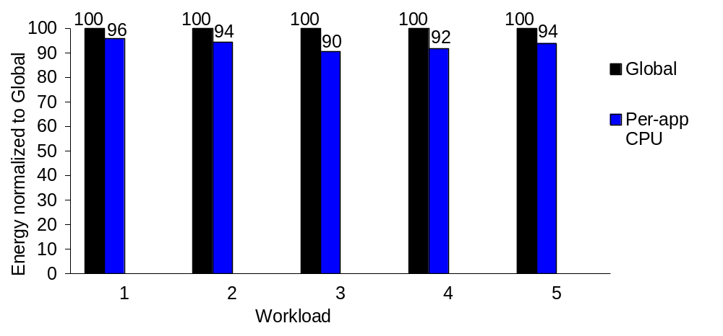
CPU + Network (Model) Energy Savings (1/3)
Per-app CPU adaptation gives modest savings
  4 to 10%, average 7%

Slide 36
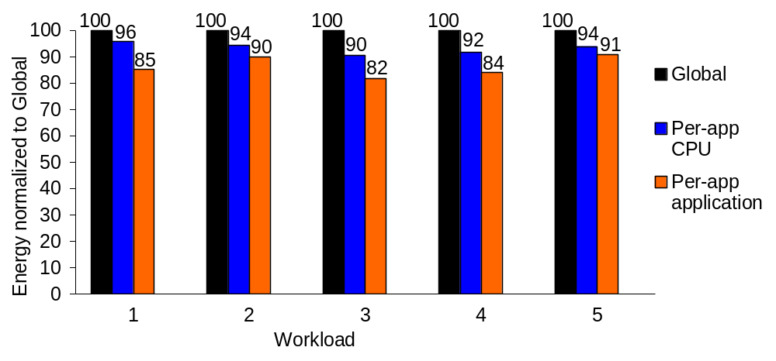
CPU + Network (Model) Energy Savings (2/3)
Per-app application adaptation saves significant energy over global
  9% to 18%, average 14%

Slide 37
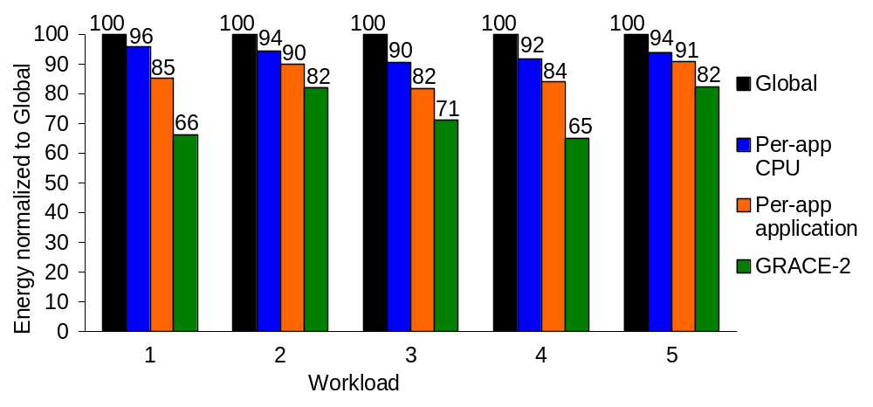
CPU + Network (Model) Energy Savings (3/3)
GRACE-2 = Global + Per-app CPU + Per-app application
  Saves significant energy over global: 18% to 35%, average 27%
  > only per-app CPU + only per-app application

Slide 38
CPU + Network (Model) – Analysis
CPU energy > network energy
  App config that does least compression is least energy
    True for all constraint scenarios
    Bytes generated by some frames > bandwidth
    ⇒ Global will not use this config
Per-app has better predictions – better resource utilization

Slide 39
Results – Measured Energy Savings
GRACE-2’s per-app adaptation saves noticeable system energy
  Network constrained workloads benefit most
  Savings between 7% and 14%, average of 10%
    This is in addition to global adaptation
Measurements include display, disk, memory system power

Slide 40
Summary
Goal: Energy efficient mobile multimedia systems
GRACE uses hierarchical cross-layer adaptations in all layers
  Our focus: per-app adaptations
Per-app adaptation effective with network constraint
  Better utilization of resources based on better predictions
  27% savings over global
  Combining per-app adaptations > additive savings

Slide 41
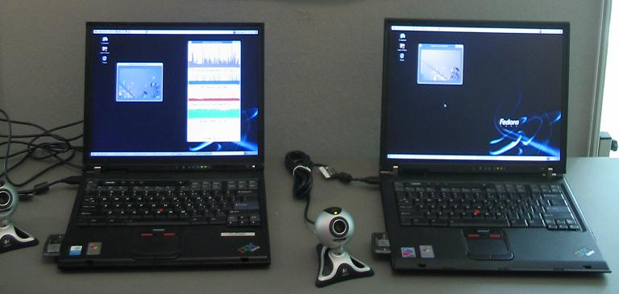
Current/Future Work
Network implementation
Integrating reliability
Other application adaptations
Improving per-app predictors

