Slide 1
Challenges in Power Management
Vibhore Vardhan
Computer Science
University of Illinois at Urbana-Champaign
vvardhan@uiuc.edu

Slide 2
Motivation
Current power management algorithms:
  Focus on single core systems
  Minimize dynamic power consumption
  DVFS most widely used technique

Slide 3
Motivation
Current power management algorithms:
  Focus on single core systems
  Minimize dynamic power consumption
  DVFS most widely used technique
BUT,
  Embedded systems moving to multi-core platforms
    e.g., Intel Duo (homogenous), TI OMAP (heterogeneous)
  Static power ≈ dynamic power

Slide 4
New Challenges
Embedded systems moving to multi-core platforms
  ⇒ Minimize total power (core 1 + core 2 +…+ core n)
Static power ≈ dynamic power
  ⇒ Minimize total power (static + dynamic)
⇒ Use DVFS + other techniques

Slide 5
Terminology
Dynamic Power Management (DPM)
  System framework to reduce total power (static + dynamic)
Controls several circuit techniques
Technique | Power Reduced (primarily)
Clock Gating | Dynamic
Dynamic Power Switching (DPS) | Static
Dynamic Voltage and Frequency Scaling (DVFS) | Dynamic
Power Gating | Static

Slide 6
Overview
Multi-core Systems
  Example – OMAP 2420 Architecture
  DPM Issues
  Related Work
Combining DVFS and DPS

Slide 7
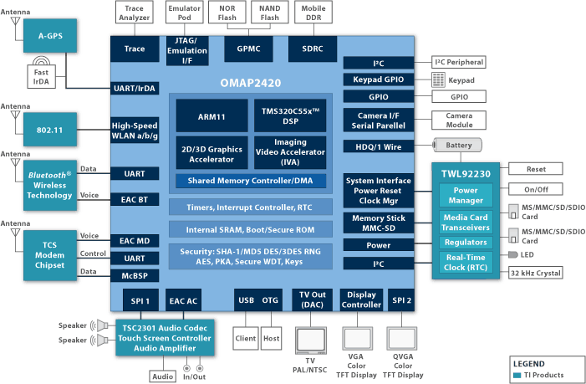
Multi-core Example – OMAP 2420

Slide 8
DPM on Multi-core Systems (1/2)
Future Work (1/2)
Problem
  Application uses more than one core
    e.g., accelerated video, graphics
    One application/core can be solved easily
  Minimize total power (core 1 + core 2 +…+ core n)
Challenges
  Adaptation used on one core influences other cores
    e.g., same voltage plane
  Effect of relationship between cores
    e.g., master-slave vs. producer-consumer

Slide 9
DPM on Multi-core Systems (2/2)
Future Work (1/2)
Approach
  Profile multi-core applications on 2420
    Find load distribution, relationship across cores
  Figure out usable circuit techniques
  Develop algorithms based on theoretical models
    e.g., minimize energy of core having maximum load
  Leverage findings from GRACE project
    Multiple cores vs. multiple system components (network, CPU, etc.)
  Implement in a real system

Slide 10
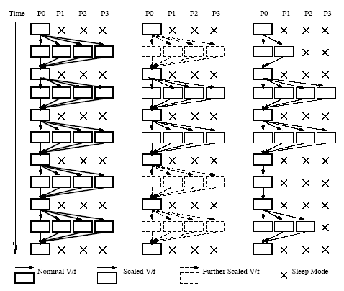
Related Work – Homogenous Multi-core (1/2)
DPM of parallel computation on CMPs [Li 06]
Given
  Power budget
  Performance target
Find
  Number of cores N
  DVFS point for all cores F

Slide 11
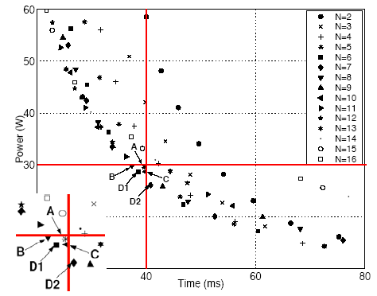
Related Work – Homogenous Multi-core (2/2)
Solution (for reducing 2-d search space)
  Binary search + hill climbing
Results
  N varies across workloads
  Algorithm near optimal
Thoughts
  Simplified system
  Implementation issues

Slide 12
Related Work – Heterogeneous Multi-core
Minimize energy in distributed embedded systems
  Papers from real-time community, SoC
  DVFS based techniques
Solution
  Static schedule based on task graph, thread frame etc.
  Run-time schedule handles variations
Thoughts
  Feasibility of generating task-graphs
  Mobile devices operate in dynamic environment

Slide 13
Overview
Multi-core Systems
  OMAP 2420 Architecture
  DPM Issues
  Related Work
Combining DVFS and DPS

Slide 14
Combining DVFS and DPS (1/2)
Future Work (2/2)
Problem
  Static power ≈ dynamic power
  Complex trade-off between static and dynamic power
Challenges
  DPS reduces static power
    ↓ running-time ↓ static
    ↑ voltage ↑ dynamic (possibly)
  DVFS reduces dynamic power
    ↓ voltage ↓ static
    ↑ running-time ↑ static (possibly)

Slide 15
Combining DVFS and DPS (2/2)
Approach
  Combine DVFS + DPS
    Minimize total power (static + dynamic)
  Compare DVFS and DPS on 2420
    Theoretical calculations based on published parameters
    Find feasibility of DVFS + DPS
  Propose algorithm based on these calculations
  DPS requires saving/restoring context
    Not all context needs to be saved/restored
      Leverage findings from reliability papers

Slide 16
Q&A
Other ideas?

