Slide 1
Designing Reliable Systems from Unreliable Components: the Challenges of Transistor Variability and Degradation
Author: Shekhar Borkar (Intel)
Presenter: Alex Li

Slide 2
Motivation (1 of 2)
Limitation in VLSI transistor integration
  Past: die size, chip yields, design productivity
  Now: energy consumption, power dissipation, power delivery
Leakage current keeps increasing
  Solutions: leakage avoidance, tolerance, circuit control techniques

Slide 3
Motivation (2 of 2)
Technology scaling ⇒ New limitations
  Future: variability, soft errors, device degradation
Challenge: design reliable systems with unreliable transistors?

Slide 4
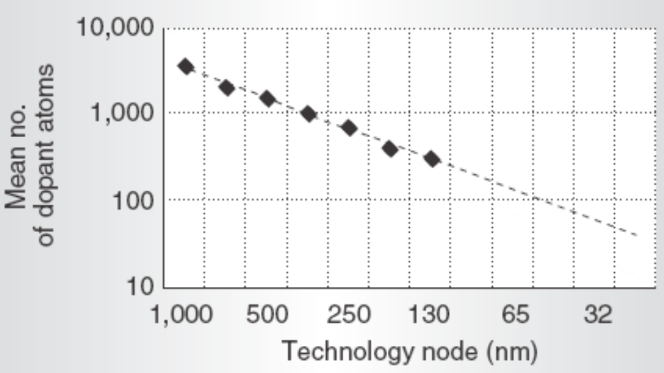
Variation Sources (1 of 3)
Random dopant fluctuations (static)
  1/1000 = 0.1% (250nm)
  1/100 = 1% (65nm)
  1/60 = 1.6% (32nm)

Slide 5
Variation Sources (2 of 3)
Due to sub-wavelength lithography (static)
  (wavelength - feature_size) keeps increasing
  Line edge roughness ⇒ variations

Slide 6
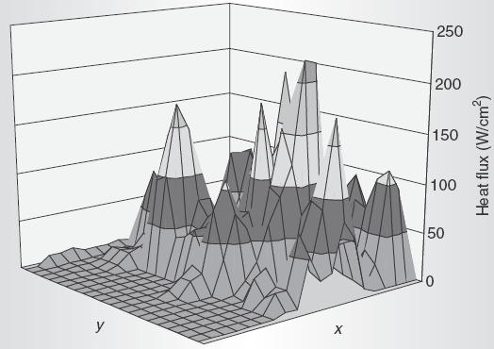
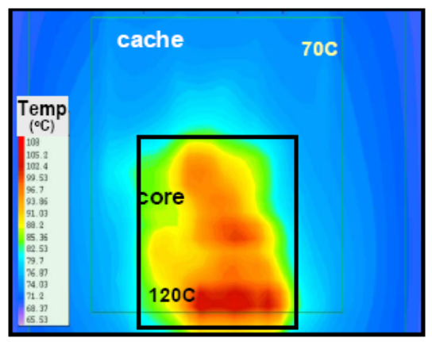
Variation Sources (3 of 3)
On-chip heat flux (dynamic)
  Δtemp lead to
    Δleakage
    Δpower demand (dynamic+static)
  Supply voltage scaling ⇒ supply current jump

Slide 7
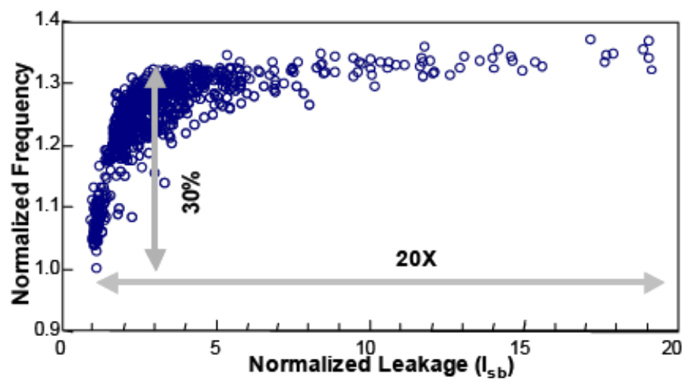
Variation Impact
Process variations result in
  30% Δfrequency
  ~50% Δtotal power
    leakage power: 30-50% of total
    5x to 10x Δleakage power

Slide 8
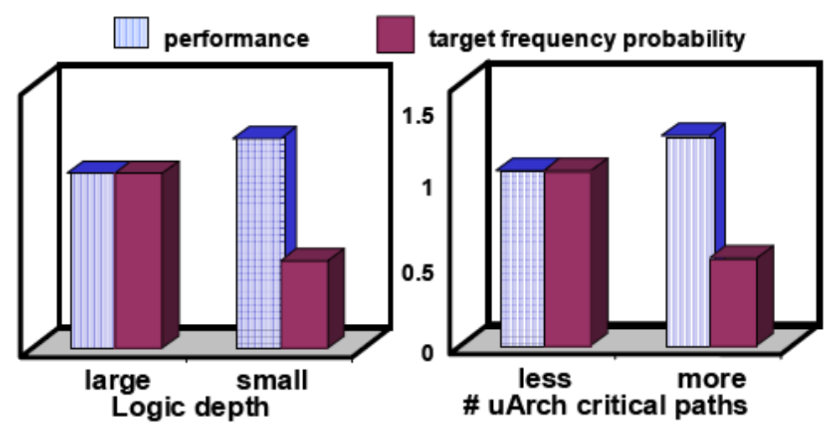
Variation Tolerance (1 of 2)
High-freq, deep-pipeline designs less tolerant
Downsizing indiscriminately increases variation impact
Future design tools need consider variation
  Optimize for power and its dist. besides freq

Slide 9
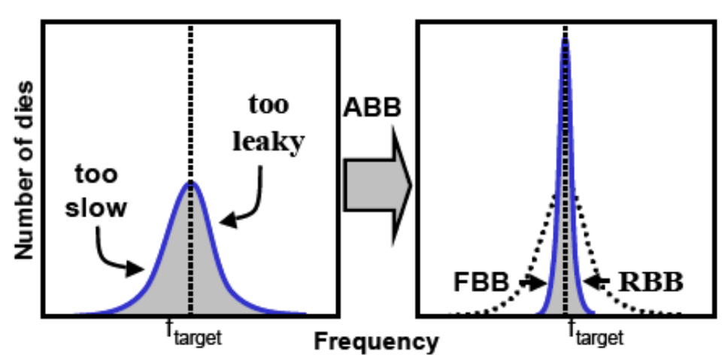
Variation Tolerance (2 of 2)
Circuit level: Body Bias Control
  Forward BB to increase freq
  Reverse BB to reduce leakage
  Adaptive BB = FBB + RBB
  Both die-to-die and within-die

Slide 10
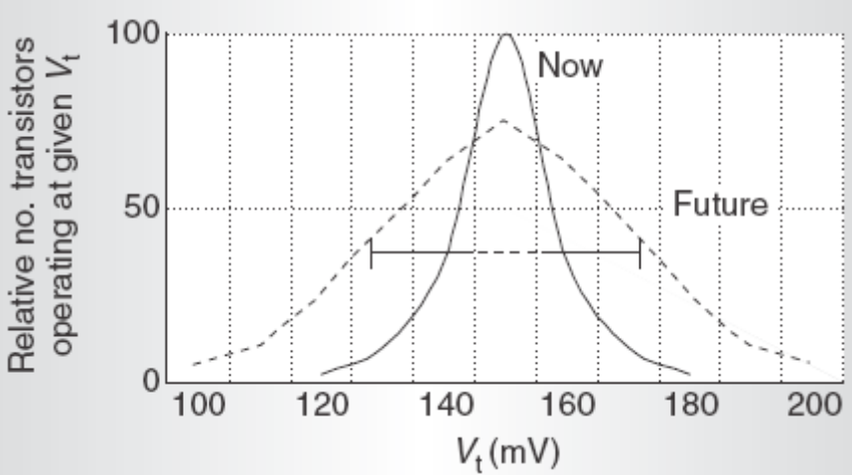
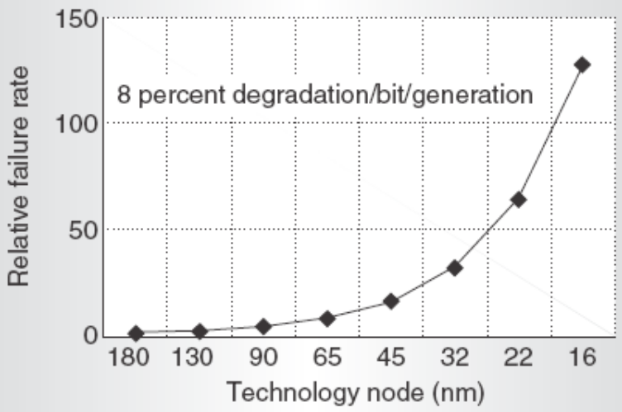
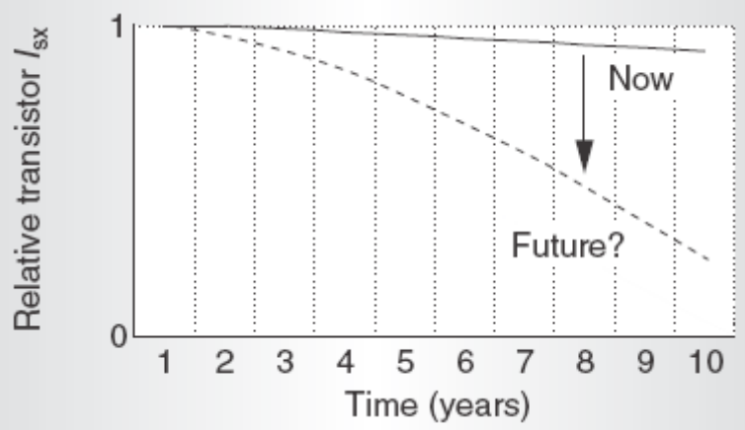
Extreme Variations

Slide 11
Reliability
Low supply voltage ⇒ exp leakage current
  Burn-in testing obsolete
  Cannot weed out bad chips
Soft errors
Aging and Degradation
Need collective effort
  Fab, u-arch, testing, SW, etc.

Slide 12
Future Work
Design optimizations
  Now: deterministic - power & performance
  Next: probabilistic - reliability, yield, binning
Reliable designs
  Circuit: Razor
  System: RSE & DIVA
Farther future
  Resilient u-arch
    Self-testing, self-reconfiguring, adaptive
    No need one-time factory testing

Slide 13
References
Borkar et al., “Parameter Variations and Impact on Circuits and Microarchitecture,” Proc. 40th Design Automation Conf. (DAC 03)
Rabaey et al., “Digital Integrated Circuits: A Design Perspective,” 2nd Edition, Prentice-Hall.

