Slide 1
Cross-Border transaction Platform
Ratinder Singh
Ratinder.singh@npci.org.in
Emp. code-24203

Slide 2
Use case
For transacting internationally with cost-effective and fast approach.
Transparent process is required.
Distributed energy resources optimal utilization and diversified secure platform.
A peer-to-peer model

Slide 3
Solution
Blockchain technology usage to implement distributed ledger for secure, transparent and traceble system.
A platform for common space for all the organisations.
Dilema of slow process of international transaction is eliminated.
Hinders the fault and problems faced with failed payments.

Slide 4
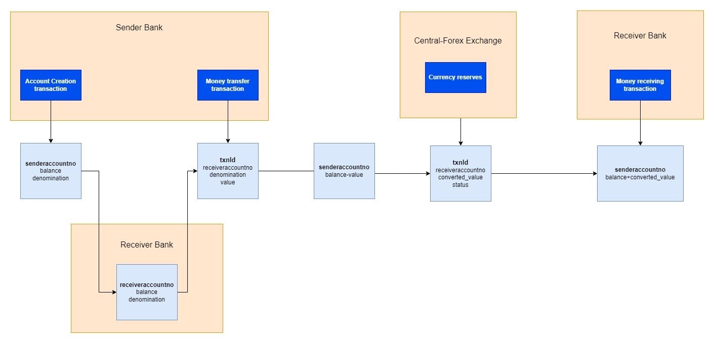
Workflow

Slide 5
Workflow
Senderbank Creates moneytransfer transaction
Updates sender’s account balance
Central Bank System approves/rejects the moneytransfer transaction
Receiver checks the balance
Based on approval only, receiver bank will update the balance of receiveraccountno

Slide 6
Assets
Senderbank
Senderaccountno
Balance
Central Bank System
Transaction ID
Senderaccountno
Receiverbank
Receiveraccountno
denomination
Recevieraccountno
value
Balance
denomination

Slide 7
Participants
Country Banks
Sender, receiver
Central Banking authority

Slide 8
Transactions
Monetary transactions, debit only
Transaction request raised by sender
Transaction processed and intimated to central authority
Request of transaction implied to receiver's bank

Slide 9
PDC implementation
Accessing certain personal information , balance of sender and receiver with their respective banks only.

Slide 10
Enhancements
Changing rates in foreign exchange central bank would have been nice, which will fetch current rates only. Here in this project, rates were statically fixed.
Events to be followed, when status is false. Allowing capability of central bank to reject a money transfer request.
Inclusion of UI for better user experience.
Multiple banks intricacies, for better view of complex management.

