Slide 1
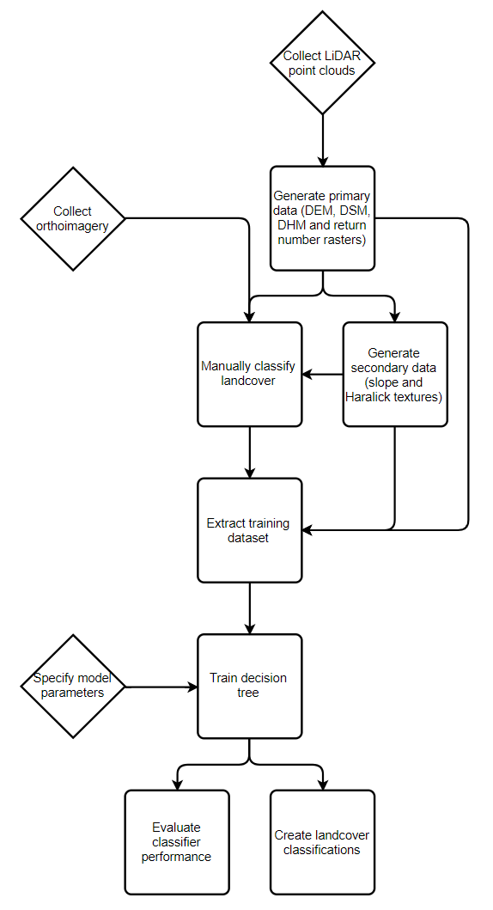
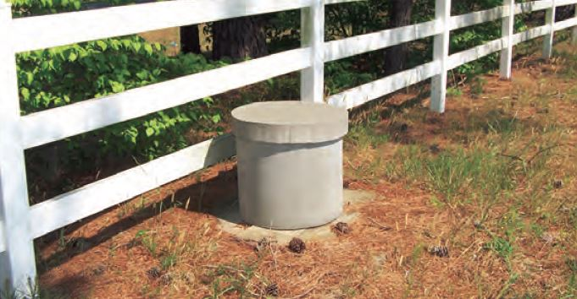


619698: A Generalizable Strategy for Riparian Vegetation Assessment Using LiDAR
Sky Jones¹, Dr. Racha El Kadiri², Dr. Henrique Momm³
American Geophysical Union Fall Meeting 2019
¹Undergraduate Student, Middle Tennessee State University Department of Geosciences; ²Assistant Professor, Middle Tennessee State University Department of Geosciences; ³Associate Professor, Middle Tennessee State University Department of Geosciences
Study Areas
Abstract
Sample Output
Hydrologists, watershed planners, stream restorationists and other investigators have long used LiDAR derived-data to classify riparian landcover, but the classification models that have been developed are limited in scope, requiring reinvestigation and retraining for each new study area. We have generalized this LiDAR-based approach to landcover classification by showing that a single model can perform accurate 3-class landcover classification in 7 watersheds across the United States with dissimilar ecological and geomorphological characteristics. Multiple models were investigated that use various combinations of LiDAR-derived datasets that account for inconsistencies in data preparation and collection between different LiDAR data vendors. The landcover classification scheme used was “trees”, “herbaceous vegetation” and “other”, which is sufficient for many remote-sensed watershed investigations.
Training Data
(2-3 orthophoto views along with predicted landcover. Decision tree probably too big to place legibly)
Model Performance
Landcover was manually classified for each watershed using LiDAR-derived data products and temporally concurrent aerial orthoimagery as a reference. These landcover classifications and data products were used to train the decision tree classifier.
Secondary data products were created by applying a given procedure to each of the primary data products. LiDAR intensity values were not used because there is no set standard for normalization of intensity, meaning values from different LiDAR missions cannot be compared.
This is just a sample; will want to include the above table as well as a comparison of F1 scores for each watershed
Simplified Workflow
Discussion
Future Work
The model will be refined further by adding additional dissimilar study areas, in particular watersheds dominated by open prairies or suburban development. In the near future it may be possible to incorporate LiDAR intensity values into the model as vendors begin to standardize this parameter, allowing accurate comparison of intensity values collected during different missions. Performance may be improved by adjusting decision tree boundaries with an optimization heuristic such as a genetic algorithm or simulated annealing.
Discussion of success and shortcomings (as of now, can’t discern impervious surfaces which is a big problem, but less so if we consider the model is intended to classify riparian corridors, and also textural analysis has not yet been implemented)
Acknowledgements
Thank you to my advisors Dr. Racha El Kadiri and Dr. Henrique Momm for their guidance and support during this project, and to the National Resources Conservation Service for funding. Additional thanks to Conner Reed for his assistance with creating the training landcover classifications.
References
Haralick, R. M., Shanmugam, K., & Dinstein, I. (1973). Textural Features for Image Classification. IEEE Transactions on Systems, Man, and Cybernetics, SMC-3(6), 610–621. doi: 10.1109/tsmc.1973.4309314
Kashani, A., Olsen, M., Parrish, C., & Wilson, N. (2015). A Review of LIDAR Radiometric Processing: From Ad Hoc Intensity Correction to Rigorous Radiometric Calibration. Sensors, 15(11), 28099–28128. doi: 10.3390/s151128099
Momm, H., Easson, G., & Kuszmaul, J. (2009). Evaluation of the use of spectral and textural information by an evolutionary algorithm for multi-spectral imagery classification. Computers, Environment and Urban Systems, 33(6), 463–471. doi: 10.1016/j.compenvurbsys.2009.07.007

