Slide 1

pyfluv
A Python package for stream analysis
Sky Jones
Sky.Jones@kci.com

Slide 2
What is pyfluv?
pyfluv is a free and open source Python package that provides a high level programmatic interface for interacting with geomorphological stream surveys
(and other restoration-related data)

Slide 3
Goals of pyfluv
Provide an high level, extensible programming library for analyzing stream surveys
Encourage standardized data formatting and facilitate the analysis of large amounts of data
e.g., meta-analyses, remotely sensed data
Demonstrate novel techniques for stream analysis

Slide 4
Benefits of programmatic analysis
Repeatability and precision
Document every step of analysis from raw data to final results
Automation
Create scripts that instantly analyze field data
Write routines to analyze large amounts of remotely sensed data

Slide 5
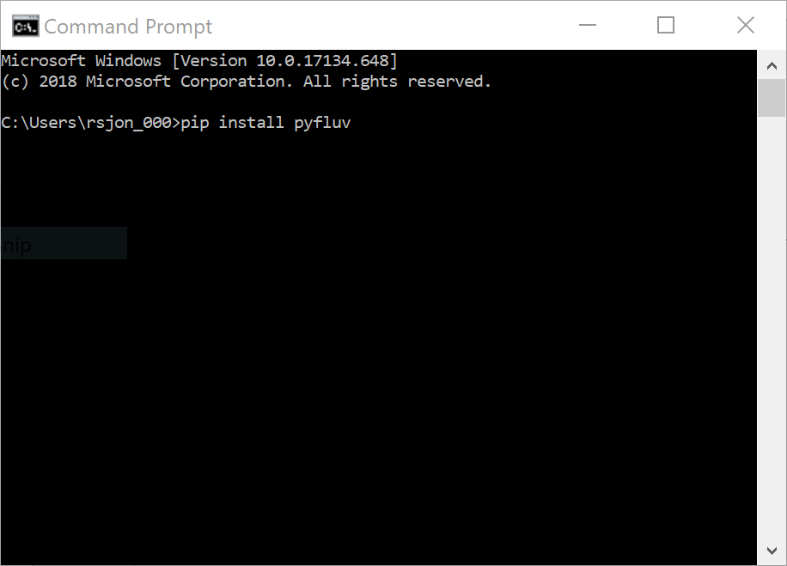
Downloading pyfluv
pip install pyfluv from the terminal
Source code available at https://github.com/rsjones94/pyfluv

Slide 6
A short demonstration Full tutorials at https://github.com/rsjones94/pyfluv-notebooks

Slide 7
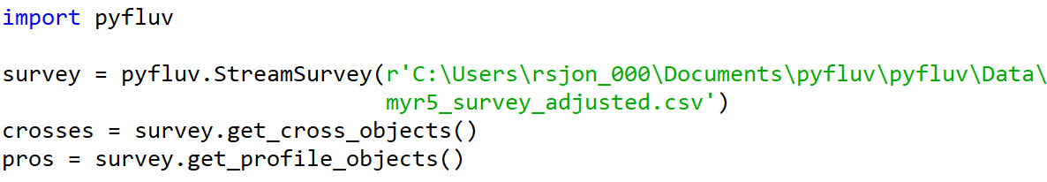
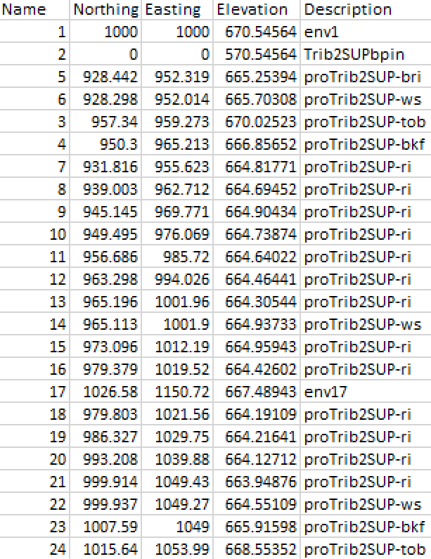
Reading in a survey
The survey contains
1516 points
14 cross sections
6 longitudinal profiles

Slide 8
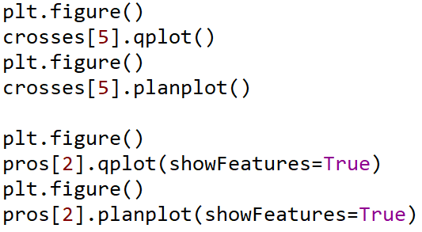
Quickplotting

Slide 9
