Slide 1


A Python package for stream analysis
Sky Jones
Email: Sky.Jones@kci.com
Github: https://github.com/rsjones94/pyfluv

Slide 2
What is pyfluv?
pyfluv is a free and open source Python package that provides a high level programming interface for working with geomorphological stream surveys
(and other restoration-related data)

Slide 3
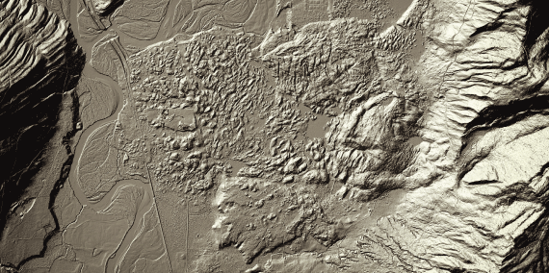
Benefits of programmatic analysis
Repeatability and precision
Document every step of analysis from raw data to final results
Automation
Create scripts that instantly analyze field data
Write routines to analyze large amounts of remotely sensed data
Image: WA-DNR

Slide 4
Goals of pyfluv
Provide a high level, extensible programming library for analyzing stream surveys, with a focus on stream restoration
Encourage standardized data formatting and facilitate the analysis of large amounts of data
e.g., meta-analyses, remotely sensed data
Demonstrate novel techniques for stream analysis

Slide 5
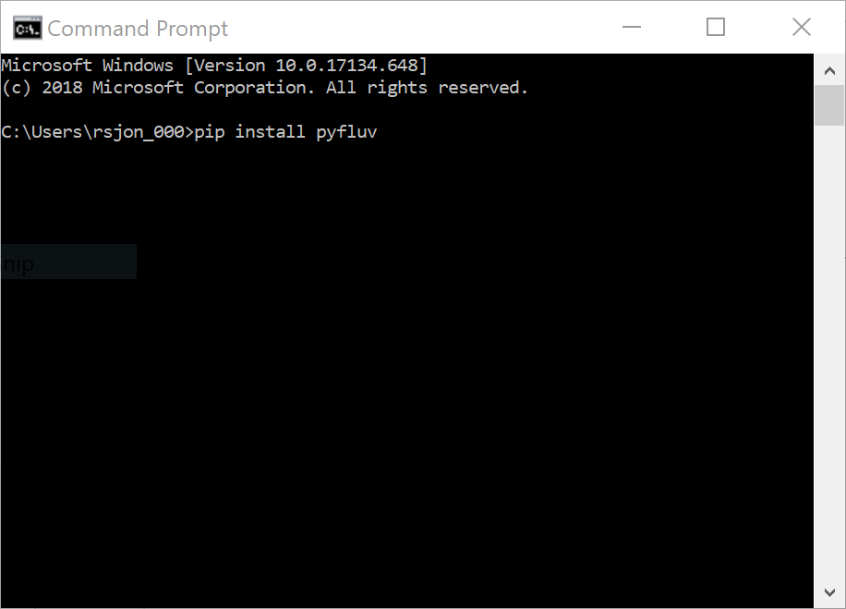
Downloading pyfluv
Anyone with Python can pip install pyfluv from the terminal
Source code available at https://github.com/rsjones94/pyfluv

Slide 6
A short demonstration Full tutorials at https://github.com/rsjones94/pyfluv-notebooks

Slide 7
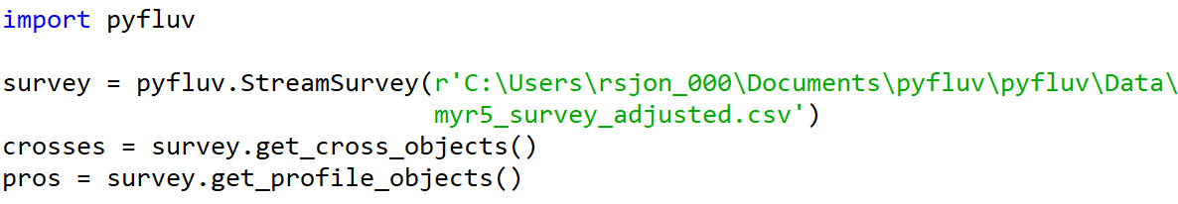
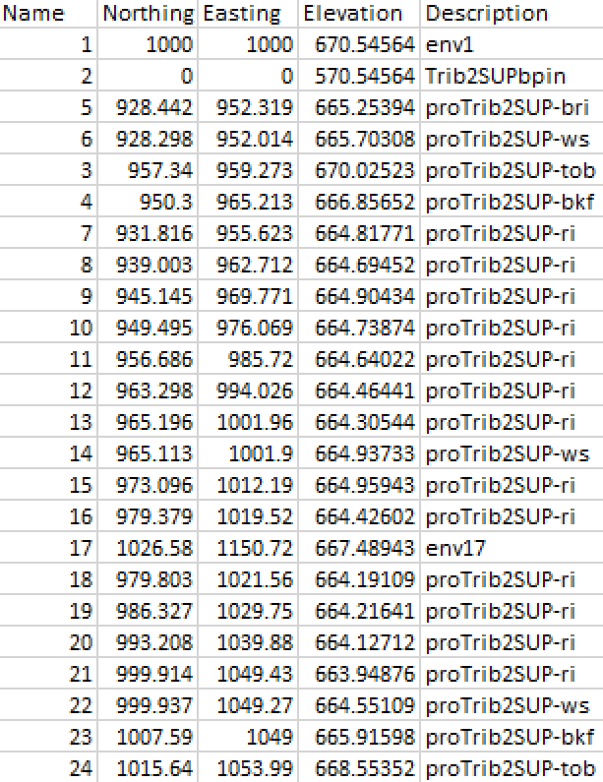
Reading in a survey
The survey contains
1516 points
14 cross sections
6 longitudinal profiles

Slide 8
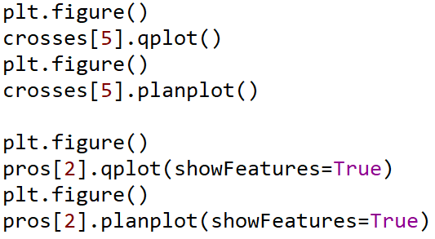
Quickplotting

Slide 9
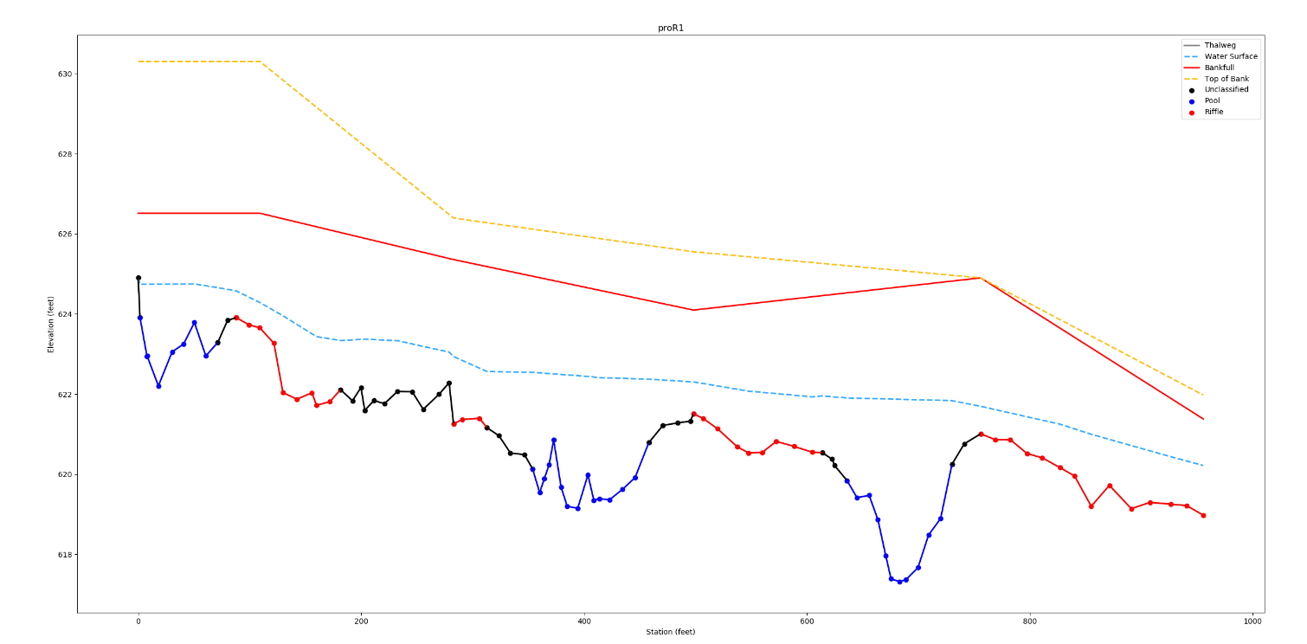
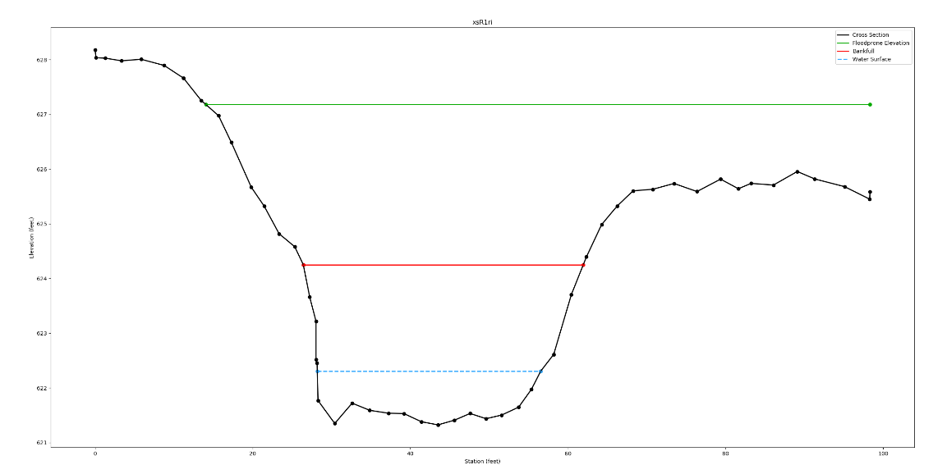
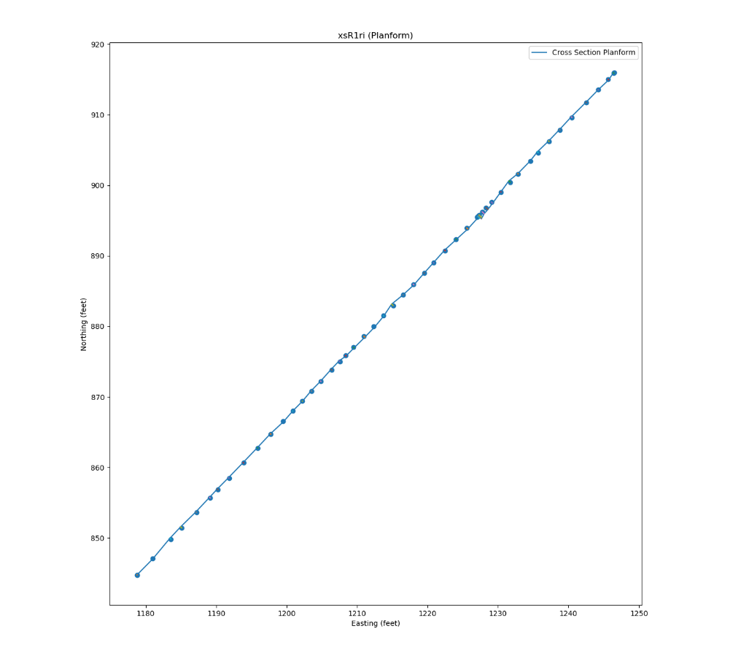
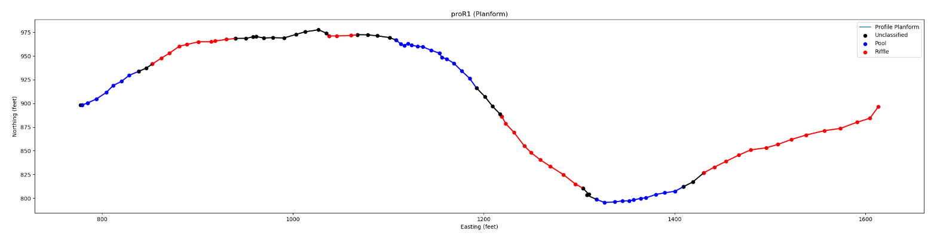

Slide 10

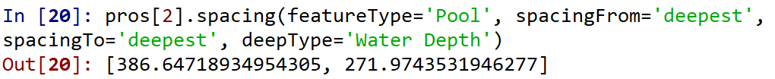
Extracting statistics
CrossSections
Area
Width
Hydraulic radius
Shear stress
Shear velocity
Stream power
Flood prone elevation
Entrenchment ratio
Mean and max depth
Flow velocity
Discharge rate
Width/depth ratio
Froude number
Bank slopes*
Profiles (and Features)
Feature spacing
Sinuosity
Length
Slopes (water, bankfull, etc.)
Max depth
Planform geometry*

Slide 11
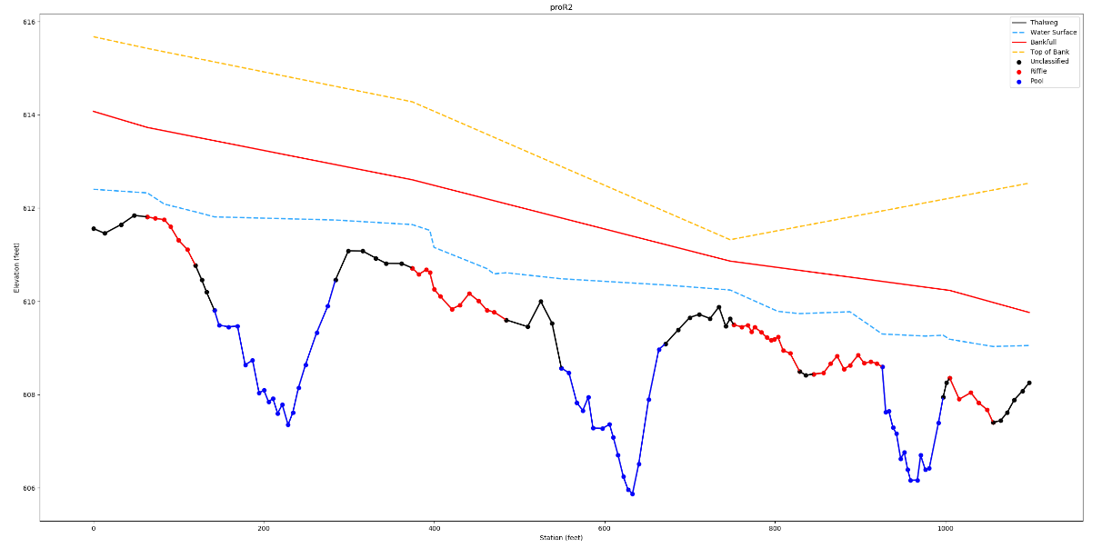
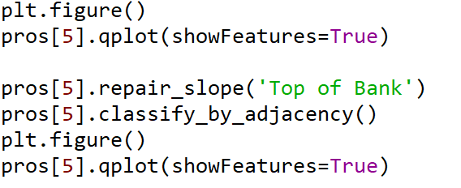
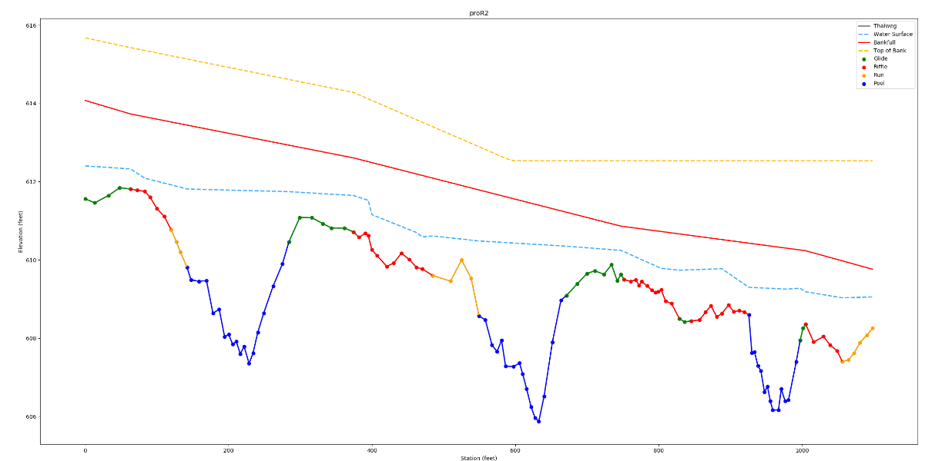
Profile methods
Reclassify Features
Repair slopes

Slide 12
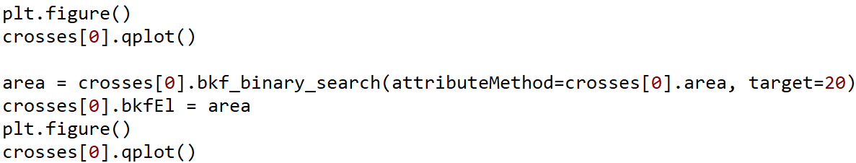
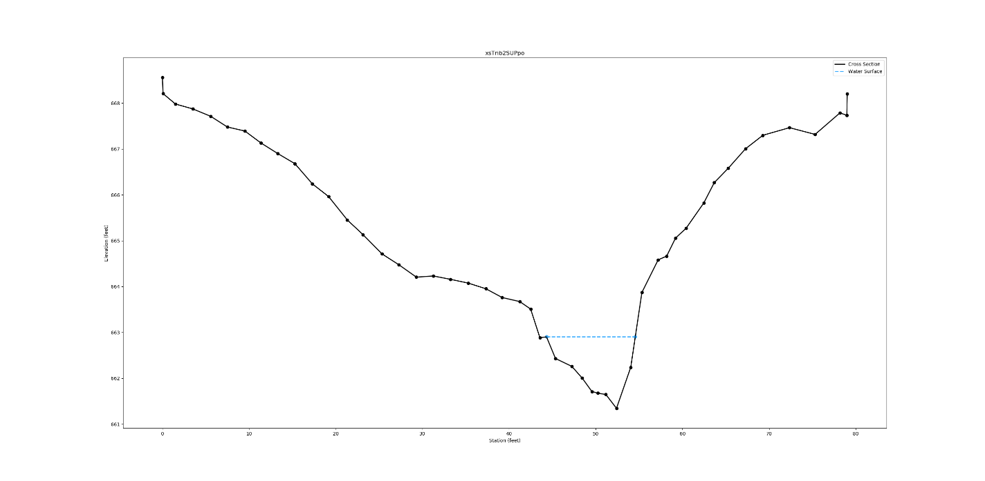
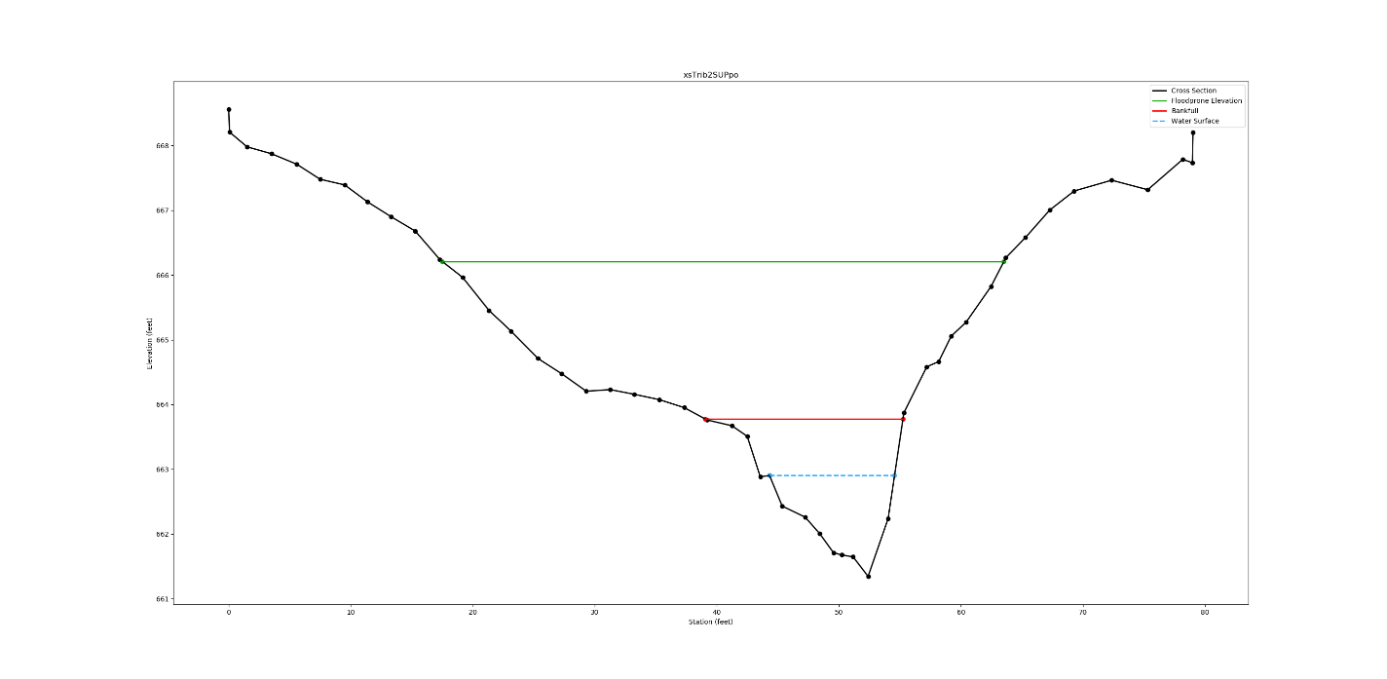
CrossSection methods
Find bankfull elevation based on desired bankfull area

Slide 13
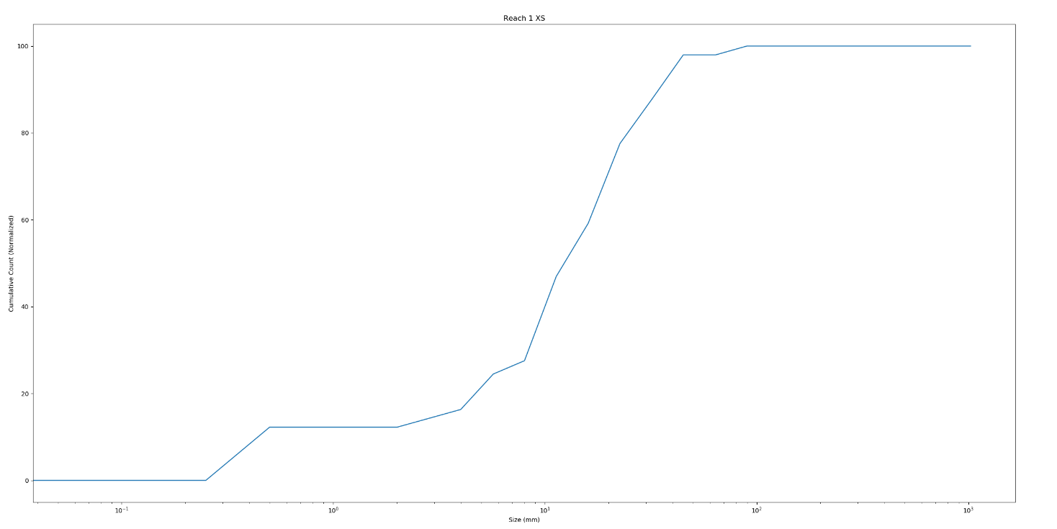
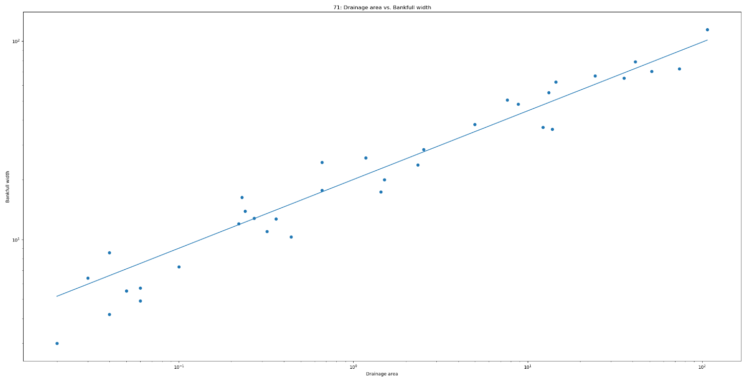
Other features
Rating curve generation*
Profile data interpolation
Trendline fitting
Grain size analysis
dX particle size
Sorting, skewness, kurtosis
Plotting
Reference reach analysis
Lines of best fit
Confidence intervals
Plotting

Slide 14
Predictive algorithms
Algorithms meant to facilitate the analysis of stream data that are lacking field callouts and cannot be manually inspected
Large amounts of remotely sensed data
Meta-analyses that include data with irregularly formatted/inconsistent callouts

Slide 15
Predictive algorithms (continued)
Top of bank identification
Find the elevation of maximum flow release (stage of incipient flooding) in a cross section
Substrate differentiation*
Identify the points in a cross section where channel substrate transitions to channel bank
Feature classification
Identify pools and riffles in a profile based on water slope and depth
Breakpoint detection*
Split a profile into multiple profiles based on changes in profile statistics

Slide 16
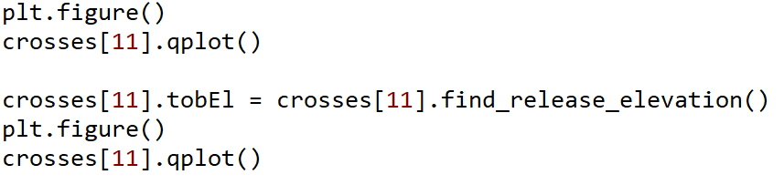
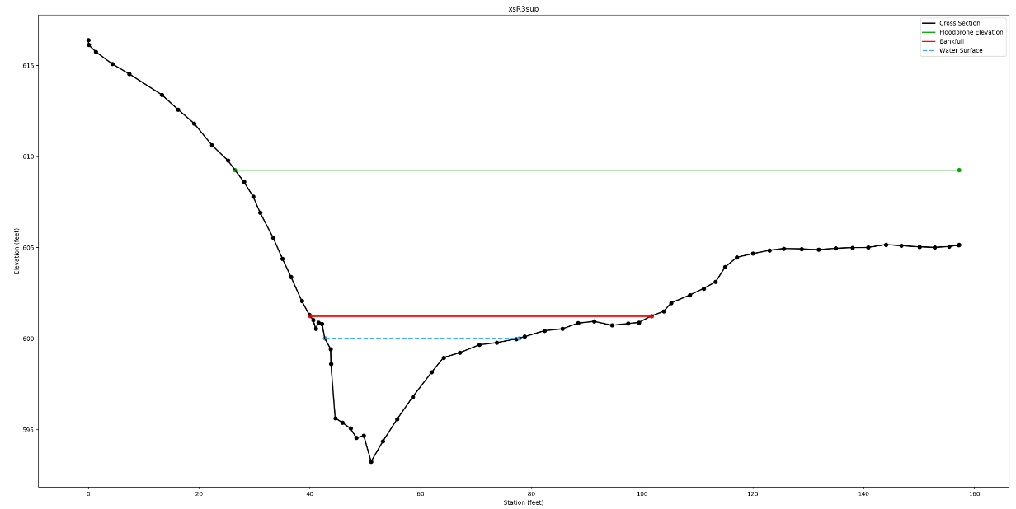
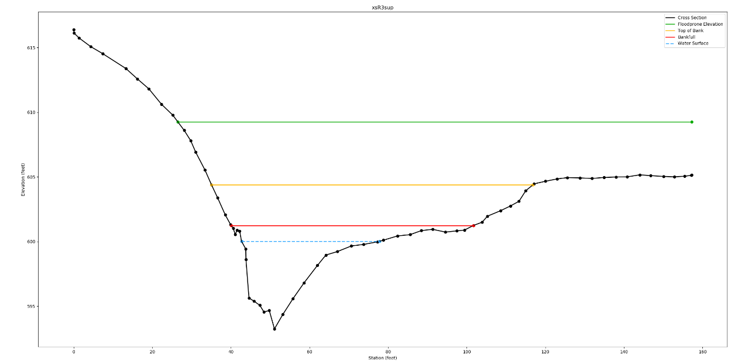
Top of bank identification
Can be estimated as the point where a key derivative is maximized
1st derivative of hydraulic radius with respect to elevation
2nd derivative of width with respect to elevation
3rd derivative of area with respect to elevation

Slide 17
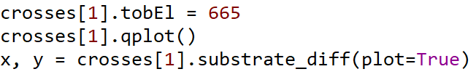
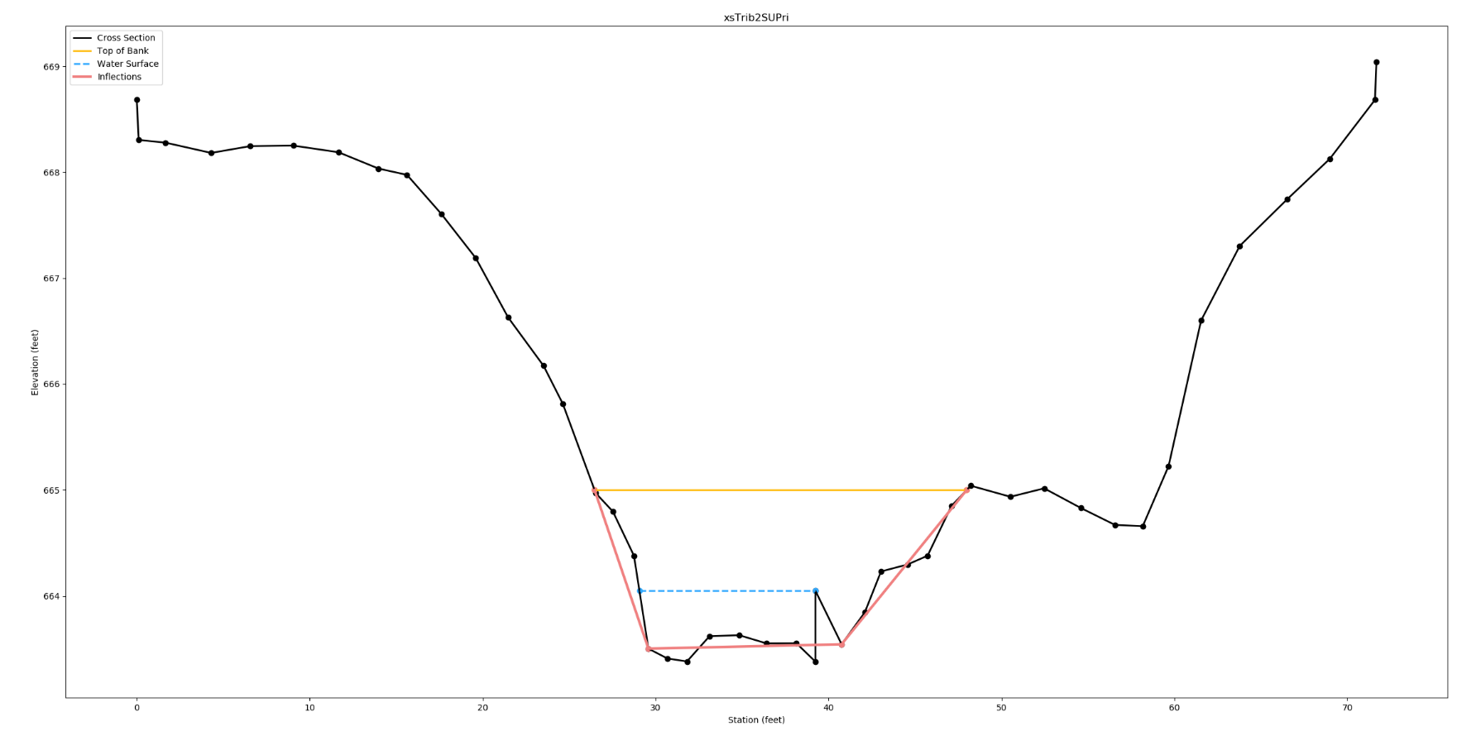
Substrate differentiation
Most channels can be approximated by 3-5 points**
The outermost line segments represent channel banks
**Optimal solution to this problem is very slow

Slide 18
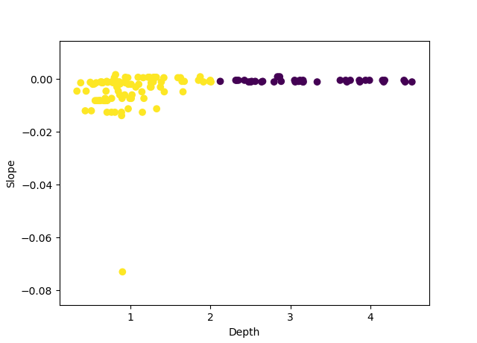
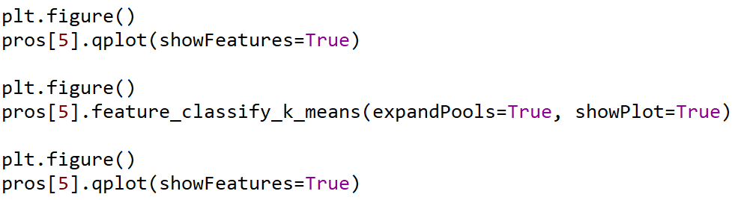
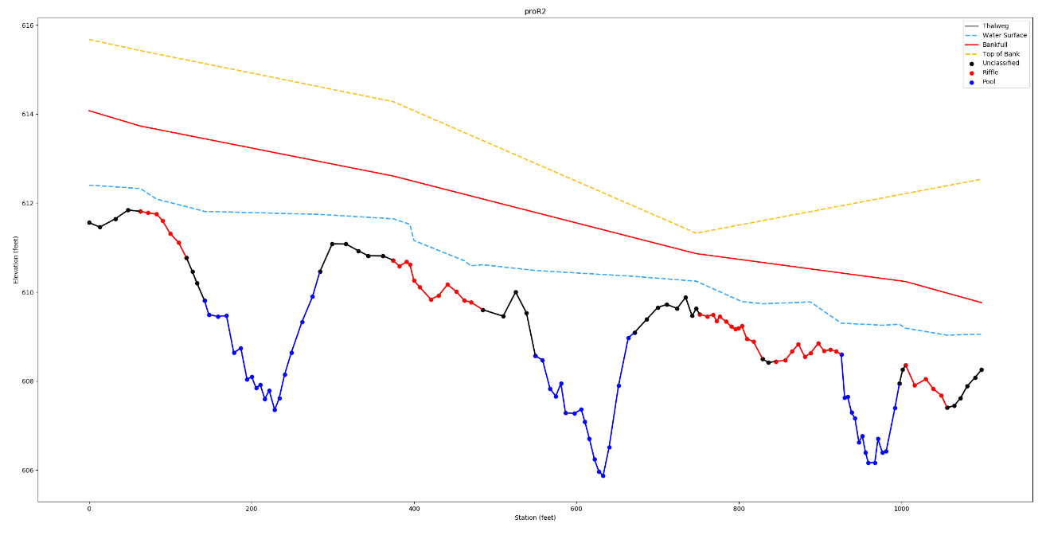
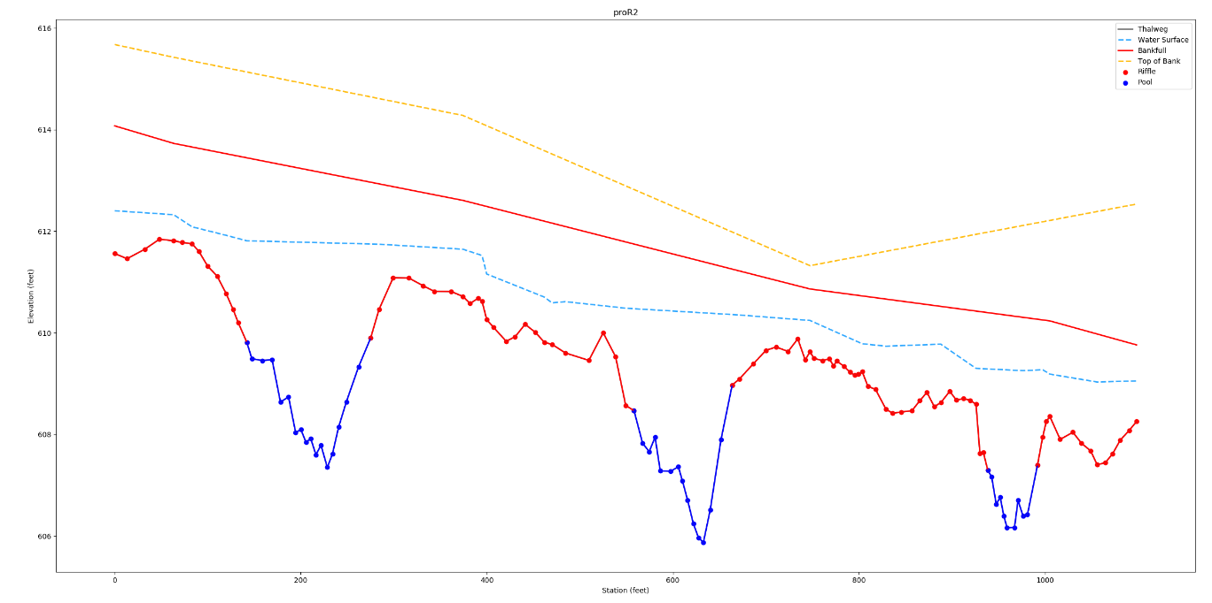
Feature classification
Riffles and pools have distinct morphological signatures
Use k-means algorithm to distinguish between them

Slide 19
pyfluv benefits
Faster, more accurate, more repeatable analyses
Modular components that can be extended to conduct more complex work
Totally free

Slide 20

Questions
Sky Jones
Email: Sky.Jones@kci.com
Github: https://github.com/rsjones94/pyfluv

