Slide 1
SplitBill
Group no : 59
Project : IT314- Software Engineering
TA : Pinak Gajera
Instructor : Prof. Jayprakash Lalchandani
End Semester Viva
Date : 15 May 2022

Slide 2
Team details
Team members
Devesh Modi (201901173)
Ravindersingh Khalsa (201901179)
Hastin Dave (201901225)
Srushti Menpara (201901307)
Devyanish Koul (201901444)
Dhaval Vaidya (201901462)
Team leader
Dhaval Vaidya (201901462)

Slide 3
Objective
To design and implement a web based software system for the users to track their expenses so that they are neither bothered about managing individual or group expenses nor splitting the shared bill at the time of spending when they are having fun.
To help the user to calculate how much they owe or are owed.
Suggest the user a simpler way to combine and settle payments.
This project also aims to help users in managing recurring expenses like paying maid, electricity or water bills, rent etc.

Slide 4
Functional Summary
User should be able to set/ reset the currency he wishes to use.
User should be able to add or delete expense.
User can pay for others and the amount should be splitted among the friends.
Splitting can be equally or unequally like based on percentage or custom.
User should be able to see his past activities.
User should be able to see his balance.
Expense details include name, date, added by, image, location, category.
The user should be able to create groups like one for house sharing, one for weekend, one for a friends trip etc and add contacts to it .
The user should be able subscribe to or unsubscribe to recurring payments.
The user should be able to export the split policy for one group to other groups.
System should be integrated with payment gateways.
When an expense is added for any member then that member should be notified about it. The member adding the expense should be able to send a personalized message along with the request.

Slide 5
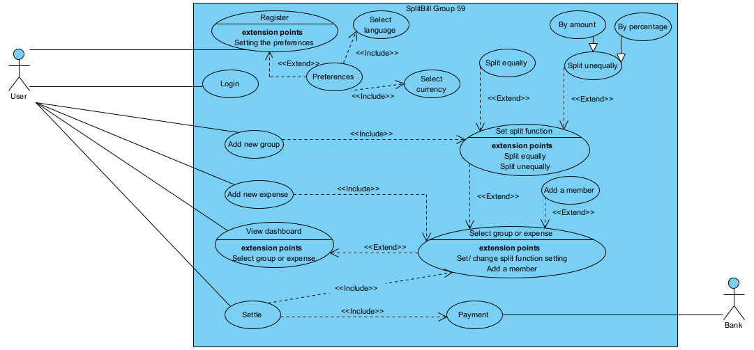
Top level use case model

Slide 6
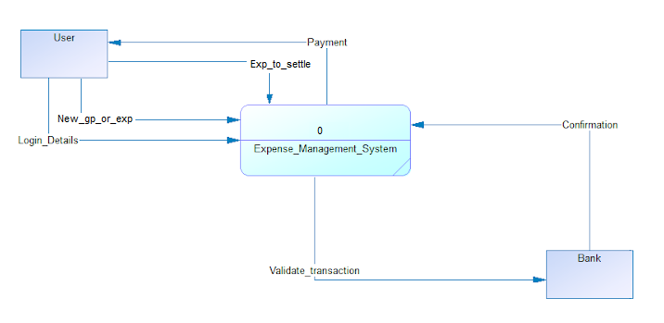
Context diagrams
DFD Level 0

Slide 7
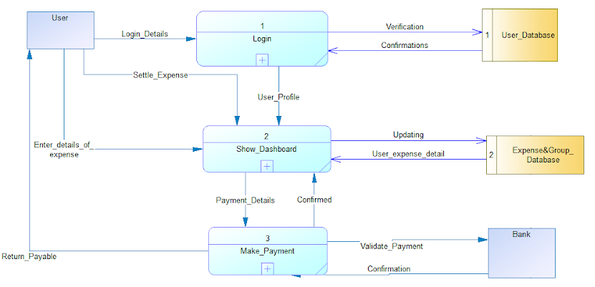
DFD Level 1

Slide 8
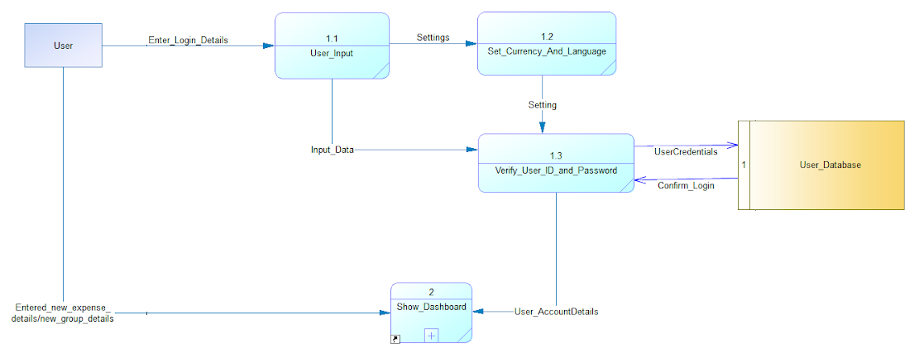
DFD Level 2
Process 1

Slide 9
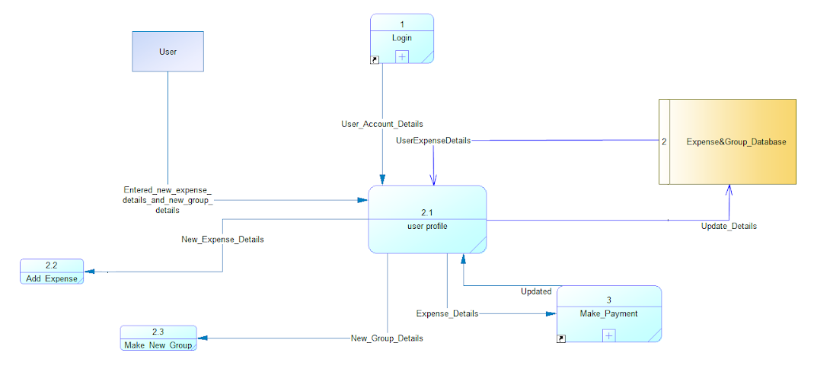
DFD Level 2
Process 2

Slide 10
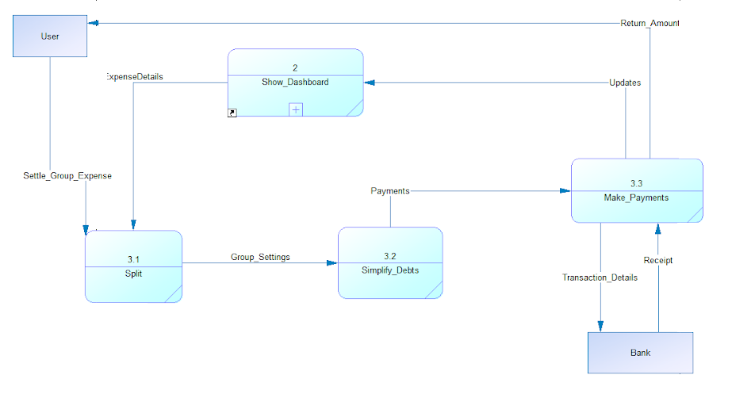
DFD Level 2
Process 3

Slide 11
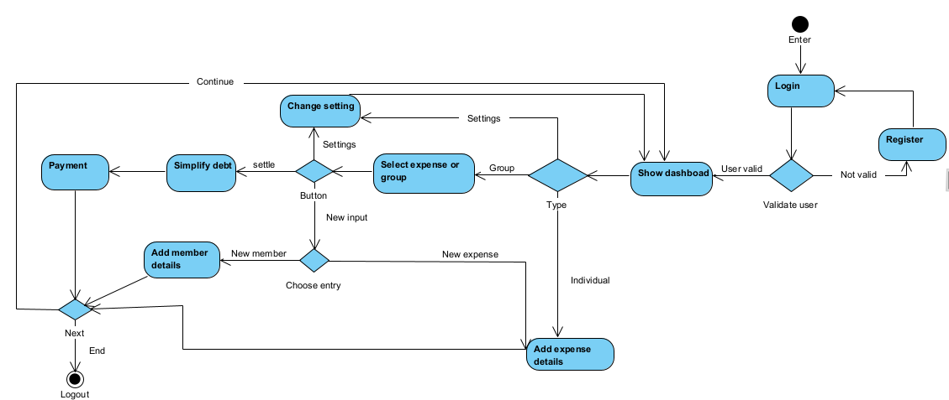
Activity diagram

Slide 12
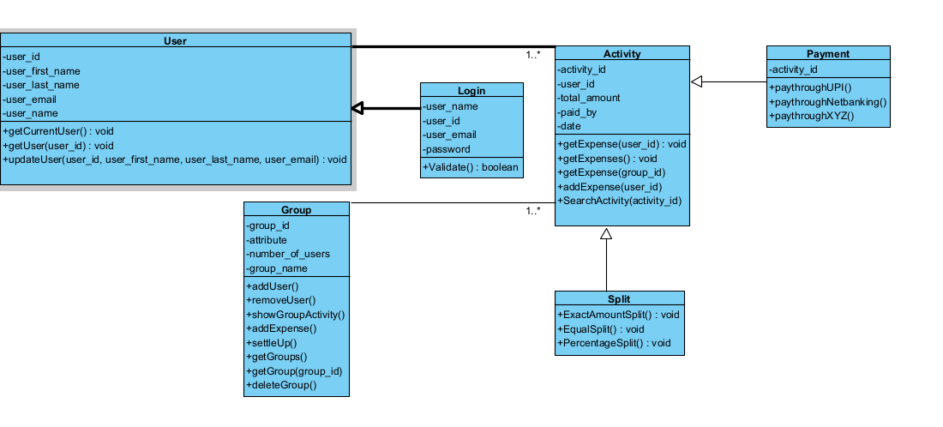
Class Diagram

Slide 13
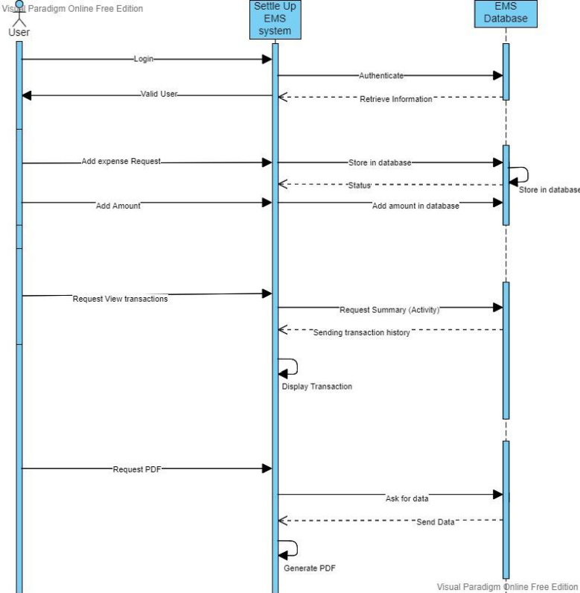
Sequence diagram : Settle the debt

Slide 14
Technologies / Tools and Libraries
SyBase PowerDesigner
Agile Management tool
Req view Tool
Visual Paradigm tool
Git and Github
MERN
Mongodb
Express JS
Reacy JS
Node JS
HTML
CSS

Slide 15
Summary of implementation
Software | Versions
HTML | 5.0.0
CSS | 3.0.0
Javascript | ES2015
React JS | 18.1.0
Node JS | 16.15.0
We built our frontend using HTML and CSS.
We built our backend using Node JS.
We used NoSQL database MongoDB.

Slide 16
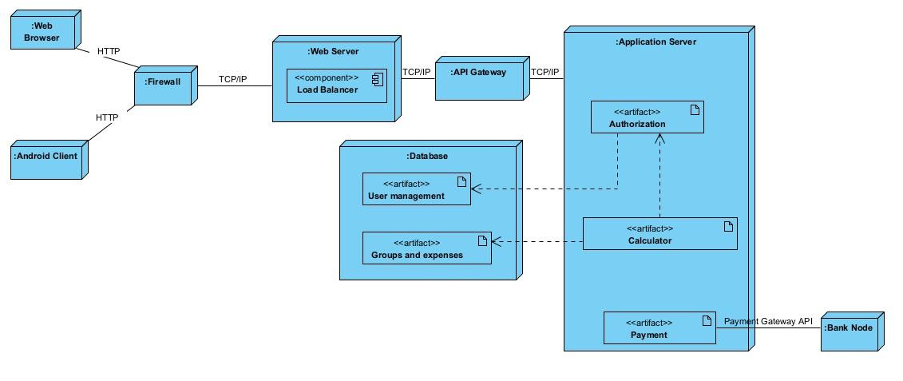
Deployment diagram

Slide 17
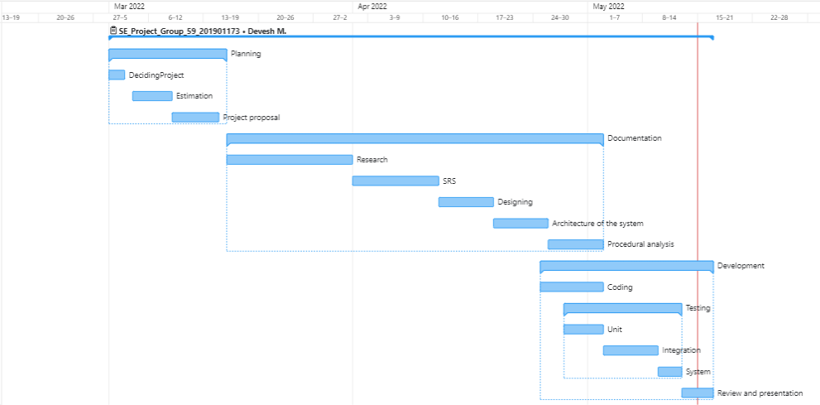
Gantt Chart (using wrike.com)

Slide 18
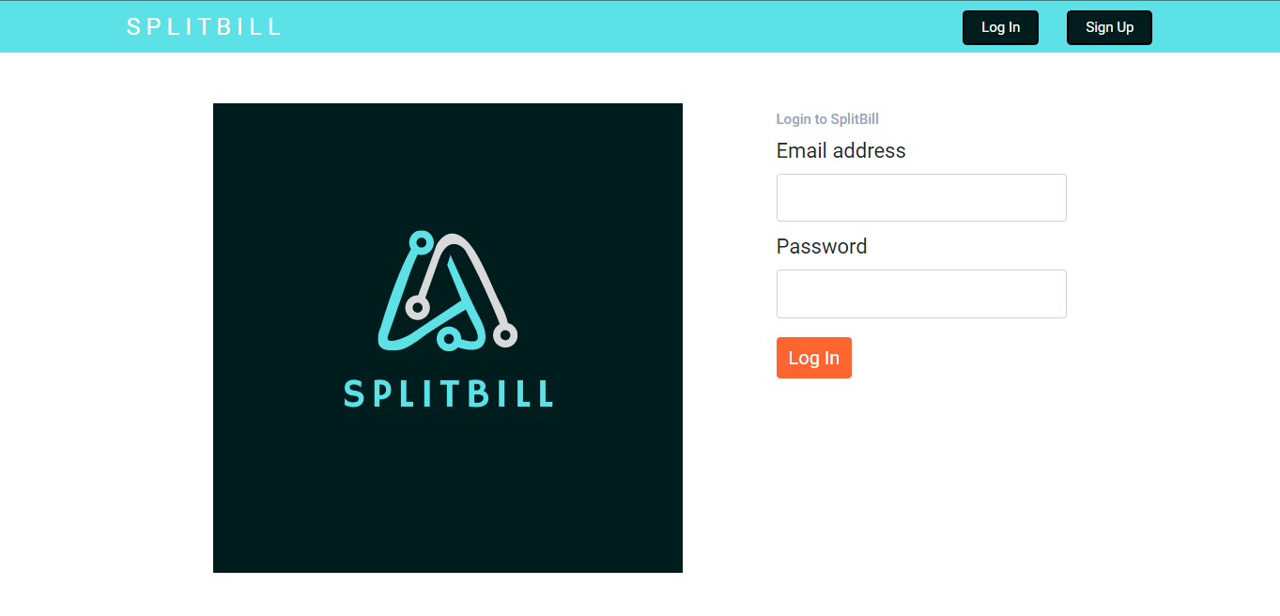
Application navigation using UI/UX
Beside is the home page of our system.
This has options to login or sign up.
On logging in this navigates the user to dashboard.

Slide 19
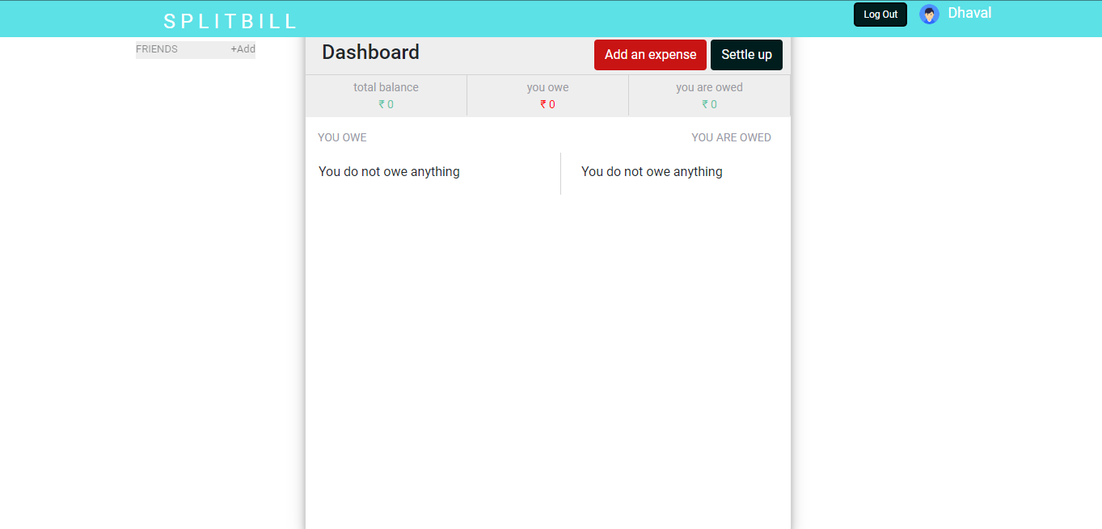
Application navigation using UI/UX
Above is the dashboard for the user. It shows user name and all the options available to the user. On clicking it navigates to respective pages.

Slide 20
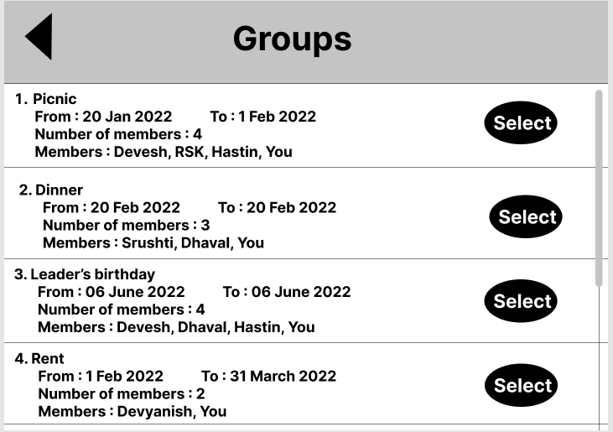
Application navigation using UI/UX
Below is the list view of all the groups a user is member of. On clicking “See groups” we see this page.

Slide 21
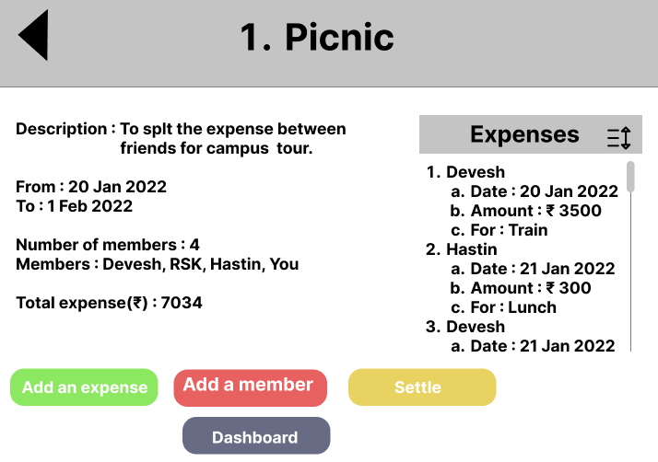
Application navigation using UI/UX
Besides is the details of a person’s expenses.On clicking “Select” from group list we see this page.

Slide 22
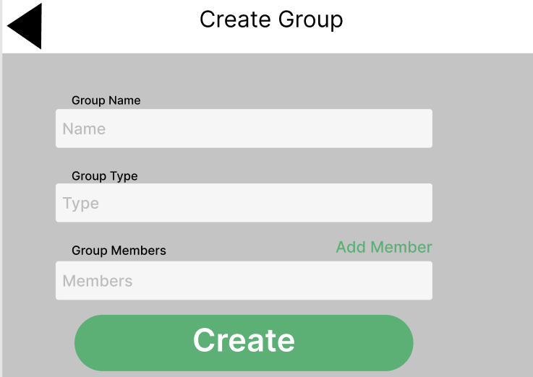
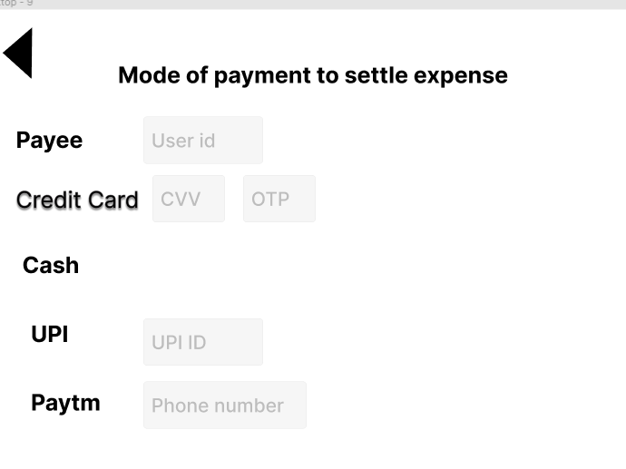
Application navigation using UI/UX
Above is the form to create a new group. On clicking “Create groups” on dashboard we see this page.
Above is the form to create a settle payment. On clicking “settle” on dashboard or from group details we see this page.

Slide 23
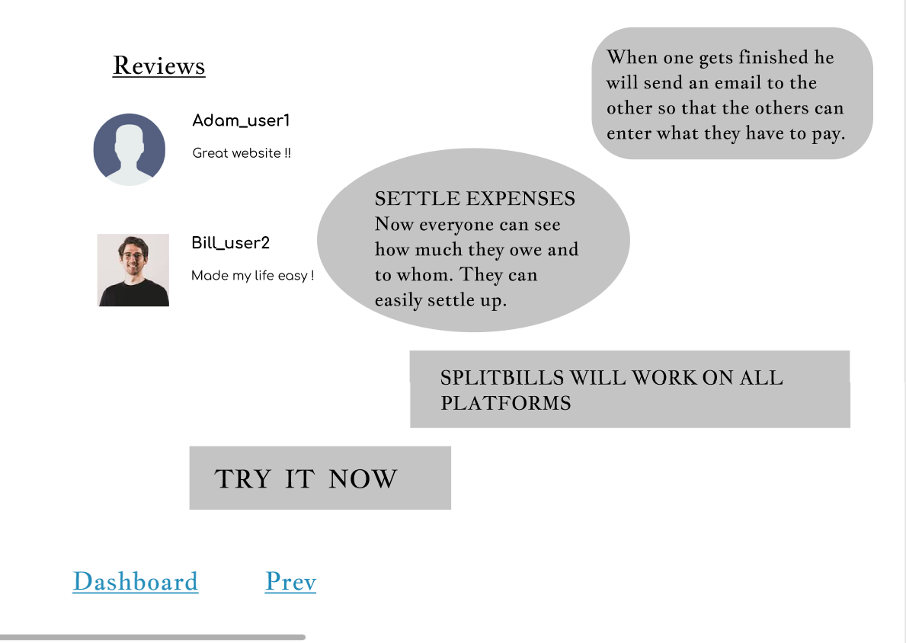
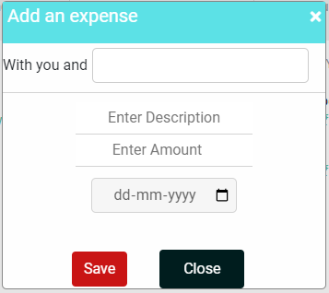
Application navigation using UI/UX
Above is the form to create a new expense. On clicking “Add expense” on dashboard or in group details page we see this page.
Above is the about page. On clicking “About” on dashboard we see this page.

Slide 24
Github Link
https://github.com/rsk-171/SplitBill.git

Slide 25
Testing summary
UNIT TESTING
Test | Use case definition | Test result
User management | Test login and sign up | Passed
Create a group | Add an group in users profile | Not implemented
Add an expense | Add an expense in users profile as individual or the selected group | Passed
Dashboard | Dashboard shows the summary | Passed
Settle | Settle payments | Passed
Front end | Easy to use front end and guide to use the software | Passed

Slide 26
Testing summary
INTEGRATION TESTING
Test | Use case definition | Test result
Simplify debt | Based on the splitting policy and groups the users are members of find a way to settle with least number of transactions. | Passed
Navigations | Navigation are correct as per UI/UX design | Passed
Communication | Test communication between business logic and database | Passed
Messaging | Message the users that they have been added to a group or an expense | Not implemented

Slide 27
Demonstration

Slide 28
Individual contributions
Devesh Modi (201901173)
Data flow diagram, Component diagram, package diagram, Activity diagram, Communication diagram, Use case diagram and Timing diagram
Documentation (Project management document, Weekly Status Report)
UI/UX for Dashboard, Group-list-view, settle and Group-detail
Testing
Presentation
Ravindersingh Khalsa (201901179)
Class diagram, Object diagram and Composite Structure diagram
UI/UX for make new group, dashboard, group -list-view
Coding
Website Development
Testing
Presentation
Hastin Dave (201901225)
Documentation (Project detail document)
Class diagram and Sequence diagram
UI/UX for adding expense and settle
Presentation

Slide 29
Individual contributions
Srushti Menpara (201901307)
Documentation (Project detail document, Project management document)
Data flow diagram and Sequence diagram.
Templates
Testing
Presentation
Devyanish Koul (201901444)
State Machine diagram,
UI/UX for about pages
Research on functionalities
Presentation
Dhaval Vaidya (201901462)
Research on requirements
Documentation
Implementation in Sybase PowerDesigner
Coding
Website Development

Slide 30
THANK YOU

