Slide 1
SplitBill
Group no : 59
Project : IT314- Software Engineering
TA : Pinak Gajera Sir
Instructor : Prof. Jayprakash Lalchandani
Mid Semester Feedback
Date : 15 April 2022

Slide 2
Team details
Team members
Devesh Modi (201901173)
Ravindersingh Khalsa (201901179)
Hastin Dave (201901225)
Srushti Menpara (201901307)
Devyanish Koul (201901444)
Dhaval Vaidya (201901462)
Team leader
Dhaval Vaidya (201901462)

Slide 3
Objective
To design and implement a web based or android based software system for the users to track their expenses so that they are neither bothered about managing individual or group expenses nor splitting the shared bill at the time of spending when they are having fun.
To help the user to calculate how much they owe or are owed.
Suggest the user a simpler way to combine and settle payments.
This project also aims to help users in managing recurring expenses like paying maid, electricity or water bills, rent etc.

Slide 4
Functional Summary
User should be able to set/ reset the currency he wishes to use.
User should be able to add or delete expense.
User can pay for others and the amount should be splitted among the friends.
Splitting can be equally or unequally like based on percentage or custom.
User should be able to see his past activities.
User should be able to see his balance.
Expense details include name, date, added by, image, location, category.
The user should be able to create groups like one for house sharing, one for weekend, one for a friends trip etc and add contacts to it .
The user should be able subscribe to or unsubscribe to recurring payments.
The user should be able to export the split policy for one group to other groups.
System should be integrated with payment gateways.
When an expense is added for any member then that member should be notified about it. The member adding the expense should be able to send a personalized message along with the request.

Slide 5
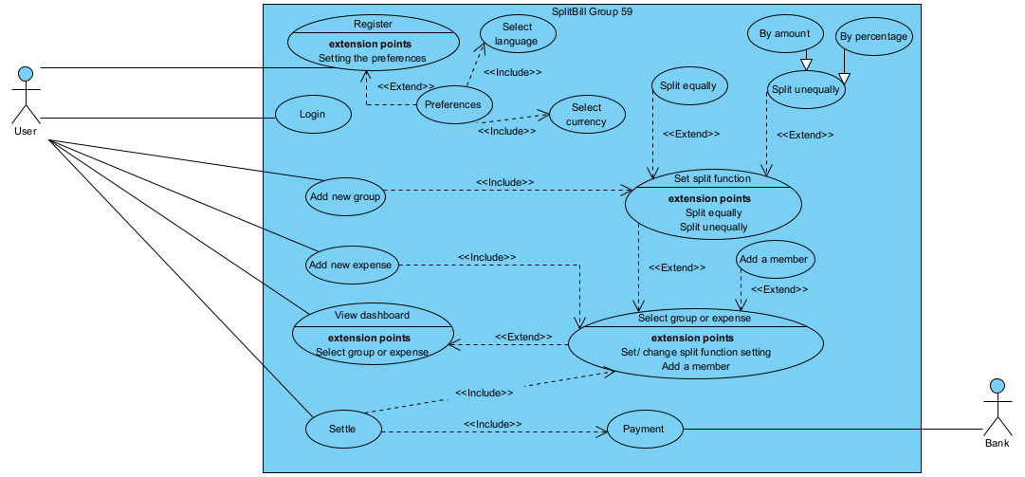
Top level use case model

Slide 6
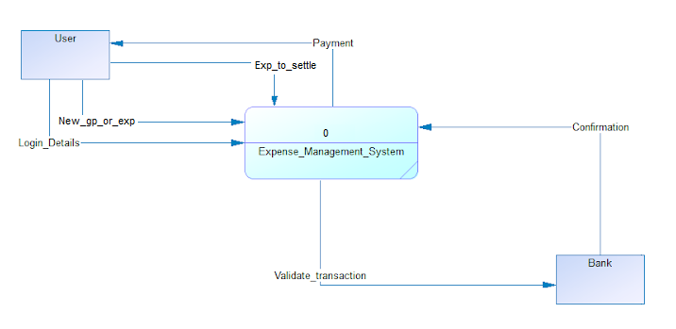
Context diagrams
DFD Level 0

Slide 7
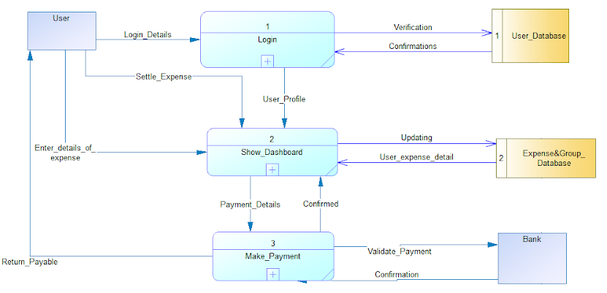
Context diagrams
DFD Level 1

Slide 8
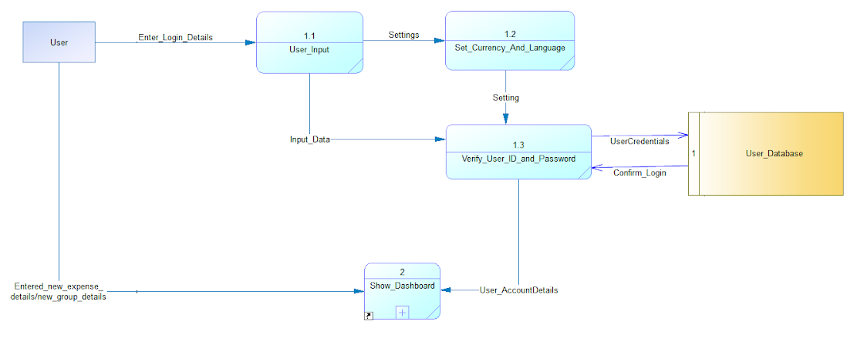
Context diagrams
DFD Level 2
Process 1

Slide 9
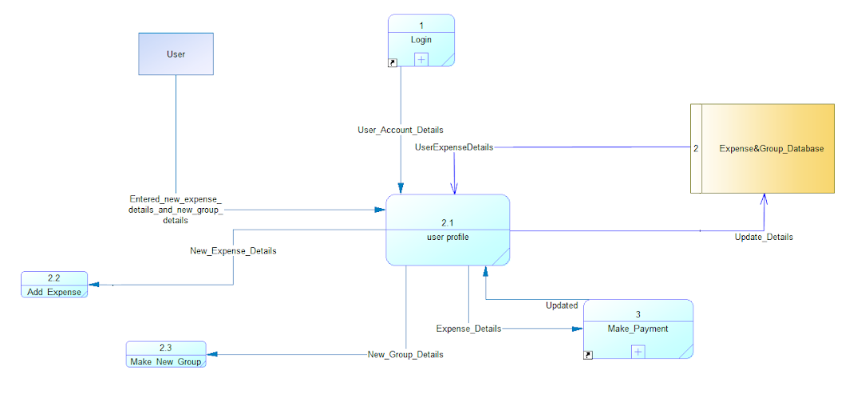
Context diagrams
DFD Level 2
Process 2

Slide 10
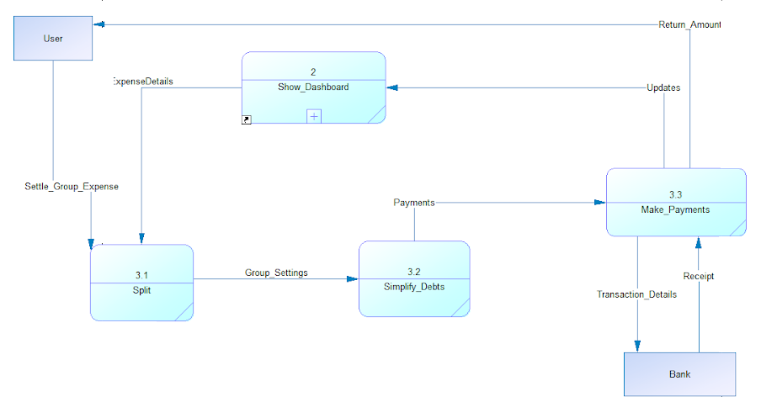
Context diagrams
DFD Level 2
Process 3

Slide 11
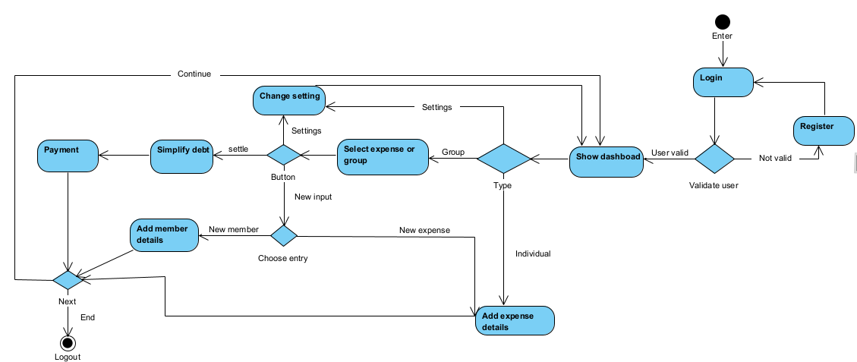
Activity diagram

Slide 12
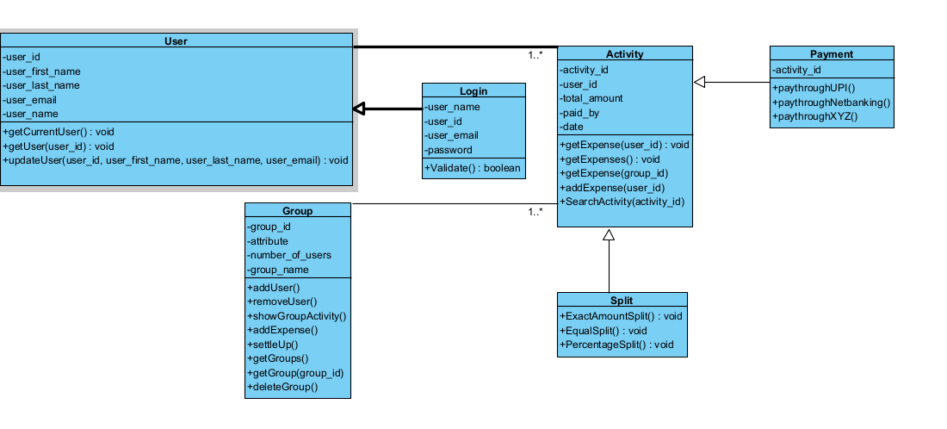
Class Diagram

Slide 13
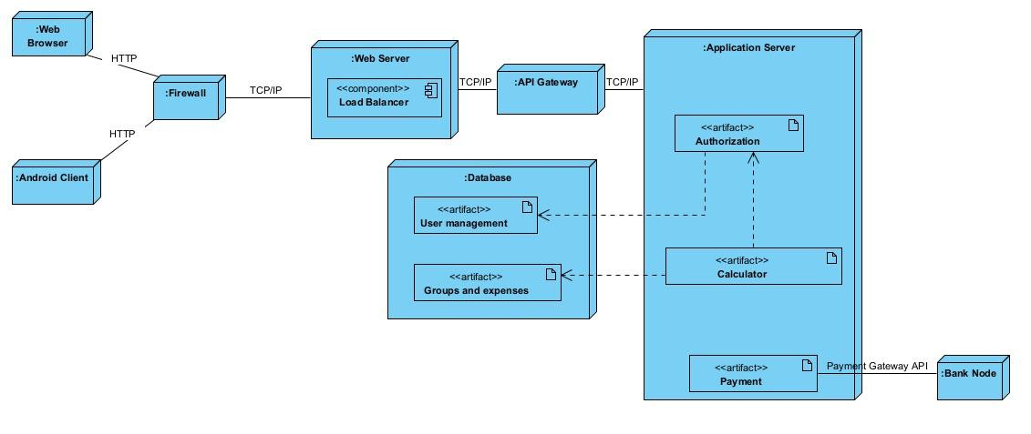
Deployment diagram

Slide 14
Technologies / Tools and Libraries (Tentative)
SyBase PowerDesigner
Agile Management tool
Req view Tool
Visual Paradigm tool
Azure portal and cloud CLI
Git and Github
Django or Android Studio or MERN
HTML
CSS

Slide 15
THANK YOU

