Slide 1

School of Computer Science and Engineering
Department of Computer Engineering and Technology (DCET)
Full Stack Development
Mini Project
BTech CSE (Cybersecurity & Forensics) Panel-A
Group members:
1032230441 : Dhiraj Rajput 1032230771: Hrishikesh Bywar
1032231329: Sushant Kumar 1032231907: Ashish Sharma

Slide 2
Problem Statement & Proposed Solution
Problem Statement
Standard encryption methods face the problem of conspicuousness, where high-entropy, statistically random data becomes visibly opaque and a desirable target for attacks. This vulnerability is compounded by traditional key management systems, which create a discoverable and critical single point of failure.
Proposed Solution: Obscura
Multi-layered Security: Combines industry-standard AES-256-GCM cryptography with high-capacity steganography.
Key Obfuscation: The decryption key is embedded into the pixel data of an
inconspicuous PNG image, successfully obscuring it in plain view.
Zero-Knowledge Architecture: The server never holds both the encrypted data and the key simultaneously; the link between them is permanently broken after encoding.

Slide 3
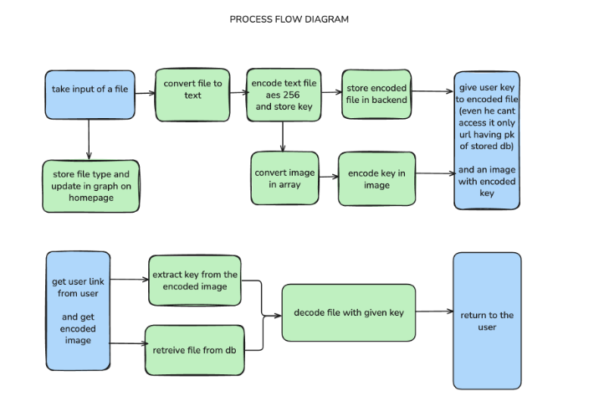
Process Flow Diagram & System Architecture
System Architecture
1. Decoupled Design: A modern client-server application separating the React UI from the Node.js secure backend.
2. Zero-Knowledge Storage : The database only stores encrypted ciphertext and non-sensitive metadata; it is structurally impossible to store the key.
Process Flow
1. Encoding (Encryption): 📄➡ 🔒➡ 🖼
File is uploaded to server memory via Multer.
File is encrypted using AES-256-GCM; a unique key and IV are generated.
Key and IV are embedded into a new PNG "key-image" using Sharp.
Ciphertext is stored in MongoDB; Key-image is downloaded by the user; server memory is purged.
2. Decoding (Decryption): 🖼➡🔓➡📄
User uploads their unique PNG key-image.
System extracts the AES key and IV from the image pixels.
Ciphertext is retrieved from DB and decrypted; integrity is validated via GCM Auth Tag.

Slide 4






Technical Stack with Reasoning
Backend: Node.js & Express
Reasoning: Non-blocking, event-driven I/O architecture ideal for handling heavy I/O operations like file processing without blocking the main thread.
Image Processing: Sharp (libvips)
Reasoning: Provides high-speed, in-memory manipulation of raw pixel data for steganography, significantly faster than JS-only alternatives.
Database: MongoDB & Mongoose 🐾
Reasoning: Mongoose offers a schema-enforced data persistence layer, allowing a minimalist model that intentionally omits key storage fields.
Frontend: React & Vite
Reasoning: Delivers a fast, responsive user experience that hides cryptographic complexity behind a friendly interface.
Cryptography: AES-256-GCM 🛡
Reasoning: An Authenticated Encryption (AEAD) mode that simultaneously provides confidentiality, integrity, and authenticity, preventing data tampering.

Slide 5
Challenges Faced during development
Achieving True Zero-Knowledge:
Designing a system where administrators or attackers breaching the server cannot access plaintext data required strict architectural isolation.
This necessitated ensuring all sensitive operations (encryption, key embedding) occur solely in-memory, avoiding any disk I/O of plaintext data.
Performance vs. Security Trade-off:
Steganographic systems are often slow; overcoming this required leveraging optimized C++ bindings (via Sharp) to keep pixel manipulation from blocking the Node.js event loop.
Data Integrity Assurance:
Moving beyond simple encryption to ensure data wasn't tampered with in transit or at rest required implementing AES-GCM for its built-in authentication tag validation.

Slide 6
Limitation and scope of the project with future projection extension
Scope: Full end-to-end user flow for encoding (encrypting/generating key- image) and decoding (parsing key-image/decrypting) any file type.
Limitation: The in-memory processing design creates a practical upper limit on file size dependent on available server RAM.
Future Projection Extensions
Large-File Support (GridFS): Integrating MongoDB GridFS to chunk files, enabling terabyte-scale data support while maintaining zero-knowledge.
Algorithm Agility: Abstracting logic to allow users to select different cryptographic (e.g., ChaCha20) or steganographic algorithms.
API-Driven Workflows: Developing capabilities for batch encoding/decoding of entire directories for automated secure backups.

Slide 7
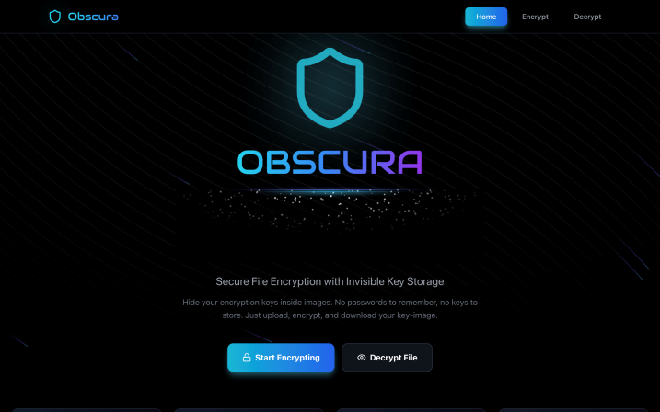
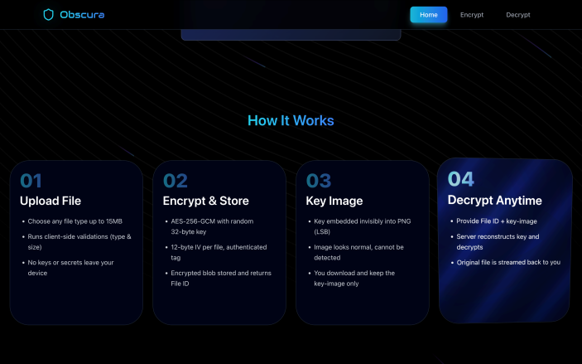
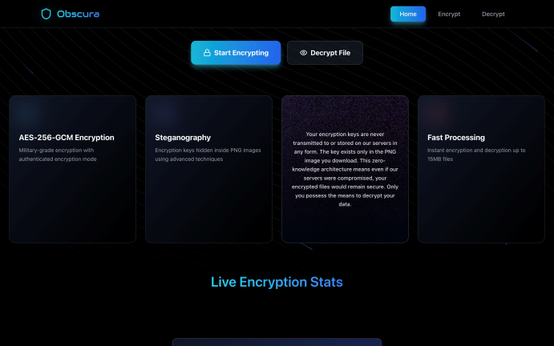
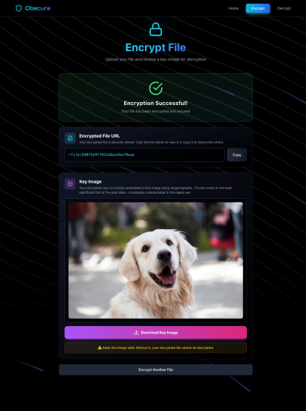
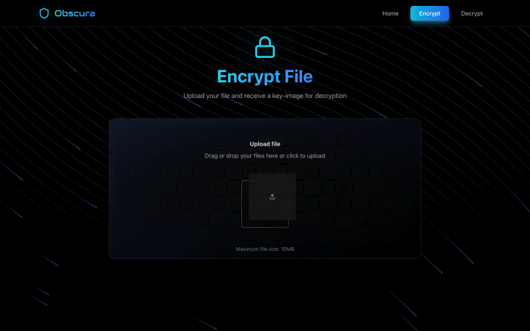
Working Demo
Front page
How it works
Front page (info)
Encryption page
Picture upload

Slide 8
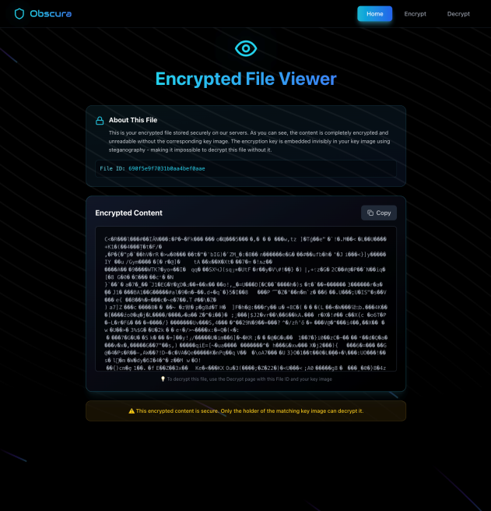
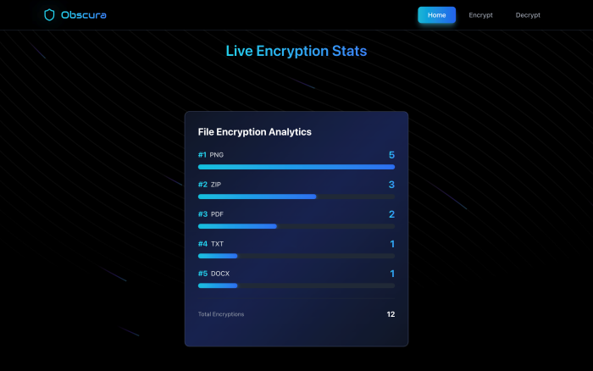
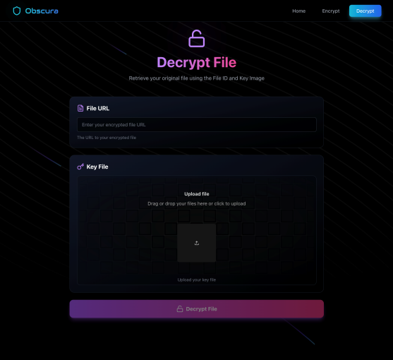
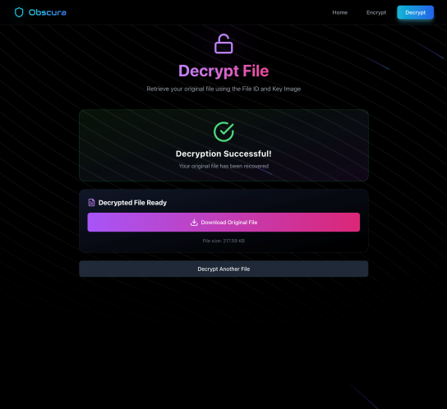
Live encryption update
Encrypted file viewer
Decryption page
Decryption success

Slide 9
Q/A
Thank You
We are now open to questions

