Slide 1
CAPSTONE CLASSIFICATION PROJECT
Coronavirus Tweet sentimental analysis
By Amit s kashyap

Slide 2
Steps followed
Importing necessary packages and libraries.
Mount the drive in colab and read the .csv file.
Analysing the data sheet.
Removing null/NAN/duplicate rows.
Drop certain columns/combined certain columns to make our data sheet free Avoid of any irrelevant data.
Applying the concept of Data Wrangling and Data Visualization such that we can analyse the data sheet and retrieve required information.

Slide 3
Problem Statement
This challenge asks you to build a classification model to predict the sentiment of COVID-19 tweets. The tweets have been pulled from Twitter and manual tagging has been done then.

Slide 4
Description of columns
Column_name | Column_description
User_ name | Name of user
Screen_name | The screen used for tweets
Location | Country where usually tweets
TweetAt | Date on which tweets
Sentiments | It can be positive, negative, neutral
Original tweets | Tweets made in the from sentences

Slide 5
EDA visualization
Here we present the basic as well as some advanced observations retrieved from the data sheet.
Pre-processing the tweets to perform Normalization, Stop Word Removal, Stemming & Lammetization
Plot a wordcloud of most frequent words used in tweets (location-wise).
Plot geographical distribution of tweets.
Plot frequency of tweets/user and so on

Slide 6
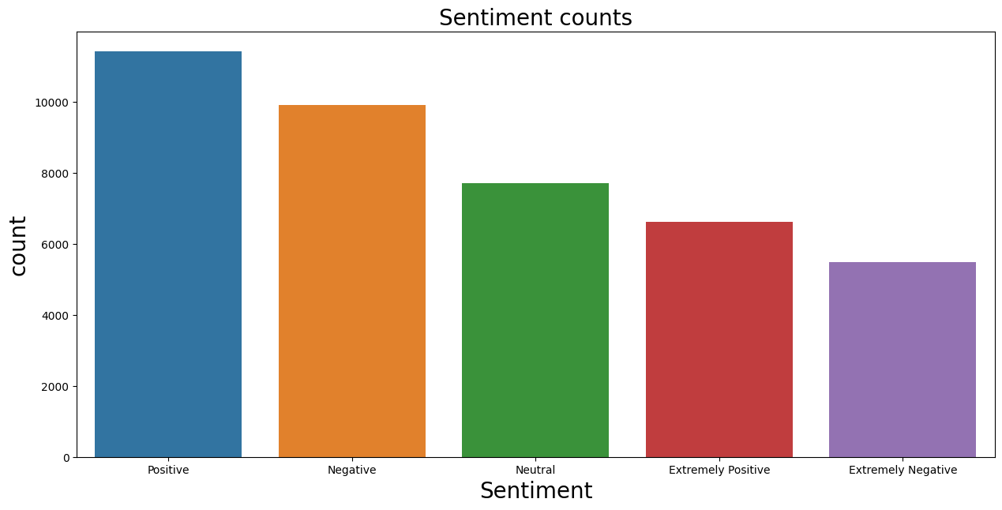
1. Sentiments counts
Number of positive sentiments are higher than all other sentiments
.

Slide 7
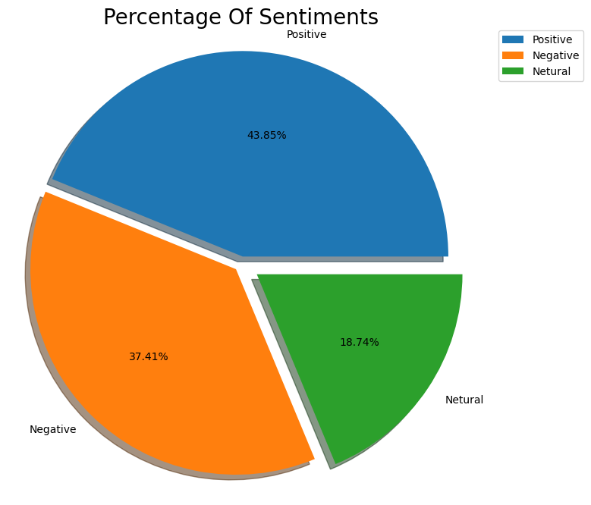
2. Pie chart
As per pie chart we say that the percentage of positive is 43.85% and for negative is 37.41%.

Slide 8
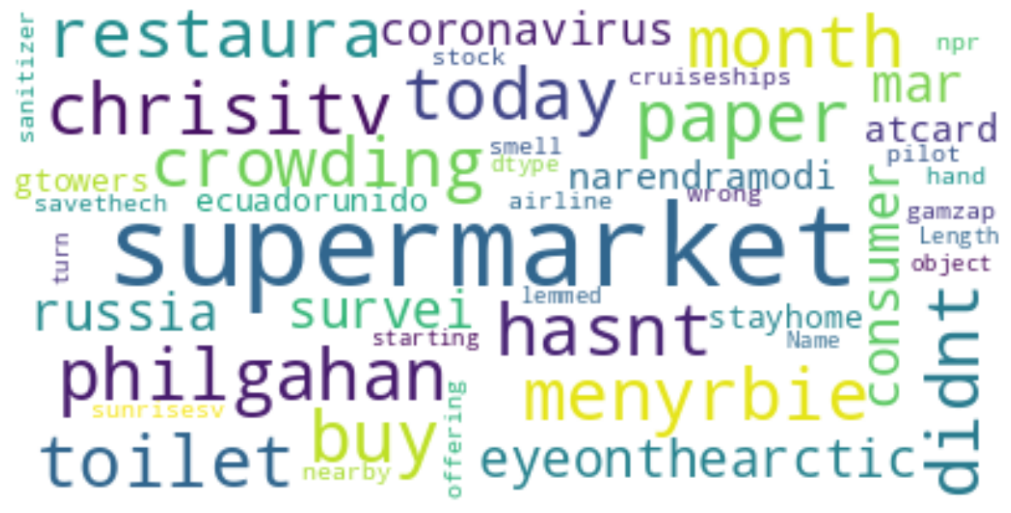
3. Neutral sentiment word cloud
During the covid phase people usually used word such as supermarket, today, crowding, etc to express their ideas via tweets

Slide 9
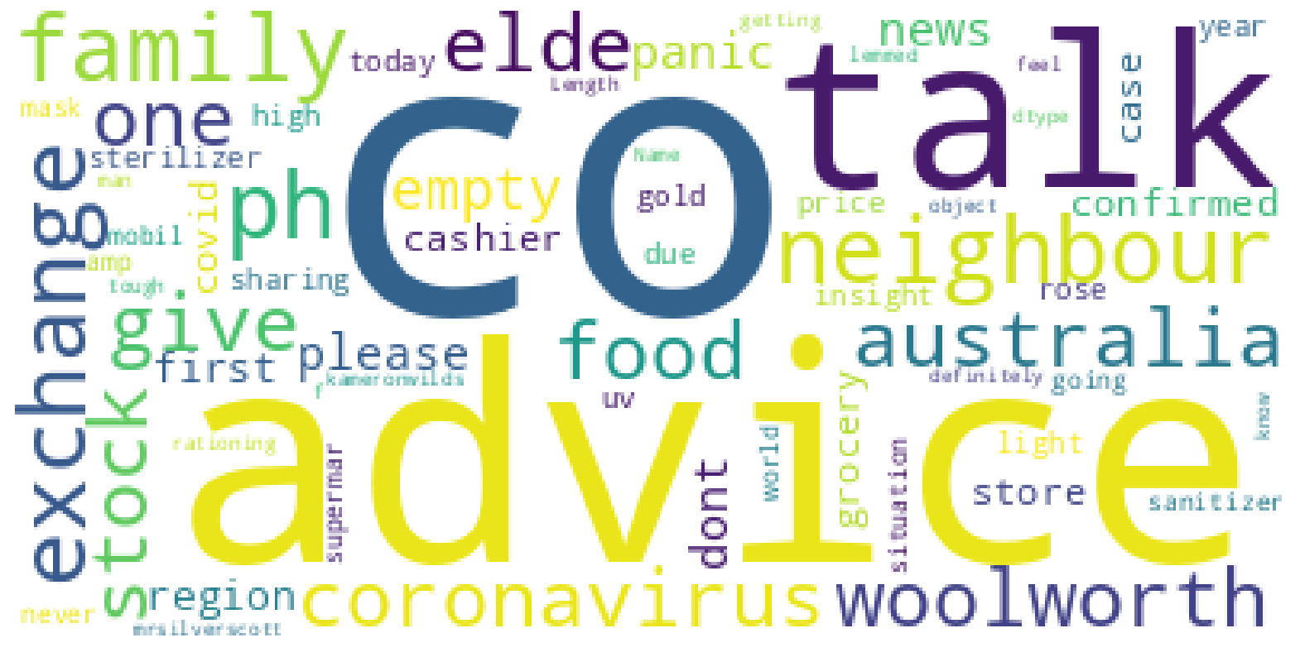
3. Positive sentiment word cloud
During the covid phase people usually used word such as advice, CO, talk, etc to express their ideas via tweets

Slide 10
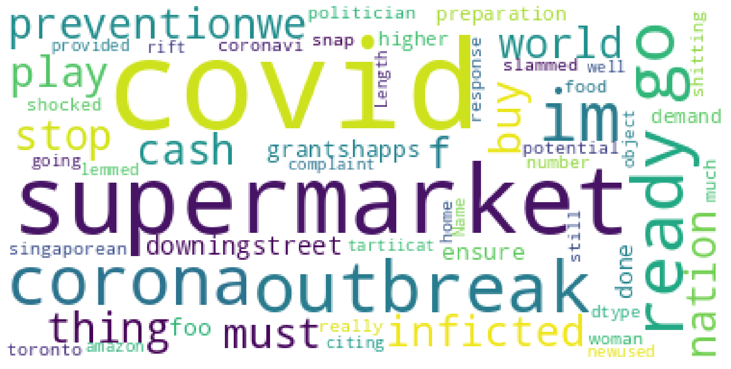
4. Negative sentiments word cloud
These word cloud for negative sentiments words used more is out break, supermarket, preventions etc to express their views on negative result of covid.

Slide 11
Model used for implementation
1- Logistics regression method with gridsearch cv
2- Decision tree classifier
3- support vector machine classifier
Accuracy based on count vectorizer
)
Logistics regression gridsearchcv | 78%
Decision tree classifier | 69%
Support vector machine | 76%

Slide 12
Model used for implementation
1- Logistics regression method with gridsearch cv
2- Decision tree classifier
3- support vector machine classifier
Accuracy based on TF/IDF
)
Logistics regression gridsearchcv | 77.38%
Decision tree classifier | 60.54%
Support vector machine | 76%

Slide 13
Conclusion
We applied 3 different machine learing models namely, Logistic Regression with Grid Search CV, Desision Tree Classifier,SVM Classifier for both Count Vector And TF IDF Vectorisation techniques. We conclude that the machine is generating best results for Logistic Regression with Grid Search CV model with and Accuracy score of 78% and 77% respectively for Count vector and TF/idf Vector, followed by SVM. Also, we observed that no overfitting is seen for the data, and we can deploy this model.The sentiments of future tweets can be easily predicted using this model.
)

Slide 14
THANK YOU

