Slide 1
CAPSTONE UNSUPERVISED PROJECT
Zomato restaurant clustering and sentimental analysis
By Amit s kashyap

Slide 2
Steps followed
Importing necessary packages and libraries.
Mount the drive in colab and read the .csv file.
Analysing the data sheet.
Removing null/NAN/duplicate rows.
Drop certain columns/combined certain columns to make our data sheet free Avoid of any irrelevant data.
Applying the concept of Data Wrangling and Data Visualization such that we can analyse the data sheet and retrieve required information.

Slide 3
Problem statement
The problem statement for this project is to analyze and understand the restaurant industry in India by utilizing data from the Indian restaurant aggregator and food delivery start-up, Zomato. The project aims to gain insights into the sentiments of customer reviews, cluster Zomato restaurants into different segments, and analyze the data to make useful conclusions in the form of visualizations. The data analyzed includes information on cuisine, costing, and customer reviews. The project aims to assist customers in finding the best restaurant in their locality and aid the company in identifying areas for growth and improvement in the industry. Additionally, the project aims to use the data for sentiment analysis and identifying critics in the industry through the metadata of reviewers.

Slide 4
Problem statement
Restaurant DataSet
There are 105 total observation with 6 different features.
Feature like collection and timing has null values.
There is no duplicate values i.e., 105 unique data.
Feature cost represent amount but has object data type because these values are separated by comma ','.
Timing represent operational hour but as it is represented in the form of text has object data type.
Review DataSet
There are total 10000 observation and 7 features.
Except picture and restaurant feature all others have null values.
There are total of 36 duplicate values for two restaurant - American Wild Wings and Arena Eleven, where all these duplicate values generally have null values.
Rating represent ordinal data, has object data type should be integer.
Timing represent the time when review was posted but show object data time, it should be converted into date time.

Slide 5
EDA visualization
Here we present the basic as well as some advanced observations retrieved from the data sheet.
Pre-processing the tweets to perform Normalization, Stop Word Removal, Stemming & Lammetization
Plot a wordcloud of most frequent words used in tweets (location-wise).
Plot geographical distribution of tweets.
Plot frequency of tweets/user and so on

Slide 6
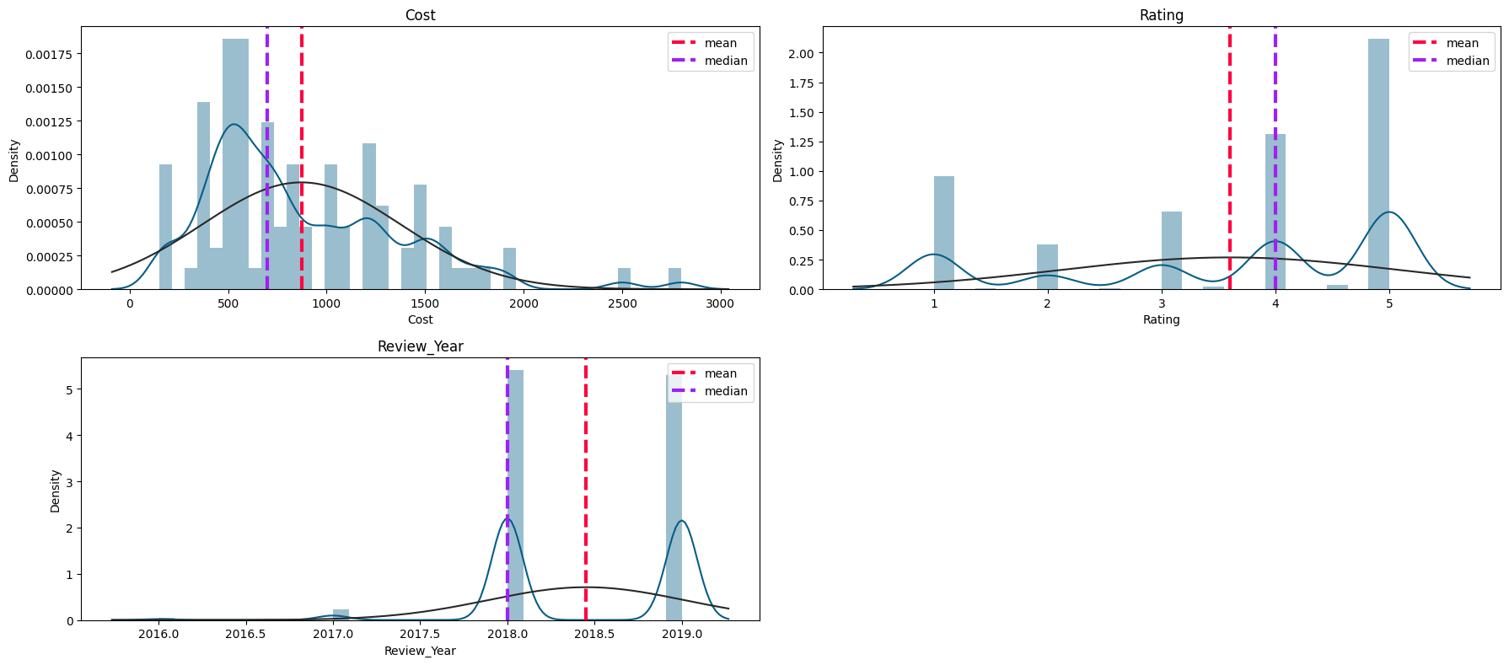
Chart 1 displot

Slide 7
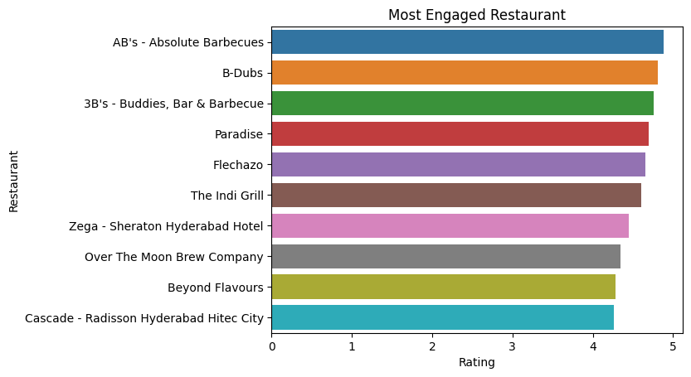
Chart 2

Slide 8
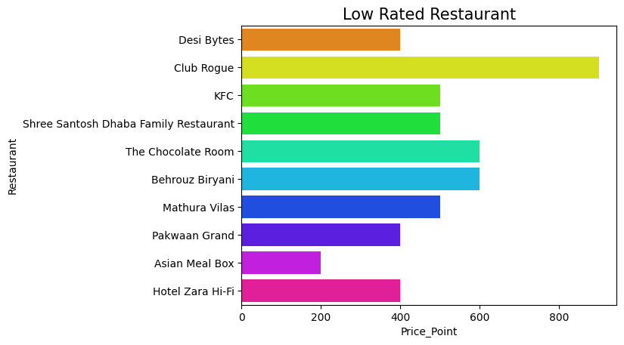
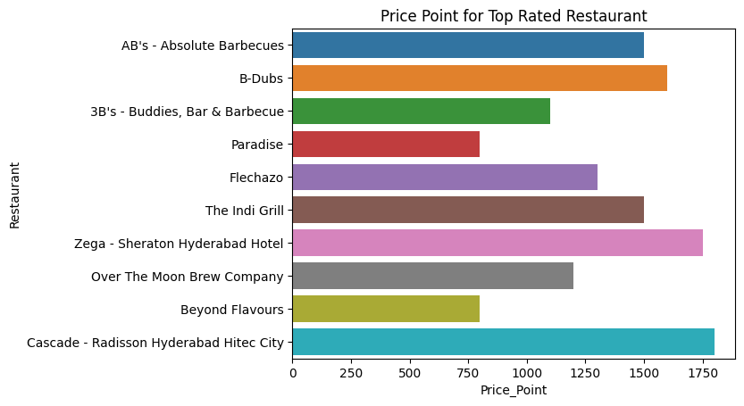
Chart 3

Slide 9
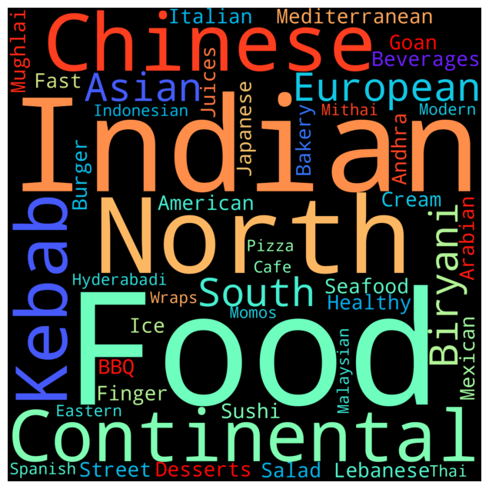
Word cloud for cuisine

Slide 10
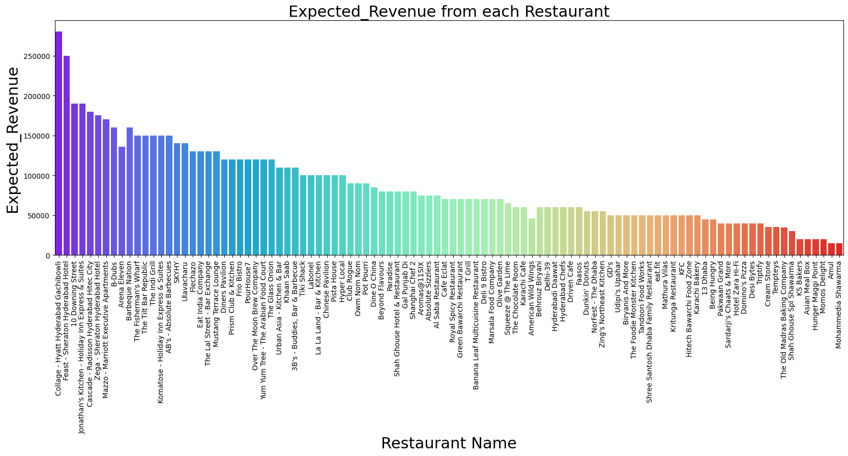
Restaurant with revenue

Slide 11
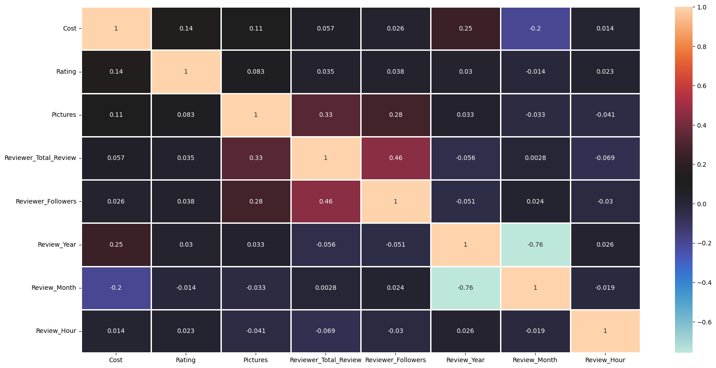
Correlation heatmap

Slide 12
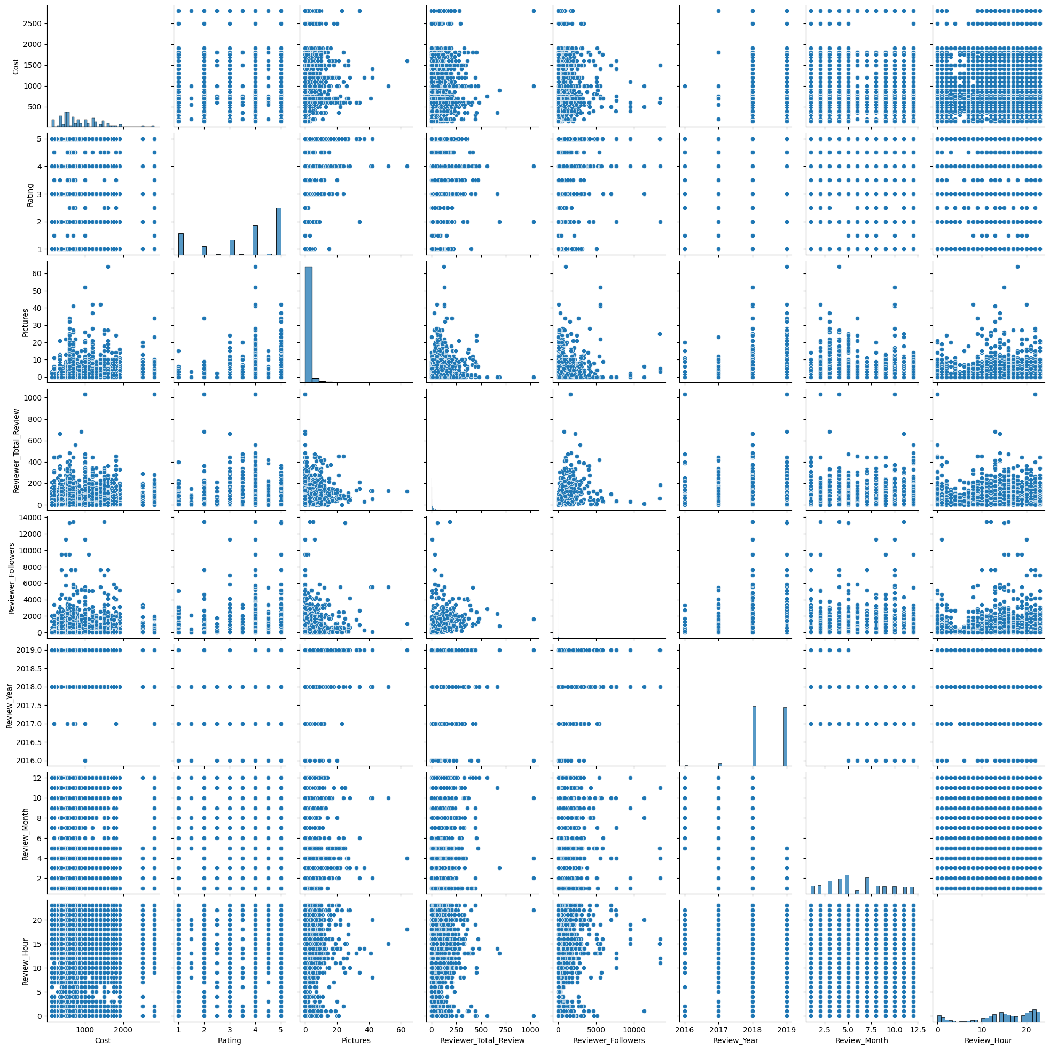
Pairplot

Slide 13
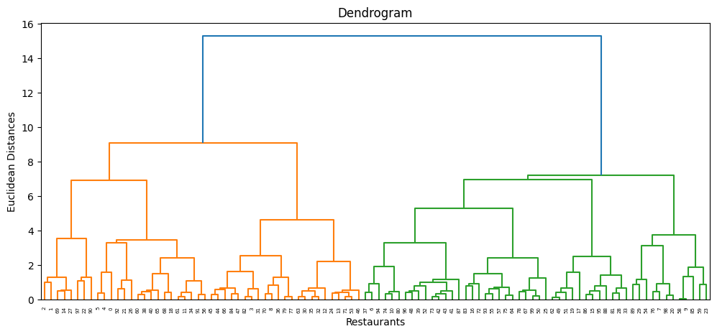
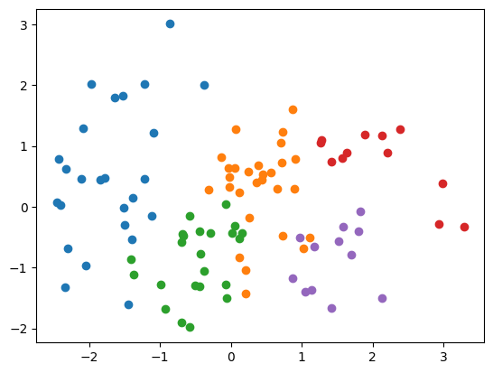
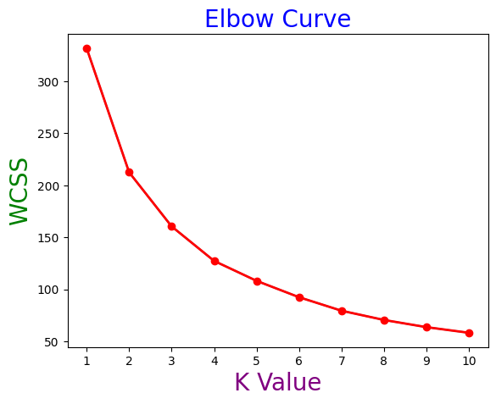
Sentimental analysis

Slide 14
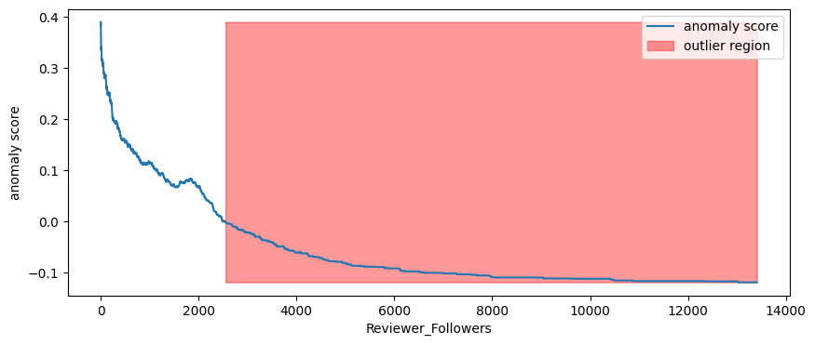
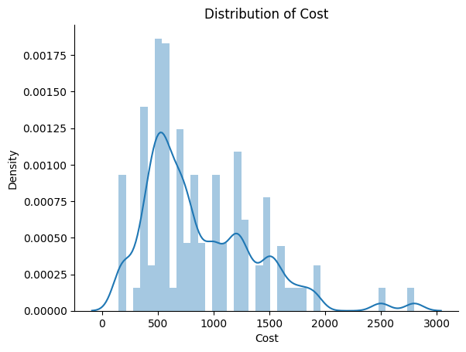
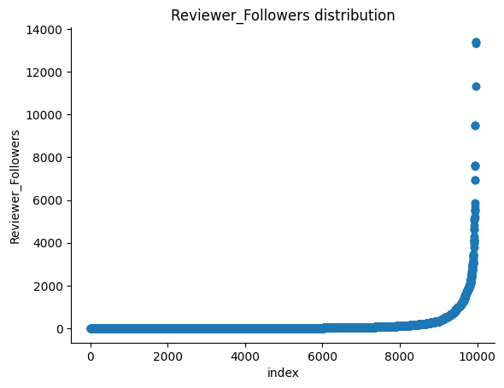
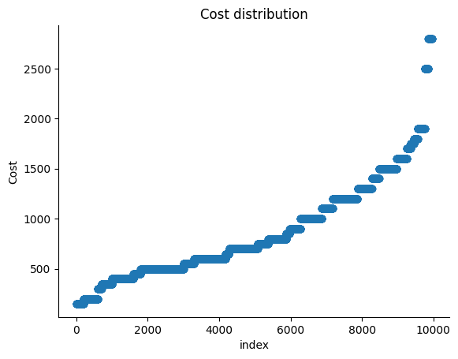
OUTLIERS

Slide 15
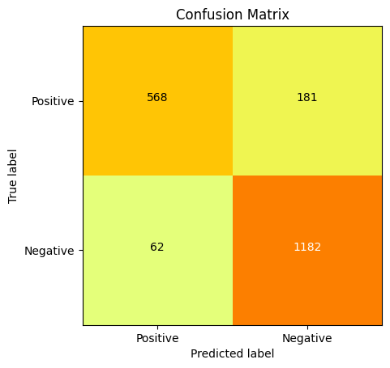
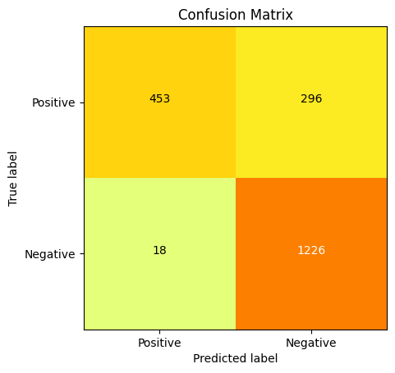
LOGISTIC REGRESSION

Slide 16
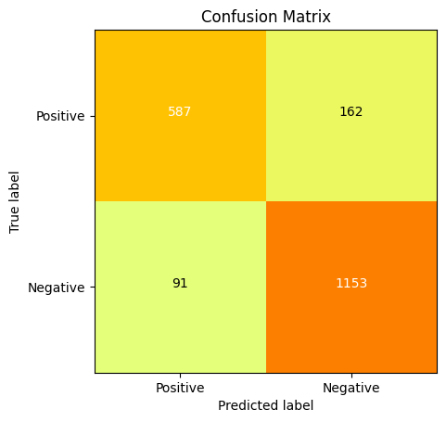

XGBOOST MODEL

Slide 17
Model used for implementation
1- Logistics regression
2- Xgboost
Accuracy before evaluation
)
Logistics regression | 80.11%
Xgboost | 81.33%

Slide 18
Model used for implementation
1- Logistics regression
2- xgboost
Accuracy after evaluation
)
Logistics regression gridsearchcv | 80.38%
Xgboost | 83.59%

Slide 19
Conclusion
Overall, this analysis provided valuable insights into the customer's experience with Zomato, and it could be used to guide future business decisions and improve the service. Additionally, by combining clustering and sentiment analysis techniques, a more comprehensive understanding of customer feedback was achieved.
restaurant Collage - Hyatt Hyderabad Gachibowli is most expensive restaurant in the locality which has a price of 2800 for order and has 3.5 average rating. Hotels like Amul and Mohammedia Shawarma are least expensive with price of 150 and has 3.9 average rating.
Price point for high rated hotel AB's= Absolute Barbecues is 1500 and price point for low rated restaurant Hotel Zara Hi-Fi is 400.
)

Slide 20
THANK YOU

