Slide 1
CSC 478/678
Principles of Wireless Networks
Instructor: Dr. Jing Deng
jing.deng@uncg.edu
Petty 166

Slide 2
Course introductions
Syllabus
  All announcements will be made on Canvas
Project
  Wireless network simulation based on numpy or MATLAB
  You will be guided to simulate and compare a few simple protocols.
  Project report and short presentation at the end.

Slide 3
Chapter 1: Introduction
A case for mobility
History of wireless communication
Research areas

Slide 4
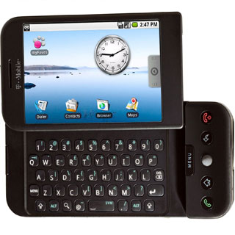
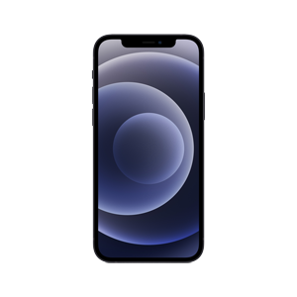
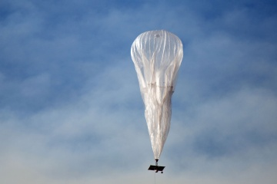
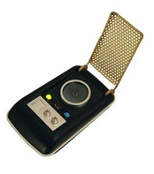
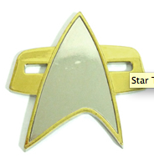
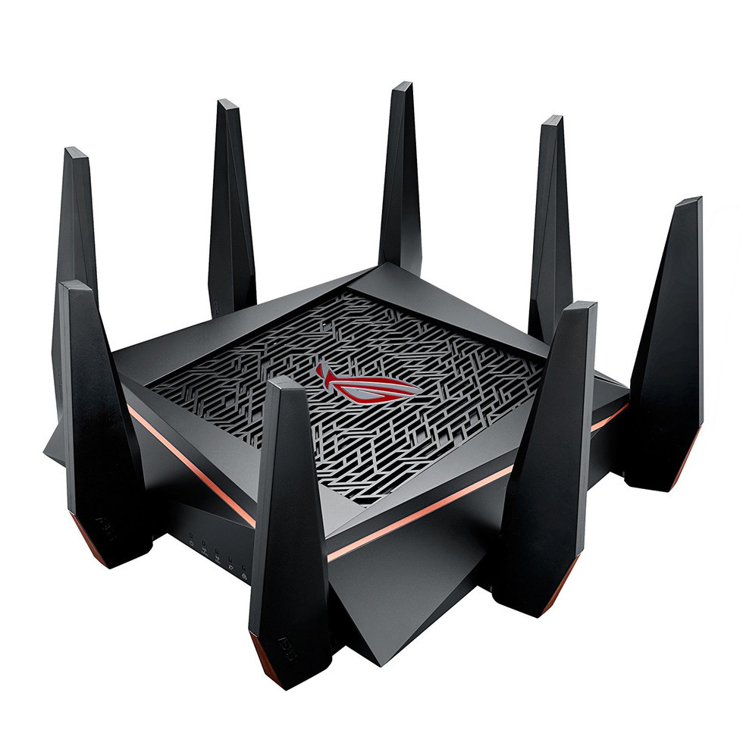
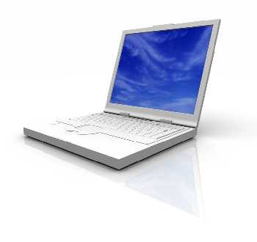

Wireless devices

Slide 5
Device Connections
Computers are integrated into everyone’s life.
  They are small, cheap, portable, replaceable.
  Many of these are networked. But how to network them is THE question we will work on.
Technology works in the background.
  Computers are aware of their environment and can adapt quietly.
  Location awareness is one of the many techniques. Computers recognize the location of the user and react differently.
Advances in technology have major impacts.
  There are more computing power in ever smaller devices.
  They have flat, lightweight displays with low power consumption.
  They carry new user interfaces. Some are due to small dimensions.
  High bandwidth per cubic meter becomes available.
  There are different networks, e.g., WLAN, HIPERLAN, etc. in use.

Slide 6
Mobile communication
There are usually two aspects of mobility:
  user mobility: users communicate (wireless) "anytime, anywhere, with anyone"
  device portability: devices can be connected anytime, anywhere to the network
Wireless and Mobile are certainly not the same.
Wireless vs. mobile Examples
✗ ✗ stationary computer
✗ ✓ notebook in a hotel
✓ ✗ wireless LANs in historic buildings
✓ ✓ smart phones, PDAs
Need for mobile communication:
  local area networks: standardization of IEEE 802.11,
  ETSI (HIPERLAN)
  Internet: Mobile IP extension of the internet protocol IP
  wide area networks: e.g., internetworking of GSM and ISDN

Slide 7
Wireless/Mobile Applications I
Vehicles
  transmission of news, road condition, weather, music, etc.
  personal communication using GSM
  position via GPS
  local ad-hoc network with vehicles close-by to prevent accidents, guidance system, redundancy
  vehicle data (e.g., from bus, high-speed train) can be transmitted in advance for maintenance
Emergencies
  early transmission of patient data to the hospital, current status, first diagnosis
  replacement of a fixed infrastructure in case of earthquakes, hurricanes, fire etc.
  crisis, war, ...

Slide 8
Typical application: road traffic
UMTS, WLAN,
DAB, GSM,
TETRA, ...
ad hoc
Personal Travel Assistant,
DAB, PDA, laptop,
GSM, UMTS, WLAN,
Bluetooth, ...

Slide 9
Wireless/Mobile Applications II
Travelling salesmen
  direct access to customer files stored in a central location
  consistent databases for all agents
  mobile office can make work much more efficient
Replacement of fixed networks
  remote sensors, e.g., weather, underground activities
  flexibility for expos and large meetings
  LANs in historic buildings
Entertainment, education, ...
  outdoor Internet access
  intelligent travel guide with up-to-date
  location dependent information
  ad-hoc networks for
  multi user games
Built
150BC

Slide 10
Location dependent services
Location aware services
  what services, e.g., printer, fax, phone, server etc. exist in the local environment
Follow-on services
  automatic call-forwarding, transmission of the actual workspace to the current location
Information services
  "push" : e.g., current special offers in the supermarket
  "pull": e.g., where is the Black Forrest Cherry Cake?
Support services
  caches, intermediate results, state information etc. "follow" the mobile device through the fixed network
Privacy
  who should gain knowledge about the location.

Slide 11

Mobile devices
Pager
receive only
tiny displays
simple text
messages
PDA
simple graphical displays
character recognition
simplified WWW
Laptop
fully functional
standard applications
Sensors,
embedded
controllers
Mobile phones
voice, data
simple text displays
HTTP, larger screens
Palmtop
tiny keyboard
simple versions
of standard applications
performance

Slide 12
Problems caused by mobility
Power consumption
  limited computing power, low quality displays, small disks due to limited battery capacity
  CPU: power consumption ~ CV²f
    C: internal capacity, reduced by integration
    V: supply voltage, can be reduced to a certain limit
    f: clock frequency, can be reduced temporally
Loss of data
  higher probability, should be considered ahead of time
Limited user interfaces
  compromise between size of fingers and portability
  integration of character/voice recognition, abstract symbols
Limited memory
  limited value of mass memories with moving parts
  flash-memory or ? as alternative

Slide 13
Wireless vs. fixed networks
Higher loss-rates due to interference
  emissions of, e.g., engines, lightning
Restrictive regulations of frequencies
  frequencies have to be coordinated (cognitive radio approach)
Low transmission rates
  local some 10Mbit/s, slower than 100Mbps on wired networks
Higher delays, higher jitter
  connection setup time with GSM in the second range, several hundred milliseconds for other wireless systems
Lower security, simpler active attacking
  radio interface accessible for everyone, base station can be simulated, thus attracting calls from mobile phones
Always shared medium
  secure access mechanisms important

Slide 14
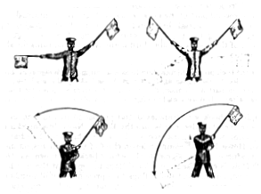
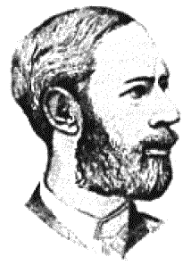
A brief history
People used light for communication.
  heliographs, flags ("semaphore"), ...
  150 BC smoke signals for communication;
  (Polybius, Greece)
  1794, optical telegraph, Claude Chappe
electromagnetic waves
  1831 Faraday demonstrated electromagnetic induction
  J. Maxwell (1831-79): theory of electromagnetic Fields, wave equations (1864)
  H. Hertz (1857-94): demonstrated
  with an experiment the wave character
  of electrical transmission through space
  (1886)

Slide 15
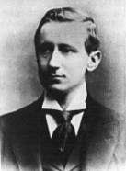
History, cont’d
1895 Guglielmo Marconi
  first demonstration of wireless
  telegraphy (digital!)
  long wave transmission, high
  transmission power necessary (> 200kw)
1907 Commercial transatlantic connections
  huge base stations (30-100m high antennas)
1915 Wireless voice transmission
  New York - San Francisco
1920 Discovery of short waves by Marconi
  reflection at the ionosphere
  smaller sender and receiver
1926 Train-phone on the line Hamburg - Berlin
  wires parallel to the railroad track

Slide 16
History, cont’d
1928 many TV broadcast trials (across Atlantic, color TV, TV news)
1933 Frequency modulation (E. H. Armstrong)
1982 Start of GSM-specification
  goal: pan-European digital mobile phone system with roaming
1983 Start of the American AMPS
  Advanced Mobile Phone System, analog
1984 CT-1 standard (Europe) for cordless telephones
1991 2G cellular service
1994 IS-95 (CDMA)
2000 3G cellular networks
2008 4G LTE
2018 5G

Slide 17
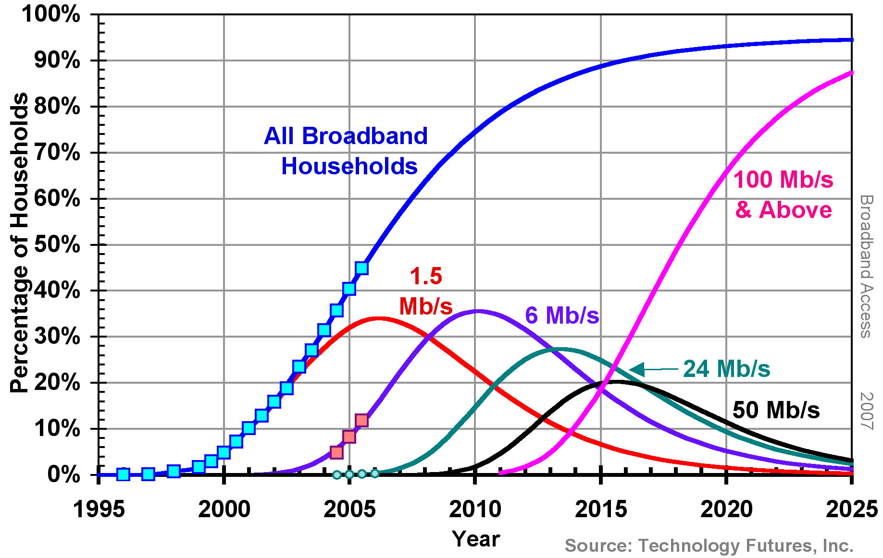
Broadband data rate

Slide 18
Areas of research
Wireless Communication
  transmission quality (bandwidth, error rate, delay)
  modulation, coding, interference
  media access, regulations…
Mobility
  location dependent services
  location transparency
  quality of service support (delay, jitter, security)…
Portability
  power consumption
  limited computing power, sizes of display, ...
  Usability…

Slide 19
Simple reference model
Application
Application
Transport
Transport
Network
Network
Network
Network
Data Link
Data Link
Data Link
Data Link
Physical
Physical
Physical
Physical
Radio
Medium

Slide 20
The seven-layer model
Application layer
Transport layer
Network layer
Data link layer
Physical layer
  service location
  new applications, multimedia
  adaptive applications
  congestion and flow control
  quality of service
  addressing, routing,
  device location
  hand-over
  authentication
  media access
  multiplexing
  media access control
  encryption
  modulation
  interference
  attenuation
  frequency

