Slide 1
Chapter 2: Wireless Transmission
Frequency and signal
Channel and propagation
Multiplexing
Modulation

Slide 2
Frequencies for communication
AM Radio
twisted pair
coax cable
mmWave (5G)
optical transmission
1 Mm
300 Hz
10 km
30 kHz
100 m
3 MHz
1 m
300 MHz
10 mm
30 GHz
100 μm
3 THz
1 μm
300 THz
VLF
LF
MF
HF
VHF
UHF
SHF
EHF
infrared
visible light
UV
FM Radio
VLF = Very Low Frequency UHF = Ultra High Frequency
LF = Low Frequency SHF = Super High Frequency
MF = Medium Frequency EHF = Extra High Frequency
HF = High Frequency UV = Ultraviolet Light
VHF = Very High Frequency

Slide 3
Frequencies in use
VHF-/UHF-ranges for mobile radio
simple, small antenna for cars
Better propagation characteristics, relatively reliable connections
SHF and higher for directed radio links, satellite communication
large bandwidth available
Wireless LANs use frequencies in UHF to SHF spectrum
some systems planned up to EHF
limitations due to absorption by water and oxygen molecules (shorter distance)
weather dependent fading, signal loss caused by heavy rainfall, fog etc.

Slide 4
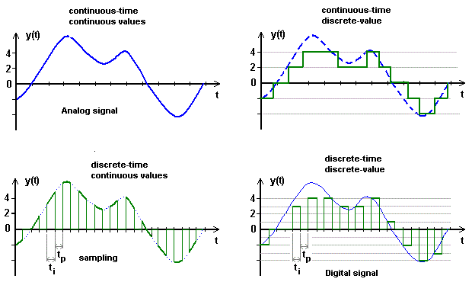
Signal basics
Wireless signal is a physical representation of data
A function of time and location
Determined by parameters, which represent data
Signal classification
continuous time/discrete time
continuous values/discrete values
analog signal =
continuous time
and continuous values
digital signal
discrete time and
discrete values

Slide 5
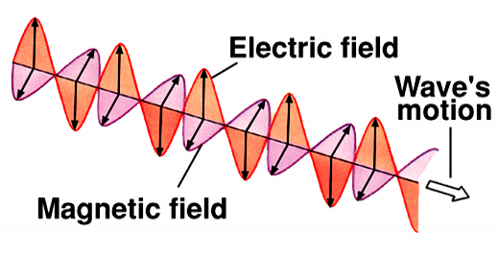
Radio waves
Radio waves are in fact E/M waves
Electric and Magnetic fields
Maxwell Equations demonstrated that variable E-field will generate a variable M-field, and vice versa.
Traverse
meaning that such signals will actually travel through space, or vacuum without any medium.
Frequency, or rate of signal oscillation, f
E-field and M-field will always have the same frequency.
Any frequency is possible.
E
B

Slide 6
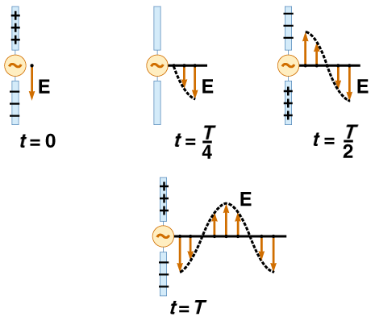
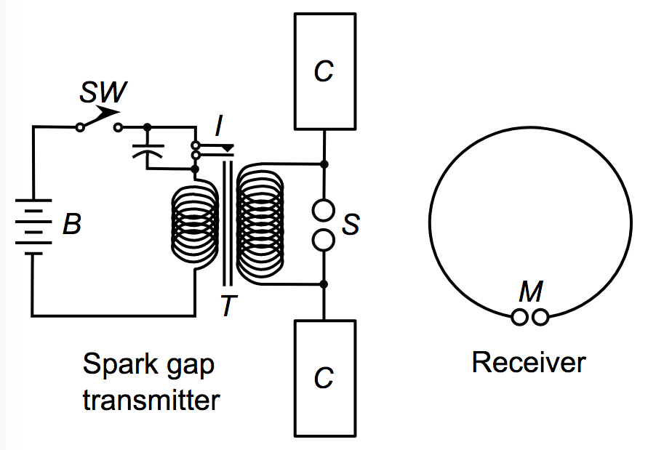
Generation of radio waves
Radio wave generation can start from variable E-field in a dipole antenna.
T as signal period
T=1/f
t=0, E is at maximum value. Decreasing
t=T/4, E is at 0.
t=T/2, E is at negative maximum value.
t=3T/4, E is at 0.
t=T, E is at maximum value again.

Slide 7
Propagation
The easiest way for radio waves to propagate is line-of-sight.
Meaning that sender and receiver can see each other.
And no barrier in between.
Reflection is also possible
Similar to light
Role of the Ionosphere
100 MHz
10 MHz
1 MHz
Earth

Slide 8

Wave propagation
Wireless signals propagate in a similar way as water waves
Starting from center
Slowly expands
By-passing larger objects with the help of water (media)
Reflection, etc.
Source: http://www.gemini.edu/

Slide 9
Antennas: isotropic radiator
Radiation and reception of electromagnetic waves, coupling of wires to space for radio transmission
Isotropic radiator: equal radiation in all directions (three dimensional) - only a theoretical reference antenna
Real antennas always have directive effects (vertically and/or horizontally)
Radiation pattern: measurement of radiation around an antenna
z
y
z
y
x
ideal
isotropic
radiator
x

Slide 10
Antennas: simple dipoles
Real antennas are not isotropic radiators but, e.g., dipoles with lengths λ/4 on car roofs or λ/2 as Hertzian dipole
shape of antenna proportional to wavelength
Example: Radiation pattern of a simple Hertzian dipole
Antenna gain
maximum power in the direction of the main lobe compared to the power of an isotropic radiator (with the same average power)
λ/4
λ/2
y
y
z
simple
dipole
x
z
x
side view (xy-plane)
side view (yz-plane)
top view (xz-plane)

Slide 11
Antennas: directed and sectorized
Often used for microwave connections or base stations for mobile phones (e.g., radio coverage of a valley)
y
y
z
directed
antenna
x
z
x
side view (xy-plane)
side view (yz-plane)
top view (xz-plane)
z
z
sectorized
antenna
x
x
top view, 3 sector
top view, 6 sector

Slide 12
Antenna: diversity
Grouping of 2 or more antennas
multi-element antenna arrays
Antenna diversity
switched diversity, selection diversity
receiver chooses antenna with best signal
sometimes dynamically
diversity combining
combine output power to produce gain
phase-shifting needed to avoid cancellation
λ/2
λ/2
λ/4
λ/2
λ/4
λ/2
+
+
ground plane

Slide 13
Signal propagation ranges
Transmission range
communication possible
low error rate
Detection range
detection of the signal possible
no communication possible
Interference range
signal may not be detected
signal adds to the background noise
sender
transmission
distance
detection
interference
Usually, R_{T} < R_{D} < R_{I}

Slide 14
Signal propagation, details
Propagation in free space always like light (straight line)
Receiving power proportional to 1/d²
d = distance between sender and receiver (area of sphere surface)
Received signal power is also additionally influenced by
fading (frequency dependent)
shadowing
reflection at large obstacles
scattering at small obstacles
diffraction at edges
shadowing
reflection
scattering
diffraction

Slide 15
Multipath propagation
Signal can take many different paths between sender and receiver due to reflection, scattering, diffraction
Time dispersion: signal is dispersed over time
interference with “neighbor” symbols, Inter Symbol Interference (ISI)
Signal reaches a receiver directly. So is a second (weaker) copy with phase shifted. Or a third.
distorted signal depending on the phases of the different parts
signal at sender
signal at receiver

Slide 16
Effects of mobility - fading
Channel characteristics change over time and location
signal paths change
different delay variations of different signal parts
different phases of signal parts
quick changes in the power received (short-term fading)
Additional changes in
distance to sender
obstacles further away
➔ slow changes in the
average power received
(long-term fading)
power
long term
fading
t
short term fading

Slide 17
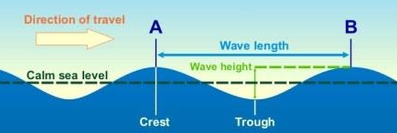
Wavelength
Radio signals travel at speed of light
c = 3*10⁸ m/s
Frequency, f
Defined as number of oscillations per second
Wavelength, λ
Defined as the distance between two points at the same phase
c = λ f
Higher frequency
⬄ shorter wavelength

Slide 18
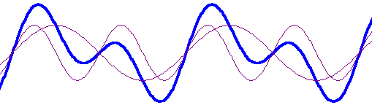
Periodic signals
Example of a signal:
s(t) = A_{t} sin(2 π f_{t} t + ϕ_{t})
1
1
0
0
t
t
ideal periodic signal
real composition
(based on harmonics)
Sum of two
sine waves

Slide 19
Sine wave parameters
Peak amplitude (A)
Frequency (f )
Period (T )
Phase (φ)
Wavelength (λ)
maximum value or strength of the signal over time; typically measured in volts
Rate, in cycles per second, or Hertz (Hz) at which the signal repeats
amount of time it takes for one repetition of the signal (T = 1/f)
measure of the relative position in time within a single period of a signal
distance occupied by a single cycle of the signal
Or, the distance between two points of corresponding phase of two consecutive cycles

Slide 20
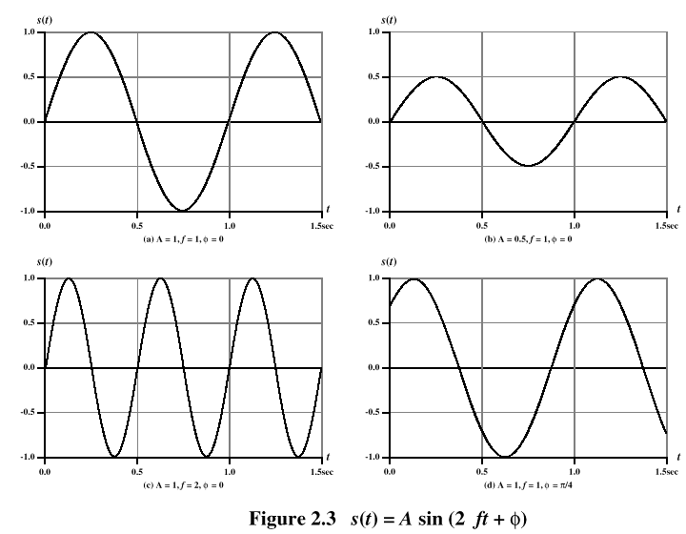
Example of signals
A=1
f=1Hz
φ = 0
X-axis can be time or distance (space)

Slide 21
Frequency-Domain Concepts
Frequency
Just the number of signal repetitions in each second.
Usually signals are not simple ones, but combination of different signals
Bandwidth
The size (in frequency) of the signal from lowest frequency to highest frequency
Low-band filtering, high-band filtering, etc. can help with filtering those signals/noise that we don’t want.

Slide 22
Representing datum in signals
Different representations of signals
Deals with how to carry information
Amplitude, frequency, phase representation
Composed signals can be transferred into frequency domain for better understanding
using Fourier transformation
Digital signals have some special requirements:
infinite number of frequencies for perfect transmission
modulation with a carrier frequency for transmission that will make them analog signals for wireless transmissions.
A [V]
A [V]
Q = M sin ϕ
t[s]
ϕ
I= M cos ϕ
ϕ
f [Hz]

Slide 23
Data Communication Terms
Data - entities that convey meaning, or information
Signals - electric or electromagnetic representations of data
Transmission - communication of data by the propagation and processing of signals
In this course, we focus on delivery of data through wireless media/channels

Slide 24

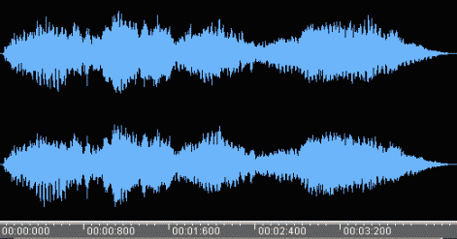
Examples of Analog and Digital Data
Analog
Video
Audio
Digital
Text
Integers

Slide 25
Analog Signals
A continuously varying electromagnetic wave that may be propagated over a variety of media, depending on frequency
Examples of media:
Copper wire media (twisted pair and coaxial cable)
Fiber optic cable
Atmosphere or space propagation
Analog signals can help propagate both analog and digital data

Slide 26
Digital Signals
A sequence of voltage pulses that may be transmitted over a copper wire medium
Transmission generally easier than analog signaling
Less susceptible to noise interference
Suffer more from attenuation
Digital signals can help propagate both analog and digital data

Slide 27
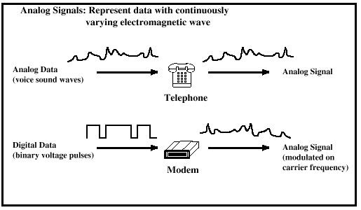
Analog Signaling

Slide 28
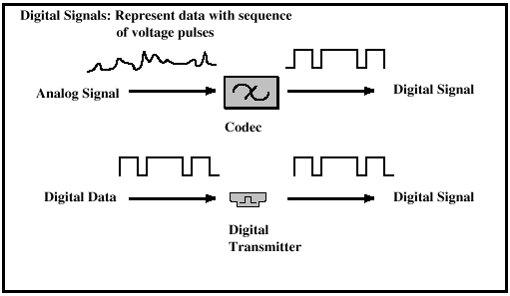
Digital Signaling

Slide 29
Different combinations
Digital data, digital signal
Equipment for encoding is less expensive than digital-to-analog equipment
Analog data, digital signal
Conversion permits use of modern digital transmission and switching equipment
Digital data, analog signal
Some transmission media will only propagate analog signals
Examples include optical fiber and satellite
Analog data, analog signal
Analog data easily converted to analog signal

Slide 30
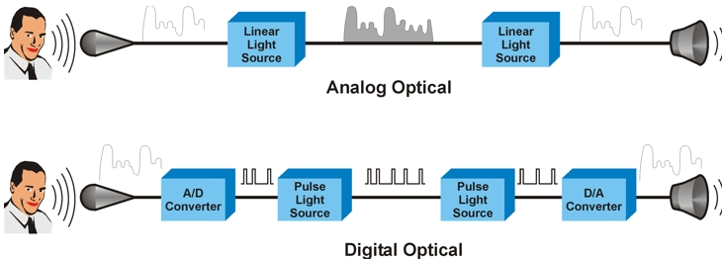
Analog Transmission
Transmit analog signals without regard to content
Attenuation limits length of transmission link
Cascaded amplifiers boost signal’s energy for longer distances but can cause distortion
Noise accumulates over distance
Analog data can tolerate distortion
Introduces errors in digital data

Slide 31
Digital Transmission
Concerned with the content of the signal
Attenuation endangers integrity of data
Digital Signal
Repeaters achieve greater distance
Repeaters recover the signal and retransmit
Analog signal carrying digital data
Retransmission device recovers the digital data from analog signal
Generates new (and usually cleaner) analog signal

Slide 32
Chapter outline
Frequency and signal
Channel and propagation
Multiplexing
Modulation

Slide 33
Channel capacity
Impairments, such as noise, limit data rate that can be achieved
For digital data, to what extent do impairments limit data rate?
Data rate: the number of bits sent/received successfully
Channel Capacity
the maximum rate at which data can be transmitted over a given communication path, or channel, under given conditions
Note that a different condition will lead to different channel capacity.

Slide 34
Concepts Related to Channel Capacity
Channel bandwidth - the bandwidth of the transmitted signal as constrained by the transmitter and the nature of the transmission medium (in Hertz, Hz)
Noise - average level of noise over the communication path
Error rate - rate at which errors occur
Error = transmit 1 and receive 0; transmit 0 and receive 1
E.g., sent 1011 and received 1001, 1/4=25% error rate.
0.1% error rate means that 1 error per 1Kbits data
Energy level of signal also plays an important role, thus…

Slide 35
Signal-to-Noise Ratio
Ratio of the power in a signal to the power contained in the noise that’s present at a particular point in the transmission
Typically measured at a receiver
Signal power to noise power ratio (SNR, or S/N)
A high SNR usually represents a high-quality signal.
Fewer repeaters needed.
SNR sets upper bound on achievable data rate (or channel capacity)

Slide 36
dB, dBW, and dBm
dB is a ratio, converted to logarithm
For example, ratio of r=100
Converted to dB = 10log₁₀ (100) = 20 dB
dBW is a power unit, in relation to Watt
The transmission of a signal is 1000 Watt
Or 10log₁₀ (1000W/1W) = 30 dBW
dBm is also a power unit, in relation to mW
The transmission of a signal is 0.01 mW
Or 10log₁₀ (0.01mW/1mW) = -20 dBm

Slide 37
Shannon Capacity Formula
Equation:
Represents theoretical maximum that can be achieved
Upper bound of achievable data rate
In practice, only much lower rates achieved
Formula assumes white noise (thermal noise)
Impulse noise is not accounted for
Attenuation distortion or delay distortion not accounted for

Slide 38
Example
Spectrum of a channel between 3 MHz and 4 MHz ; SNR_{dB} = 24 dB
Using Shannon’s formula

Slide 39
Chapter outline
Frequency and signal
Channel and propagation
Multiplexing
Modulation

Slide 40
Multiplexing
channels k_{i}
k₁
k₂
k₃
k₄
k₅
k₆
Multiplexing in 4 dimensions
space (s)
time (t)
frequency (f)
code (c)
Goal: multiple users for a shared medium
Important: guard spaces needed!
c
t
c
s₁
t
s₂
f
f
c
t
s₃
f

Slide 41
Frequency multiplex
Spectrum separation
Spectrum separated into smaller bands
Each channel/user gets one band/frequency
Advantages:
no dynamic coordination necessary
Also works for analog signals
Disadvantages:
waste of bandwidth if the traffic is distributed unevenly
Not flexible enough
guard spaces
k₁
k₂
k₃
k₄
k₅
k₆
c
f
t

Slide 42
Time multiplex
A channel gets the whole spectrum for a certain amount of time
Advantages:
only one carrier in the medium at any time
Achieves high throughput even with many users
Disadvantages:
Precise time
synchronization necessary
k₁
k₂
k₃
k₄
k₅
k₆
c
f
t

Slide 43
Time and frequency multiplex
Combination of both methods
A channel gets a certain frequency band for a certain time
Advantages:
better protection against tapping
protection against frequency selective interference
higher data rates compared to code multiplex (next)
Issues
precise coordination required
k₁
k₂
k₃
k₄
k₅
k₆
c
f
t

Slide 44
Code multiplex
Each channel has a unique code
All channels use the same spectrum at the same time
Advantages:
bandwidth efficient
no coordination and synchronization necessary
good protection against interference and tapping
Disadvantages:
lower user data rates
more complex signal regeneration
Implemented using spread spectrum technology
k₁
k₂
k₃
k₄
k₅
k₆
c
f
t

Slide 45
Chapter outline
Frequency and signal
Channel and propagation
Multiplexing
Modulation

Slide 46
Modulation
Digital modulation
digital data is translated into an analog signal (baseband)
ASK, FSK, PSK - main focus in this chapter
differences in spectral efficiency, power efficiency, robustness
Analog modulation
shifts center frequency of baseband signal up to the radio carrier
Motivation
smaller antennas (e.g., λ/4)
Frequency Division Multiplexing
medium characteristics

Slide 47
Modulation and demodulation
analog
baseband
signal
digital
data
digital
modulation
analog
modulation
101101001
radio transmitter
radio
carrier
analog
baseband
signal
digital
data
analog
demodulation
synchronization
decision
101101001
radio receiver
radio
carrier
Your cable modem is doing essentially the same thing.

Slide 48
Digital modulation
Modulation of digital signals known as Shift Keying
Amplitude Shift Keying (ASK):
very simple
low bandwidth requirements
very susceptible to interference
Frequency Shift Keying (FSK):
needs larger bandwidth
Phase Shift Keying (PSK):
more complex
robust against interference
1
0
1
t
1
0
1
t
1
0
1
t

Slide 49
Advanced Phase Shift Keying
BPSK (Binary Phase Shift Keying):
bit value 0: sine wave
bit value 1: inverted sine wave
very simple PSK
low spectral efficiency
robust, used e.g. in satellite systems
QPSK (Quadrature Phase Shift Keying):
2 bits coded as one symbol
symbol determines shift of sine wave
needs less bandwidth compared to BPSK
more complex
DQPSK - Differential QPSK
0010,1101 → compute the differential bits
0011,1011
Q
I
1
0
10
Q
11
I
00
01

Slide 50
Quadrature Amplitude Modulation
Quadrature Amplitude Modulation (QAM): combines amplitude and phase modulation
it is possible to code n bits using one symbol
2^{n} discrete levels, n=2 identical to QPSK
bit error rate increases with n
Q
0010
0001
16-QAM (4 bits = 1 symbol)
Symbols 0011 and 0001 have the same phase, but different amplitude. 0000 and 1000 have different phase, but same amplitude. used in standard 9600 bit/s modems
0011
0000
I
1000

