Slide 1
Mobile Communications
Chapter 3 : Media Access

Slide 2
Media access control (MAC)
Sometimes also called Multiple access control
MAC sublayer at Layer 2
  Frame delimiting and recognition
  Addressing of destination stations (both as individual stations and as groups of stations)
  Conveyance of source-station addressing information
  Transparent data transfer of LLC PDUs, or of equivalent information in the Ethernet sublayer
  Protection against errors, generally by means of generating and checking frame check sequences
  Control of access to the physical transmission medium

Slide 3
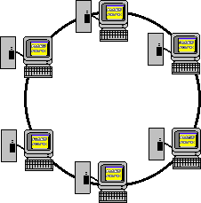
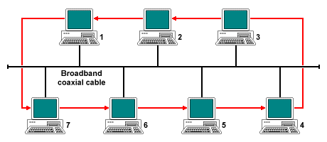
Fixed-network MAC schemes
Token ring (IEEE 802.5)
  Nodes form a physical connection ring
  A 3-byte frame (called token) travels around the ring
  Only nodes capturing the token can transmit.
  Thus, only one node will send at any time
Token bus (IEEE 802.4)
  Virtual ring technology
  Actually coaxial cable as bus
Carrier Sense Multiple Access /
Collision Detection
  Nodes sense the carrier before they send.
  Shortly after sending, check for collisions.

Slide 4
Motivation for wireless MAC
Can we apply media access methods from fixed networks?
Example CSMA/CD
  Carrier Sense Multiple Access with Collision Detection
  send as soon as the medium is free, listen into the medium if a collision occurs (original method in IEEE 802.3)
Problems of using fixed-network MACs in wireless networks
  signal strength decreases proportional to at least d²
  (potential) tokens or controls can easily be lost.
  Dynamic network topology with nodes moving around.
  Sometimes, no central control at all.

Slide 5
Motivation – hidden/exposed terminals
Hidden terminals
  A sends to B, C cannot receive A
  C wants to send to B, C senses a “free” medium (CS fails)
  collision at B, A cannot receive the collision (CD fails)
  A is “hidden” for C
Exposed terminals
  B sends to A, C wants to send to another terminal (not A or B)
  C has to wait, CS signals a medium in use
  but A is outside the radio range of C, therefore waiting is not necessary
  C is “exposed” to B
A
B
C

Slide 6
Motivation - near and far terminals
Terminals A and B send, C receives
  signal strength decreases proportional to the square of the distance, 1/d², in free space
  the signal of terminal B therefore overshadows A’s signal
  C cannot receive from A
If C for example was an arbitrator for sending rights, B would drown A’s signal at physical layer
Also severe problem for CDMA-networks, which require precise power control.
A
B
C

Slide 7
Access methods SDMA/FDMA/TDMA
Multiplexing schemes are applicable here.
SDMA (Space Division Multiple Access)
  segment space into sectors, use directed antennas
  cell structure
FDMA (Frequency Division Multiple Access)
  assign a certain frequency to a transmission channel between a sender and a receiver
  permanent (e.g., radio broadcast), slow hopping (e.g., GSM), fast hopping (FHSS, Frequency Hopping Spread Spectrum)
TDMA (Time Division Multiple Access)
  assign the fixed sending frequency to a transmission channel between a sender and a receiver for a certain amount of time
Notes:
15

Slide 8
FDD/FDMA - general scheme
f
960 MHz
124
935.2 MHz
1
200 kHz
20 MHz
915 MHz
124
890.2 MHz
1
t
FDD = Frequency Division Duplex,
i.e., separation of uplink/downlink traffic in frequency

Slide 9
Random access techniques
Next, we focus on random access techniques that allow wireless users to perform medium access at will.
Reasons for random access include:
  Dynamic user set, so fixed assignments are wasteful.
  Dynamic user traffic pattern, so fixed rotation wasteful as well.
  Etc.
Successful strategies include:
  Competitions are likely and forced.
  Failed transmissions can be tried again later.
  Balancing contention level and channel idle time.
During evaluation, these are measured:
  Throughput/goodput
  Delay
  Fairness

Slide 10
Throughput/goodput
Throughput usually is defined as the rate of useful data transmission, in terms of bps, bits per second.
  If a channel supports the transmission of 800 kbits in each second, its throughput is then 800 kbps.
  This is basically data rate.
Goodput looks at the ratio of the channel data rate is used to transmit useful data.
  Ratio is between 0 and 1, or a percentage.
  The larger the better.
  Goodput doesn’t change with channel data rate. Therefore, when we move a technique from a 1Mbps channel to a 10Mbps channel, the goodput remains the same, e.g., 0.6.
  Better comparison metric.
Sometimes people use throughput and goodput interchangeably.
  One with unit; the other is unit-less.

Slide 11
Delay
Delay is measured as the duration between the time when the message/packet is ready for transmission and the time when it is received at the receiver.
  Since we focus on wireless transmission and computer networks usually have wired segment in the connection links, we usually count the wireless segments but not the end-to-end delay.
Includes different delay components:
  Queueing delay: time waiting in queue
  Transmission delay: time for the entire message to be transmitted.
  Propagation delay: time for radio signal to propagate.
  Retransmission delay: if failed in one transmission, additional time is needed for next try.
  Processing delays: at sender and at receiver
Different users in the same network may experience different delays.
  Unfair

Slide 12
Fairness
Does every user in the network get its fair share of the resource?
  A simple and no-brainer scheme is to allow only one user to use the wireless channel. Great throughput, but unfair.
Different definition of fairness measurements
  Max/min fairness: maximum throughput divided by minimum throughput
  In Max/min fairness measurement, the lower the better.
  A fairest system has fairness of 1.
  Another example would be Jain’s fairness (skipped)
Example:
  Four-user network and their throughput
  A: 0.4 B: 0.3 C: 0.2 D: 0.1
  Max/min fairness
    F = 0.4/0.1 = 4
  Another example (and which one is better?)
  A: 0.4 B: 0.25 C: 0.25 D: 0.1

Slide 13
ALOHA
Developed by researchers at Univ. of Hawaii in 1970’s
  ALOHA means hello, bye, and a lot others
  It was designed for satellite communication system’s uplink MAC scheme, from different islands in Hawaii.
The idea of ALOHA is straightforward
  Send the packet as it arrives, no matter what
  Simple, low-cost, low performance
collision
sender A
sender B
sender C
t

Slide 14
Slotted ALOHA
ALOHA’s throughput was poor
  Low utilization of the wireless channel
  Can we do better?
Slotted ALOHA was proposed
  Users are not allowed to send their packets as they arrive.
  Instead, they should wait until next time slot
  Therefore, all those packets arriving during last time slot will be sent at the start of the next time slot.
collision
sender A
sender B
sender C
t

Slide 15
Poisson distribution
In order to analyze ALOHA’s throughput, we need to introduce Poisson arrivals (and a little math)
  Poisson arrival represents a special arrival probability density function (PDF)
  The prob. of n arrivals in a unit time based on a large population:
  Therefore, Pr(0)=e^{-G}, etc.
Poisson distribution is important because it tells us how many packet transmissions start in that period of time.
  Chance of idle channel Pr(0)
  Chance of successful transmission Pr(1)
  Chance of collisions P_{e} = Pr(2)+Pr(3)+… = 1 – Pr(0) – Pr(1)
T unit times

Slide 16
Throughput of Pure ALOHA
The chance of successful transmission is the chance that no other user packets arrive during the 2 units of time
Suppose the user packet arrival rate is G (in each unit time)
For each arrived packet, the chance of success is
  P_{s} = Pr(0) = e^{-2G}
Overall, throughput of pure ALOHA is
  S = G*P_{s} = G*e^{-2G}
Maximum throughput? Dependent on the value of G
  First derivative of S over G: e^{-2G}+G*(-2)*e^{-2G}
  Setting this to zero, we get G*=0.5, S*=0.184

Slide 17
Throughput of Slotted ALOHA
The chance of successful transmission is the chance that no other user packets arrive during the 1 unit of time
Suppose the user packet arrival rate is G (in each unit time)
For each arrived packet, the chance of success is
  P_{s} = Pr(0) = e^{-G}
Overall, throughput of slotted ALOHA is
  S = G*P_{s} = G*e^{-G}
Maximum throughput? Dependent on the value of G

Slide 18
DAMA - Demand Assigned Multiple Access
Channel efficiency only 18% for ALOHA, 36% for Slotted ALOHA (assuming Poisson distribution for packet arrival and fixed packet length)
Reservation can increase efficiency to 80%
  a sender reserves a future time-slot
  sending within this reserved time-slot with collision unlikely
  reservation also causes higher delays
  typical scheme for satellite links
Examples for reservation algorithms:
  Explicit Reservation according to Roberts (Reservation-ALOHA)
  Implicit Reservation (PRMA)
  Reservation-TDMA

Slide 19
Access method DAMA: Explicit Reservation
Explicit Reservation (Reservation Aloha):
  Two phases: reservation phase and transmission phase
    Reservation phase (ALOHA mode) for reservation:
    competition on small reservation slots, collisions possible
    Transmission phase (reserved mode) for data transmission within successful reserved slots (no collisions)
  it is important for all stations to keep the reservation list consistent at any point in time and, therefore, all stations have to maintain time-synchronized
collision
t
Aloha
reserved
Aloha
reserved
Aloha
reserved
Aloha
Notes:
24

Slide 20
Access method DAMA: PRMA
Implicit reservation (PRMA - Packet Reservation MA):
  A certain number of slots form a frame. Frames are repeated
  stations compete for empty slots according to the slotted aloha principle
  Use of this slot implied for the future
  competition for this slots starts again as soon as the slot was empty in the last frame
  Works great for continuous data streams
reservation
1
2
3
4
5
6
7
8
time-slot
ACDABA-F
frame₁
A
C
D
A
B
A
F
ACDABA-F
frame₂
A
C
A
B
A
AC-ABAF-
frame₃
A
B
A
F
collision at
reservation
attempts
A---BAFD
frame₄
A
B
A
F
D
ACEEBAFD
frame₅
A
C
E
E
B
A
F
D
t
Notes:
25

Slide 21
Access method DAMA: Reservation-TDMA
Reservation Time Division Multiple Access
  every frame consists of N mini-slots and x data-slots
  every station has its own mini-slot and can reserve up to k data-slots using this mini-slot (i.e. x = N * k).
  other stations can send data in unused data-slots according to a round-robin sending scheme (best-effort traffic)
e.g. N=6, k=2
N mini-slots
N * k data-slots
reservations
for data-slots
other stations can use free data-slots
based on a round-robin scheme
Notes:
26

Slide 22
Nodes contending in larger areas
So far, we have focused on contentions in smaller regions, in which nodes can hear each other.
  Therefore, the network of the contending nodes is fully-connected.
  There is a connection between each pair of nodes. Such connectivity links help nodes to avoid misunderstandings of channel status. For example, busy channel is always known to everyone.
When nodes contend in larger areas, some of them can hear others.
  Non-fully connected network.
  In order to reach from one node to another, a multi-hop connection may be needed. For example, A connects to B, B connects to C, and C connects to D.
    A – B – C – D

Slide 23
CSMA revisited
CSMA is to require nodes to check channel availability before using it.
  The way to check channel availability is carrier sensing.
  If transmission carrier is found, the channel is busy. Otherwise, the channel is idle.
CSMA works reasonably well in fully-connected networks, but not in multi-hop networks
    E – S – D – H
  Suppose S is transmitting to D.
  H senses no carrier. It is hidden from the current transmission. H is defined as a hidden terminal.
  E senses a carrier. It is exposed to the current transmission (although it is far away from the receiver D). E is an exposed terminal.

Slide 24
Hidden/exposed terminals
Hidden terminals should not transmit at all.
  And the reason is …
Exposed terminals should be allowed to transmit.
  And the reason is …
    E – S – D – H
However, using CSMA, the above two are not maintained.
  Leading to failed transmissions, more retransmissions, lower throughput.

Slide 25
MACA - collision avoidance
MACA (Multiple Access with Collision Avoidance) uses short signaling packets for collision avoidance
  Originally designed in AppleTalk by amateur radio operators.
  RTS (request to send): a sender requests the right to send from a receiver with a short RTS packet before it sends a data packet
  CTS (clear to send): the receiver grants the right to send as soon as it is ready to receive
  The purpose of CTS is two-fold: channel reservation and notification
  Illustrations on next slide.
Signaling packets contain
  sender address
  receiver address
  packet size
Used in IEEE 802.11 DCF (Distributed Coordination Function) CSMA/CA

Slide 26
MACA explained
MACA avoids the problem of hidden terminals
  S needs to send D
  S sends RTS first
  H has to wait after
  overhearing CTS
MACA avoids the problem of exposed terminals
  S sends to D
  to another terminal
  E has packets to send,
  it doesn’t have to wait
RTS
CTS
CTS
S
D
H
RTS
RTS
CTS
D
S
E

Slide 27
Throughput of MACA
The calculation of MACA throughput is more complex, requiring additional information
  Control packet length, L_{c}
  Data packet length, L_{d}
  Modeling of data collision chances
Assume G packet arrivals per unit time
  P_{s} = Pr(0) = e^{-2G}
Time can be divided into three different phases
  Failed, Idle, and Successful times
  T_{f}, T_{i}, T_{s}
  Throughput can be computed
  T_{s} / (F*T_{f} + (F+1)*T_{i} + T_{s})
  F: the average number of failed transmissions before each success
Failed
Idle
Successful

Slide 28
Throughput of MACA, cont’d
We can normalize every term to the unit of control packet transmission time
  Control packets are sent in 1 unit of time
  Data packets are sent in L_{d}/L_{c} units of time
Durations
  T_{s} = 2 + L_{d}/L_{c} T_{i} = 1/G T_{f} ≈ 1.5
The calculation of F requires geometric distribution
  Flips a coin repeatedly until seeing a head. Count the number of flips.
  In each flip, finding head with a probability p.
  Pr(1) = p, Pr(2) = (1-p)p, … Pr(n) = (1-p)^{n-1}p
  F=E[n]-1
Failed
Idle
Successful

Slide 29
Effective throughput
In the successful transmission time, only a portion of it is used to send actual data.
  Other times control messages are sent
  Actual throughput should be multiplied by
      η = L_{d}/L_{c} / (2 + L_{d}/L_{c})
Therefore, L_{d}/L_{c} affects effective throughput
  L_{d}/L_{c} = 100, η = 98%
  L_{d}/L_{c} = 1, η = 33%
Conclusions
  Do not use control packets for short data packets
Failed
Idle
Successful

Slide 30
MACAW
MACA has no acknowledgment mechanism, but packets get lost all the time
  Due to collisions, or poor signal quality
  Retransmissions at network/transport layer costly
MACAW (MACA for Wireless)
  Adds ACK message
  RTS – CTS – DATA – ACK sequence
New problems
  E can’t send
  CTS may be lost
  ACK lost
  Etc. (details on next slide)
RTS
CTS
CTS
E
S
D
H
DATA
ACK

Slide 31
MACAW’s problems
Several problems in MACAW
  None is taken care of in IEEE 802.11.
Exposed terminal nodes cannot start transmission
  Such as E. The reason is that S needs to receive ACK.
CTS can be collided.
  CTS colliding with other control packets. Those nodes not overhearing the CTS packet may start transmission later to interfere with DATA transmission.
Lost ACK due to collisions. Retransmission?
RTS
CTS
CTS
E
S
D
H
DATA
ACK

Slide 32
State diagram of IEEE 802.11 DCF
sender
receiver
idle
idle
packet ready to send; RTS
data;
ACK
RxBusy
time-out;
RTS
wait for the
right to send
RTS;
CTS
ACK
time-out ∨
data;
NAK
time-out ∨
NAK;
RTS
CTS; data
wait for ACK
wait for
data
ACK: positive acknowledgement
NAK: negative acknowledgement
RxBusy: receiver busy
RTS; RxBusy

Slide 33
RI-BTMA
Problems of having control packets on the same channel as data packets
  Costly collisions
  DATA-DATA, control-control, and DATA-control collisions
  Missing control packets would mean additional collisions later on
Researchers tried to eliminate such collisions with an additional channel
  This is called busy tone signal
  Carrying one-bit information continuously, busy vs. not busy
Receiver-Initiated Busy-Tone Multiple Access
  RTS – BT – DATA
BT
RTS
BT
Data Ch.
E
DATA
S
D
H
f

Slide 34
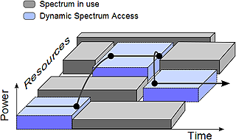
RTS-CTS Dialogue Useful
Surprisingly useful for the design of many MAC schemes. We will discuss two MAC schemes for Cognitive radio network below.
Cognitive radio networks are those allowing secondary users (SUs) to use licensed channels when they are not occupied by primary users (PUs)
There are mainly two categories:
  DCC: Dedicated Control Channel schemes
  SP: Split Phase schemes

Slide 35
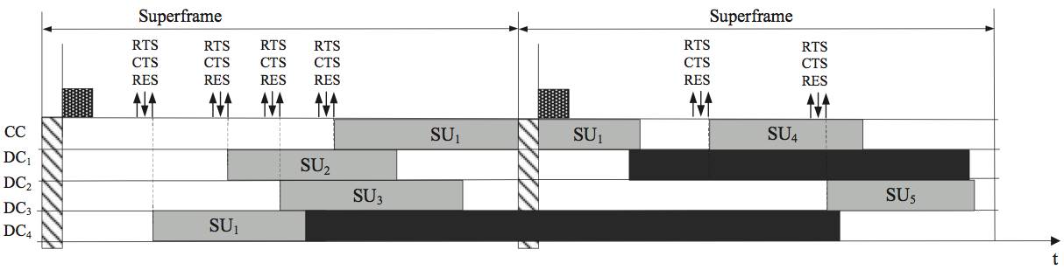
DCC Schemes
Using a dedicated control channel (hopefully won’t change)
With RTS/CTS/REServation exchange
Each successful dialogue leads to the use of one available channel
What’s fashion does the control channel function:
  CSMA, CSMA/CD, CSMA/CA, ALOHA, slotted-ALOHA?

Slide 36
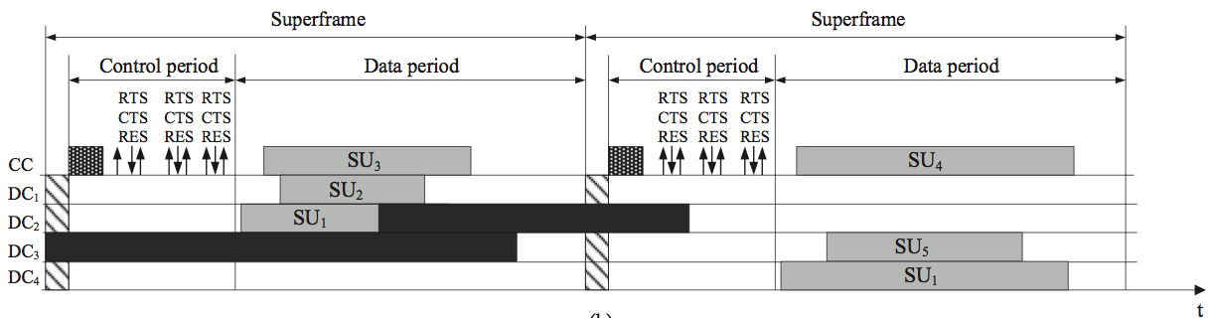
SP Schemes
Splitting a superframe into two phases:
  Control period
  Data period
RTS/CTS/RES exchanges occurring control period.
Data transmissions take place in data period
What happens if Primary Users come back?

Slide 37
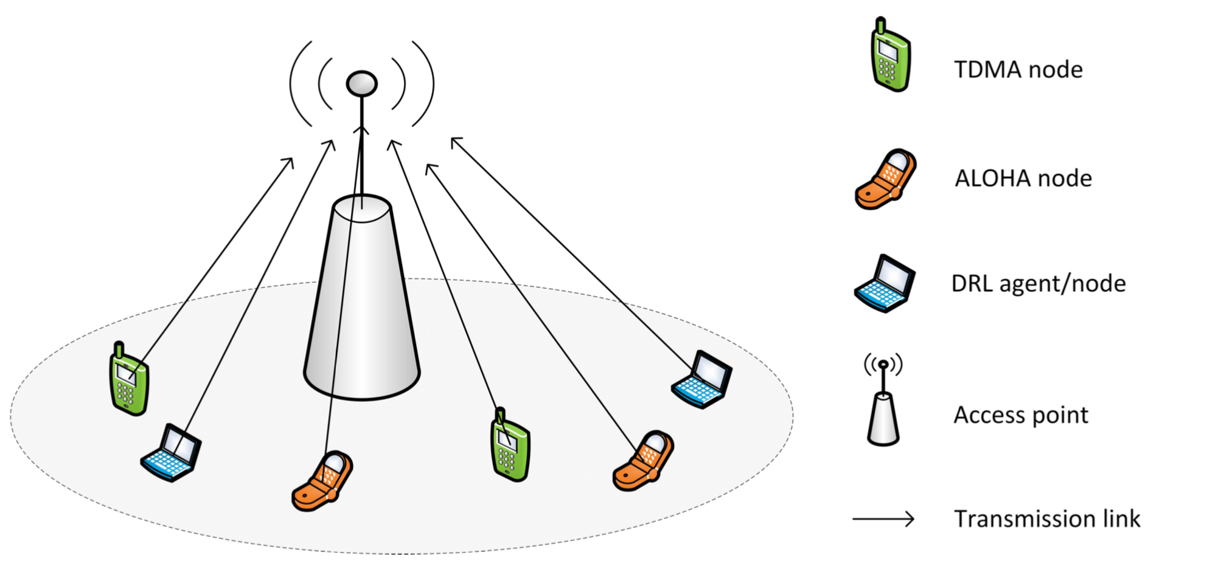
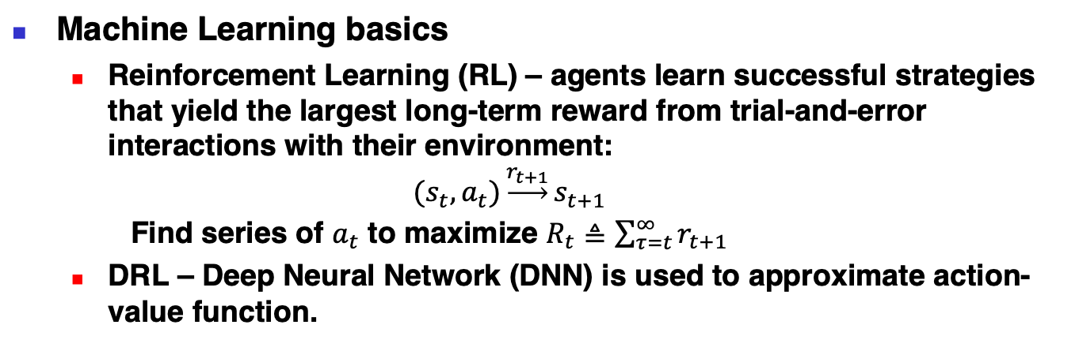
Deep-Reinforcement Learning Multiple Access
Y. Yu, T. Wang and S. C. Liew, "Deep-Reinforcement Learning Multiple Access for Heterogeneous Wireless Networks," in IEEE Journal on Selected Areas in Communications, vol. 37, no. 6, pp. 1277-1290, June 2019, doi: 10.1109/JSAC.2019.2904329.
Machine Learning basics
  Reinforcement Learning (RL) – agents learn successful strategies that yield the largest long-term reward from trial-and-error interactions with their environment:
  $${(s}_{t},a_{t})\underset{→}{r_{t+1}}s_{t+1}$$
  Find series of $a_{t}$ to maximize $R_{t}≜\sum_{τ=t}^{∞}{r_{t+1}}$
  DRL – Deep Neural Network (DNN) is used to approximate action-value function.
Heterogeneous Networks, i.e., with multiple protocols are being used.

Slide 38
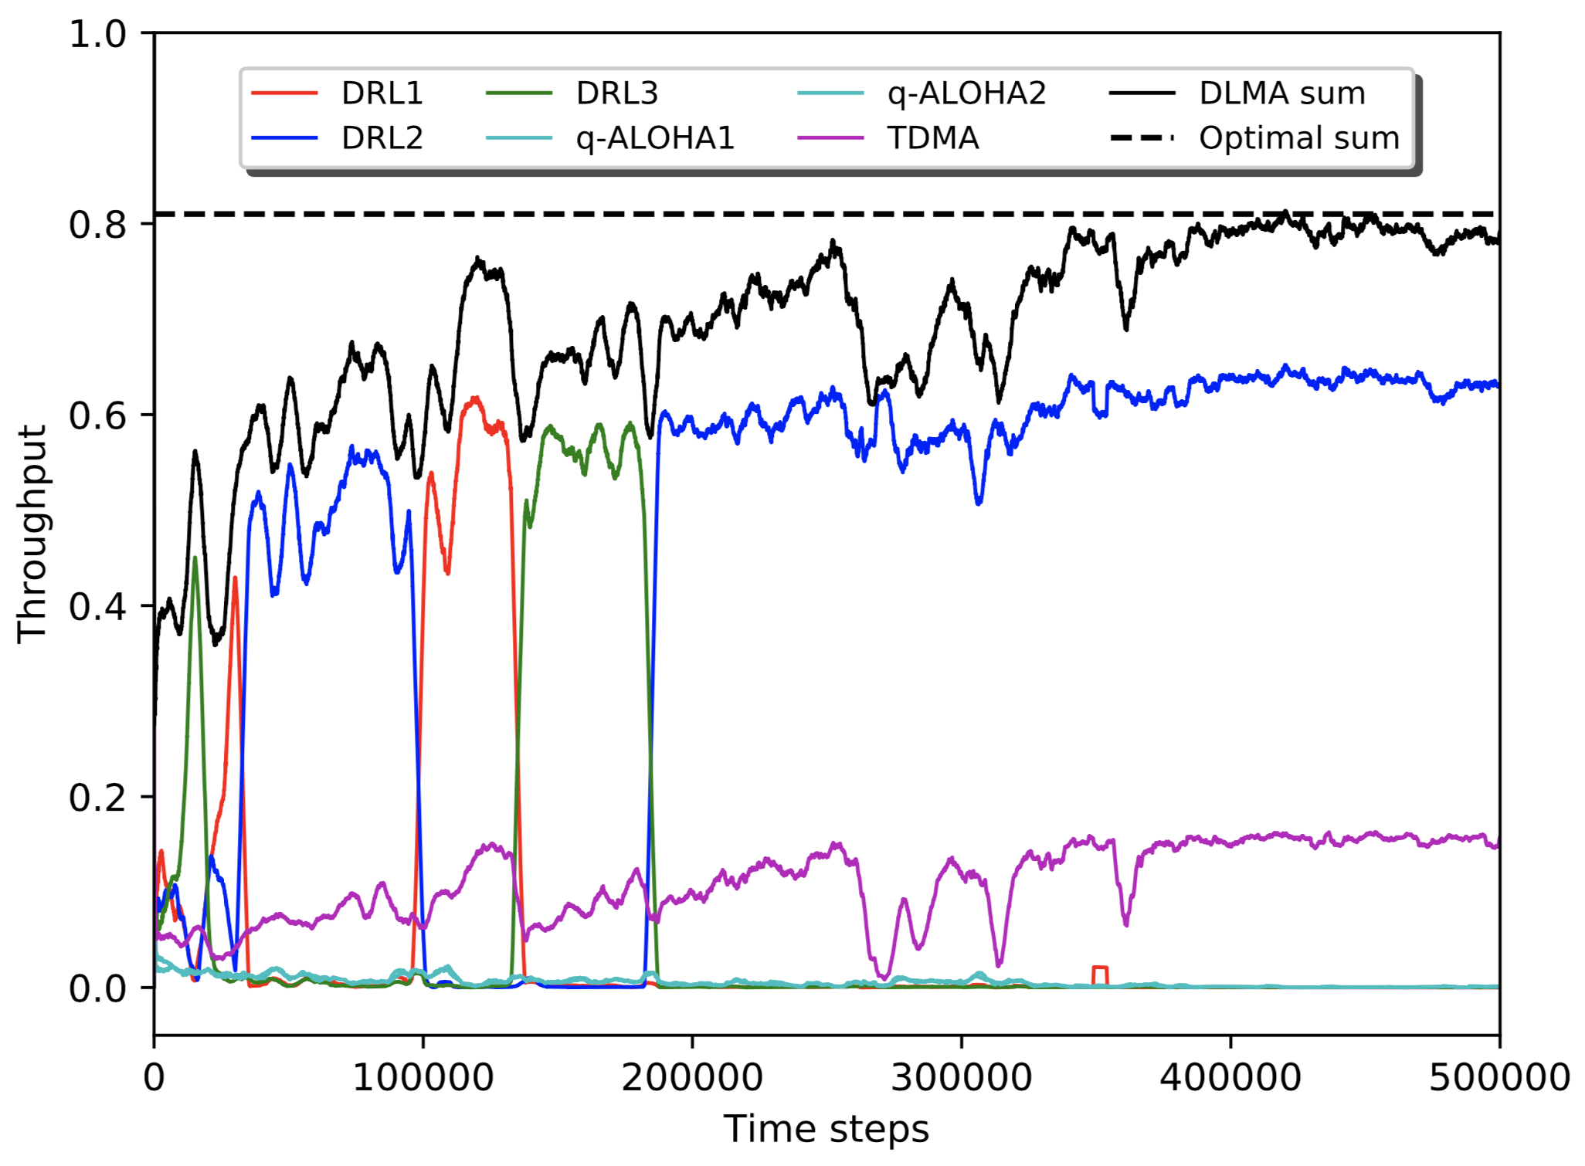
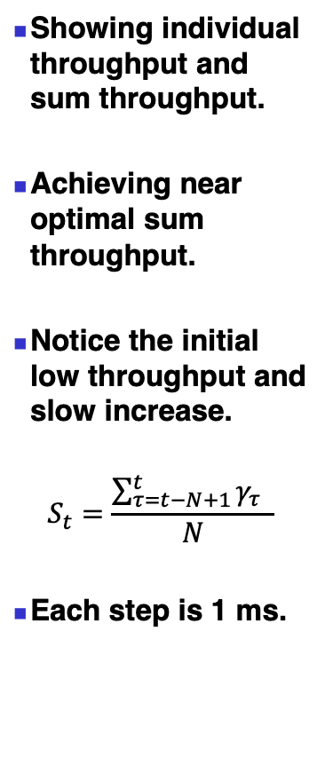
Throughput dynamics
Showing individual throughput and sum throughput.
Achieving near optimal sum throughput.
Notice the initial low throughput and slow increase.
$$S_{t}=\frac{\sum_{τ=t−N+1}^{t}{γ_{τ}} }{N}$$
Each step is 1 ms.

Slide 39
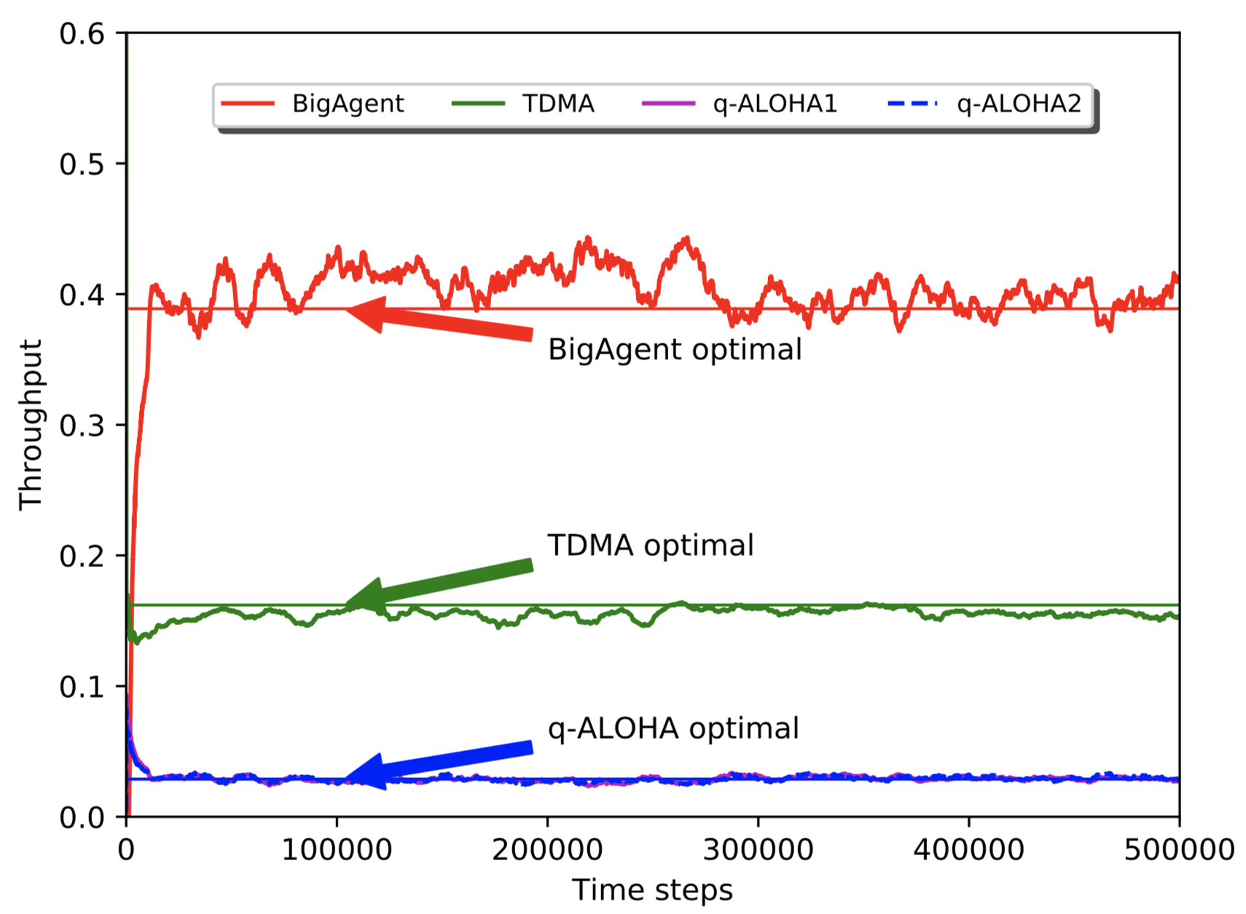
Throughput Separation
q-ALOHA gets about 0.03 throughput.
TDMA gets about 0.18 throughput.
A combination of three DRL nodes achieve 0.38 throughput.
Total throughput is 0.6.

