Slide 1
Chapter 4: Ad Hoc Routing
Slides based on materials from Intel.com

Slide 2
Introduction
So far, we have discussed …
wireless signal representation and propagation (node to node)
Medium Access Control (MAC), multiple nodes to a common receiver
We will zoom out and look at the information delivery inside the entire network but not just neighborhoods. Suppose node 3 needs to send information toward node 6. Where should it send such information?
Who should 3 send it to?
Who should forward it? To what direction?
4
1
6
5
7
3
2

Slide 3
Routing
Routing consists of two fundamental steps
Forwarding packets to the next hop (from an input interface to an output interface in a traditional wired network)
Determining how to forward packets (building a routing table or specifying a route)
Forwarding packets is easy (as long as MAC is in place), but knowing where to forward packets (especially efficiently) is hard.
Reach the destination
Minimize the number of hops (path length)
Minimize delay
Minimize packet loss
Minimize cost (to derive routes)
Packet: a self-contained message that includes different information such as source, destination, data, timestamp, correction, etc.

Slide 4
Routing Decision Point
Which node decides where to route the packet forward
Source routing
Sender determines a route and specifies it in the packet header. All intermediate nodes follow the info on packet.
Supported in IP, although not the typical routing scheme
Hop-by-hop (datagram) routing
A routing decision is made at each forwarding point (at each router)
Standard routing scheme for IP
Virtual circuit routing
Determine and configure a path prior to sending first packet
Used in ATM (and analogous to voice telephone system)
Distance vector and link state algorithms are two examples.

Slide 5
Distance Vector Algorithms (1)
“Distance” of each link in the network is a metric that is to be minimized
Each link may have “distance” 1 to minimize hop count
Algorithm attempts to minimize distance
The routing table at each node…
Specifies the next hop for each destination
Specifies the distance to that destination
Neighbors can exchange routing table information to find a route (or a better route) to a destination

Slide 6
Distance Vector Algorithms (2)
Dest
Next
Metric
A
B
2
B
B
1
D
D
1
A
C
D
Dest
Next
Metric
Dest
Next
Metric
B
B
1
A
C
3
B
C
B
2
B
C
2
D
B
3
C
C
1
Dest
Next
Metric
A
A
1
C
C
1
D
C
2

Slide 7
Distance Vector Algorithms (3)
New connection A-C
Node A will learn of Node C’s shorter path to Node D and update its routing table
Dest
Next
Metric
A
A
1
B
B
1
D
D
1
A
C
D
Dest
Next
Metric
B
B
1
B
C
C
1
D
C
2

Slide 8
Link-State Algorithms (1)
Each node shares its link information so that all nodes can build a map of the full network topology
Link information is updated when a link changes state (goes up or down)
Link state determined by sending small “hello” packets to neighbors
Given full topology information, a node can determine the next best hop or a route from the source

Slide 9
Link-State Algorithms (2)
Link
Link
A-B
A-B
B-C
B-C
Link
C-D
C-D
A-B
A
C
D
B-C
C-D
B
Assuming the topology is stable for a sufficiently long period, all nodes will have the same topology information
But this is a strong assumption because links may change and such updates take time to propagate.
Link
A-B
B-C
C-D

Slide 10
Link-State Algorithms (3)
Link
A-B
A-C
B-C
Link
A-C
C-D
A-C
Link
A-B
A-B
A-C
A
C
D
A-C
B-C
B-C
C-D
C-D
A-C
B
Link
A-B
Nodes A and C propagate the existence of link A-C to their neighbors and, eventually, to the entire network
A-C
B-C
C-D

Slide 11
MANETs
A mobile ad hoc network (MANET) is characterized by…
Often, multi-hop networks are formed (instead of fully-connected ones).
Routing needed.
Unstable wireless links and mobile nodes lead to dynamic topology.
Logical
Topology
S
S
D
D

Slide 12
MANET vs. Traditional Routing
 | Traditional Routing | MANET Routing
Node participation | Most nodes are end-points | Every node is a potential router
Topology | Mostly static | Dynamic and changes often due to node mobility and link status changes.
Redundant Links | Usually none | A lot of links are redundant
Routing interface | Routers have multiple routing interfaces | Each node has only one routing interface
Power consumption issue | None | Great concern

Slide 13
MANET Routing
Difficult to achieve good performance
Routes change over time due to node mobility
Hard to avoid long delays when first sending packets
Hard to reduce overhead of route discovery and maintenance
Node involvement a challenge – to find better paths and reduce likelihood of partitions, with relatively low overhead.

Slide 14
Categories
Based on Decision time
Proactive or table-driven – maintain routing tables
Reactive or on-demand – determine routing on an as-needed basis
Hybrid
Network structure
Hierarchical – impose a hierarchy on a collection of nodes and reflect this hierarchy in the routing algorithm
MANET Routing Protocols
Proactive
Reactive
Hybrid
Example:
OLSR
Example:
AODV

Slide 15
Common Features
MANET routing protocols must…
Discover a path from source to destination
Maintain that path (e.g., if an intermediate node moves and breaks the path)
Define mechanisms to exchange routing information
Reactive protocols
Discover a path when a packet needs to be transmitted and no known path exists
Attempt to alter the path when a routing failure occurs
Proactive protocols
Find paths, in advance, for all source-destination pairs
Periodically exchange routing information to maintain paths

Slide 16
OLSR Concepts (1)
Optimized Link State Routing (OLSR) protocol
Proactive (table-driven) routing protocol
A route is available immediately when needed
Based on the link-state algorithm
Traditionally, all nodes flood neighbor information in a link-state protocol, but not in OLSR
Nodes advertise information only about links with neighbors who are in its multipoint relay selector set
Reduces size of control packets
Reduces flooding by using only multipoint relay nodes to send information in the network
Reduces number of control packets by reducing duplicate transmissions

Slide 17
OLSR Concepts (2)
Does not require reliable transfer, since updates are sent periodically
Does not need in-order delivery, since sequence numbers are used to prevent out-of-date information from being misinterpreted
Uses hop-by-hop routing
Routes are based on dynamic table entries maintained at intermediate nodes

Slide 18
Multipoint Relays
Each node N in the network selects a set of neighbor nodes as multipoint relays, MPR(N), that retransmit control packets from N
Neighbors not in MPR(N) process control packets from N, but they do not forward the packets
MPR(N) is selected such that all two-hop neighbors of N are covered by (one-hop neighbors) of MPR(N)
4
One optimal set for Node 4: MPR(4) = { 3, 6 }
1
6
5
7
Is there another optimal MPR(4)?
3
2

Slide 19
Multipoint Relay Selector Set
The multipoint relay selector set for Node N, MS(N), is the set of nodes that choose Node N in their multipoint relay set
Only links N-M, for all M such that N∈MS(M) will be advertised in control messages
4
MS(3) = {…, 4, …}
MS(6) = {…, 4, …}
1
6
5
7
3
2
(Assuming bidirectional links)

Slide 20
HELLO Messages
In MANET routings, HELLO messages are sent periodically to update/maintain link status.
Each node uses HELLO messages to determine its MPR set in OLSR
All nodes periodically broadcast HELLO messages to their one-hop neighbors (bidirectional links assumed)
HELLO messages are never forwarded
HELLO: NBR(4) = {1,3,5,6}
4
1
6
5
7
3
2

Slide 21
HELLO Messages (2)
Using the neighbor list in received HELLO messages, nodes can determine their two-hop neighborhood and an optimal (or near-optimal) MPR set
A sequence number is associated with this MPR set
Sequence number is incremented each time a new set is calculated
At Node 4:
NBR(1) = {2}
NBR(3) = {2,5}
NBR(5) = {3,6}
NBR(6) = {5,7}
MPR(4) = {3,6}
4
1
6
5
7
3
2

Slide 22
HELLO Messages (3)
Subsequent HELLO messages also indicate neighbors that are in the node’s MPR set
MPR set is recalculated when a change in the one-hop or two-hop neighborhood is detected
HELLO: NBR(4) = {1,3,5,6}, MPR(4) = {3,6}
4
6
MS(6) = {…, 4,…}
1
5
7
3
2
MS(3) = {…, 4,…}

Slide 23
TC Messages
Nodes send topology information in Topology Control (TC) messages
List of advertised neighbors (link information)
Sequence number (to prevent use of stale information)
A node generates TC messages only for those neighbors in its MS set
Only MPR nodes generate TC messages
Not all links are advertised
A node processes all received TC messages, but only forwards TC messages if the sender is in its MS set
Only MPR nodes propagate TC messages
The purpose is to reduce control messages.

Slide 24
AODV Concepts
Ad hoc On-demand Distance Vector routing protocol
Pure on-demand routing protocol
A node does not perform route discovery or maintenance until it needs a route to another node or it offers its services as an intermediate node
Nodes that are not on active paths do not maintain routing information and do not participate in routing table exchanges
Uses a broadcast route discovery mechanism
Uses hop-by-hop routing
Routes are based on dynamic table entries maintained at intermediate nodes
Similar to Dynamic Source Routing (DSR), but DSR uses source routing

Slide 25
Use of HELLO messages
Local HELLO messages are used to determine local connectivity
Can reduce response time to routing requests
Can trigger updates when necessary
Sequence numbers are assigned to routes and routing table entries
Used to supersede stale cached routing entries
Every node maintains two counters
Node sequence number
Broadcast ID

Slide 26
AODV Route Request
Initiated when a node wants to communicate with another node, but does not have a route to that node
Source node broadcasts a route request (RREQ) packet to its neighbors
4
1
6
5
7
3
2
type
flags
resvd
hopcnt
broadcast_id
dest_addr
dest_sequence_#
source_addr
source_sequence_#

Slide 27
AODV Route Request (2)
Sequence numbers
Source sequence indicates “freshness” of reverse route to the source
Destination sequence number indicates freshness of route to the destination
Every neighbor receives the RREQ either …
Returns a route reply (RREP) packet, or
Forwards the RREQ to its neighbors
(source_addr, broadcast_id) uniquely identifies the RREQ
broadcast_id is incremented for every RREQ packet sent
Receivers can identify and discard duplicate RREQ packets

Slide 28
AODV Route Request (3)
If a node cannot respond to the RREQ
The node increments the hop count
The node saves information to implement a reverse path set up (AODV assumes symmetrical links)
Neighbor that sent this RREQ packet
Destination IP address
Source IP address
Broadcast ID
Source node’s sequence number
Expiration time for reverse path entry (to enable garbage collection)

Slide 29
AODV Example (1)
4
1
6
5
7
3
2
Node 1 needs to send a data packet to Node 7
Assume that only Node 6 knows a current route to Node 7
Assume that no other route information exists in the network (related to Node 7)

Slide 30
AODV Example (2)
4
1
6
5
7
3
2
Node 1 sends a RREQ packet to its neighbors
source_addr = 1
dest_addr = 7
broadcast_id = broadcast_id + 1
source_sequence_# = source_sequence_# + 1
dest_sequence_# = last dest_sequence_# for Node 7

Slide 31
AODV Example (3)
4
1
6
5
7
3
2
Nodes 2 and 4 verify that this is a new RREQ and that the source_sequence_# is not stale with respect to the reverse route to Node 1
Nodes 2 and 4 forward the RREQ
Update source_sequence_# for Node 1
Increment hop_cnt in the RREQ packet

Slide 32
AODV Example (4)
4
1
6
5
7
3
2
RREQ reaches Node 6, which knows a route to 7
Node 6 must verify that the destination sequence number is less than or equal to the destination sequence number it has recorded for Node 7
Nodes 3 and 5 will forward the RREQ packet, but the receivers recognize the packets as duplicates

Slide 33
AODV Route Reply
If a node receives an RREQ packet and it has a current route to the target destination, then it unicasts a route reply packet (RREP) to the neighbor that sent the RREQ packet
type
flags
rsvd
prsz
hopcnt
dest_addr
dest_sequence_#
source_addr
lifetime

Slide 34
AODV Route Reply (2)
Intermediate nodes propagate the first RREP for the source towards the source using cached reverse route entries
Other RREP packets are discarded unless…
dest_sequence_# number is higher than the previous, or
destination_sequence_# is the same, but hop_cnt is smaller (i.e., there’s a better path)
RREP eventually makes it to the source, which can use the neighbor sending the RREP as its next hop for sending to the destination
Cached reverse routes will timeout in nodes not seeing a RREP packet

Slide 35
AODV Example (5)
4
1
6
5
7
3
2
Node 6 knows a route to Node 7 and sends an RREP to Node 4
source_addr = 1
dest_addr = 7
dest_sequence_# = maximum(own sequence number, dest_sequence_# in RREQ)
hop_cnt = 1

Slide 36
AODV Example (6)
4
1
6
5
7
3
2
Node 4 verifies that this is a new route reply (the case here) or one that has a lower hop count and, if so, propagates the RREP packet to Node 1
Increments hop_cnt in the RREP packet

Slide 37
AODV Example (7)
4
Dest
Next
Hops
1
6
7
4
3
5
7
3
2
Node 1 now has a route to Node 7 in three hops and can use it immediately to send data packets
Note that the first data packet that prompted path discovery has been delayed until the first RREP was returned

Slide 38
AODV Route Maintenance
Route changes can be detected by…
Failure of periodic HELLO packets
Failure or disconnect indication from the link level
Failure of transmission of a packet to the next hop (can detect by listening for the retransmission if it is not the final destination)
The upstream (toward the source) node detecting a failure propagates an route error (RERR) packet with a new destination sequence number and a hop count of infinity (unreachable)
The source (or another node on the path) can rebuild a path by sending a RREQ packet

Slide 39
AODV Example (8)
4
1
6
5
7
3
2
7
Assume that Node 7 moves and link 6-7 breaks
Node 6 issues an RERR packet indicating the broken path
The RERR propagates back to Node 1
Node 1 can discover a new route

Slide 40
DSR
Dynamic Source Routing
Another well-known reactive routing, which tries to find routes toward destination on-the-fly.
Makes use of RREQ, RREP, and RERR messages similar to AODV, but
Source decides the entire route and specifies it in the packet:
“Here is a packet from S to D and I want to send it through S-A-B-C-D”
Intermediate nodes usually do not make changes to the specified path.

Slide 41
Hierarchical Algorithms
Scalability – MANET protocols often do not perform well for large networks (especially if not dense)
Global topology is based on the connectivity of each mobile node
Clusters can be used to provide scalability
Clusters are formed (dynamically, of course) to provide hierarchy
Global routing is done to clusters
Local routing is done to nodes within a cluster
Clusters of clusters (super-clusters) can be formed to extend hierarchy
Similar in principle to IP subnets

Slide 42
Quality of Service (QoS) Routing
More complex than regular routing
Goal is to find a feasible path between source and destination, which
satisfies the QoS requirements for each admitted connection and
Optimizes the use of network resources
<5,4>
Tuple: <BW,D>
BW: bandwidth
D: delay
QoS requirement: BW≥4
<4,5>
B
C
A
<4,2>
<5,3>
<2,4>
<3,4>
E
F
<3,3>
D
<2,2>
<4,4>
Shortest path
G
QoS Satisfying path

Slide 43
Challenges of QoS Routing
Dynamic varying network topology
Imprecise state information
Scare resources
Absence of communication infrastructure
Lack of centralized control
Power limitations
Heterogeneous nodes and networks
Error-prone shared radio channel
Hidden terminal problem
Insecure medium
Other layers

Slide 44
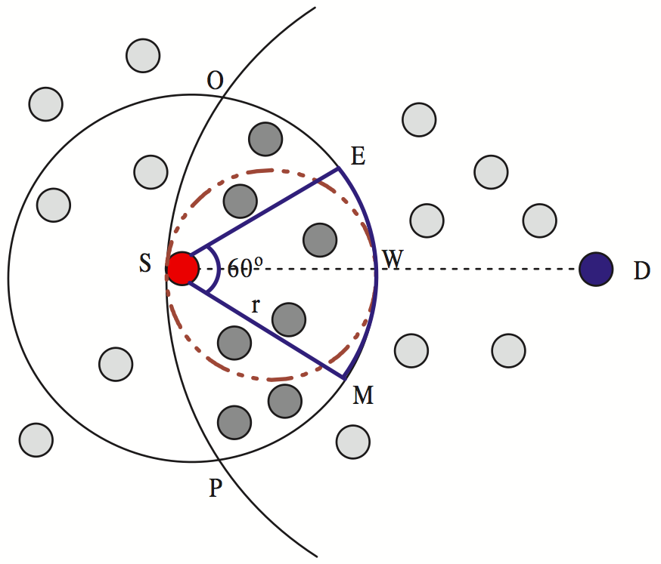
Location-based Routing
With the help of node locations (e.g., GPS-assisted), routing can be made easier and more efficient.
Assumptions:
Source location, destination location, current location all known.
Potential forwarding nodes know their relative locations as well.
Intuition:
It is beneficial to forward packets toward the direction of the destination node.
Making progress every time
Issue of local optimal and
global optimal

