Slide 1
Chapter 5. Wireless Sensor Networks

Slide 2
Outline
Sensor Hardware
Constraints
Design Factors
Protocol Stacks
Applications

Slide 3
Wireless Sensor Networks
WSNs are composed of a large number of sensor nodes, which are densely deployed either inside the phenomenon or very close to it.
Sensors
Networking, data processing techniques
Communication medium

Slide 4
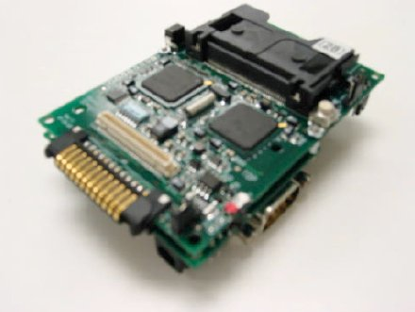
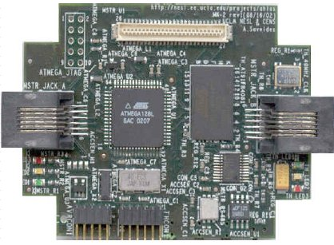
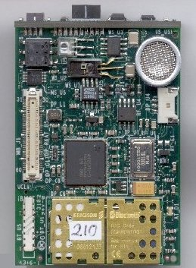
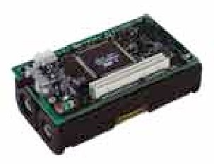
Sensor Hardware
StarGate (Intel X-Scale 400-MHz CPU)
MK-II (UCLA medusa, COTS-based)
iBadge (UCLA)
MICA Mote

Slide 5
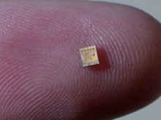
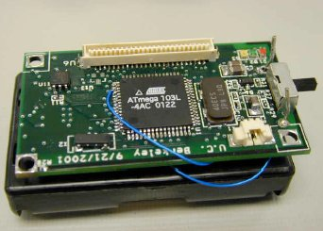
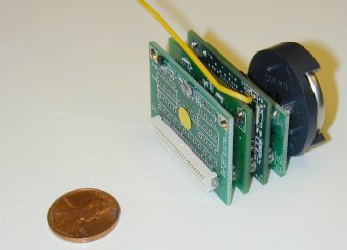
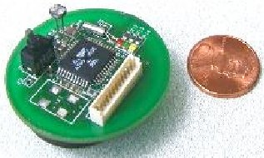
Berkeley’s Motes
COTS dust prototypes
weC Motes (light, temp)
Rene Stack
MicaZ node (250kbps, router)

Slide 6
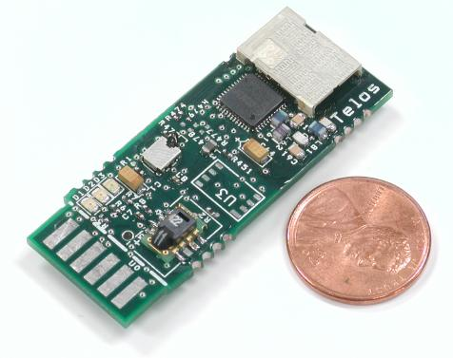
Telos Rev. B (new Mote)
Single board philosophy
Easy to use, low cost
Sensing humidity, temperature, light
250 kbps, 2.4 GHz
IEEE 802.15.4, ZigBee-ready
Quick wakeup
<6 usec

Slide 7
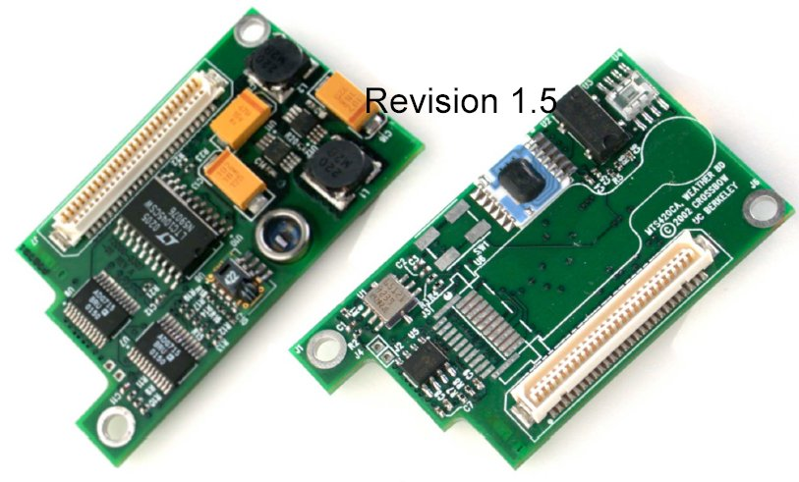
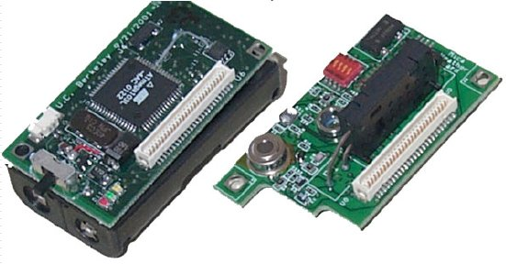
Mica weather board
Photosynthetically active radiation
Formation of carbohydrates
Relative humidity
±2%
Barometric Pressure
±1.5mbar
Temperature
±0.01C

Slide 8
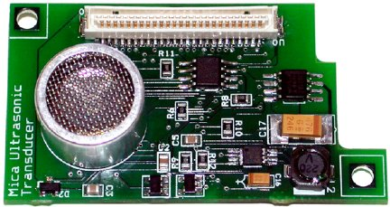
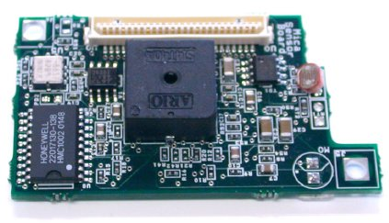
Other Sensor Boards
Ultrasonic transceiver – Localization
Used for ranging
Up to 2.5m range
0.06m accuracy
Dedicated uPU
25 kHz element
Basic Sensor board
Light (photo)
Temperature
Acceleration
Magnetometer
Microphone, tone
Detector, Sound

Slide 9
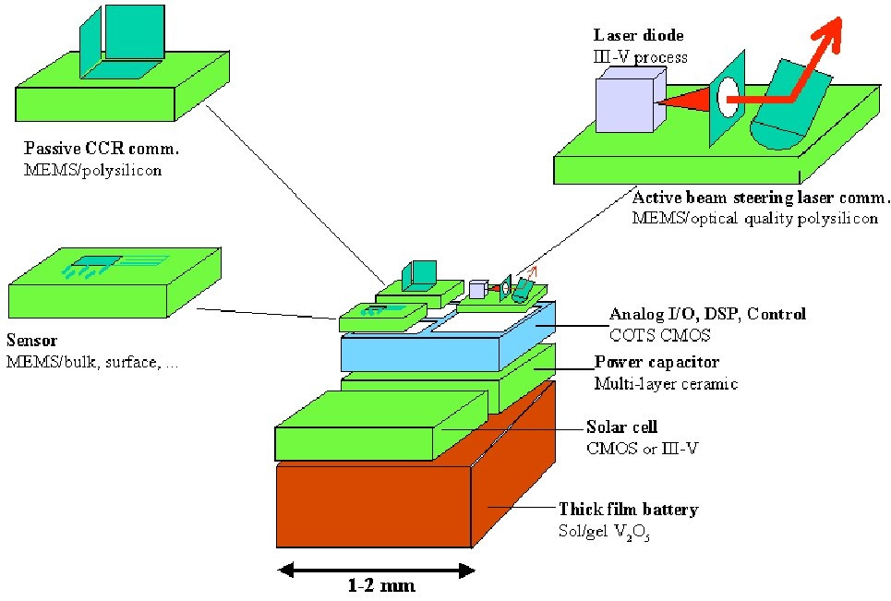
Berkeley Dust Mote

Slide 10
Outline
Sensor Hardware
Constraints
Design Factors
Protocol Stacks
Applications

Slide 11
Constraints of Sensors
Un-tethered
No tethered power, wireless
Cost
Large-scale, dense deployment
Cheaper manufacturing
Physical size
Fit into almost everywhere
Lifetime
Change of battery un-economic

Slide 12
Constraints (cont’d)
Which of the following constraints may really matter in 5-10 years from now?
Energy limitations
Design/deployment for dense networks
Dynamic radio communication environment
Large multi-hop networks
Processor speed
Memory size

Slide 13
Energy Sources
 | Available power
Battery (Zinc-Air) | 1050-1560 mWh/cm³
Battery (Lithium ion) | 300 mWh/cm³
Solar (outdoors) | 0.15-15 mW/cm²
Solar (indoors) | .006 mW/cm²
Vibrations | 0.001-0.1 mW/cm³
Acoustic Noise | 3 pWh/cm² at 75dB
Passive Human Powered | 1.8 mW (shoe inserts)
Thermal conversion | 0.002 mW ~ 5 degrees
Fuel Cells | 500 mWh/cm³

Slide 14
Communication vs. Computation costs
 | 1999 (Bluetooth) | 2004
Communication | 150 nJ/bit 1.5 mW | 5 nJ/bit 0.05 nW
Computation |  | 100 GOPS/W 10 pJ/OP
10 kbps, 10-meter radio range
Cost of communication is un-proportionally larger than cost of computation

Slide 15
WSNs vs. Traditional Distributed Systems
Energy as major constraint
Turning off unused devices
Other constraints
Memory, computation, bandwidth
Self-organized, autonomous systems
Address-free, no global names
Correlated data
Unique correlation of local data in WSNs
In-network processing possible
Single destination

Slide 16
WSNs vs. Ad hoc Networks
More nodes
several orders of magnitude higher
Sensor nodes are densely deployed
Sensor nodes are prone to failures
Some WSNs’ topology may change frequently
Communication mechanisms
Broadcast vs. peer-2-peer
Sensor nodes are limited in power, computational capacities and memory.
Sensor nodes may not have global ID.

Slide 17
Outline
Sensor Hardware
Constraints
Design Factors
Protocol Stacks
Applications

Slide 18
System Design Themes
Long-lived systems
Un-tethered, un-attended
Communication as major consumer of scarce energy
Autonomy requires robust, adaptive, self-configuring systems
Leverage data processing inside WSNs
Exploit computations near data, achieving scalability
Collaborative signal processing
Achieve desired global behavior with localized algorithms – distributed control
“The Network is the sensor”

Slide 19
Design factors: fault tolerance
Fault tolerance is the ability to sustain sensor network functionalities without any interruption due to sensor node failures.
The fault tolerance level depends on the application of the sensor networks.
Probability of no failures: R_{k}(t)=e-^{λkt}

Slide 20
Design factors: scalability
Scalability measures the density of the sensor nodes.
How many nodes in a local area.
Random distribution, N sensors in area of size A.
Density: μ(R) =(NπR²)/A

Slide 21
Design factors: production cost
Cost of a single node
Should justify the overall cost of the networks
Huge amount of functionalities:
Battery, CPU, memory, sensor, tx-rx…
A price of much less than a dollar

Slide 22
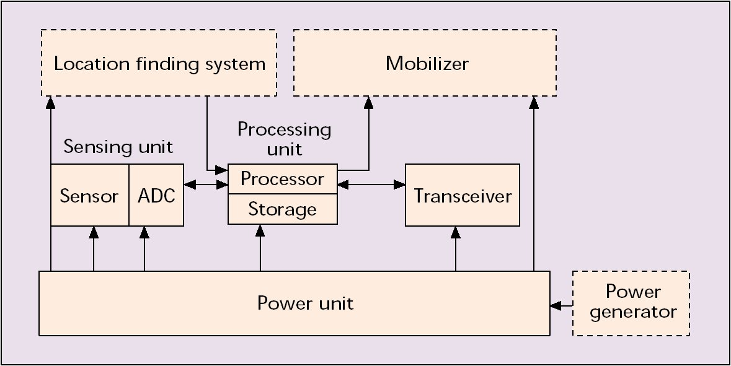
Design factors: hardware constraints

Slide 23
Design factors: network topology
Pre-deployment and deployment phase
Dropped off from planes
Or placed one-by-one
Post-deployment phase
Mobility or failure
Re-deployment
Additional nodes

Slide 24
Design factors: environment
Close to or inside the phenomenon of observation
Interior of large machinery
Bottom of an ocean
Biologically/chemically contaminated field
Battlefield
Home or building

Slide 25
Design factors: transmission media
Potential media
Radio (2.4 GHz, 891 MHz)
Infrared
Optical media
Multi-hop networks are formed

Slide 26
Design factors: power consumption
Limited reserve, hard to refill
Sensing
Do we always need to turn every node on?
Communication
Shrink the tx-range
Data processing
Process before transmission

Slide 27
Outline
Sensor Hardware
Constraints
Design Factors
Protocol Stacks
Applications

Slide 28
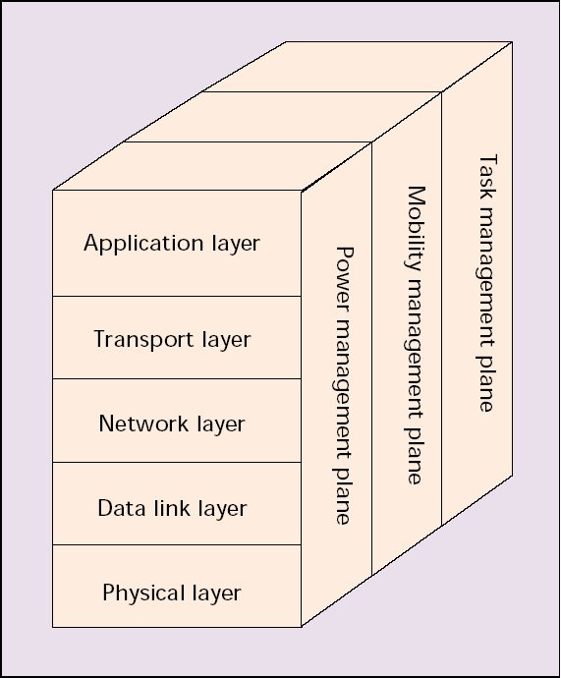
Protocol stack
Power Management
How to use its power
Mobility Management
Detecting movements
Task Management
Scheduling sensing tasks

Slide 29
Physical layer
Frequency selection
Carrier frequency generation
Signal detection
Modulation
Encryption
Receiver side

Slide 30
Physical layer: research issues
Modulation schemes
Strategies to overcome signal propagation effects
Hardware design
Optimize the transmission power of each sensor

Slide 31
Data link layer
Medium access control
Error control
Ensuring connections
point-to-point
point-to-multipoint

Slide 32
Data link layer: Medium access control (MAC)
Establish communication links
Share communication resources
Efficiency
Fairness
Conserve energy
New MAC techniques are needed

Slide 33
Data link layer: error control
Forward Error Correction (FEC)
Parity-check, e.g.
Encoding and decoding consume power
Automatic Repeat reQuest (ARQ)
Multi-hop retransmissions?
BER, SNR, E_{s}/N₀

Slide 34
Data link layer: research issues
MAC for mobile sensor networks
Determination of lower bounds on the energy required for sensor network self-organization
Error control coding schemes.
Power saving modes of operation

Slide 35
Network layer
Multi-hop networking protocols needed
As compared to Wireless LAN
Large number of hops away from sink
Several considerations:
Power efficiency
Data centric
Data aggregation
Attribute-based addressing and location awareness

Slide 36
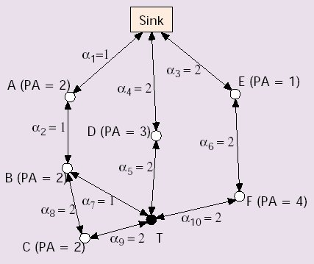
Network layer: route selections
Route 1: sink-A-B-T, PA=4, α=3
Route 2: sink-A-B-C-T, PA=6, α=6
Route 3: sink-D-T, PA=3, α=4
Route 4: sink-E-F-T, PA=5, α=6
Minimum energy: route 1
Minimum hop: route 3
Maximum available power (PA): route 2
Maximum minimum PA node: route 3
Others?

Slide 37
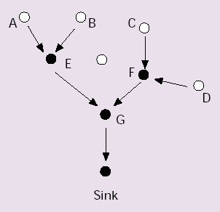
Network layer: data aggregation
Works like a reversed broadcast tree
Node E combines data from A and B
Node G does the same
Reduction of transmissions

Slide 38
Data fusion
Large amount of data for the end user
Need methods of combining or aggregating data into small set of information
Energy saving
Data aggregation (aka data fusion) can combine unreliable data readings to produce accurate signal
improving the common signal
reducing the noise

Slide 39
LEACH
LEACH (Low-Energy Adaptive Clustering Hierarchy)
A clustering-based protocol
Utilizes the randomized rotation of local cluster base stations
Evenly distribute the energy load within the network of sensors
Distributed, no need for knowledge of global network for LEACH to function

Slide 40
LEACH: energy saving
The energy saving of LEACH is achieved by combining compression with data routing
Key features of LEACH include:
Localized coordination and control of cluster set-up and operation
Randomized rotation of the cluster base stations or clusterheads and their clusters
Local compression of information to reduce global communication

Slide 41
LEACH: assumptions
The base station is fixed and located far from the sensors
All the sensor nodes are homogeneous and energy constrained
Communication between sensor nodes and the base station is expensive and no high energy nodes exist to achieve communication

Slide 42
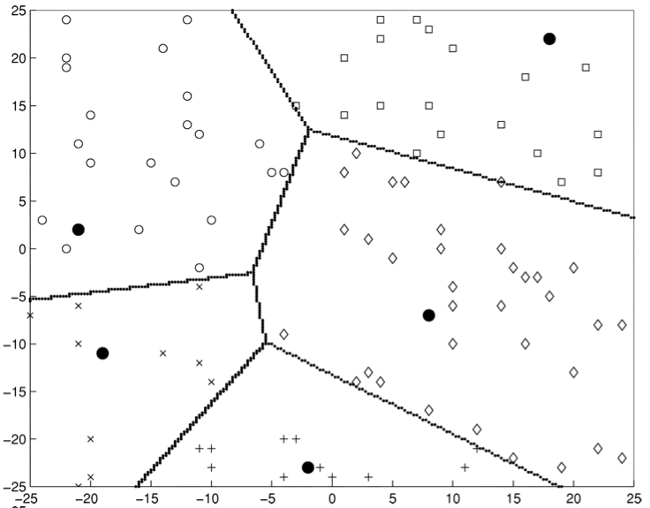
LEACH: strategies
Only CH’s are sending to BS
Rotating CH’s to avoid draining one sensor’s energy
Local compression is also used to reduce transmission

Slide 43
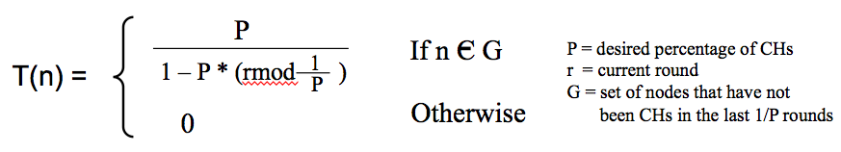
LEACH: CH selection
The node (n) decides by choosing a random number between 0 and 1
If this random number is less than T(n), the nodes become a CH for this round
The threshold is set as follows:

Slide 44
LEACH: cluster formation
CH advertisement phase
Cluster set-up phase
the non-CH nodes hear the ads of all CHs and decide which CH to join
A node joins to a CH in which it hears with its advertisement with the highest signal strength
Upon receiving all the join messages from its members, CH creates a TDMA schedule about their allowed transmission time based on the total number of members in the cluster

Slide 45
LEACH: data transmission
Each node starts data transmission to their CH based on their TDMA schedule
The radio of each cluster member nodes can be turned OFF until their allocated transmission time comes; minimizing the energy dissipation
The CH nodes must keep its receiver ON to receive all the data
Once all the data is received, the CH compresses the data to send it to BS

Slide 46
LEACH: multiple clusters
In order to minimize the radio interference between nearby clusters, each CH chooses randomly from a list of spreading CDMA codes and it informs its cluster members to transmit using this code.
The neighboring CHs radio signals will be filtered out to avoid corruption in the transmission.
Redundant clusters can be eliminated as well.

Slide 47
LEACH: advantages
Localized coordination to enable scalability, and robustness for dynamic networks
Incorporates data fusion into the routing protocol in order to reduce the amount of information transmitted to BS
Distributes energy dissipation evenly throughout the sensors, thus increasing the system lifetime of the network

Slide 48
LEACH: disadvantages
How to decide the percentage of cluster heads for a network? The topology, density and number of nodes of a network could be different from other networks
No suggestions about when the re-election needs to be invoked
The CH’s farther away from the base station will use higher power and die more quickly than the nearby ones.

Slide 49
SPIN: information dissemination
SPIN (Sensor Protocols for Information via Negotiation) is a negotiation-based information dissemination protocols.
Addressing the deficiencies of classic flooding problem
With negotiation and resource-adaptation
SPIN disseminates information
From each sensor
To all sensors
Treating all sensors as potential sink nodes

Slide 50
SPIN: meta-data
Nodes using SPIN protocols names their data using high-level data descriptors, called meta-data
Usage of meta-data negotiations is efficient
Eliminate transmission of redundant data in the network
Communication decisions can be based upon
Application-specific knowledge of the data
Knowledge of the resources available to nodes

Slide 51
SPIN: basic ideas
Operate efficiently and conserve energy
communicate with each other about the sensor data received already and the data needed still
Monitor and adapt changes in their own energy resources: extend the lifetime of the system
Four difference SPIN protocols:
SPIN-PP
SPIN-EC
SPIN-BC
SPIN-RL

Slide 52
SPIN: meta-data requirements
Used to uniquely and completely describe the data being collected by sensors
If two pieces of actual data are distinguishable, then their meta-data should also be distinguishable
Since the format of meta-data is application-specific, each application needs to interpret and synthesize its own meta-data
ADV (new data advertisement)
REQ (request for data)
DATA (data message)

Slide 53
SPIN: problem statement
Problems with conventional classic flooding
The source nodes sends data to all its neighbors and the neighbors check their record of already sent data to see if they have forwarded the data to their neighbors.
If not, they forward the data and update the record
This requires small amount of protocol state at any node, disseminates data quickly in the network
Three main issues:
Implosion - A node always sends data to its neighbors without being concerned about if the same data has been received by the neighbors from other nodes
Overlap
Resource blindness

Slide 54
SPIN: methods
Nodes negotiating with each other before transmitting data eliminates the transmission of redundant data
Nodes poll their resources before transmitting or processing data by probing the resource manager which keeps track of the resource consumption
Nodes can make efficient decisions based on the available energy level
Eliminates the possibility of overlap since the nodes can name the part of the data the nodes are interested in receiving
Resource-awareness of local resources allow sensors to make meaningful decisions to extend longevity

Slide 55
SPIN-PP
SPIN-PP works in three stages (ADV-REQ-DATA)
each stage corresponding to one of the messages
The node sends ADV message to its neighbors
Neighbors check to see if they already have received or requested this data
If not, the neighbors respond by sending REQ message to the sender
The sender responds to the REQ message sent by sending the actual DATA to the neighbors requesting the data
Silence otherwise.

Slide 56
SPIN-EC
Adds simple energy-conservation heuristic to the SPIN-PP protocol
When energy is abundant, SPIN-EC acts as SPIN-PP protocol
Whenever energy comes close to low-energy threshold, it adapts by reducing its participation
It does not prevent nodes from receiving messages such as ADV or REQ below its low-energy threshold, but prevents the nodes to handle a DATA message below the threshold

Slide 57
Directed Diffusion
data-centric approach
Data generated by sensor nodes is named using attribute-value pairs
A node requests data by sending interests for named data
Nodes diffusing the interest sets up their own caches and gradients within the network to which channel the delivery of data
During the data transmission, reinforcement and negative reinforcement are used to converge to efficient distribution

Slide 58
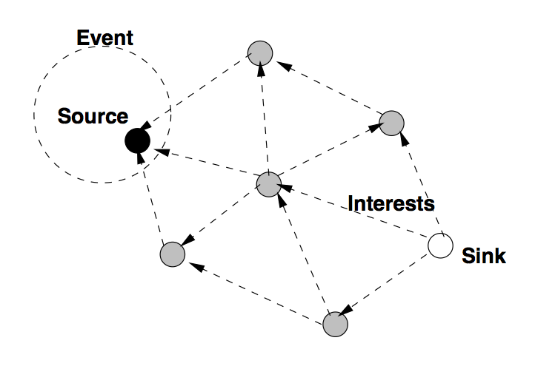
Directed Diffusion: interest
Interest is generally given by the sink node
Periodical broadcast of interest with monotonically increasing timestamp attribute for reliability purposes

Slide 59
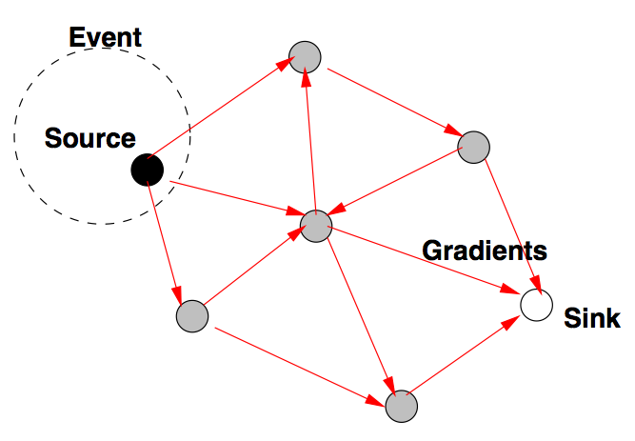
Directed Diffusion: gradient
The interest entry contains several gradient fields, up to one per neighbor
This entry has single gradient towards the neighbor
from which the interest was received with specified data rate
Individual neighbors can be distinguished by locally unique identifiers

Slide 60
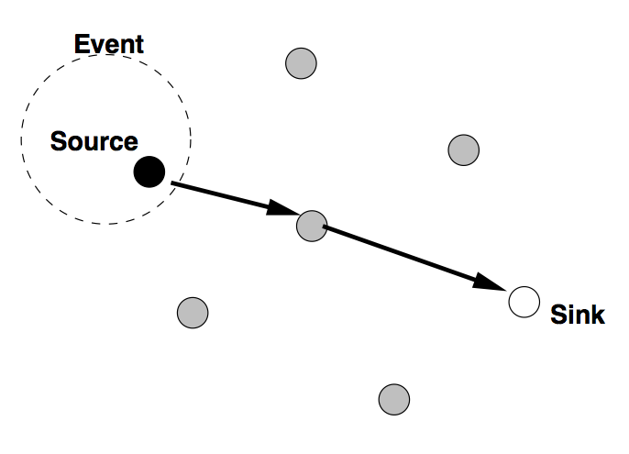
Directed Diffusion: data
Data message is unicast individually to the relevant neighbors
A node receiving a data message from its neighbors checks to see if matching interest entry in its cache exists according the matching rules described
Forwarded
Reinforcement phase

Slide 61
Directed Diffusion: advantages
Data-centric dissemination
Robust multi-path delivery
Reinforcement-based adaptation to the empirically best network path
Energy savings with in-network data aggregation and caching
Gives designers the freedom to attach different semantics to gradient values
Reinforcement can be triggered not only by sources but also by intermediate nodes

Slide 62
Three papers
[Heinzelman+ 2002] W. Heinzelman, A.P. Chandrakasan and H. Balakrishnan, An Application-Specific Protocol Architecture for Wireless Microsensor Networks, IEEE Transactions on Wireless Communications, Vol. 1, No. 4, October 2002, pp. 660-670.
[Intanagonwiwat + 2000] C. Intanagonwiwat, R. Govindan and D. Estrin, Directed Diffusion: A Scalable and Robust Communication Paradigm for Sensor Networks, In Proceedings of the Sixth Annual International Conference on Mobile Computing and Networks (MobiCOM 2000), August 2000, Boston, Massachusetts
[Kulik+ 2002] J. Kulik, W. Heinzelman and H. Balakrishnan, Negotiation-Based Protocols for Disseminating Information in Wireless Sensor Networks, Wireless Networks 8, 2002, pp. 169-185.

Slide 63
Transport layer
Needed for inter-connection with Internet or other external networks.
Little work been done:
Address-free
Data centric communication
“Show me the area with temperature higher than 80F”
New protocol needed

Slide 64
Application layer
Interface between user software and lower layer functionalities
Sensor management protocol (SMP)
Sensor control, authentication, etc.
Task assignment and data advertisement protocol (TADAP)
Task control
Sensor query and data dissemination protocol (SQDDP)
Information dissemination

Slide 65
Outline
Sensor Hardware
Constraints
Design Factors
Protocol Stacks
Applications

Slide 66
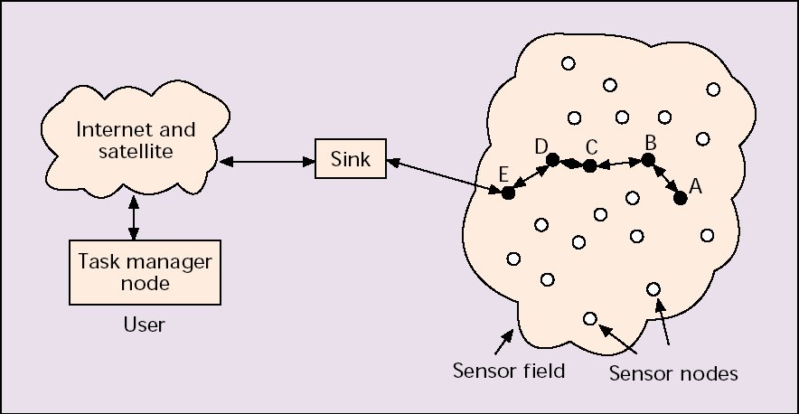
WSN example

Slide 67
What can be sensed?
temperature
humidity
vehicular movement
lightning condition
pressure
soil makeup
noise levels
the presence or absence of certain kinds of objects
mechanical stress levels on attached objects
the current characteristics such as speed, direction, and size of an object

Slide 68
Military applications
Monitoring friendly forces, equipment and ammunition
Battlefield surveillance
Reconnaissance of opposing forces and terrain
Battle damage assessment
Nuclear, biological and chemical attack detection and reconnaissance

Slide 69
Environmental applications
Forest fire detection
Wild animal spotting and tracking
Biosphere monitoring
Flood detection
Precision agriculture

Slide 70
Health application
Smart clothing
Patient monitoring
early-warning system
Tracking and monitoring patients and doctors inside a hospital
Drug administration in hospitals

Slide 71
Home applications
Home security
Home automation
Smart environment
Internet-of-Things (IoT)
Devices usually directly connected to Internet

Slide 72
Commercial applications
Inventory control
Fleet vehicle tracking and control
Smart road
“stay-in-your-lane”
Speed control
Congestion avoidance
Interactive museums

