Slide 1
Chapter 6: Spread Spectrum and Error Coding

Slide 2
Spread Spectrum
Communication: input is fed into a channel encoder
Produces analog signal with narrow bandwidth
Information-rich content requires wider bandwidth.
In traditional systems, this bandwidth does not change at all even though it can be moved to higher frequency for transmission (carrier).
Spread Spectrum: signal is further modulated using sequence of digits
Spreading code or spreading sequence, with special properties
Effect of modulation is to increase bandwidth of signal to be transmitted
With benefits

Slide 3
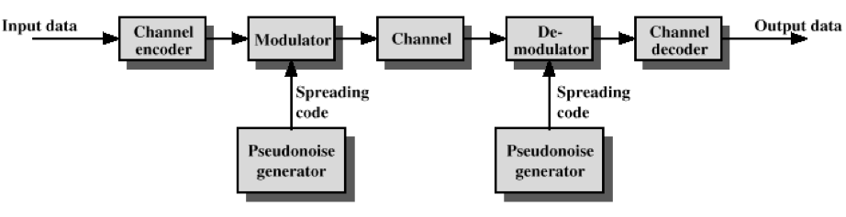
Model and benefits
Digit sequence is used to demodulate the spread spectrum signal
By feeding the received signal into a channel decoder with the same pseudorandom code/sequence
Immunity from various kinds of noise and multipath distortion
Can be used for hiding and encrypting signals
Several users can independently use the same wider bandwidth with very little interference (orthogonality)

Slide 4
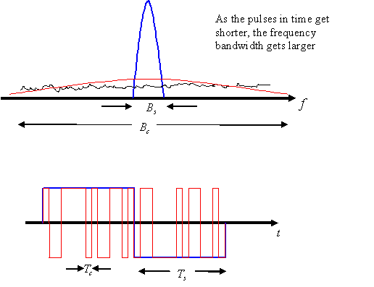
Illustration of spreading
Signal bandwidth (blue line)
Bs
After spectrum spreading (red line)
Bc
Signal is now hidden in noise!
Shorter pulse -> higher frequency

Slide 5
Reception of de-spreading
Receiver gets a combination of
Black line
Red line
Cyan line
After de-spreading
Red line becomes blue line (this is what we need)
Black line remains
Cyan line takes the form of red line!
A band-pass filter will screen most of the noise and interference.
Spike interference

Slide 6
Direct Sequence Spread Spectrum
Two categories of spread spectrum
Direct Sequence Spread Spectrum (DSSS)
Frequency Hopping Spread Spectrum (FHSS)
Each bit in original signal is represented by multiple bits in the transmitted signal
Spreading code spreads signal across a wider frequency band
Spread is in direct proportion to number of bits used
One technique combines digital information stream with the spreading code bit stream using exclusive-OR
XOR - Exclusive OR
Returning 1 only when the two inputs are different.
a XOR 1 = ~a
a XOR 0 = a
a XOR a = 0
(a XOR b) XOR c = a XOR (b XOR c)

Slide 7
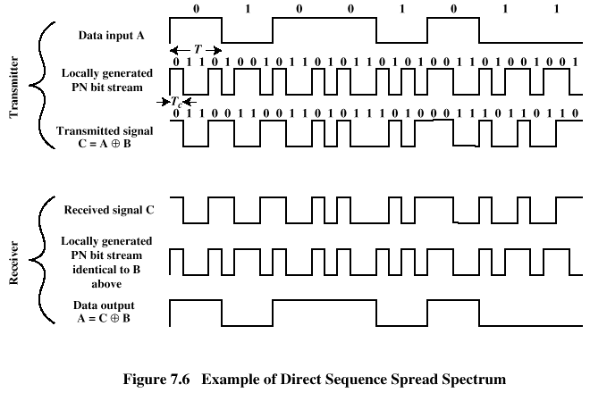
Bit Sequence XOR
A
B
C
C
B
A’
It can be proven that A’=A
Synchronization of PN bit stream

Slide 8
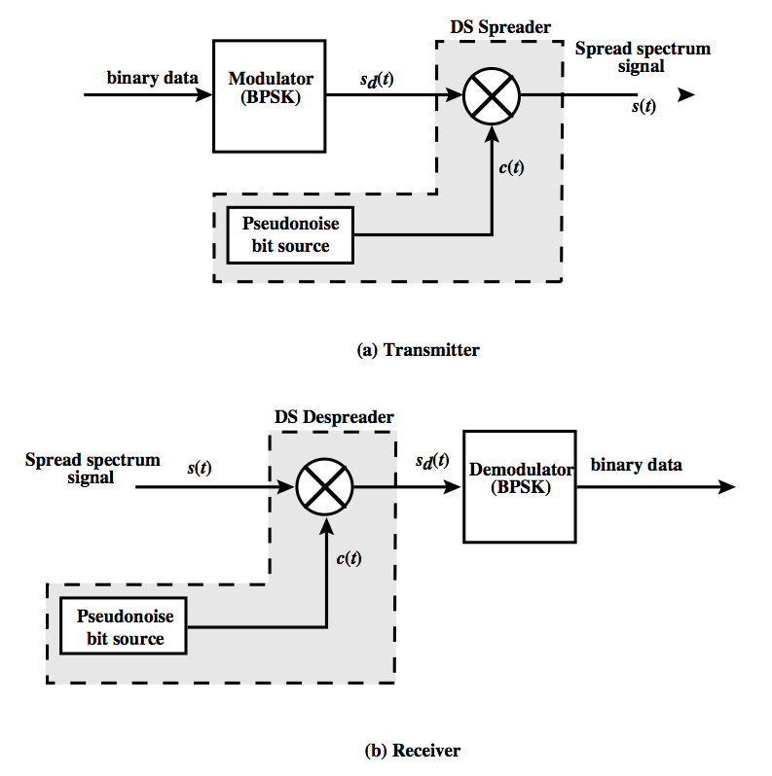
DSSS Using BPSK
Multiply BPSK signal,
s_{d}(t) = A d(t) cos(2π f_{c}t)
by c(t) [takes values +1, -1]:
s(t) = A d(t)c(t) cos(2π f_{c}t)
A = amplitude of signal
f_{c} = carrier frequency
d(t) = discrete function [+1, -1]
At receiver, incoming signal multiplied by c(t)
c(t)•c(t) = Constant (we can treat it as 1)
Incoming signal is then recovered

Slide 9
Code-Division Multiple Access (CDMA)
Different codes for different users
D = rate of data signal
Break each bit into k chips
Chips are a user-specific fixed pattern
Chip data rate of new channel = kD
If k=6 and code is a sequence of 1s and -1s
For a ‘1’ bit, A sends code as chip pattern
<c1, c2, c3, c4, c5, c6>
For a ‘0’ bit, A sends complement of code
<-c1, -c2, -c3, -c4, -c5, -c6>
Receiver knows sender’s code and performs electronic decode function
<d1, d2, d3, d4, d5, d6> = received chip pattern
<c1, c2, c3, c4, c5, c6> = sender’s code

Slide 10
CDMA Example
User A’s code = <1, –1, –1, 1, –1, 1>
To send a 1 bit = <1, –1, –1, 1, –1, 1>
To send a 0 bit = <–1, 1, 1, –1, 1, –1>
User B’s code = <1, 1, –1, – 1, 1, 1>
To send a 1 bit = <1, 1, –1, –1, 1, 1>
Receiver receiving with A’s code
(A’s code) x (received chip pattern)
User A ‘1’ bit: 6 -> 1
User A ‘0’ bit: -6 -> 0
User B ‘1’ bit: 0 -> unwanted signal, ignored

Slide 11
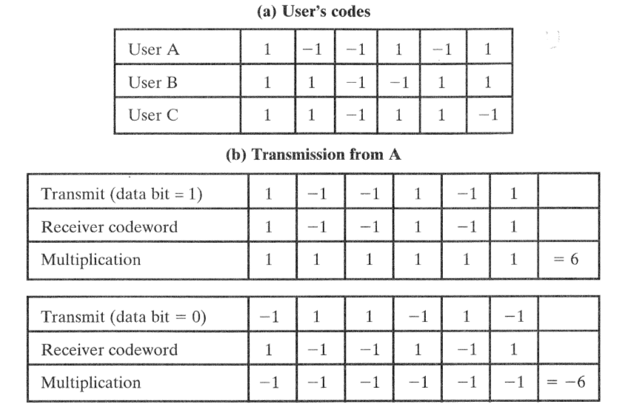
Codes of Three Users

Slide 12
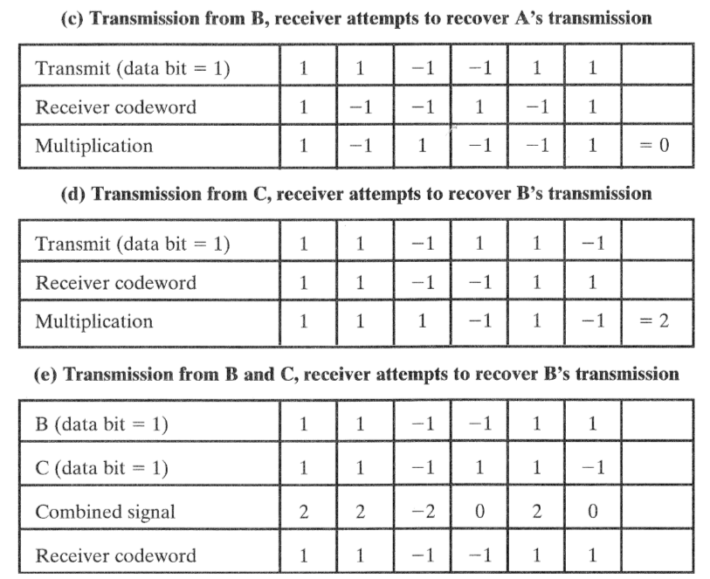
Codes of Three Users

Slide 13
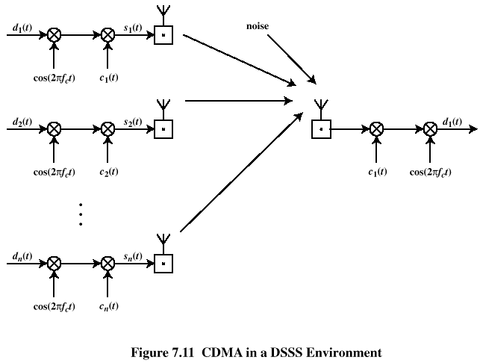
CDMA for DSSS
Ignoring attenuations and multipath reception

Slide 14
Orthogonal Codes
c_{i}(t) and c_{j}(t) should be orthogonal to each other (when i≠j)
Example:
(+1, +1, -1, -1, +1, +1)
(-1, +1, -1, +1, +1, -1)

Slide 15
Typical Multiple Spreading Approach
Spread data rate by an orthogonal code (channelization code)
Provides mutual orthogonality among all users in the same cell
Further spread result by a PN sequence (scrambling code)
Provides mutual randomness (low cross correlation) between users in different cells

Slide 16
Frequency Hopping Spread Spectrum
Signal is broadcast over seemingly random series of radio frequencies
A number of channels allocated for the FH signal
Width of each channel corresponds to bandwidth of input signal
Signal hops from frequency to frequency at fixed intervals
Transmitter operates in one channel at a time
Bits are transmitted using some encoding scheme
At each successive interval, a new carrier frequency is selected

Slide 17
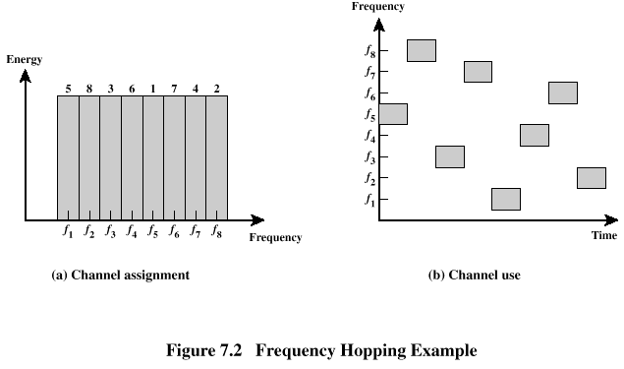
Hopping among frequencies
Channel sequence dictated by spreading code
Receiver hops between frequencies in synchronization with transmitter
Eavesdroppers hear only unintelligible blips
Attempts to jam signal on one frequency succeed only at knocking out a few bits

Slide 18
FHSS Using MFSK
MFSK signal is translated to a new frequency every T_{c} seconds by modulating the MFSK signal with the FHSS carrier signal
For data rate of R:
duration of a bit: T = 1/R seconds
duration of signal element: T_{s} = LT seconds
T_{c} ≥ T_{s} - slow-frequency-hop spread spectrum
T_{c} < T_{s} - fast-frequency-hop spread spectrum

Slide 19
Coping with Data Transmission Errors
Wireless transmissions can experience many errors.
Need to cope with such errors
Error detection codes
Detects the presence of an error
Automatic repeat request (ARQ) protocols
Discarding the block of data with error(s).
Sender retransmits same block
Error correction codes, or forward correction codes (FEC)
Designed to detect and correct errors

Slide 20
Error Probability
P_{b} : Probability of single bit error (BER)
P₀ : Probability that a frame arrives with no bit errors
P₁ : Probability of 1-bit error
P_{e}: While using error detection (capable of detecting 1-bit error), the probability that a frame arrives with undetected errors
F: number of bits per frame
i.i.d. error
occurrence
Example
P_{b}=10⁻⁶, F=1000
P₀=(1-10⁻⁶)¹⁰⁰⁰≈0.999
P₁=0.0009995
P_{e}=5x10⁻⁷

Slide 21
Error Detection Process
Transmitter
For a given frame, an error-detecting code (check bits) is calculated from data bits
Check bits are appended to data bits and both are transmitted
Receiver
Separates incoming frame into data bits and check bits
Calculates check bits from received data bits
Computation algorithm known to both
Compares calculated check bits against received check bits
Error detected if mismatch

Slide 22
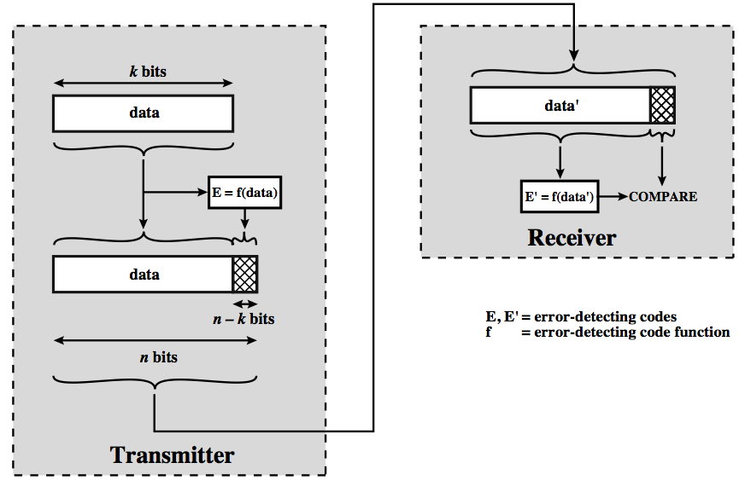
Illustration
Error can occur in data or check bits;
so this leads to wrong decisions

Slide 23
Error Detection Techniques
Parity Check
Cyclic Redundancy Check
Modulo 2 Arithmetic
Polynomials
Digital logic (hardware implementation)
We will discuss each of these in this chapter.

Slide 24
Parity Check
Parity bit appended to a block of data
Detection of errors with odd number of bits
Even parity
Added bit ensures an even number of 1s
Odd parity
Added bit ensures an odd number of 1s
Example, 7-bit character [1110,001]
Even parity [1110,0010]
Odd parity [1110,0011]

Slide 25
Parity Check Examples
Example, 7-bit character [1110,001]
Even parity [1110,0010]
It can be proven that, if only one bit is received incorrectly, the error will be detected:
[1111,0010]
Even parity will detect the error, although the error bit could be at the parity bit location.
[1110,0011]
Only detection is possible, parity check can’t tell which bit is wrong.
E.g., even parity check receiving [1011,0101]

Slide 26
Cyclic Redundancy Check (CRC)
Transmitter
For a k-bit block, transmitter generates an (n-k)-bit frame check sequence (FCS)
Resulting frame of n bits is exactly divisible by predetermined number
Receiver
Divides incoming frame by predetermined number
If remainder is 0, assumes no error

Slide 27
CRC using Modulo 2 Arithmetic (XOR)
T = n-bit frame to be transmitted
D = k-bit block of data; the first k bits of T
F = (n – k)-bit FCS; the last (n – k) bits of T
P = pattern of n–k+1 bits (predetermined divisor)
Q = Quotient
R = Remainder
Input: D; Output: F
Goal: T=(D || F)/P
has a remainder of 0
Procedure:
Divide 2^{n-k}D by P: quotient and remainder (R)
F <- R
Pattern (divisor, n-k+1 bits)
P
T
D
F
k bits
n-k bits

Slide 28
Proof of zero remainder
Remainder of T/P
Substituting,
R+R = R XOR R = 0
No remainder, so T is divisible by P

Slide 29
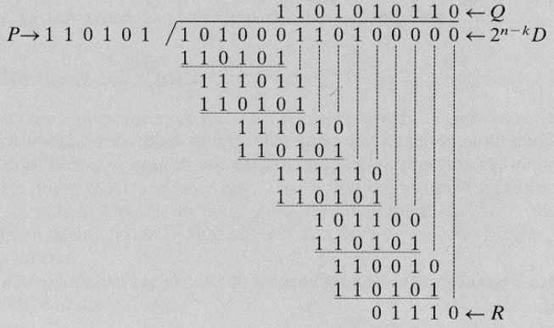
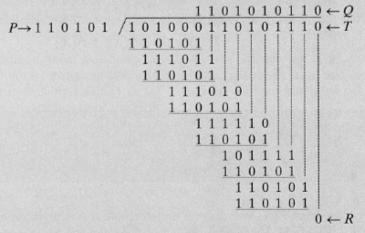
Example of CRC using XOR
D=1010001101
P=110101
F=R=01110
(n,k)
n=15, k=10, n-k=5
All calculations in XOR

Slide 30
CRC using Polynomials
All values expressed as polynomials
Dummy variable X with binary coefficients
The binary coefficients of the polynomials can represent binary numbers:
X³ +X +1 is equivalent to
1 0 1 1

Slide 31
Some P(X) Functions
P(X) needs to be indivisible to demonstrate some good properties for CRC.
Widely used versions of P(X)
CRC–12
X¹² + X¹¹ + X³ + X² + X + 1
CRC–16
X¹⁶ + X¹⁵ + X² + 1
CRC – CCITT
X¹⁶ + X¹² + X⁵ + 1
CRC – 32
X³² + X²⁶ + X²³ + X²² + X¹⁶ + X¹² + X¹¹ + X¹⁰ + X⁸ + X⁷ + X⁵ + X⁴ + X² + X + 1

Slide 32
Indivisible P(x)
How to check whether a polynomial is indivisible then?
Definition of indivisible
There exists no other polynomials g(x) and h(x) such that f(x) = g(x) * h(x)
Checking indivisible
Find all indivisible polynomials with degree lower than ceil(D(f(x))/2)
Question: why don’t we need to check other polynomials?

Slide 33
Error Detection not Enough
Error detection requires retransmission
Appropriate in wire-line transmission with low error rate (~10⁻⁹)
However, in wireless applications
error rate on wireless link can be high (~10⁻³), resulting in a large number of retransmissions
long propagation delay compared to transmission time (satellites)
One step further,
error correction after detection.

Slide 34
Block Error Correction Codes
Transmitter
Forward error correction (FEC) encoder maps each k-bit block into an n-bit block codeword
Codeword is transmitted over wireless channel
Receiver
Each block is passed through an FEC decoder
Up to a certain number of errors can be corrected

Slide 35
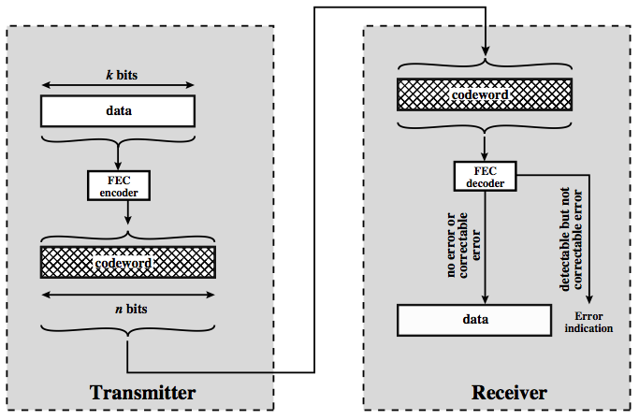
Block Diagram

Slide 36
Four Possible Results
No errors; no error detected
Codeword produced by decoder matches original codeword
Errors; detected and corrected
Errors; detected but uncorrected
Errors; undetected (and uncorrected)
Number of error bits increases

Slide 37
Block Code Principles
Hamming distance – for 2 n-bit binary sequences, the number of different bits
E.g., v₁=011011; v₂=110001; d(v1, v₂)=3
Redundancy – ratio of redundant bits to data bits
Code rate – ratio of data bits to total bits
Coding gain – the reduction in the required E_{b}/N₀ to achieve a specified BER of an error-correcting coded system

Slide 38
Hamming Distance
Imagine a code space
where the distance between any two points is measured as Hamming distance
Some codewords (points) are good choices
00111
01110
Assuming that red code words are used,
now 11100 is received. What has been sent?
h=3
00000
11100
11110
11001

Slide 39
Number of Correctable Errors
Minimum distance between any pair of codes
Number of correctable errors, t
d_{min}=5 or 6
w_{i}
w_{j}

Slide 40
Hamming Code
Designed by Richard Hamming to correct single bit error
Family of (n, k) block error-correcting codes with parameters:
Block length: n = 2^{m} – 1
Number of data bits: k = 2^{m} – m – 1
Number of check bits: n – k = m
Minimum distance: d_{min} = 3
The above code is also an SEC-DED code:
Single-error-correcting (SEC) code
Double-error-detecting (DED) code

Slide 41
Hamming Code Process
Encoding: k data bits + (n -k) check bits
Decoding: compares received (n -k) bits with calculated (n -k) bits using XOR
Resulting (n -k) bits called syndrome word
Syndrome range is between 0 and 2^{(n-k)}-1
Example:
k=7, n=10, m=3
Syndrome word can pinpoint 2³-1=7 different errors.
000 -> no error
001 -> first bit was wrong
…
111 -> seventh bit was wrong

Slide 42
Cyclic Codes
Can be encoded and decoded using linear feedback shift registers (LFSRs)
For cyclic codes, a valid codeword (c₀, c₁, …, c_{n-1}), shifted right one bit, is also a valid codeword (c_{n-1}, c₀, …, c_{n-2})
Takes fixed-length input (k) and produces fixed-length check code (n-k)
In contrast, CRC error-detecting code accepts arbitrary length input for fixed-length check code

Slide 43
BCH Codes
For positive pair of integers m and t, a (n, k) BCH code has parameters:
Block length: n = 2^{m} – 1
Number of check bits: n – k ≤ mt
Minimum distance:d_{min} ≥ 2t + 1
Correct combinations of t or fewer errors
Flexibility in choice of parameters
Block length, code rate

Slide 44
Reed-Solomon Codes
Subclass of non-binary BCH codes
Data processed in chunks of m bits, called symbols
An (n, k) RS code has parameters:
Symbol length: m bits per symbol
Block length: n = 2^{m} – 1 symbols = m(2^{m} – 1) bits
Data length: k symbols
Size of check code: n – k = 2t symbols = m(2t) bits
Minimum distance: d_{min} = 2t + 1 symbols

Slide 45
Block Interleaving
Used to spread errors for detection/correction
A burst error that may occur is spread out over a number of blocks, making error correction possible
Data written to and read from memory in different orders
Data bits and corresponding check bits are interspersed with bits from other blocks
At receiver, data are deinterleaved to recover original order

Slide 46
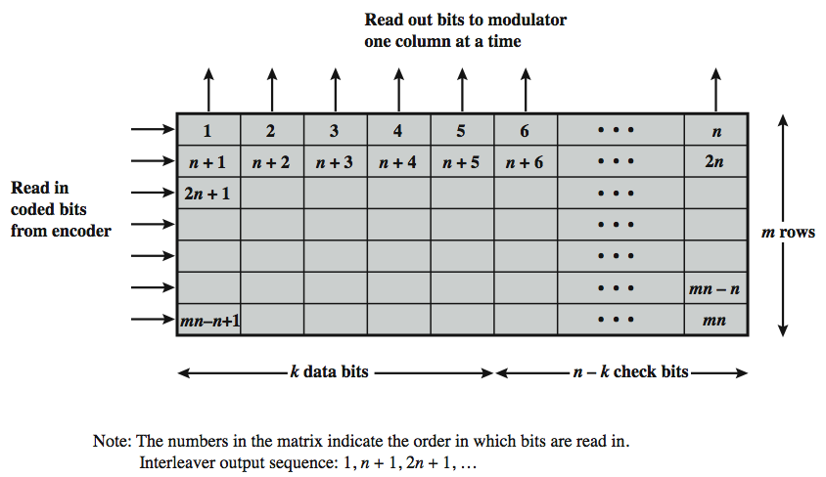
Block Interleaving Illustration

Slide 47
Error Control Requirements
Error detection
Receiver detects errors and discards PDUs
Positive acknowledgement
Destination returns acknowledgment of received, error-free PDUs
Retransmission after timeout
Source retransmits unacknowledged PDU
Negative acknowledgement and retransmission
Destination returns negative acknowledgment to PDUs in error

